Slide 1

What is CAIRIBU?
Kristina Penniston, PhD
Director, CAIRIBU Interactions Core

Slide 2



Welcome to the Meeting and the CAIRIBU Community
Collaborating for the Advancement of
Interdisciplinary Research
in Benign Urology
U54
O’Brien Urology
Centers
K12
KURe
UroEpi
Broad Benign Urology
Research Community
and Beyond!
P20
Developmental Centers
U24
O’Brien
Interactions Core

Slide 3
CAIRIBU U54 George M. O’Brien Centers
University of Wisconsin-Madison (2014-2019 and 2020-2025)
PI, Will Ricke, PhD
Project Leaders: Chad Vezina, PhD; Paul Marker, PhD; Dale Bjorling, DVM, MS; Doug Strand, PhD (University of Texas Southwestern); and Jill Macoska, PhD (University of Massachusetts Boston)
Columbia University (2015-2020)
Co-PIs, Jonathan Barasch, MD, PhD; Ali Gharavi, MD; Cathy Mendelsohn, PhD; and Anne-Catrin Uhlemann, MD, PhD
University of Pittsburgh (2015-2020)
PI, Zhou Wang, PhD
Project Leaders: Naoki Yoshimura, MD, PhD; Don DeFranco, PhD; and Rajiv Dhir, MD, MBA
Read about these Centers on the CAIRIBU website: https://niddkcairibu.urology.wisc.edu/
Kristina Penniston, PhD
Director, CAIRIBU Interactions Core

Slide 4
CAIRIBU P20 Exploratory Centers
New P20 Centers (2020-2022)
Medical College of Wisconsin (PI, Kathryn Flynn, PhD)
Children’s Hospital of Philadelphia (PI, Greg Tasian, MD, MSc)
Renewed P20 Center (2020-2022)
University of Alabama at Birmingham (PI, Dean Assimos, MD)
Completing P20 Centers (2018-2020)
BIDMC-Harvard University (PI, Mark Zeidel, MD)
Columbia University (PI, Simone Sanna-Cherchi, MD)
Washington University (PI, Indira Mysorekar, PhD)
NorthShore University HealthSystem-Purdue University (PIs, Simon Hayward, PhD and Tim Ratliff, PhD)
Read about these Centers on the CAIRIBU website: https://niddkcairibu.urology.wisc.edu/
Kristina Penniston, PhD
Director, CAIRIBU Interactions Core

Slide 5
CAIRIBU K12 Career Development Programs
Multidisciplinary Urologic Research (KURe)
Duke University (PI, Cathy Amundsen, MD)
University of Wisconsin-Madison (Co-PIs, Dale Bjorling, DVM, MS and Wade Bushman, MD, PhD)
Urological Epidemiology Institutional Research (KUroEpi)
UCSF-Kaiser Permanente (Co-PIs, Alison Huang, MD and Stephen Van Den Eeden, PhD)
University of Michigan (Co-PIs, Aruna Sarma, PhD and Quentin Clemens, MD
Read about these Centers on the CAIRIBU website: https://niddkcairibu.urology.wisc.edu/
Kristina Penniston, PhD
Director, CAIRIBU Interactions Core

Slide 6
CAIRIBU Demographics (as of December 2020)
Kristina Penniston, PhD
Director, CAIRIBU Interactions Core

Slide 7
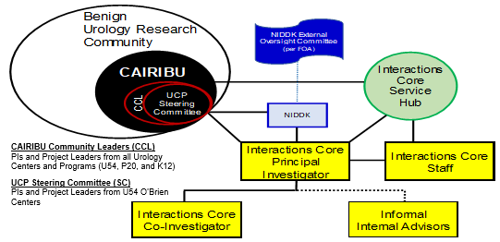
CAIRIBU Leadership
Kristina Penniston, PhD
Director, CAIRIBU Interactions Core
NIDDK External
Oversight Committee

Slide 8
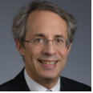
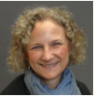
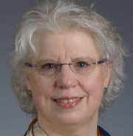
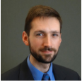

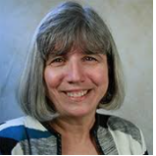
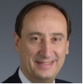
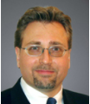
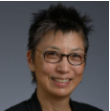
NIDDK Program Staff Involved in Benign Urology
Rob Star, MD
Director, KUH
robertstar@nih.gov
Danny Gossett, PhD
Small Business
Development; Translation
daniel.gossett@nih.gov
Ziya Kirkali, MD
Clinical Urology; Erectile Dysfunction; Urology HIV/AIDS
ziya.kirkali@nih.gov
Tracy Rankin, PhD, MPH
Deputy Director, KUH
Career Development, Diabetic Uropathy; Urology Molecular Endocrinology
tracy.rankin@nih.gov
Victoria Spruance, PhD
Neurology; Institutional Training Programs
victoria.spruance@nih.gov
Chris Mullins, PhD
Kidney and Urology Cell Biology
mullinsc@extra.niddk.nih.gov
Tamara Bavendam, MD
Women’s Urologic Health
tamara.bavendam@nih.gov
Julie Barthold, MD
New to NIDDK
Deborah Hoshizaki, PhD
Kidney & Urogenital Development, Regeneration & Repair, Urology Centers
Deborah.hoshizaki@nih.gov
Friday, December 4 during lunch break (following announcement of “best posters”)

Slide 9
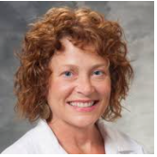
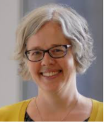
U24 Interactions Core Staff
Kristina Penniston, PhD, RDN
- PI, NIH/NIDDK U24 UW-Madison Urology Interactions Core (U24DK-127726)
- Coordinator, Collaborating for the Advancement of Interdisciplinary Research in Benign Urology
- Senior Scientist, University of Wisconsin School of Medicine and Public Health, Dept. of Urology
Betsy Rolland, PhD, MLIS
- Co-Investigator, NIH/NIDDK U24 UW-Madison Urology Interactions Core (U24DK-127726)
- PI, Coordinating Center of the Cancer Center Cessation Initiative
- Director of Team Science & Research Development, University of Wisconsin School of Medicine
and Public Health, Institute for Clinical and Translational Research
Jennifer Allmaras, MPH
- Research Specialist
Catherine Davis
- Administrative Assistant
Meet with Interactions Core PI on Friday, Dec. 4 during lunch

Slide 10
Core CAIRIBU Concepts
Foster scientific communication, coordination, and collaboration
Provide leadership in team science, both within CAIRIBU and with the broader benign urology research community
Encourage and expand the productivity of CAIRIBU Centers and Programs by providing logistical support
Enable and support the development of new leaders in benign urology research
Kristina Penniston, PhD
Director, CAIRIBU Interactions Core

Slide 11
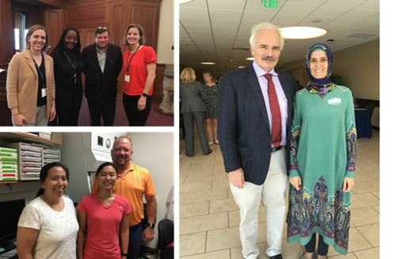
CAIRIBU Grants and Awards
Benign Urology Research Travel Grants
Benign Urology Research Training & Development Grants
CAIRIBU Interactions Core Collaboration Awards
CAIRIBU Convergence Awards
O’Brien Center Opportunity Pool Awards
Kristina Penniston, PhD
Director, CAIRIBU Interactions Core

Slide 12
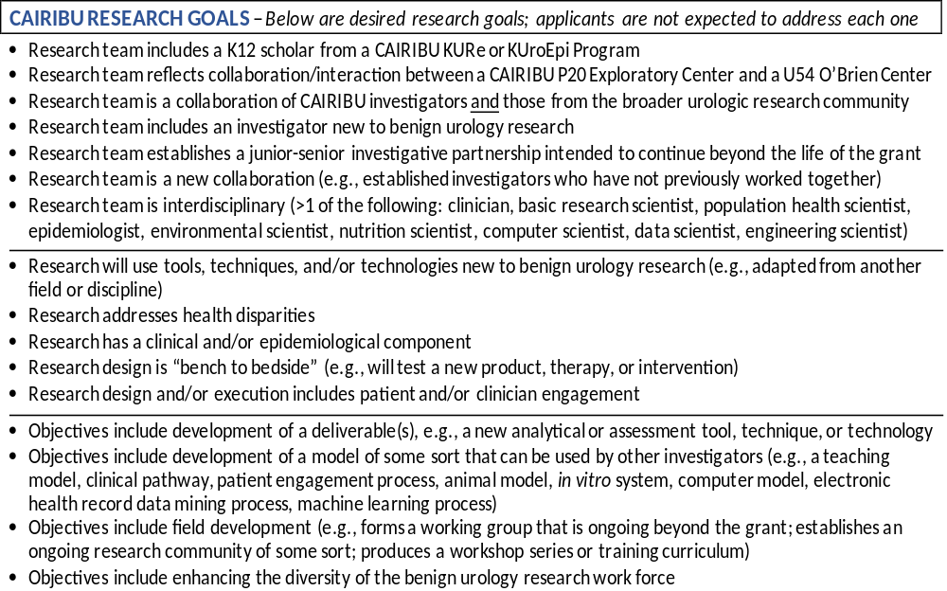
CAIRIBU Grants and Awards
Team
Methods and design
Objectives

