Slide 1

CAIRIBU 2020
Annual Meeting
December 3rd-4th, 2020
Zoom Virtual Meeting Platform

Slide 2
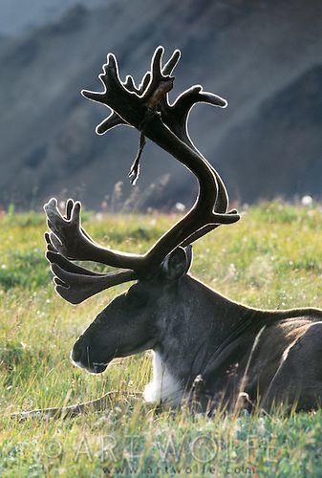


Welcome to the Meeting and the CAIRIBU Community
Collaborating for the Advancement of
Interdisciplinary Research
in Benign Urology
U54
O’Brien Urology
Centers
K12
KURe
UroEpi
Broad Benign Urology
Research Community
and Beyond!
P20
Exploratory Centers
U24
O’Brien
Interactions Core

Slide 3
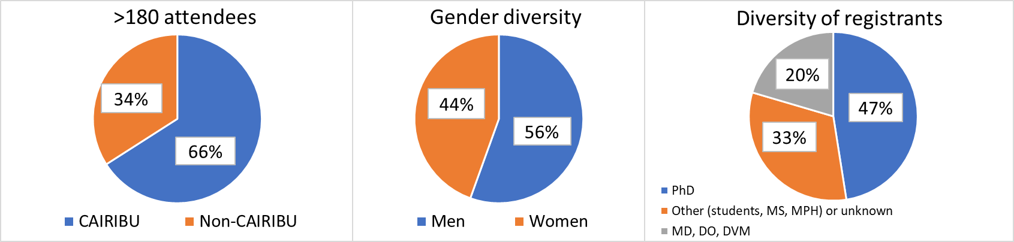

CAIRIBU 2020 Meeting: Attendees and Thanks….
Acknowledgments:
CAIRIBU 2020 Meeting Program Committee
CAIRIBU 2020 Abstracts & Poster Session Committee
CAIRIBU 2020 Trainee Event Organizing Committee
CAIRIBU Community Leaders and Outside Speakers
Mark Dennis and the Scientific Consulting Group
NIDDK Staff and Dr. Mark Nelson
Dr. Kris Penniston, Director, Interactions Core
Trainee Event Organizing Committee:
Renee Vickman, PhD
Casey Steadman, PhD
Marvin Langston, PhD
Diya Binoy Joseph, PhD
Scott Bauer, MD
Collaborating for the Advancement of Interdisciplinary Research in Benign Urology

Slide 4
Meeting Materials Available
https://niddkcairibu.urology.wisc.edu/
View and download meeting materials from CAIRIBU website (“Virtual Meeting Materials”)
Full meeting program
Select Welcome/Info Meeting Slide Sets
Full text abstracts:
  by CAIRIBU Center/Program
  by presenters’ last names
Description of CAIRIBU P20 Exploratory Centers
  Abstracts
  Posters
Order of flash talks for poster session

Slide 5
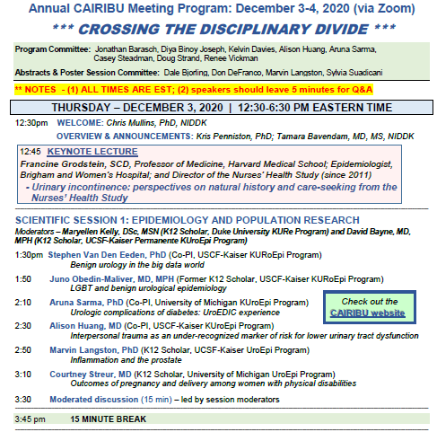
CAIRIBU 2020 Meeting Program – Day 1
Poster session
4:00-6:30 p.m.
1-min flash talks
Individual Zoom breakout rooms for Q&A with presenters
Vote for “people’s choice” awards
All abstracts and PDF posters are available on CAIRIBU website

Slide 6
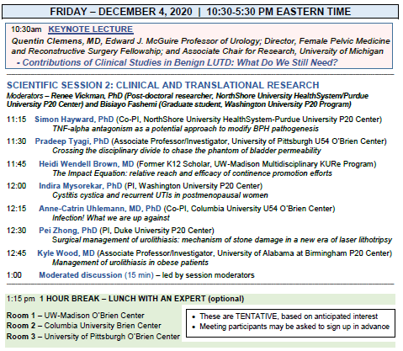
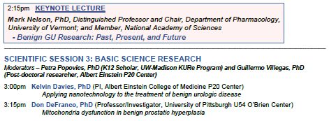
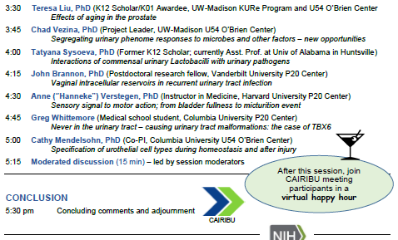
CAIRIBU 2020 Meeting Program – Day 2
1:15-2:00 p.m. Informal lunchtime Q&A – feel free to drop in
Zoom room 1: Kris Penniston, PhD (PI, CAIRIBU U24 Interactions Core)
Zoom room 2: NIDDK Program Officers
Zoom room 3: Columbia University U54 George M. O’Brien Center (Co-
PIs, Jonathan Barasch, MD, PhD, Ali Gharavi, MD, Cathy
Mendelsohn, PhD, and Anne-Catrin Uhlemann, MD, PhD)

Slide 7
CAIRIBU 2020 Scientific Sessions
Each is preceded by a keynote speaker
Speakers will receive a “2 min warning” if time running out
If time allows, questions and comments will be directed to each speaker
  Moderators will select from Zoom chat box
If no time, will move to next speaker
15 min Q&A at the end of each session
  Moderators will from Zoom chat box

Slide 8
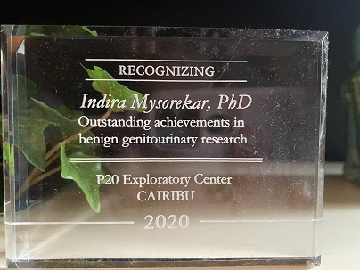
CAIRIBU 2020 P20 Center Acknowledgments
Completing P20 Exploratory Centers
BIDMC-Harvard University
PI, Mark Zeidel, MD
Columbia University
PI, Simone Sanna-Cherchi, MD
Washington University
PI, Indira Mysorekar, PhD
NorthShore University HealthSystem & Purdue University
  PIs, Simon Hayward, PhD and Tim Ratliff, PhD
Read about these and other P20 Centers on the CAIRIBU website:
https://niddkcairibu.urology.wisc.edu/

Slide 9
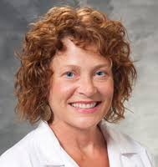
What a Difference 2 Years Can Make!!
R01 Research Portfolio
Benign Urology Research Community
P20 Exploratory Centers
U54 Urology O’Brien Centers
Institutional K awards
KURe
UroEpi
Notes:
We have more work to do to take it to the next level - where the CAIRIBU LEARNING COMMUNITY works together to support the broader benign urology research community and builds the R01 portfolio.
In the past year, NIDDK has filled a crucial need to make this possible.
We thank Dr. Will Ricke for recommending Dr. Kris Penniston for a role that will
develop and lead inter-center communications and interactions,
organize available resources
build visibility.
Kris has been on board for 5 months and is largely responsible for the organization of this meeting as her first major task. Thank you, Kris.

Slide 10

Planning the CAIRIBU December Meeting: Getting Acquainted, Building Trust and Developing Leadership Skills
Notes:
I have had the opportunity to work in many different settings - private practice, different academic practices, the pharma industry and the NIH.
Through integrating into these very different environments I grew to understand that key to creating trust and working towards common goals is getting to know people outside of their “role” and hierarchy.
That is why the venue for these meetings is purposefully isolated; why we are seated at round tables, why we planned activities that are more casual.
We need you to use this meeting to get to know each other. Find something in common with as many people as possible. Don’t be intimidated by those who have “made it” in your eyes. They were you not that long ago.
Create your own Learning Community that can be sustained.
Stay engaged and have fun.

Slide 11
Creating a Learning Community to Experiment with – Developing Young Investigators While Enriching and Supporting the Broader Research Community
Benign Urology Investigator Community
U54
P20
K12
Notes:
There are some structural challenges to building a LEARNING COMMUNITY – the community will be slightly different every year.
U54 and K12 grants are funded for 5 years with different start and end dates.
P20 Developmental Centers are funded for 2 years.
The O’Brien Centers are subject to competitive review.
NIDDK needs an organic LEARNING COMMUNITY that will be supportive of benign urology researchers that thrives independent of the funding mechanism.

Slide 12
  Why is NIDDK Investing So Much Money and Energy in Building a Learning Community?
  Challenges facing researchers interested in benign urology conditions
  There is not a cohesive “story” for these conditions
  Three different medical specialties have a piece of the story
  Most of the conditions are treated by surgeons with limited time to think like a scientist
  Conditions are not routinely screened for
    Become apparent only when symptoms are recognized and reported
  Lack of objective marker of conditions
  Most conditions are associate with some degree of stigma limiting self-report and advocacy
    Limits usefulness of big data
  Perceived impact is primarily quality of life
    Many conditions are normalized and accepted

Slide 13
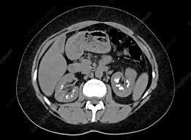
Urinary Stone Disease is an Outlier Amongst Benign Urology Conditions
Stones can be SEEN and measured
Not considered quality of life condition
No Stigma
Presents with Pain
Present in Billing Data Bases
Stones can lead to Renal Failure
Nephrology – a nonsurgical specialty conducts some of the research

Slide 14
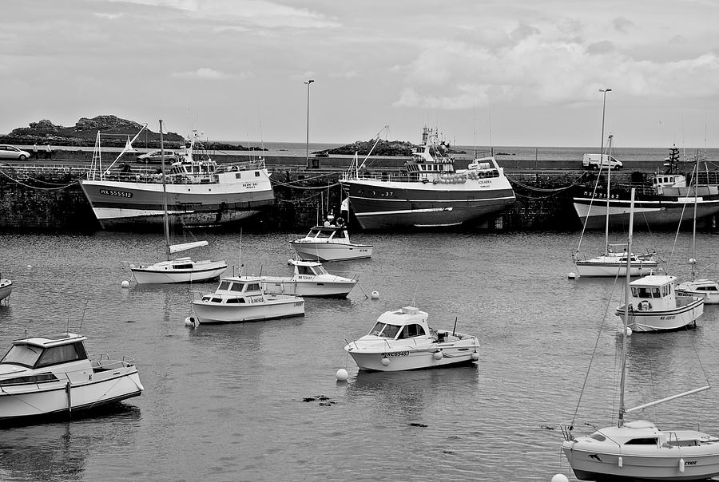
Researchers at all Stages of their Careers Must Support Each Other and the New Science; New Researchers and their Technologies Need to be Captivated by the Challenges, Impact and Importance of these Conditions
Notes:
This is not without its challenges.
There is some inherent competitiveness to research. Investigators feel they are competing against each other for funding.
We encourage each of you to trust that the knowledge you gain and relationships you build during this and subsequent meetings can deliver on the old saying “rising tides lift all boats”.

Slide 15
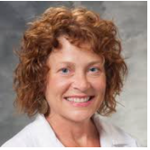
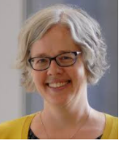
First Line of Support: U24 Interactions Core Staff
Kristina Penniston, PhD, RDN
- PI, NIH/NIDDK U24 UW-Madison Urology Interactions Core (U24DK-127726)
- Coordinator, Collaborating for the Advancement of Interdisciplinary Research in Benign Urology
- Senior Scientist, University of Wisconsin School of Medicine and Public Health, Dept. of Urology
Betsy Rolland, PhD, MLIS
- Co-Investigator, NIH/NIDDK U24 UW-Madison Urology Interactions Core (U24DK-127726)
- PI, Coordinating Center of the Cancer Center Cessation Initiative
- Director of Team Science & Research Development, University of Wisconsin School of Medicine
and Public Health, Institute for Clinical and Translational Research
Jennifer Allmaras, MPH
- Research Specialist
Catherine Davis, BS
- Administrative Assistant
Meet with Interactions Core PI on Friday, Dec. 4 during lunch

Slide 16
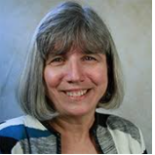
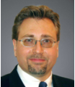
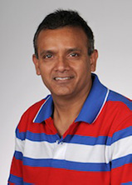
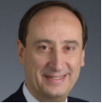
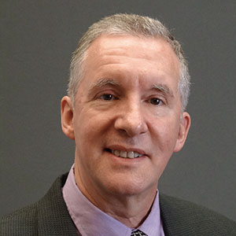
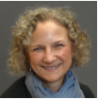
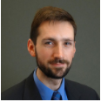
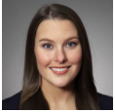
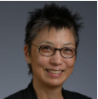
NIDDK Program Staff
Chris Mullins, PhD
Urology Centers
Project Scientist
mullinsc@extra.niddk.nih.gov
Deepak Nihalani, PhD
Urology Centers
Program Official
deepak.nihalani@nih.gov
Julie Barthold, MD
New to NIDDK
julia.barthold@nih.gov
Ziya Kirkali, MD
Clinical Urology
ziya.kirkali@nih.gov
Kevin Abbott, MD, MPH
Kepi Program Officer
Program Official
kevin.abbott@nih.gov
Tracy Rankin, PhD, MPH
Deputy Director, KUH
Program Officer KURe
tracy.rankin@nih.gov
Danny Gossett, PhD
Small Business
Development; Translation
daniel.gossett@nih.gov
Victoria Spruance, PhD
Neurology; Institutional Training Programs
victoria.spruance@nih.gov
Deborah Hoshizaki, PhD
Kidney & Urogenital Development, Regeneration & Repair, Urology Centers
deborah.hoshizaki@nih.gov
Friday, December 4 during lunch break (following announcement of “best posters”)

