Slide 1

Wednesday, Nov. 29
CAIRIBU MEETING 2023

Slide 2
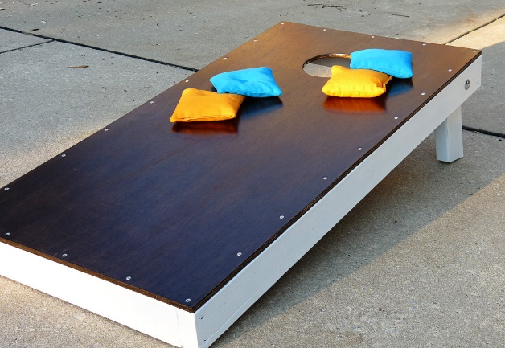

Welcome
Meetings matter
  Personalized networking and interaction
  Face-to-face impressions and connections
  Informal discussions
  Sharing ideas, making plans
  Friendly competition… CAIRIBU Cornhole

Slide 3
Introductions
Organizers from CAIRIBU Interactions Core
  Jennifer Allmaras
  Mariana Coughlin
  Anna Barrett
Organizers from NIDDK’s Scientific Consulting Group
  Mark Dennis
  Lauren

Slide 4
Housekeeping
Meeting rooms – Mostly this floor
Restrooms – On this floor to left
Coffee and tea – Available all day
Break at 3:00 PM – Includes refreshments
  Small store in the lobby area if needing other snacks, beverages
Dinner – Next door after poster session
Poster session – Outside this room in foyer (5-7:00 PM)
  Put up your posters anytime today but before 5:00 PM
CAIRIBU Cornhole tournament – SIGN UP NOW
Thursday night dinners (optional) – SIGN UP BEFORE TOMORROW LUNCH

Slide 5
Housekeeping
PRESENTERS
  Load your presentations with Paulo (AV tech) or with Jennifer
  Do this some time before your session
MODERATORS
  Sit up at front table
  Keep presenters on time; may wish to give 1-2 min warning
  If time, may entertain Q&A immediately after presentation
    Otherwise wait until end-of-session Q&A period

Slide 6
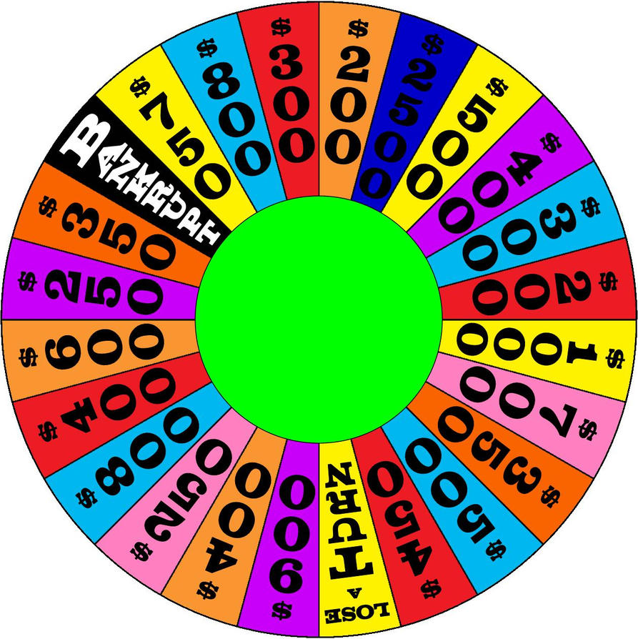
ENGAGEMENT – Wheel of Urology

Slide 7

ENGAGEMENT – Polls
QUIZZZ.com

Slide 8
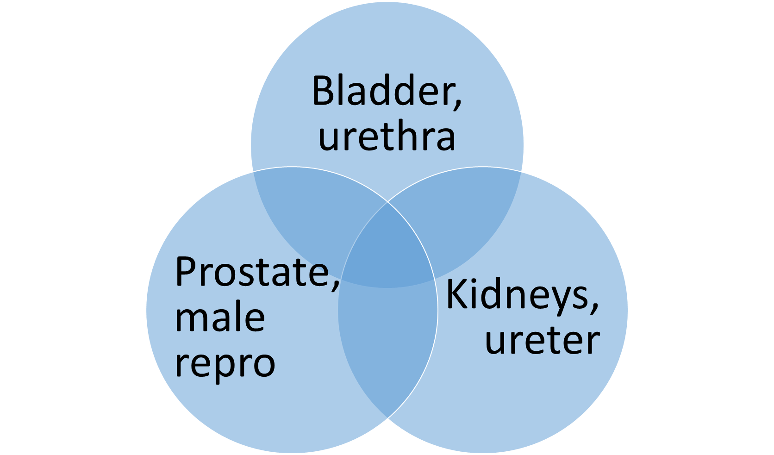
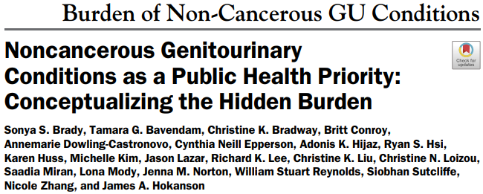
Non-Cancerous GU Conditions
Hundreds of millions worldwide affected
Not so “benign”
High costs
Hidden burden
Problems are complex
Read:
Infection
Neuro
Aging
Genetics
Fibrosis
CAKUT
Collaborating for the Advancement of Interdisciplinary Research in Benign Urology

Slide 9
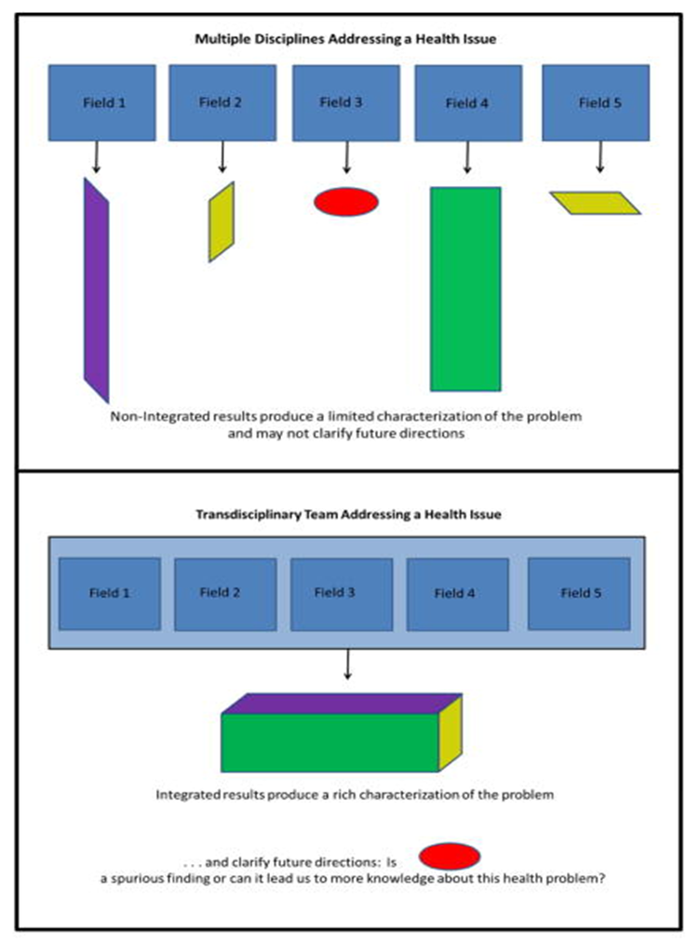
Complex Problems
Multiple Disciplines Addressing a Research Question
Research questions larger, more intricate
The more we know, the more to know
New fields of inquiry (e.g., -”omics,” “big data”) and technology = specific mastery
Non-integrated results produce a limited characterization of the problem and does not clarify future directions
Transdisciplinary Team Addressing the Question
Integrated results produce a rich characterization of the problem…
…and clarify future directions. Is a spurious finding? Or can it lead to more knowledge about the problem?

Slide 10
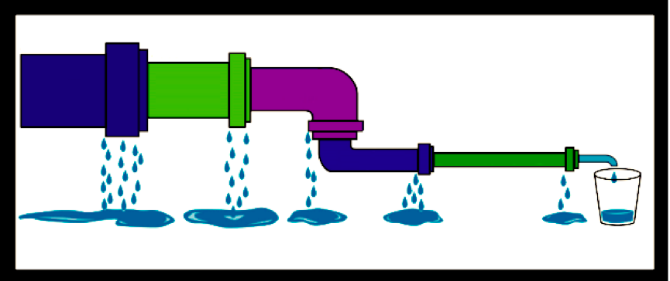
Students
Postdocs & fellows
Faculty and academic staff scientists; urologists
Scientists, urologists
Collaborating for the Advancement of Interdisciplinary Research in Benign Urology

Slide 11

Impact of Fewer Provider on LUTS
More severe bladder damage?
More $$ lost to incontinence meds and materials?
Lower QOL, more missed work days?
Disparate care due to low regional urologist density?
Collaborating for the Advancement of Interdisciplinary Research in Benign Urology

Slide 12

The CAIRIBU community will catalyze collaboration across basic
science and clinical disciplines to identify and address gaps
in knowledge related to biology, physiology, biochemistry,
genomics, genetics, and metabolism of benign GU diseases
Goals:
Support the next generation of urologic researchers with education and mentoring
Enhance knowledge of mechanisms associated with normal development, function, and disease pathology related to the urinary tract, kidney, and prostate
Cultivate new research tools and ideas by expanding the collaborative network within and outside of the traditional urologic research field
Reduce the burden of benign urologic illness and disability by developing and testing new therapies to effectively treat, manage, and prevent these diseases
CAIRIBU Interactions Core creates transdisciplinary
Infrastructure to promote research collaborations,
encourage and embrace new investigators into
the field, and train and mentor the next generation

Slide 13
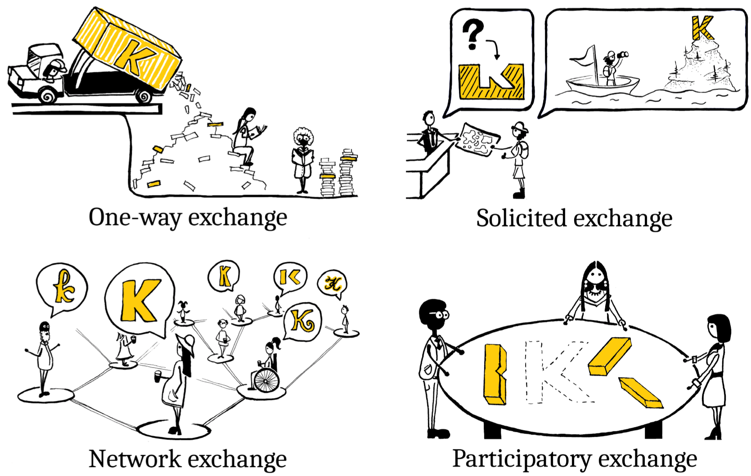

Collaboration Requires Exchange of Knowledge
Knowledge exchange
Westwood et al, Ecol Solut Evid 2023;4:e12214

Slide 14






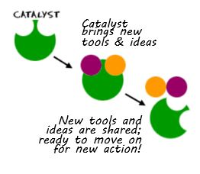



s

Slide 15

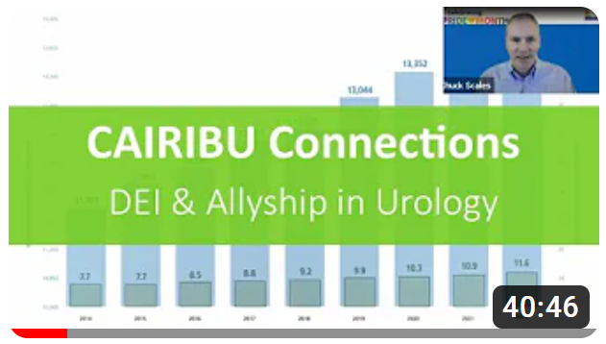
CAIRIBU Community
A bridge
  Connect investigators capable of addressing critical knowledge gaps
  Exchange knowledge = learn
  Develop tools that make collaboration easier
  Strengthen our forces
  Increase visibility and funding for urology research
A conscious force for increasing diversity and numbers within the urology workforce pipeline, bringing:
    New perspectives
    New technologies
    New approaches

Slide 16
CAIRIBU Meeting Brings Together…
George M. O’Brien Urology Cooperative (U54) Research Centers
  (1) UW-Madison, (2) Columbia University, (3) Stanford University
FORWARD P20 Centers and P20 Exploratory Centers
  Michigan Interdisciplinary Center for Urology Research & Education
  Duke University
  Mayo Clinic University
K12 KURe and KUroEpi Programs
  UW-Madison KURe
  Duke University KURe
  * NEW * NEW: Stanford University KURe
  UCSF-Kaiser Permanente KUroEpi
  University of Michigan KUroEpi
NIDDK Program Officers, invited guests, collaborative-minded investigators from the broader community

Slide 17
2023 CAIRIBU Meeting Planning
Began in March 2023
Committee of CAIRIBU leaders:
  Jill Macoska…………… ..UMass Boston (UW-Madison O’Brien)
  Cathy Mendelsohn… ..Columbia University (O’Brien Center)
  Jonathan Pollack………Stanford University (O’Brien Center)
  Nathan Tykocki……… ..Michigan State (MI-Cure P20 Center)
  Chad Vezina……………..UW-Madison (KURe K12 Program)
  Bernadette Zwaans.. ..Oakland University/Beaumont Health (MI-Cure P20 Center)

Slide 18
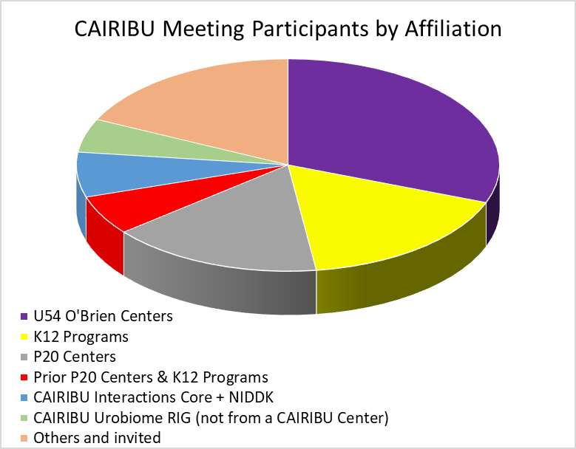
2023 CAIRIBU Meeting Demographics
117 registered
  54% women + non-binary
  Of students who registered, 70% are women or NB

Slide 19
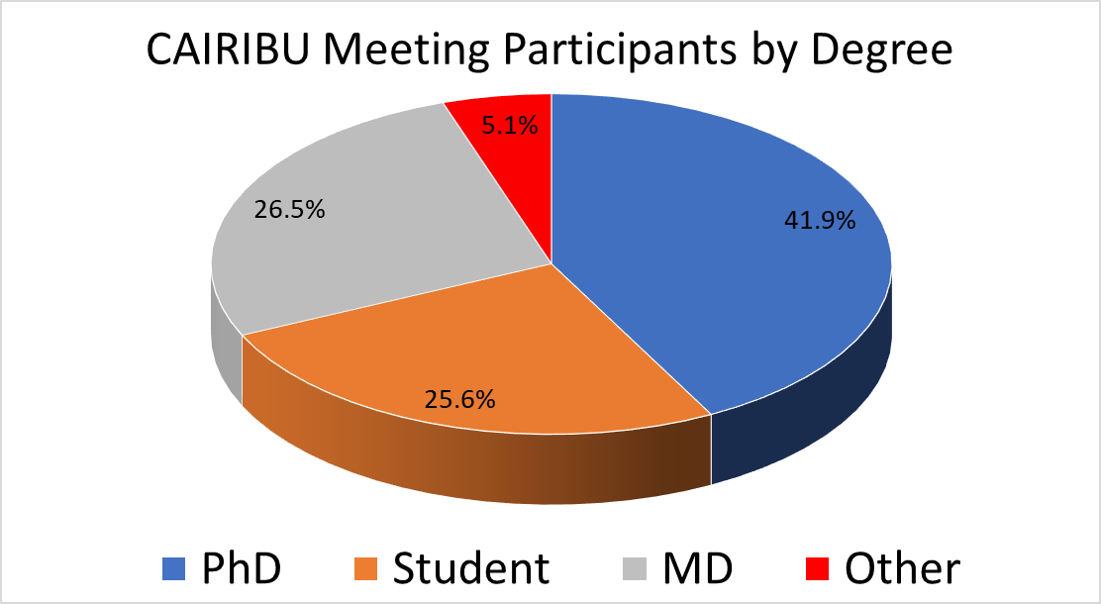
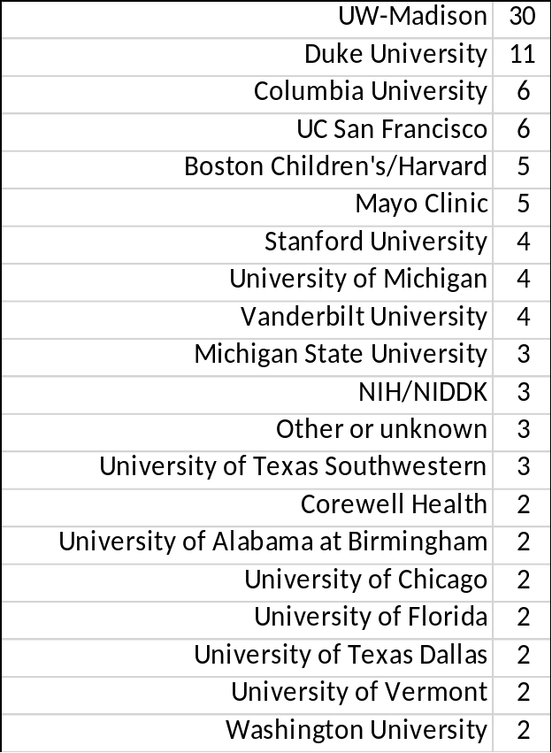
2023 CAIRIBU Meeting Demographics

Slide 20
2023 CAIRIBU Meeting - Wednesday
Presentations and scientific sessions - Basie A
Refreshments during break
Networking and interactions sessions - Lester Young and Jay McShann rooms
Poster session and cash bar - Basie foyer (5:00-7:00 PM)
  Get your posters up now or any time today
Dinner - Basie B
Time after dinner for Urobiome RIG to meet

Slide 21
QUICK QUESTIONS FOR TRAINEES
In this afternoon’s networking sessions:
  How many plan to bring IDPs

Slide 22
2023 CAIRIBU Meeting - Thursday
Breakfast - Basie B
Presentations and scientific sessions - Basie A
Refreshments during break
Lunch and presentation - Basie B (12:30 PM)
Networking and interactions sessions - Lester Young and Jay McShann rooms
Reception & cash bar - Basie B (6:30-7:30 PM)
Dinner on your own; reservations for small groups available

Slide 23
2023 CAIRIBU Meeting - Friday
Breakfast - Basie B
Presentations and scientific sessions - Basie A
Poster awards
Refreshments during break
Take-home messages, 12:00 noon
Adjourn, 1:00 PM

Slide 24
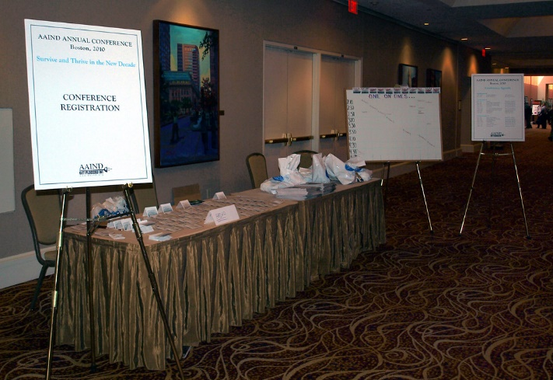
2023 CAIRIBU Meeting Materials
Program
  List of CAIRIBU Centers and K12 Programs
  List of CAIRIBU Interactions Core awards recipients, 2021 through the present
Abstracts booklet
List of abstract reviewers
Meeting evaluation form
List of meeting registrants

Slide 25
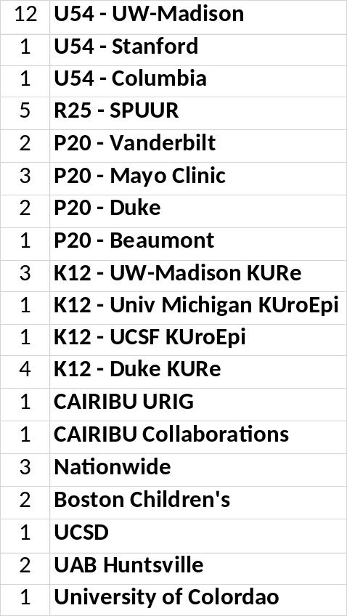
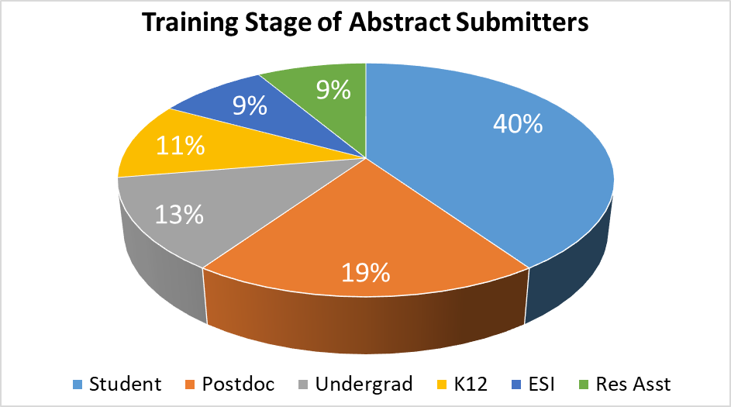
2023 CAIRIBU Meeting Abstracts
47 submitted
  54% women
  77% CAIRIBU-affiliated (current & prior)

Slide 26
Dr. Gerald Herrera
2004-Present; Adjunct Assistant Professor, Pharmacology, University of Vermont
2005-Present; Vice President, Research and Development, Med Associates, Inc.
2007-Present; President, Catamount Research and Development, Inc.

Slide 27
Thursday, Nov. 30
CAIRIBU MEETING 2023

Slide 28
2023 CAIRIBU Meeting Day 1
Presenters in Session 1:
  Tracy Rankin, PhD, MPH
  James Brooks, MD
  Whitney Sweeney, PhD
  Michael Bailey, PhD
  Catherine Brownstein, PhD, MPH
  Charles Scales, Jr., MD, MSHS
Moderators:
  Ali Gharavi, MD
  Cathy Mendelsohn, PhD
Wednesday Networking and Interactions Sessions:
Chad Vezina, PhD
Lori Uttech-Hanson, MEd
Alexander Birbrair, PhD
Tracy Rankin, PhD
Dorrie Lamb, PhD
Whitney Sweeney, PhD

Slide 29




















CAIRIBU Research Community
Who is CAIRIBU?
Community of funded U54 Centers, P20 Centers, and K12 Programs
Investigators and trainees from previously funded Centers
NIDDK Program Officers
Colleagues and collaborators of CAIRIBU-affiliated investigators and trainees

Slide 30
CAIRIBU Research Community
What is CAIRIBU?
Collaborative-minded, organized community within the broader non-cancerous genitourinary research community
CAIRIBU Interactions Core:
  Create platforms for exchange of knowledge
  Develop infrastructure for community-building, learning, training, and mentoring
  Expand reach and visibility of CAIRIBU-affiliated research
  Identify and catalyze potential fruitful research interactions
  Measure effects and impact

Slide 31

CAIRIBU Interactions Core Metrics
Assess effect and impact
  Beginning of year → Levels of Collaboration Survey
    Center and Program leaders
  Annually → CAIRIBU Census
  Twice annually → Progress Surveys
    EVERYONE, from trainees to leaders
  CAIRIBU Collaboration Awards → Progress Reports
  Events, activities → Engagement, participation, attendance

Slide 32

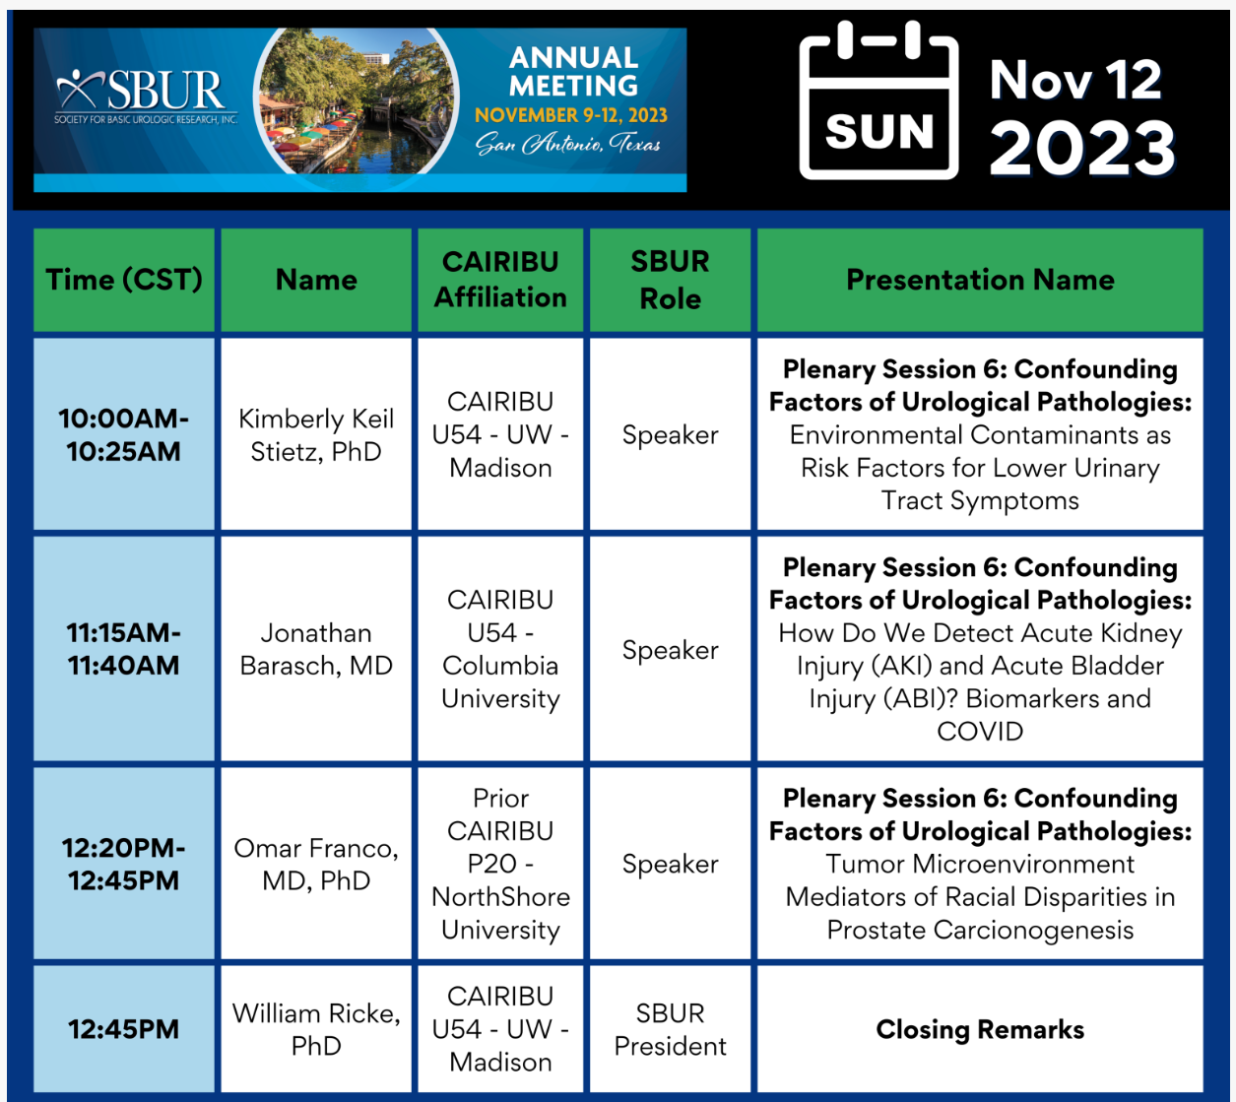
CAIRIBU Engagement at Other Meetings
ROCK Society, Jan 2024
SoBPD, Feb 2024
SUFU, Feb 2024
CMI, March 2024
GUDMAP, April 2024
AUA, May 2024
AUGS, May 2024
SBUR, Nov 2024

Slide 33
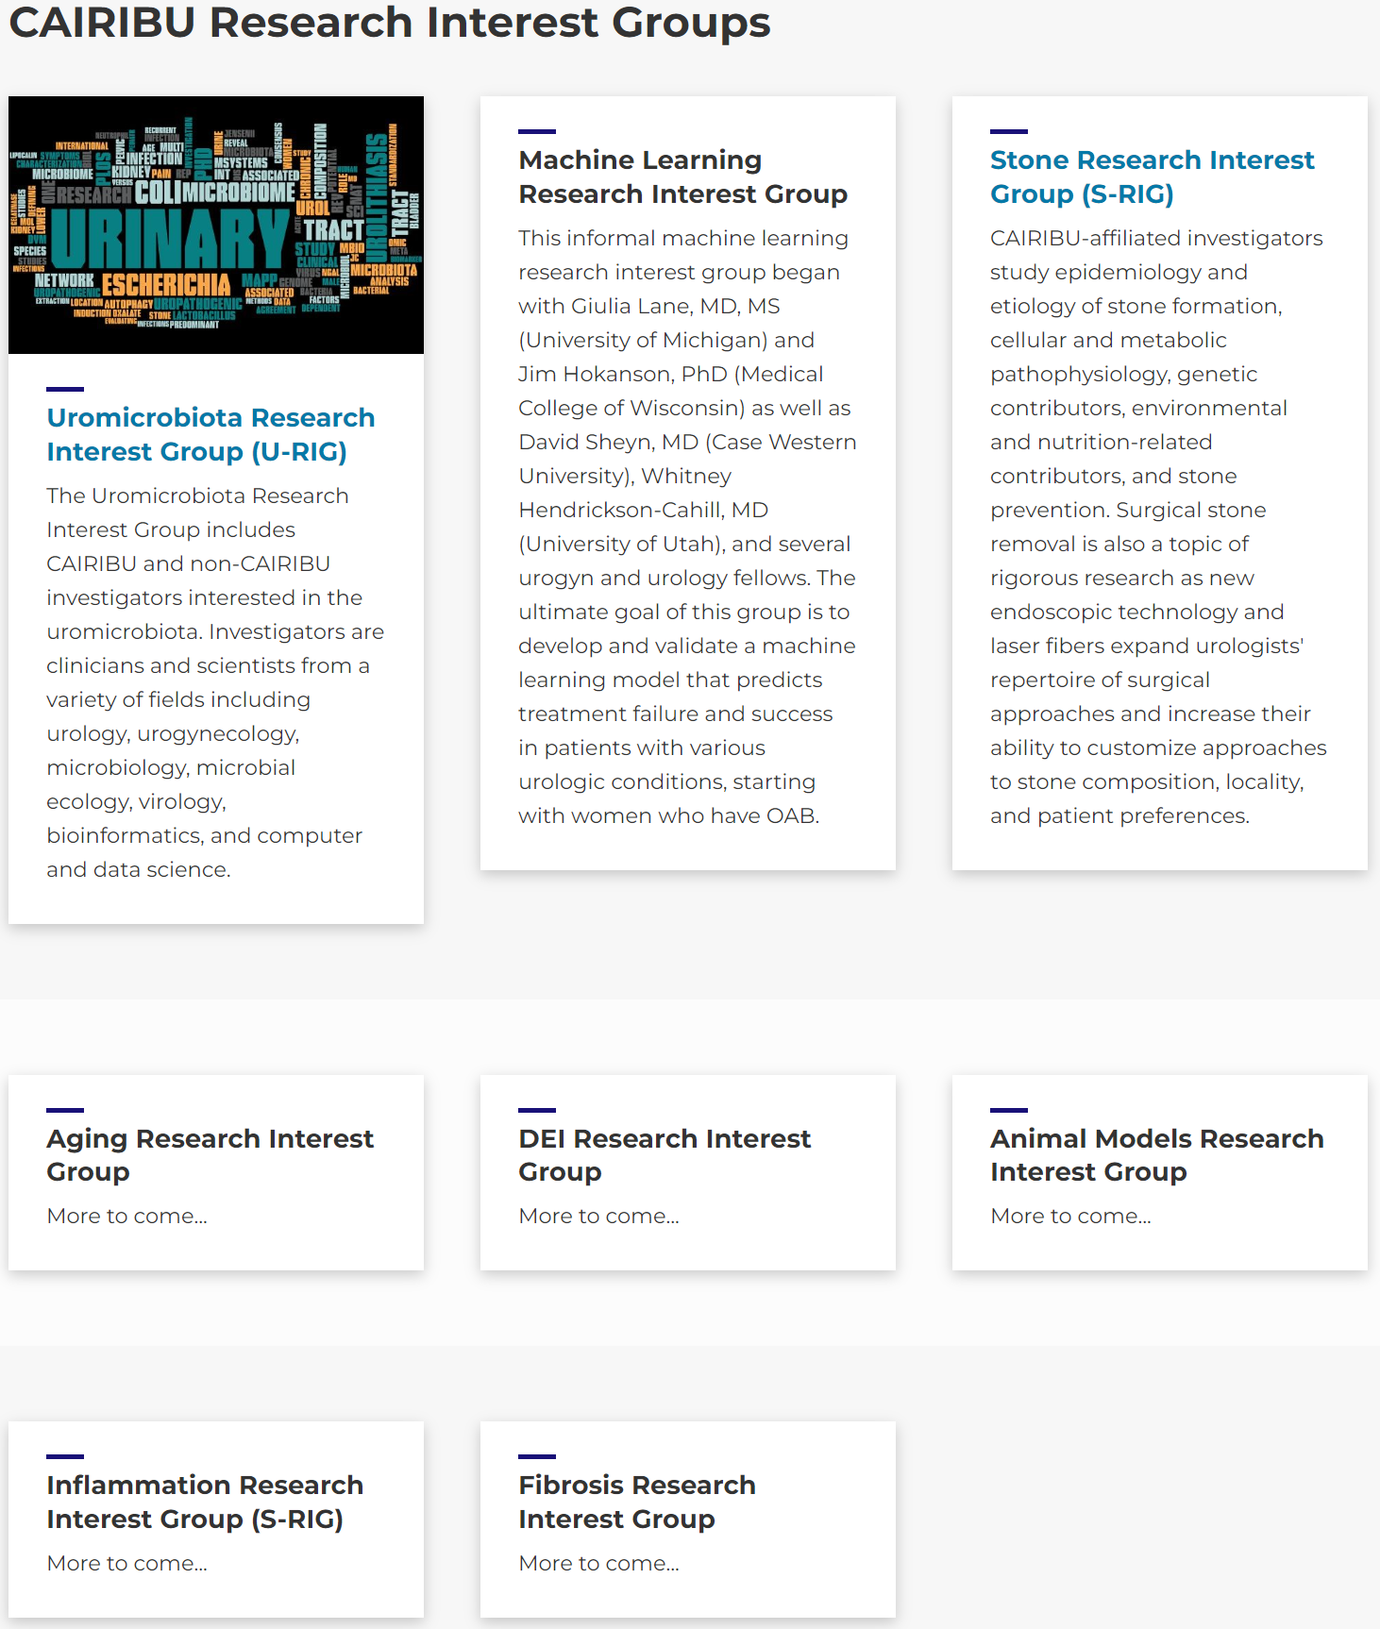
CAIRIBU Interactions Core Initiatives
Research Interest Groups (RIGs)
  Urobiome RIG
  Stones RIG
  Machine Learning/AI RIG
  Other: Aging, DEI, Animal Models
Series:
  Patient engagement in research
  Principles of team science
  2024??? TBD…

Slide 34
CAIRIBU Interactions Core Events
s

Slide 35
CAIRIBU Interactions Core Events
K12 Scholar Seminars
ARCTICS Community Forums
Graduate Student Seminars
Urobiome RIG Research Hours
CAIRIBU Catalyst Conversations
CAIRIBU Connections
CAIRIBU interviews/podcast

Slide 36

CAIRIBU Interactions Core Resources
CAIRIBU YouTube channel
Funding announcements
Trainee development resources
Events listing
List of other urology organizations
Collaborative science tools
CAIRIBU kiosk

Slide 37
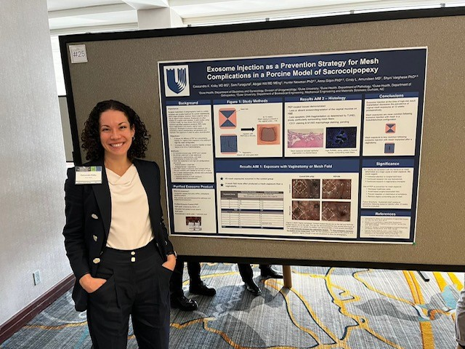
2023 CAIRIBU Meeting
Important platform for:
  Exchange of knowledge
  Community building
  Gaining visibility and attention
  Networking
  Forging potential for future interactions
  Fostering and encouraging trainees

Slide 38
2023 CAIRIBU Meeting Census
Undergraduates
Medical school/vet school students
Graduate students
Other trainees and research support staff
Postdoctoral investigators
K12 scholars
  Current
  Prior
Early-stage investigators not otherwise mentioned

Slide 39
2023 CAIRIBU Meeting Census
NIDDK Program Officers
Leaders and investigators affiliated with:
  Current KURe and KUroEpi K12 Programs
  Current U54 Urology O’Brien Centers
  Current P20 Exploratory and FORWARD Centers
Leaders of prior CAIRIBU Centers and Programs

Slide 40
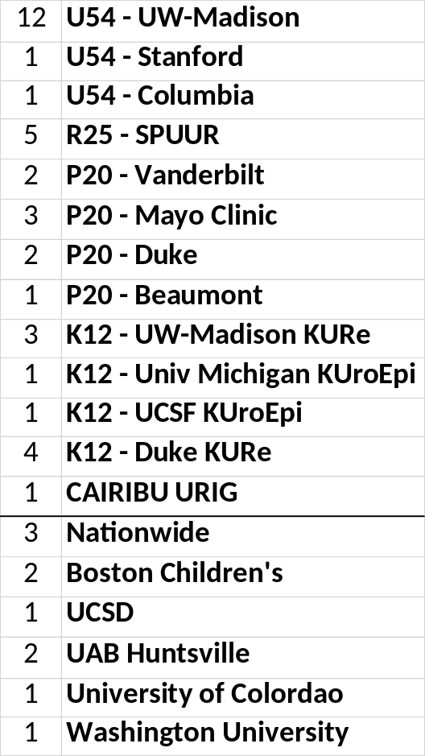
2023 CAIRIBU Meeting Abstracts
47 submitted
  54% women
  77% CAIRIBU-affiliated (current & prior)

Slide 41
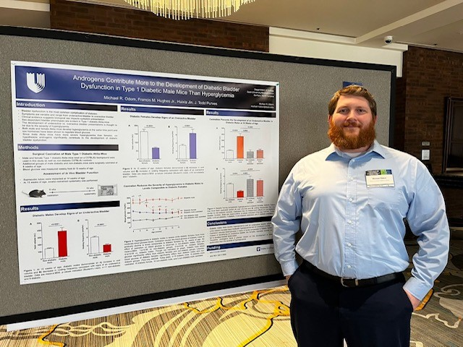
2023 CAIRIBU Meeting Poster Session
Focus on trainees and early-stage investigators
Typically one of the most popular aspects of the annual meeting
A few “best posters” will be announced tomorrow

Slide 42
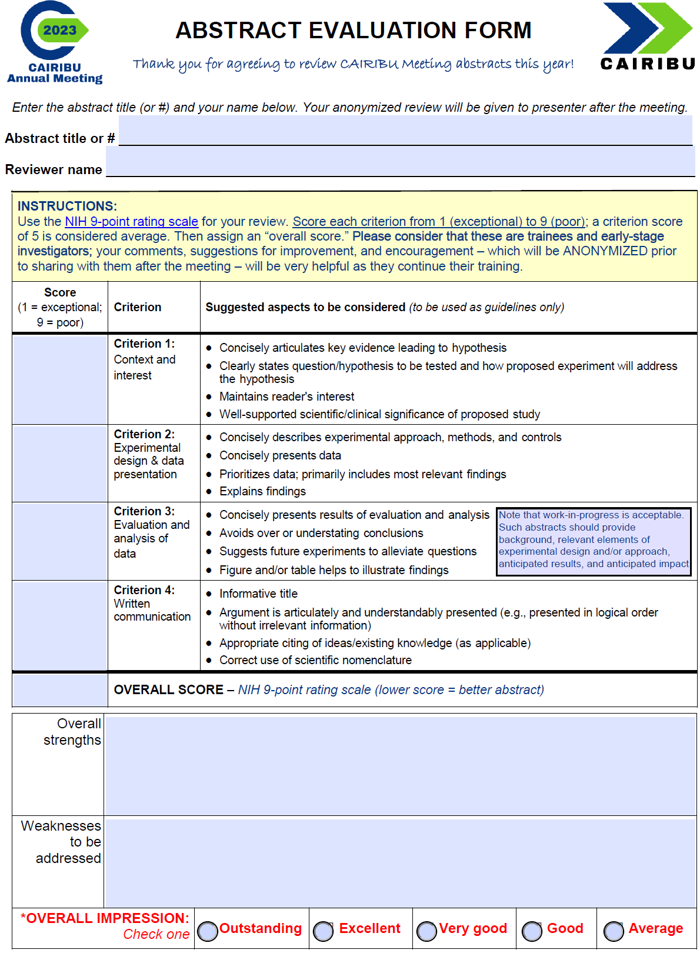
Abstract Reviewers
71 invited
  62 responded
  58 provided reviews
  76% CAIRIBU-affiliated
196 abstract reviews assigned
  3.4 ± 0.70 abstracts per reviewer
    (min-max, 2-5)
Each trainee will receive anonymized comments of their abstracts

Slide 43

Best Abstracts
ESIs, K12 Scholars, postdoctoral investigators
  Michael Odom, PhD, K12 Scholar, Duke University KURe Program – Abs #10
Graduate students
  Sara Stuedemann, UW-Madison, student in Dr. LaTasha Crawford’s lab (UW-Madison KURe Program) – Abs #26
  Ajinkya Limkar, UW-Madison, student in Dr. William Ricke’s lab (UW-Madison Urology O’Brien Center) – Abs #14

Slide 44
Best Posters
6 awards will be announced tomorrow

Slide 45
2023 CAIRIBU Meeting - Thursday
Next CAIRIBU Cornhole tournament round…
Presentations and scientific sessions in Basie A
Refreshments during break
Lunch and presentation in Basie B (12:30 PM)
Networking and interactions sessions in Lester Young and Jay McShann rooms
  Round 1: Important discussions
  Break
  Round 2: Urobiome and other RIGs

Slide 46
2023 CAIRIBU Meeting - Thursday
Networking reception & cash bar – Basie B (6:30-7:30 PM)
  Wheel of Urology
  CAIRIBU Cornhole
  Pictionary
Dinner on your own – Reservations at 8:00 at several local restaurants
  Sign-up by end of lunch TODAY

Slide 47
Dr. Dolores Lamb

Slide 48
Friday, Dec. 1
CAIRIBU MEETING 2023

Slide 49

Thank You CAIRIBU Leaders
Kristina Penniston, PhD
PI and Director, U24 Interactions Core
(U24-DK-127726)
Senior Scientist, Department of Urology
UW-Madison School of Medicine & Public Health
Email: penn@urology.wisc.edu
CAIRIBU Interactions Core
Web: https://www.cairibu.urology.wisc.edu
Email: CAIRIBU@urology.wisc.edu
Twitter: @CAIRIBU1
NIH/NIDDK Program Officers
Chris Mullins, PhD, Project Scientist
Deepak Nihalani, PhD, Program Official
Collaborating for the Advancement of Interdisciplinary Research in Benign Urology

Slide 50

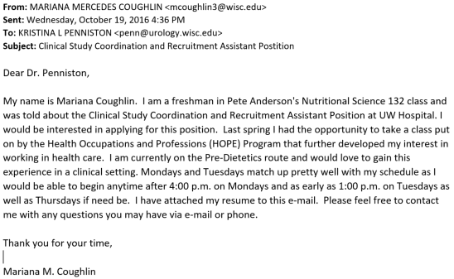
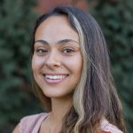

Thank You IC Staff
Jennifer Allmaras, MPH Hired December 2020 Promoted June 2022 to Research Program Coordinator
Mariana Coughlin, MS Hired June 2022 Promoted August 2023
Anna Barrett, student
(currently a junior)
Hired April 2023
Collaborating for the Advancement of Interdisciplinary Research in Benign Urology

Slide 51
2023 CAIRIBU Meeting - Friday
Breakfast in Basie B
Presentations and scientific sessions in Basie A
Poster awards
Refreshments during break
Take-home messages, 12:00 noon
Adjourn, 1:00 PM

Slide 52
2023 CAIRIBU Meeting Abstracts
47 submitted
  54% women
  77% CAIRIBU-affiliated (current & prior)

Slide 53
Abstract Reviewers
71 invited
  62 responded
  56 provided reviews
  76% CAIRIBU-affiliated
196 abstract reviews assigned
  3.4 ± 0.70 reviews per reviewer
    (min-max, 2-5)

Slide 54
CAIRIBU Meeting 2023 – Best Abstracts
Early-stage investigators, K12 Scholars, postdoctoral researchers
  Michael Odom, PhD, Duke University K12 KURe Program
Graduate students, research associates
  Sara Stuedemann, UW-Madison (mentor, K12 Scholar LaTasha Crawford, PhD, VMD)
  Ajinkya Limkar, UW-Madison (mentor, William Ricke, PhD)

Slide 55
CAIRIBU Meeting 2023 – Best Posters
Genetics Lily Hiltebeitel
Hormones & fibrosis Ren Katz
Lower urinary tract dysfunction Monica Ridlon
Structural & functional Qingsong Fan
Techniques & measurement Alex Polasko
Urobiome & infection Kelly Weldon

Slide 56
Future CAIRIBU Meetings
3-year rotation
  2 years in mid-central US
  1 year in DC area
2023 – Kansas City
2024 – Chicago? St. Louis? Detroit? Milwaukee?
2025 – DC area
Wednesday morning meeting – trainees, ESIs

Slide 57
CAIRIBU Meeting Evaluation
Online
On paper

