Slide 1
Making your mark in urology research
James D. Brooks, MD
Keith and Jan Hurlbut Professor
Vice Chair, Department of Urology
Director, Stanford U54 O’Brien Urology Research Center

Slide 2
Outline
Define your question
Know thyself
Mentoring
Work Hard
Collaborate
Keep your perspective
Have Fun
Li, B & Brooks, JD, Trans Urol Androl 7: 903, 2018

Slide 3
Define your Question and Goals
Pick and important question: Broad, but not too broad.
Be strategic: The question needs to be one that you can answer with existing technologies
To make your mark, your research and lab must be your top priority.
  Clinician/scientists take note: Difficult to do single port surgery and single cell sequencing at the same time

Slide 4
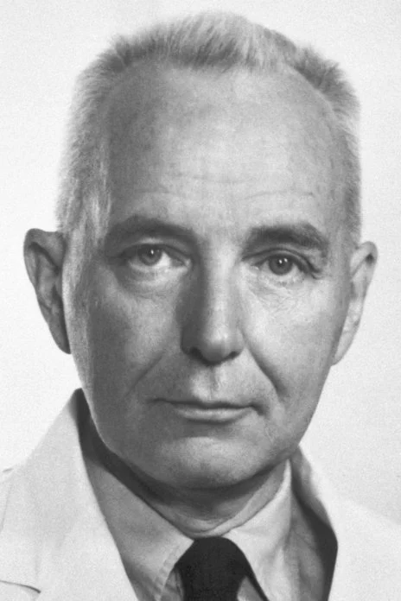
You need some tachycardia
Charles Huggins, MD: 2nd Urologist to win the Nobel prize for his work in steroid hormones in breast and prostate cancer
Recorded seminar at UCLA: “Choose a research topic that interests you deeply. It has to give you tachycardia”
Your topic should make you eager to go to work
Nobel, 1966

Slide 5
Know thyself
Few, if any of us, can do everything well
Recognize your weaknesses
  For basic scientists, can be a challenge to frame clinical relevance for research questions; grants now demand it!
  For clinicians, limited experience with rapidly moving fields and technologies

Slide 6
Know thyself
Recognize your strengths
  Basic scientists: rigor, technology, time
  Clinicians: know important questions and pressure points. Have access to patients and samples and know how to collect the right samples
If available, consider taking a leadership course. Many of these offer assessments of leadership styles that can give you insights into how you interact with others.

Slide 7
Mentoring
Find a mentor or mentors:
  Often senior person inside or outside of department. Must be independent of any evaluation of you.
  Peers also serve as important mentors
  Be a good mentee: schedule meetings, come with prepared questions
Be a good mentor: You learn from all of your trainees.

Slide 8
Do the work
Deliver for your trainees and collaborators.
Make time to keep up with your learning and following he literature. Block it out in your schedule
Review grants and papers
Publish!
Don’t feel like you need to set aside big blocks of time. A 15 minute downtime is a chance to read a paper or write a sentence or two for a paper.

Slide 9
Collaborate
Know your local flora and fauna:
  go to talks at your institution
  be present physically (not Zoom) and try to meet people
  make appointments with anyone you think could be helpful
Look for individuals that do something completely different from you and your lab.
In particular, look for collaborators in completely different disciplines. It is fun to learn from each other. Often the most fruitful collaborations are at the interface of disciplines

Slide 10
Be a good collaborator
Teach and support trainees in your collaborator’s laboratory
Be the collaborator you would like to work with
  Do not ghost your collaborators
  Deliver on what is expected
  If you are sent a manuscript, read, edit, contribute
Personal chemistry is important
Be nimble: if something isn’t working, try a new approach or move on. A collaboration is not a marriage.

Slide 11
Have perspective
Take care of your lab members, your family, yourself and your community
Take the long view – avoid fights over trivial issues such as authorship.
Learn to say “Yes” and “No”.
  “Yes” to collaborations
  “Yes” to talks at meetings and universities. Pay attention to the grey hairs in the first row
  “No” to administrative tasks in the early part of your career
  “No” to most book chapters or reviews in low impact journals

Slide 12
Remember to role of luck
Sometimes research works because you are in the right place at the right time and without planning, have asked the right question that can be answered with existing technology
However, “chance favors the prepared mind”. I pay particular attention to experimental results that are the opposite of what I had predicted.
When things go poorly – persevere, they will get better.
When things go well – be humble.

Slide 13
Have fun
There are so many things to love about research: Researchers are some of the very few that get to pursue their own creative ideas
You get to interact with young people and potentially change their lives, even with your off-handed comments
Finding new stuff is great. We get the bonus that it can actually help people, either immediately or decades from now.
If you have fun, your lab members have fun and there is a feed-forward

Slide 14
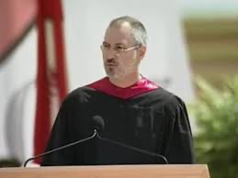
If it is not fun, honestly reassess
“. . . for the past 33 years, I have looked in the mirror every morning and asked myself: “If today were the last day of my life, would I want to do what I am about to do today?” And whenever the answer has been “No” for too many days in a row, I know I need to change something.”
42M views
Steve Jobs, Stanford University commencement speech 2005
https://news.stanford.edu/2005/06/12/youve-got-find-love-jobs-says/

Slide 15
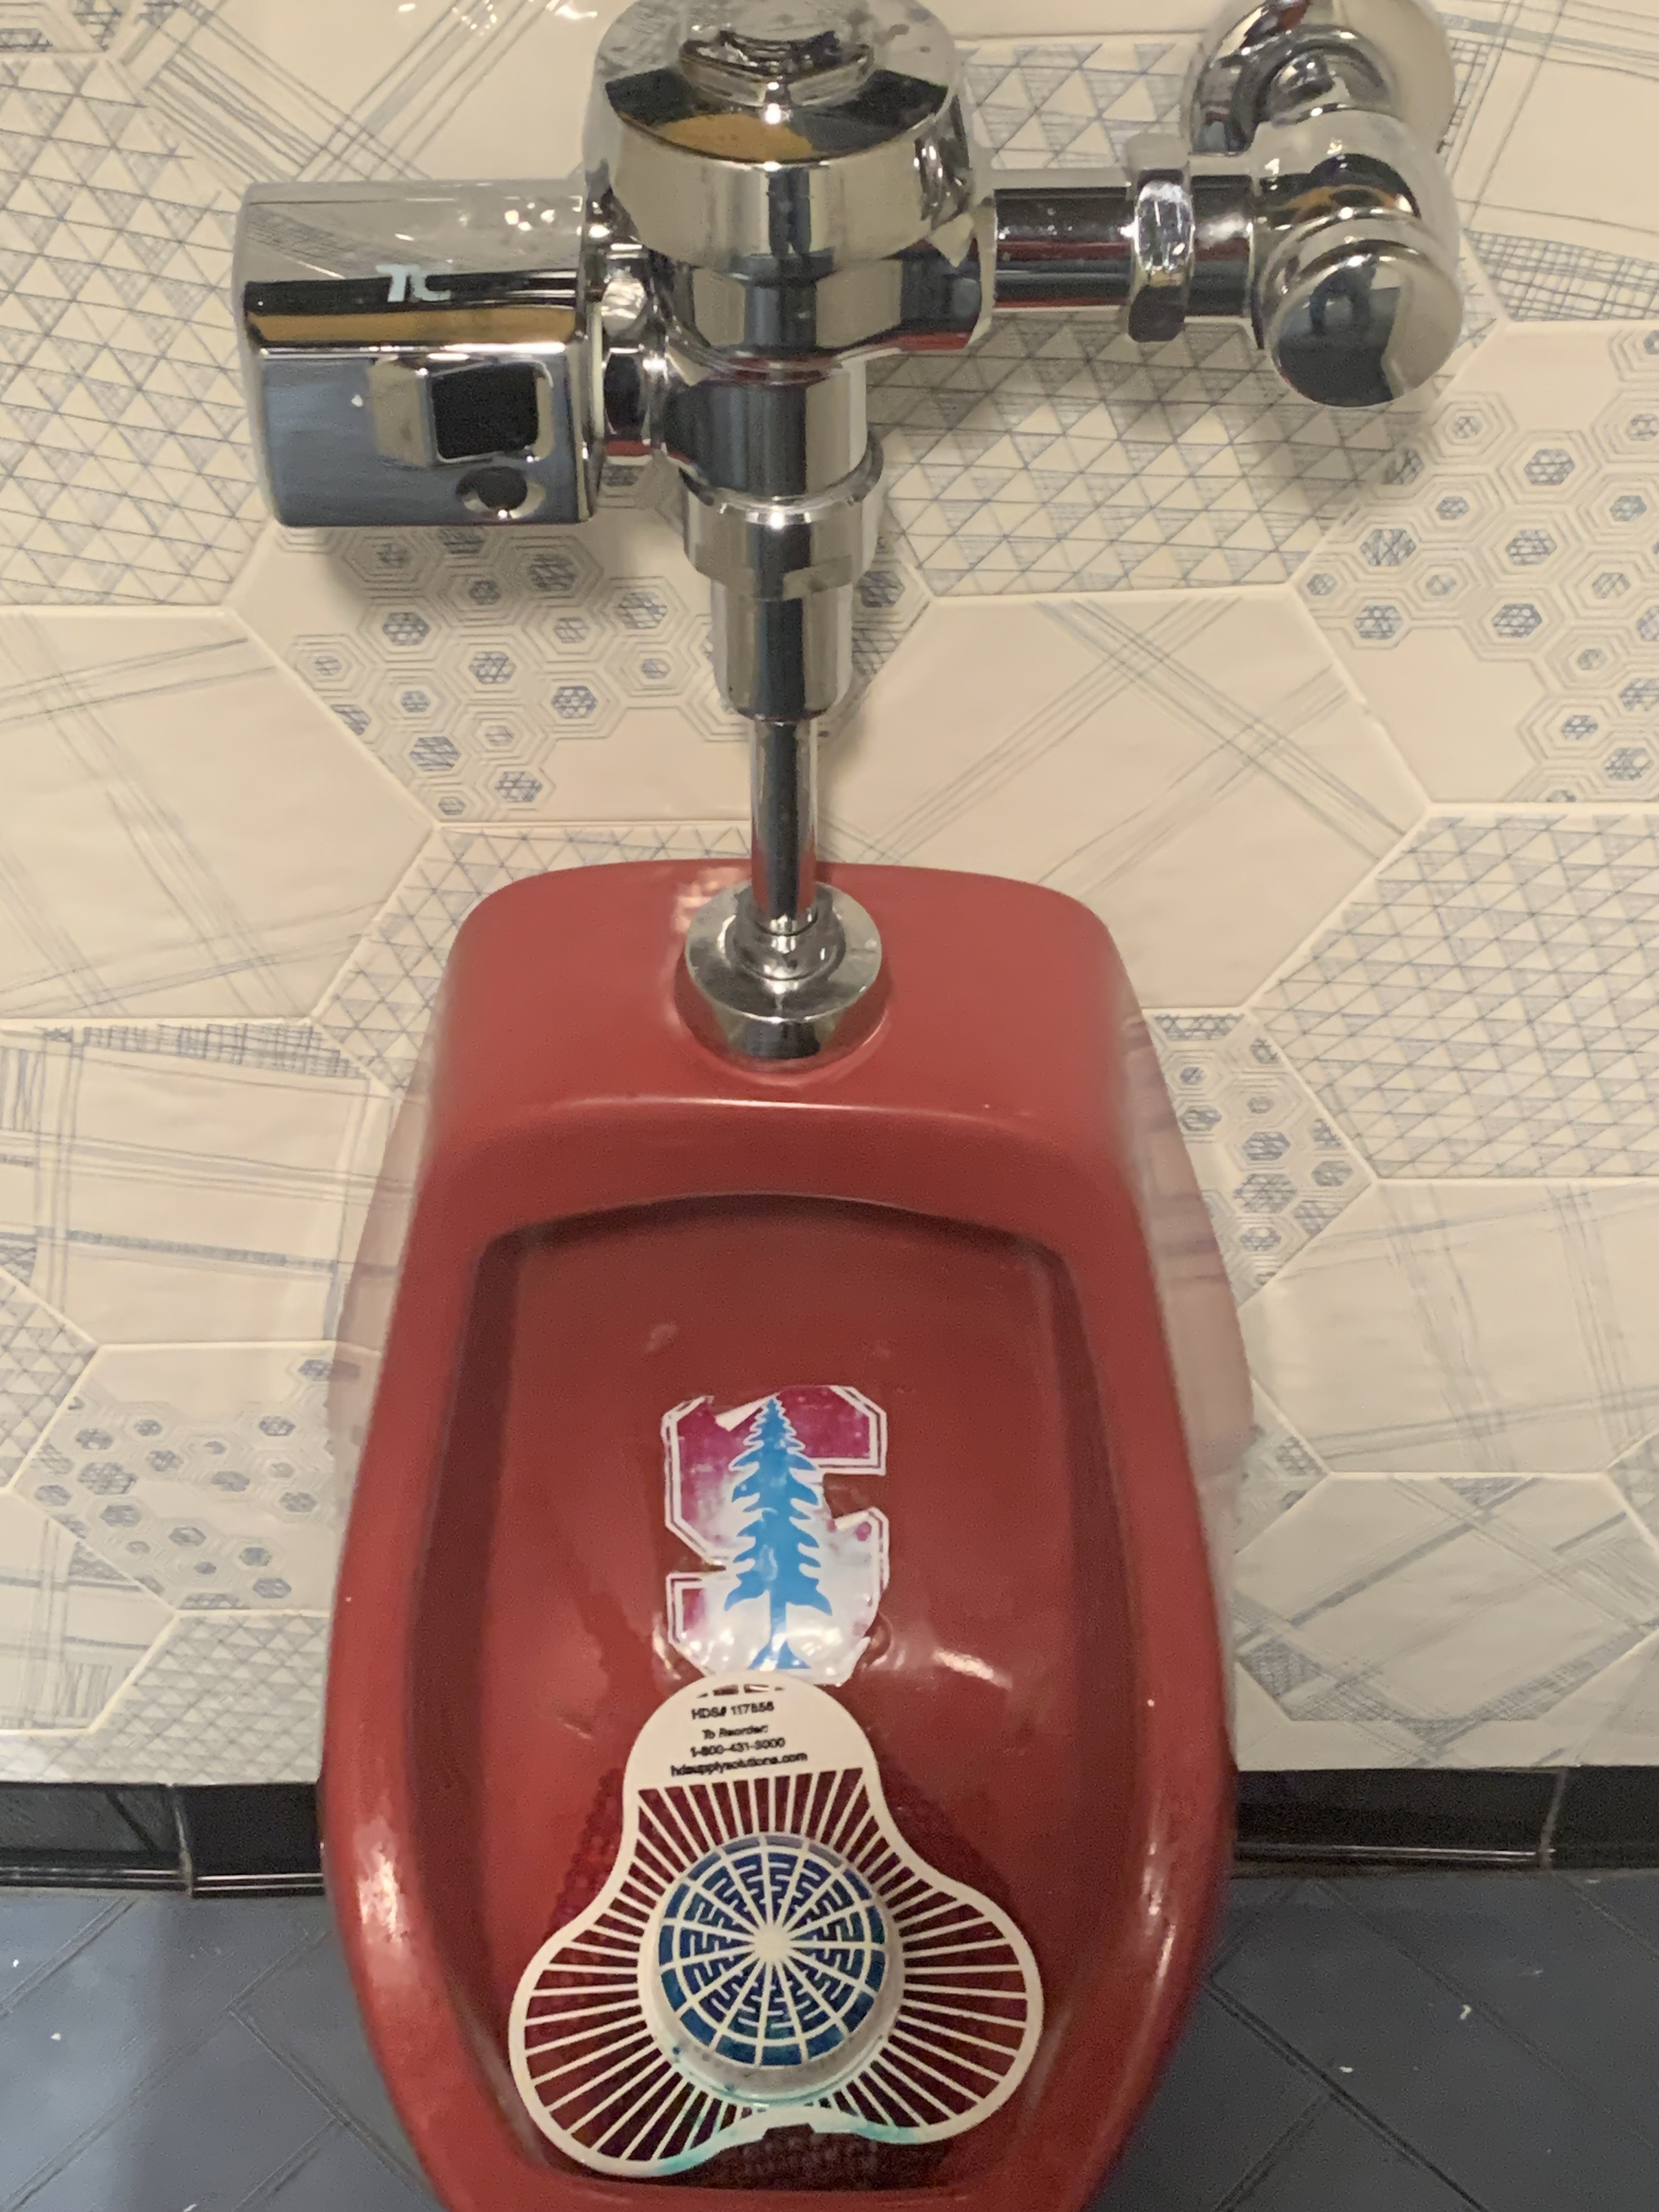
Thank you for listening
Stanford O’Brien Urology Research Center
Photo taken at University of California, Berkeley, courtesy of Al Roth (Nobel, 2012, Economics).

Slide 16
Good luck – make us proud!

