Slide 1


CAIRIBU 2023 Annual Meeting
Welcome and Opening Remarks
Chris Mullins, PhD
NIDDK Project Scientist for the Urology Centers Program

Slide 2

NIDDK Urology Centers Program Goals
Foster diverse, innovative and impactful research into
benign (non-cancer) urologic conditions within the
NIDDK’s mission
Build the urologic research community through
scientific and training/career development
opportunities at different career stages
Expand the scope of urology research to include expertise from
broad disciplines
Serve as a resource for the larger urology research community

Slide 3
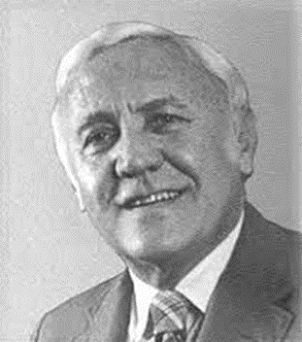

Evolution of the NIDDK
Urology Centers Programs
George M. O’Brien
Urology Centers
Established by
Congressional Mandate
(Independent P50s)
1st Annual Urology
Programs Directors
Meeting
(U54s, P20s, K-12)
Exploratory
Centers
(P20)
FORWARD
Centers
(P20)
Conversion of O’Brien
Urology P50 Centers
to Cooperative U54s
Urology Centers
Program
Interactions
Core PILOT
Urology Centers
Program
Interactions
Core (U24)
Planning
Centers
(P20)
Developmental
Centers
(P20)
CAIRIBU Program
(and 1st Annual
Meeting)
1987
2010
2012
2013
2018
2019
2020
2021
>20 Years of Urology Program Scientists and “Tweaks”:
Julie Barthold, MD
Deepak Nihalani, PhD
Chris Mullins, PhD
Tamara Bavendam, MD
Tracy Rankin, PhD, MPH
Deborah Hoshizaki, PhD
Leroy Nyberg, MD

Slide 4



CAIRIBU: A Novel Program for Promoting Collaborative Research and Training in Urology
Collaborating for the Advancement of
Interdisciplinary Research
in Benign Urology
Broad Urology
Research Community
and Beyond!
U54
O’Brien Urology
Centers
K12
KURe
UroEpi
P20
Exploratory and
FORWARD Centers
U24
O’Brien
Interactions Core

Slide 5

Some Major Areas of Emphasis:
2010-Present
Collaboration within and among Urology
Centers/Training Programs
Collaboration/sharing with and service to the
broad urology community
Support and integration of New/Early/Junior
Investigators and Trainees
Promote innovative, multi-disciplinary approaches with diverse expertise
Enhancing translational/clinical relevance for all studies
Leverage Center findings for new grant applications and studies
Flexibility for Programs to address changing needs

Slide 6
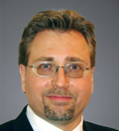
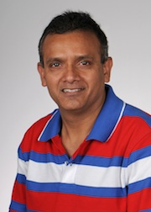
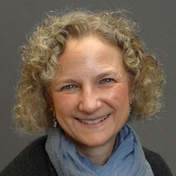
NIDDK Program Officers for
Urology Centers and Training
Urology Centers Project Scientist
Chris Mullins, PhD
Cell Biology Programs in Kidney and Urologic Disease mullinsc@mail.nih.gov
Urology Centers Program Officer
Deepak Nihalani, PhD
Kidney and Urology Centers Programs
deepak.nihalani@nih.gov
Training and Career Development Programs
Tracy Rankin, PhD, MPH
Deputy Director, KUH
Career Development, Diabetic Uropathy; Endocrinology
tracy.rankin@nih.gov
For a Complete List see
the NIDDK Website
https://www.niddk.nih.gov/

Slide 7
CAIRIBU 2023 Annual Meeting
Special Thanks to……
2023 Meeting Planning Committee
U54 and P20 Centers Directors and Investigators
K Award Training Programs Directors and Trainees
Dr. Kris Penniston and CAIRIBU/Centers Interactions Core Staff
Guest Speakers and Attendees
Scientific Consulting Group (SCG) Staff

