Slide 1

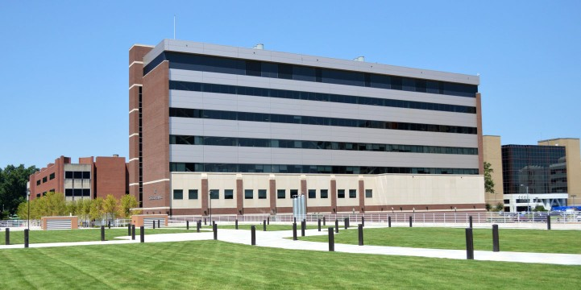

G protein-coupled bitter taste receptors suppress BK channels
and enhance urinary bladder smooth muscle contractility
Wenkuan Xin and Georgi V. Petkov
University of Tennessee Health Science Center, Memphis, TN

Slide 2
I have worked with Dr. Petkov since 2011,
  2011 to 2015 a member of a group at the University of South Carolina
  2015-2020 as a collaborator and Principal Investigator based in China
  2020- joined Dr. Petkov’s P20- Developmental Center

Slide 3
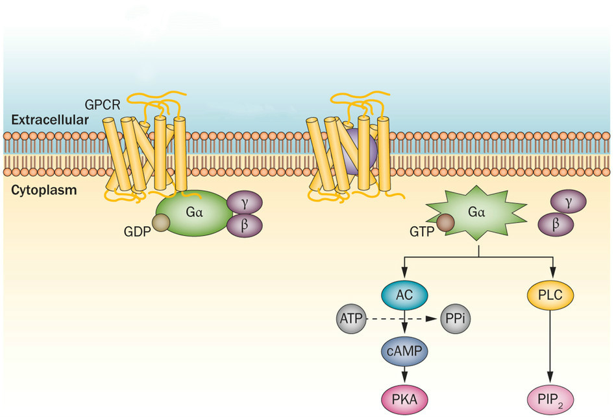
Background
G-protein-coupled receptors are the largest and most diverse group of cell membrane receptors.
GPCRs play a role in a large array of functions in the human body.
GPCRs are the most prominent cell membrane proteins as pharmacological drug targets.
https://www.nature.com/scitable/topicpage/gpcr-14047471/

Slide 4
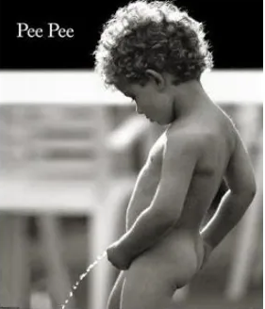
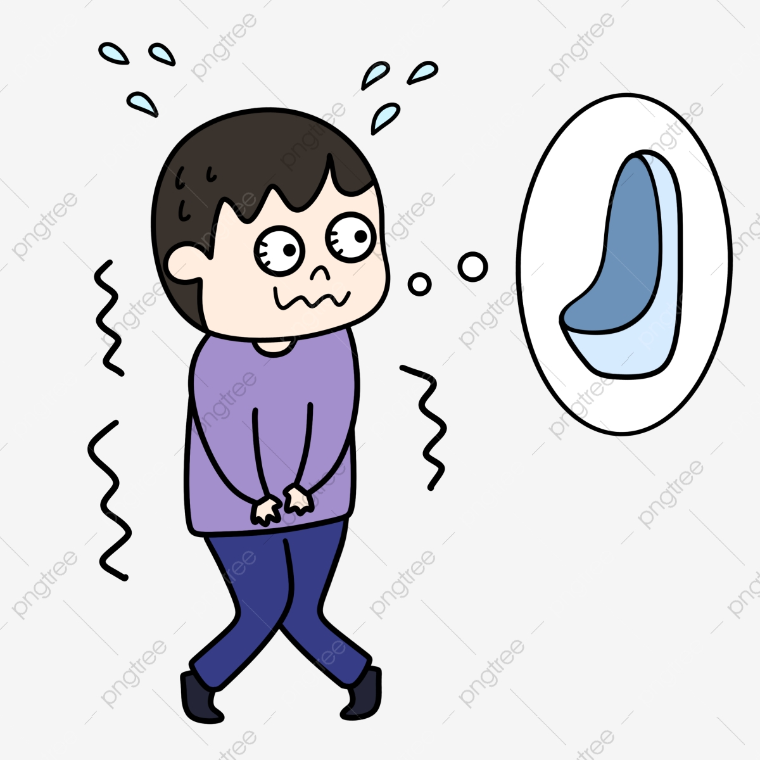
Background
GPCRs are essential regulators
of bladder smooth muscle (BSM) function
Muscarinic receptors are needed for
bladder voiding.
β3-AR facilitate BSM relaxation during bladder storage phase.
Acetylcholine is the endogenous agonist.
Mirabegron is a β3-AR agonist for OAB.

Slide 5
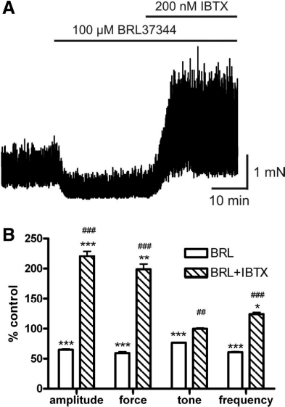
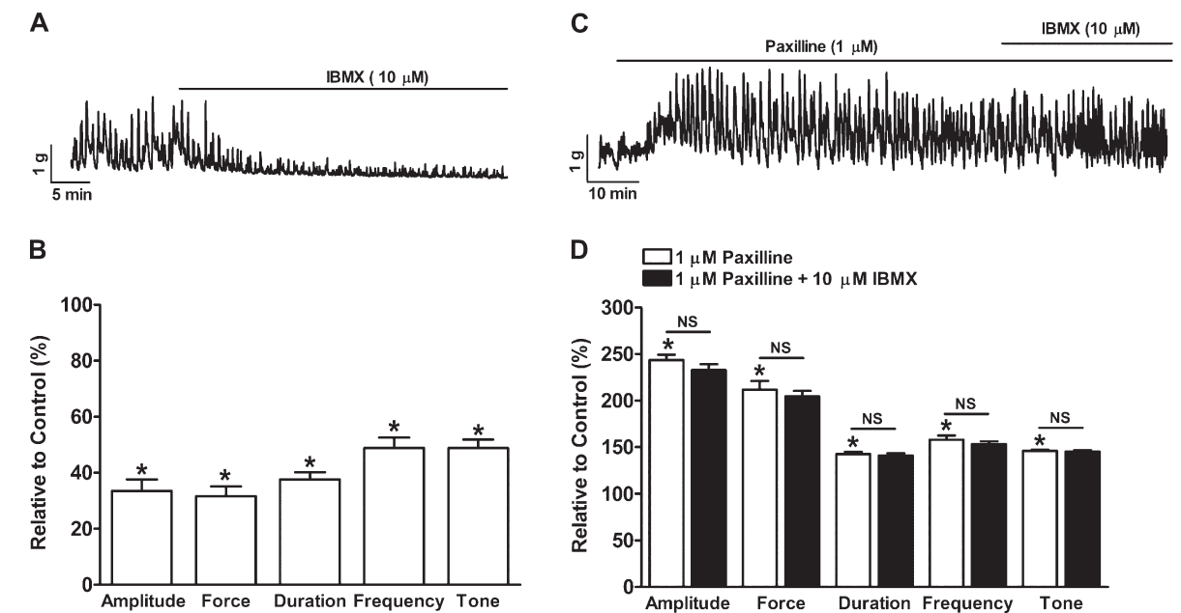
Our previous findings
Stimulation of β3-adrenoceptors relaxes rat urinary UBM via activation of BK channel.
Inhibition of cAMP/PKA with H-89 or KT-5720 significantly increased spontaneous phasic contractions of isolated BSM strips.
PDE blockade with IBMX significantly reduced spontaneous phasic contractions of human BSM-isolated strips.
Xin W, Li N, Cheng Q, Fernandes VS and Petkov GV (2014) . Am J Physiol Cell Physiol 307:C1142-1150.
Xin W, Li N, Cheng Q and Petkov GV (2014b). J Pharmacol Exp Ther 349:56-65.
Xin W, Cheng Q, Soder RP, Rovner ES and Petkov GV (2012) . Am J Physiol Renal Physiol 303:F1300-F61306
Xin W, Li N, Fernandes VS, Chen B, Rovner ES and Petkov GV (2016). Am J Physiol Renal Physiol 310:F994-999
Xin W, Li N, Fernandes VS and Petkov GV (2016b). Am J Physiol Renal Physiol 310:F1377-1384.
Xin W, Soder RP, Cheng Q, Rovner ES and Petkov GV (2012b). Am J Physiol Cell Physiol 303:C1079-C1089
Hristov KL, Cui X, Brown SM, Liu L, Kellett WF and Petkov GV (2008). Am J Physiol Cell physiol 295:C1344-C1353.

Slide 6
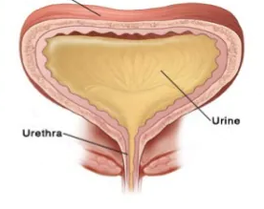
Muscarinic receptors are needed for
bladder voiding.
β3-AR facilitate BSM relaxation during bladder storage phase.
Acetylcholine is the endogenous agonist.
Mirabegron is a β3-AR agonist for OAB.
However, there is a lack of knowledge about the role of GPCR in underactive bladder (UAB).

Slide 7
Underactive bladder (UAB)
UAB cannot empty with high residual volume and is a significant clinical problem.
UAB may be myogenic with impaired bladder smooth muscle with unknown etiology.
The decreased contraction strength or duration of bladder smooth muscle prevents the timely and efficient emptying of the bladder.
Chancellor MB, Bartolone SN, Lamb LE, Ward E, Zwaans BMM and Diokno A (2020) Underactive Bladder; Review of Progress and Impact From the International CURE-UAB Initiative. Int Neurourol J 24:3-11

Slide 8
What we know
UAB cannot empty with high residual volume and is a significant clinical problem.
UAB may be myogenic with impaired bladder smooth muscle with unknown etiology.
The decreased contraction strength or duration of bladder smooth muscle prevents the timely and efficient emptying of the bladder.
Cyclic AMP-hydrolyzing Phosphodiesterase (PDE) can enhance bladder smooth muscle contractility.
Bitter taste receptor (Tas2r)-coupled Gαgustducin is the intrinsic PDE activator and can increase the tonic contraction in vascular smooth muscle.

Slide 9
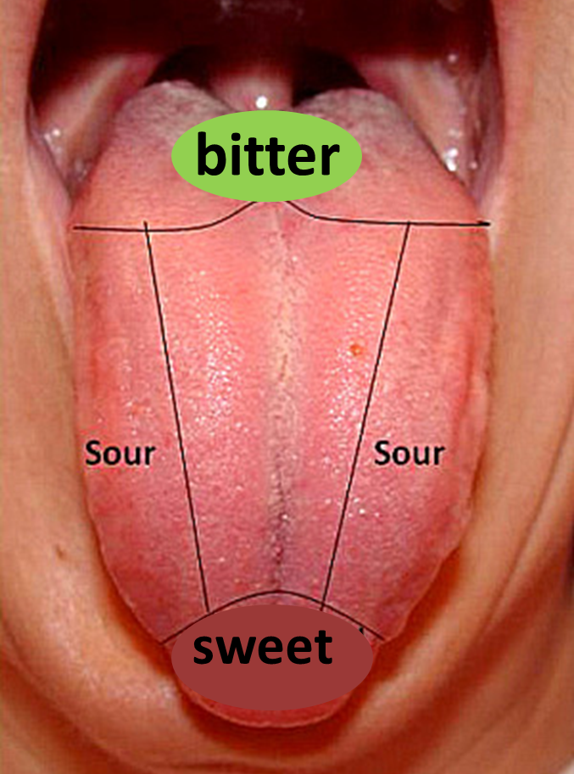
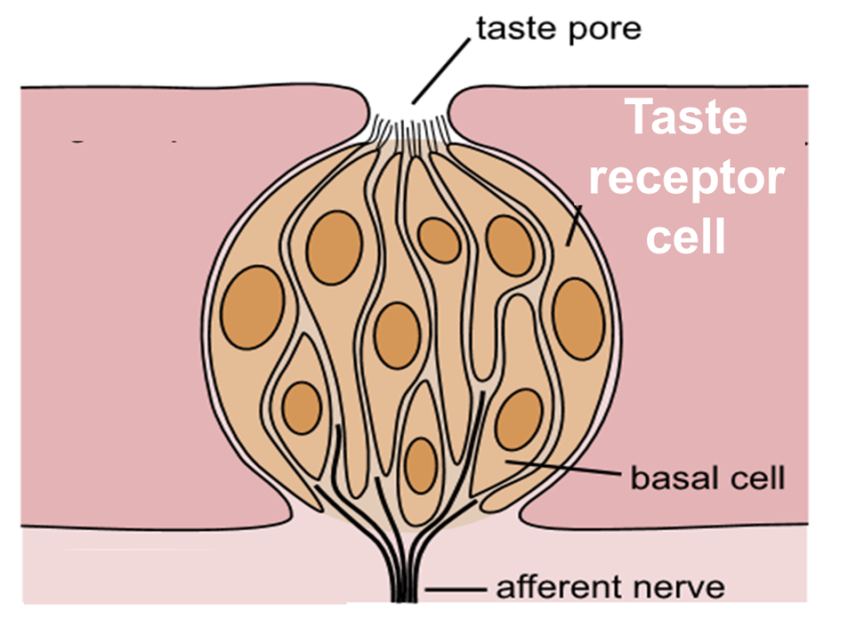
Bitter taste receptors mediate the bitter sensation and were first discovered in the taste bud.
Tas2rs include 25 subtypes in humans and 35 in rats.

Slide 10
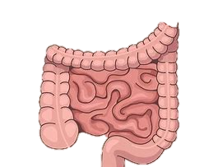
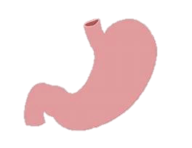
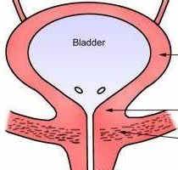
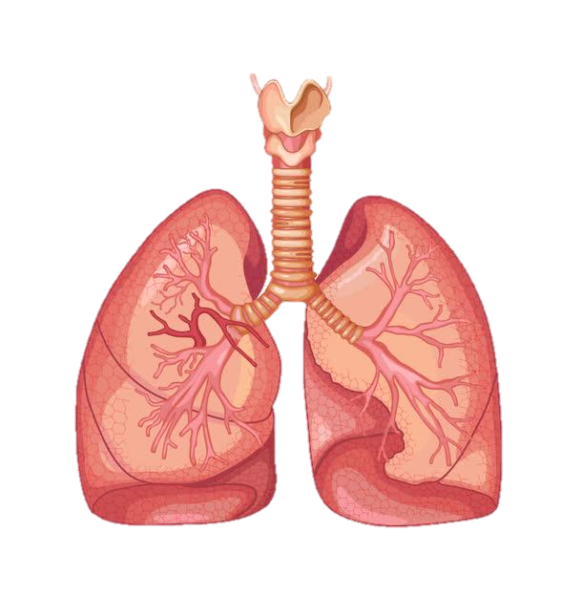
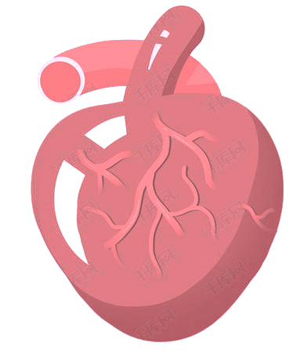
Recent studies showed that bitter taste receptors are expressed in tissues beyond taste buds.
bladder

Slide 11
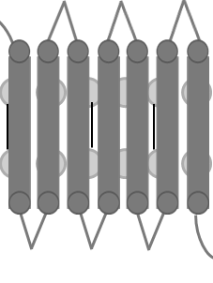
Beta adrenergic receptor activates AC/cAMP/PKA signaling.
β-AR
BK
channel
β-AR
K⁺
K⁺
K⁺
Gαs
β
γ
PDE
AC
Bladder
Relaxation
5’AMP
cAMP
ATP
PKA

Slide 12
The question is that any GPCR may activate PDEs in the bladder.
β-AR
BK
channel
β-AR
K⁺
?
K⁺
K⁺
Gαs
β
γ
PDE
AC
Enhances bladder
contractility
Bladder
Relaxation
5’AMP
cAMP
ATP
PKA

Slide 13
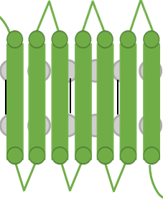
We hypothesize that Gα gustducin activates phosphodiesterase, suppresses cAMP/PKA activity, thereby enhances bladder smooth muscle contractility.
Tas2r
β-AR
BK
channel
K⁺
K⁺
K⁺
β₃
Gαs
β
α-gustducin
γ
γ₁₃
PDE
AC
Enhances bladder
contractility
Bladder
Relaxation
5’AMP
cAMP
ATP
PKA

Slide 14
Preliminary data
We screened all 35 Tas2rs and found that four Tas2rs mRNA are expressed in rat BSM
BSM
BSMC
A：BSM tissue: Tas2r40、108、126、135、137, 143; four G protein
B：BSM cell: Tas2r108、126、135、137, 143; four G protein
BSM (A) : n = 4, N = 4; BSM cells (B) : n = 3, N = 6
BSM cells isolated form two rats were pooled for one experiment

Slide 15
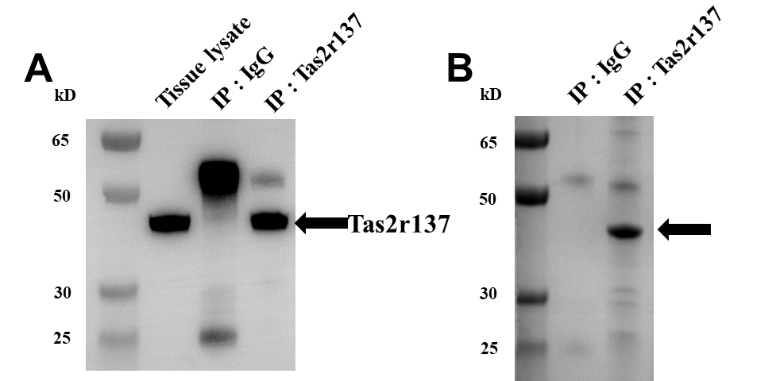
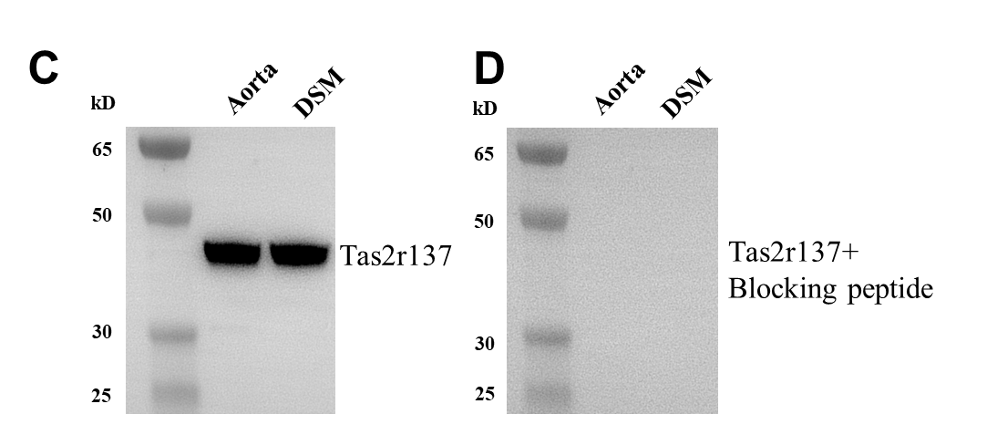
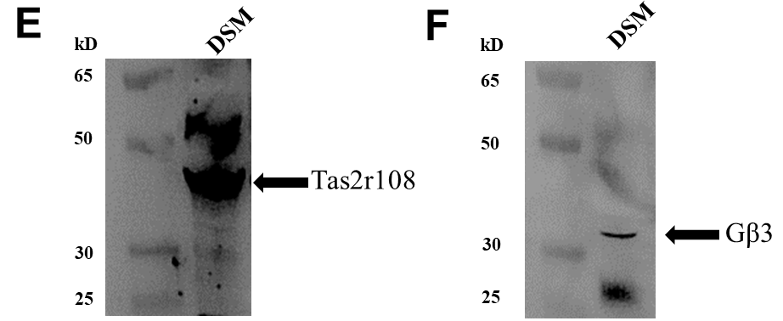
Preliminary data
Two Tas2rs proteins are expressed in BSM
BSM
BSM
Reference | UniquePepCount | Score
sp|Q67ET7|TA2R137 | 1 | 3.42
BSM
BSM
(A, B) IP Tas2r137; (D) blocking peptide for Tas2r137; (C, E, F) Western blot for Tas2r137, Tas2r108, and Gβ3

Slide 16
Preliminary data
Tas2r137 and gustducin are co-expressed in BSM cells
Scale bar: 10 µm for all images. n = 3, N = 3

Slide 17
Preliminary data
Diphenidol increased the spontaneous phasic contractions in BSM
two-way ANOVA with Sidak’s multiple comparisons test. control group: n = 7, N = 7, Diphenidol: n = 7, N = 7.
Notes:
Diphenidol is used to relieve or prevent nausea, vomiting, and dizziness caused by certain medical problems.

Slide 18
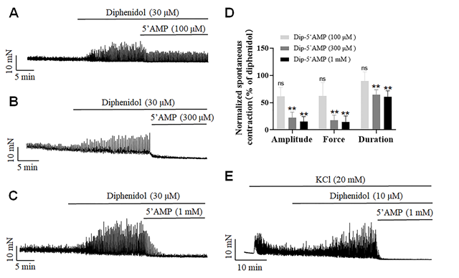
Preliminary data
Bitter-masking agent 5’AMP blocked the stimulatory effect of diphenidol on BSM

Slide 19
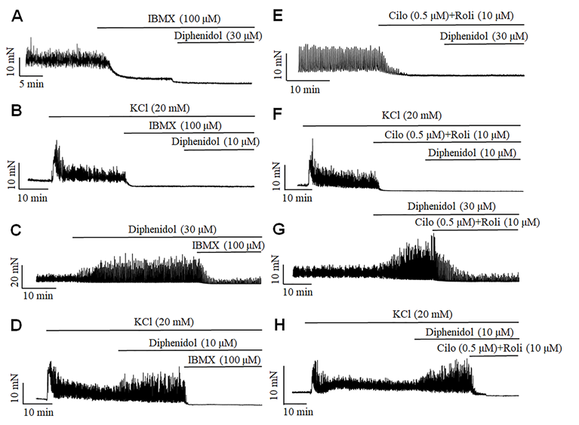
Preliminary data
The blockade of PDEs abolished the stimulatory effect of diphenidol on BSM contractility
Notes:
Diphenidol is used to relieve or prevent nausea, vomiting, and dizziness caused by certain medical problems.

Slide 20
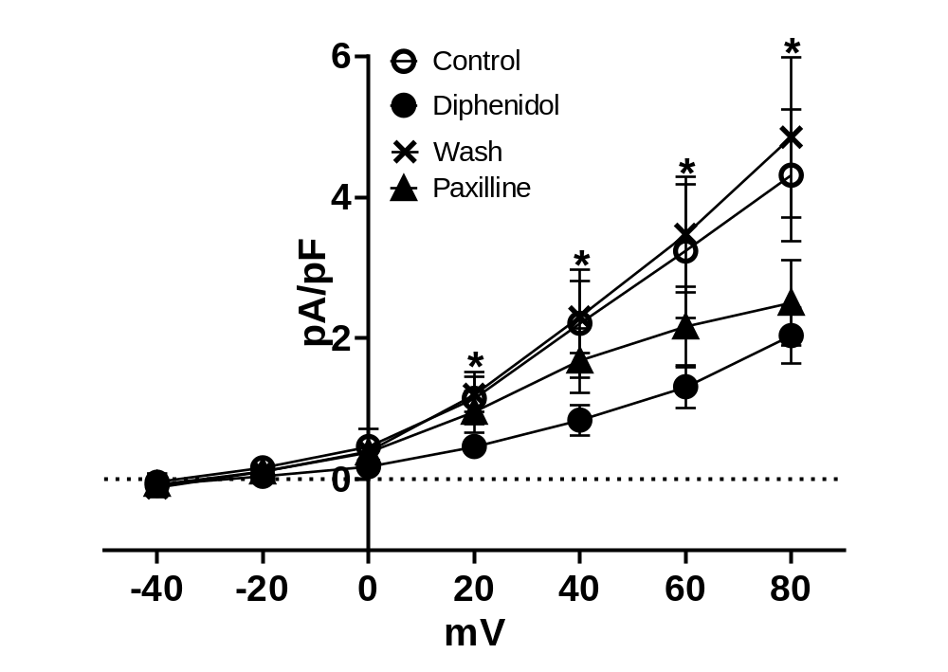
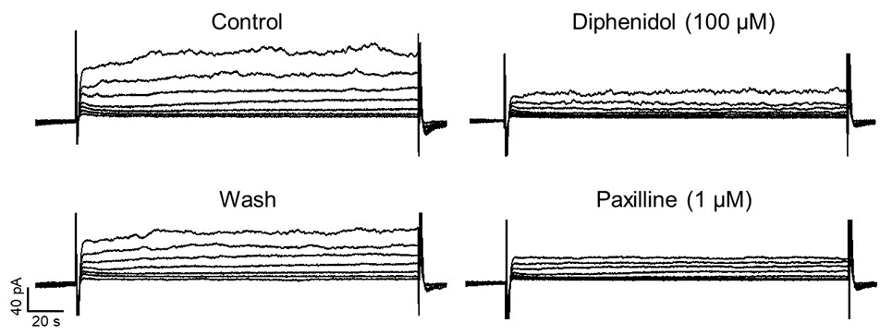
Preliminary data
Perforated whole-cell voltage-clamp recording
Diphenidol inhibited BK channels in BSM cells
n = 5, N = 5; *P<0.05
Notes:
Diphenidol is used to relieve or prevent nausea, vomiting, and dizziness caused by certain medical problems.

Slide 21
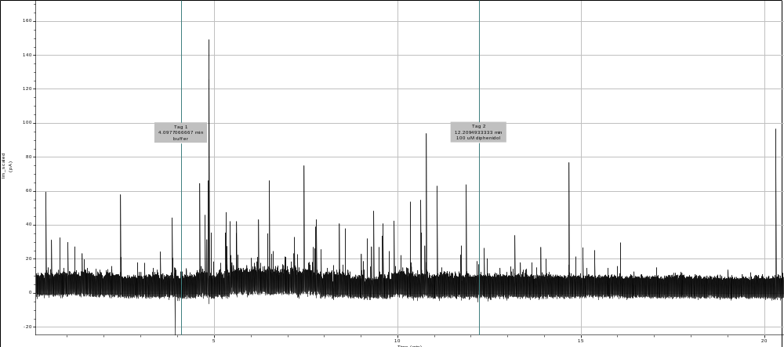
Preliminary data
Whole-cell voltage-clamp recording at -10 mV
Diphenidol inhibited spontaneous transient BK currents in BSM cells
100 µM diphenidol
Buffer
Notes:
Diphenidol is used to relieve or prevent nausea, vomiting, and dizziness caused by certain medical problems.

Slide 22
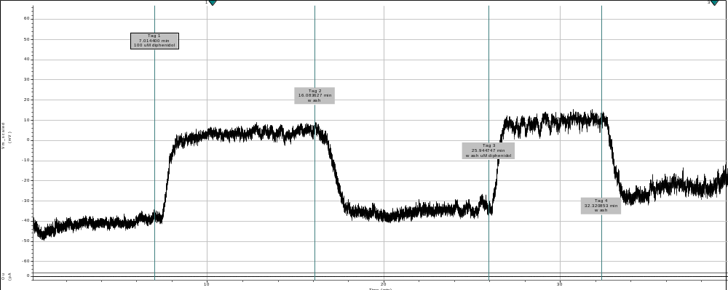
Preliminary data
Whole-cell current-clamp recording
Diphenidol depolarized BSM cells membrane potential
100 µM diphenidol
wash
100 µM diphenidol
wash
Notes:
Diphenidol is used to relieve or prevent nausea, vomiting, and dizziness caused by certain medical problems.

Slide 23
Hypothesis and Aims
Bitter taste receptors are express in bladder smooth muscle. They can activate phosphodiesterases (PDEs), suppress large conductance voltage- and calcium activated potassium (BK) channel activity, and thus enhance bladder smooth muscle excitability and contractility.
Bitter taste receptors could be novel pharmacological targets for drugs to treat UAB.
Aim 1. Determine gene and protein expression profiles of Tas2rs and their coupled G proteins in BSM and the spatial correlation between gustducin and PDEs.
Aim 2: Elucidate Tas2r-mediated regulation of BSM excitability and contractility. Investigate the underlying mechanisms involving G proteins, PDE/cAMP/PKA, K⁺ ion channels.
The finding of this project will provide knowledge about GPCR in the underactive bladder (UAB).

Slide 24
Acknowledgement
Finding support: P20 DK123971
R01 DK106964
SWU 115086, 104290
BC2018042

Slide 25
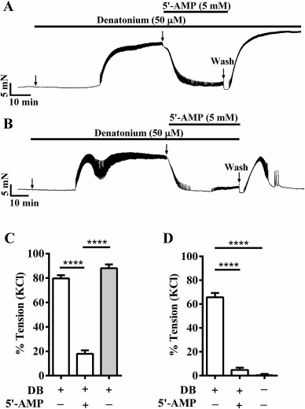
Bitter taste receptors enhanced the endothelium-denuded rat aorta tonic contraction
Liu M, Qian W, Subramaniyam S, Liu S and Xin W (2020a) Denatonium enhanced the tone of denuded rat aorta via bitter taste receptor and phosphodiesterase activation. Eur J Pharmacol:172951

