Slide 1


Collaborating for the Advancement of Interdisciplinary Research in Benign Urology
Collaborative research in benign urology: challenges and potential
Kristina Penniston, PhD, RDN
Senior Scientist, University of Wisconsin School of Medicine and Public Health
PI, CAIRIBU U24 Interactions Core (DK127726)

Slide 2
Agenda
CAIRIBU Website URL: https://niddkcairibu.urology.wisc.edu
History and background (5 min)
Specific aims (5 min)
Accomplishments (15 min)
Challenges (10 min)
Future directions (5 min)
Discussion
Collaborating for the Advancement of Interdisciplinary Research in Benign Urology

Slide 3

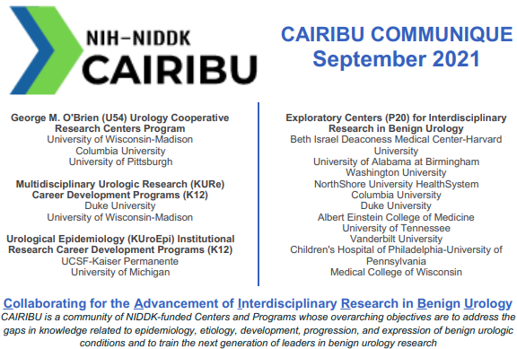
History and background
CAIRIBU Website URL: https://niddkcairibu.urology.wisc.edu
July 2018 “pilot” initiative
  Directed by NIDDK Program Officers
  Took over coordinating work of UW-Madison O’Brien Center
  Funded from money set aside at UW-Madison
  Accomplishments:
    Monthly leadership meetings
    Website
    Monthly CAIRIBU Communique
    Streamlined/standardized O’Brien Center Opportunity Pool application/review process
    2 annual meetings
January 2020 RFA (DK-10-034) for Urology Centers Program Interactions Core
  NOA September 2020
Collaborating for the Advancement of Interdisciplinary Research in Benign Urology

Slide 4
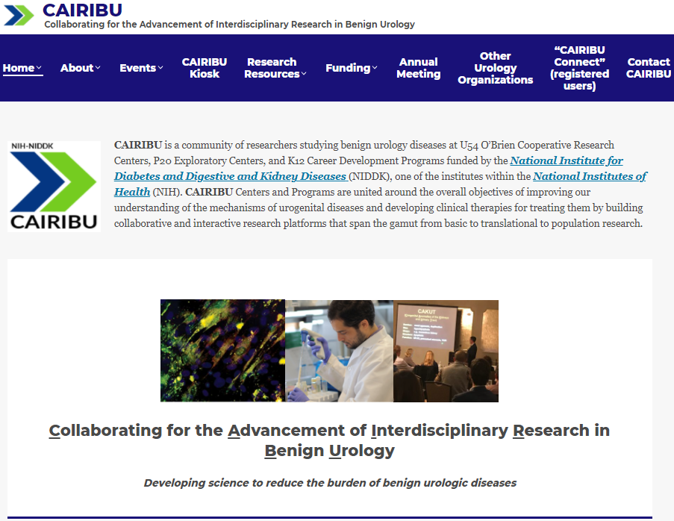
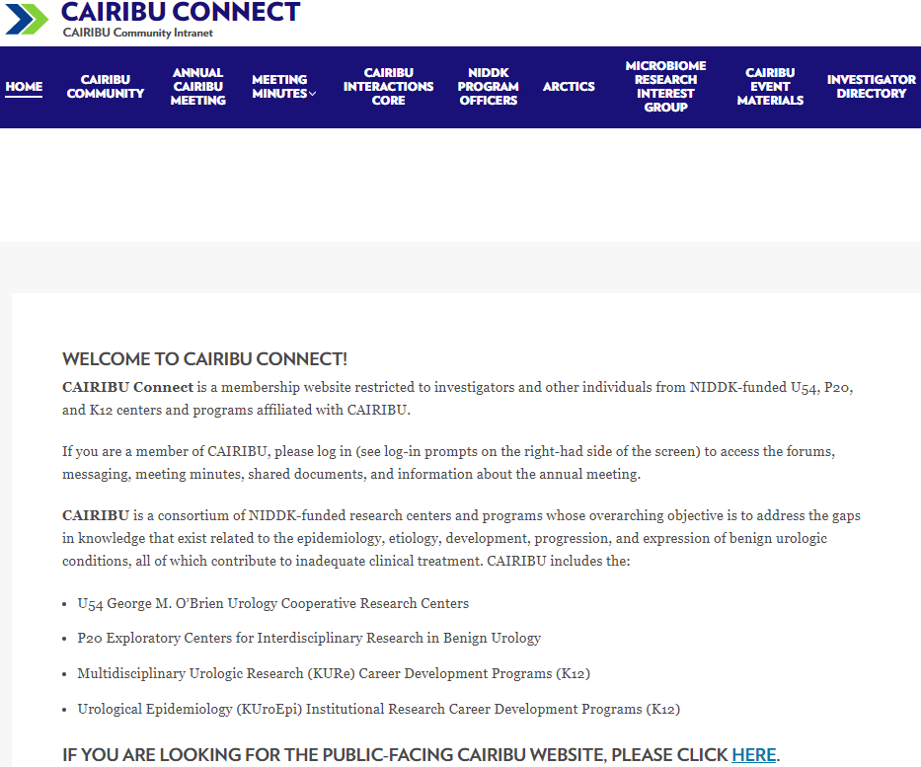
CAIRIBU website & CAIRIBU Connect (intranet)
Collaborating for the Advancement of Interdisciplinary Research in Benign Urology

Slide 5
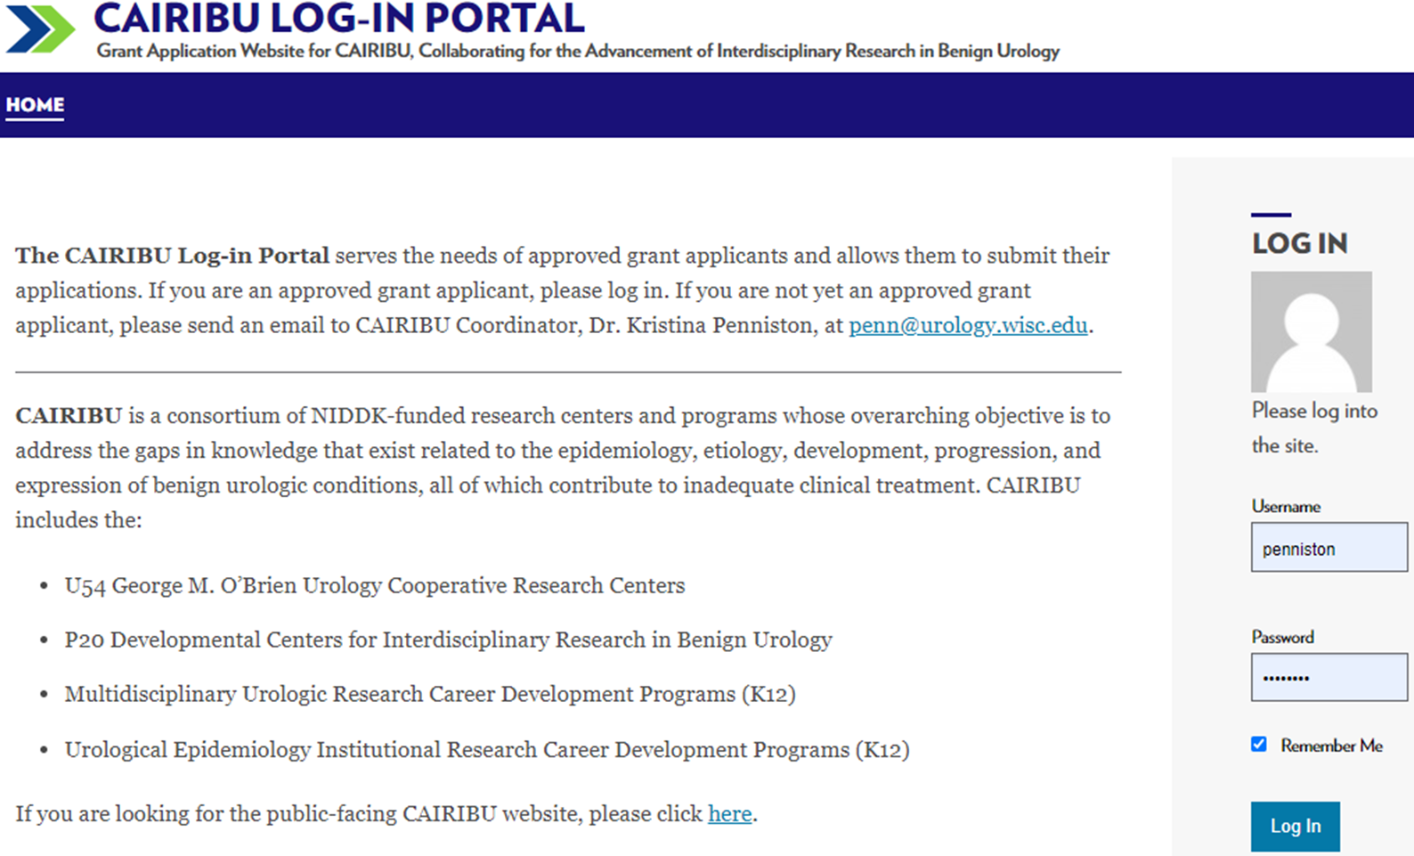
CAIRIBU grants/awards portal
Collaborating for the Advancement of Interdisciplinary Research in Benign Urology

Slide 6
Agenda
CAIRIBU Website URL: https://niddkcairibu.urology.wisc.edu
History and background (5 min)
Specific aims (5 min)
Accomplishments (15 min)
Challenges (10 min)
Future directions (5 min)
Discussion
Collaborating for the Advancement of Interdisciplinary Research in Benign Urology

Slide 7
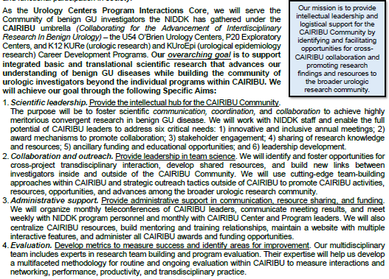
Specific aims
CAIRIBU Website URL: https://niddkcairibu.urology.wisc.edu
Build and foster sense of trust required to share knowledge, resources, and ideas
Collaborating for the Advancement of Interdisciplinary Research in Benign Urology

Slide 8
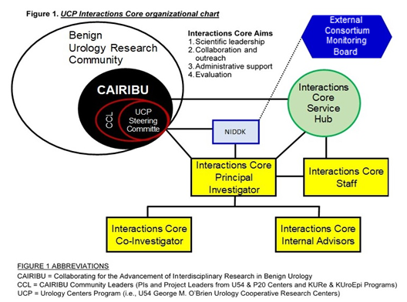
Organizational structure
CAIRIBU Website URL: https://niddkcairibu.urology.wisc.edu
Regular meetings with NIDDK Program Officers enable 2-way communication and collaborative interactions
Input of POs is critical for ensuring alignment with NIDDK objectives and goals
POs provide feedback on current efforts and directions re: future initiatives
(Infrastructure)
Collaborating for the Advancement of Interdisciplinary Research in Benign Urology

Slide 9
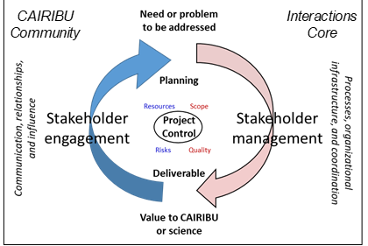
Interactions Core engagement approach
GOALS
Maximize CAIRIBU leaders’ engagement in:
  Making organizational decisions
  Developing CAIRIBU research priorities
  Providing leadership and direction within CAIRIBU
  Enable sharing of knowledge, ideas, and resources between Centers and across CAIRIBU
  Optimize CAIRIBU investigators’ and trainees’ engagement with the broader benign urologic research community
  Facilitate CAIRIBU investigators’ and trainees’ engagement in inter- and trans-disciplinary research interest groups
Adapted by KP from model developed by the Association for Project Management

Slide 10
Agenda
CAIRIBU Website URL: https://niddkcairibu.urology.wisc.edu
History and background (5 min)
Specific aims (5 min)
Accomplishments (15 min)
Challenges (10 min)
Future directions (5 min)
Discussion
Collaborating for the Advancement of Interdisciplinary Research in Benign Urology

Slide 11
Interactions Core Aim 1
CAIRIBU Website URL: https://niddkcairibu.urology.wisc.edu
Collaborating for the Advancement of Interdisciplinary Research in Benign Urology

Slide 12


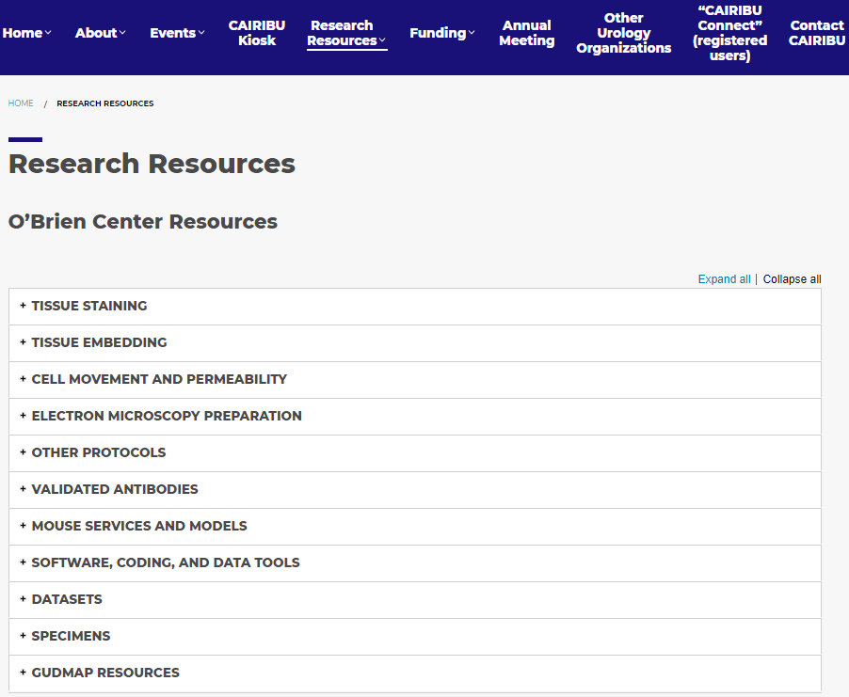
Accomplishments – Aim 1
CAIRIBU Website URL: https://niddkcairibu.urology.wisc.edu
Priorities for CAIRIBU Collaboration Awards
Goals for research team:
Includes an investigator new to benign urology research
Establishes a new junior-senior investigative partnership that will beyond the life of the grant
Is a collaboration of CAIRIBU investigators and those from the broader urology research community
Includes a K12 Scholar from a CAIRIBU KURe or KUroEpi Program
Reflects a collaboration/interaction between a CAIRIBU P20 Exploratory and U54 O’Brien Center
Is a new collaboration (e.g., investigators who have not previously worked together)
Is interdisciplinary, includes >1 of the following disciplines: clinician, basic research, population health, epidemiology, environmental science, toxicology, nutrition, mathematics, computer scientist, data science, engineering
Goals for research design and objectives:
Incorporates tools, techniques, and/or technologies new to benign urology research
Addresses health disparities
Has a clinical and/or epidemiological component
Design is “bench to bedside” (e.g., will test a new project, process, therapy)
Design and/or execution includes significant patient and/or clinician engagement
Will develop a sharable model (e.g., a teaching model, clinical pathway, patient engagement process, animal model, computer model, electronic health record data mining process)
Objectives include field development, such as forming a working group that continues beyond the life of the grant, establishing an ongoing research community, or produces a workshop series or training curriculum
Enhances the diversity of the benign urology research workforce
Innovative and inclusive meetings
  Bi-monthly leadership meetings, ad hoc committee meetings, annual meetings
Award mechanisms to promote collaboration
  CAIRIBU Collaboration Awards, CAIRIBU Convergence Awards, CAIRIBU Research Training and Development Grants
Stakeholder engagement
  Rationale, tools and methods
Sharing knowledge and research resources
Ancillary funding, educational opportunities
Leadership development
2020 CAIRIBU meeting
22 speakers in 3 sessions
Women, 11 | Men, 11
Established investigator, 13 Early-career stage, 9
U54 Centers, 6 P20 Centers, 8 K12 Programs, 9*
*current and former K Scholars
6 moderators
4 women | 2 men
All were trainees or early-career stage investigators
Collaborating for the Advancement of Interdisciplinary Research in Benign Urology

Slide 13
Interactions Core Aim 1
CAIRIBU Website URL: https://niddkcairibu.urology.wisc.edu
Collaborating for the Advancement of Interdisciplinary Research in Benign Urology

Slide 14






Accomplishments – Aim 2
CAIRIBU Website URL: https://niddkcairibu.urology.wisc.edu
Build collaborations within CAIRIBU
  Foster and facilitate nascent collaborations
Build research collaborations that enhance diversity and address disparities in the benign GU research workforce and workforce pipeline
  CAIRIBU-wide strategy for attracting URMs to CAIRIBU Centers and Programs in development
  Templates for CARIBU Centers and Programs to use in their own outreach are in development
Promote CAIRIBU broadly within GU community
Stakeholder engagement
  CAIRIBU P20 Centers collaborated to submit PCORI grant application
  Build other collaborations to go after DOD and other grants requiring patient engagement
The Urobiome
Collaborating for the Advancement of Interdisciplinary Research in Benign Urology

Slide 15
Interactions Core Aim 1
CAIRIBU Website URL: https://niddkcairibu.urology.wisc.edu
Collaborating for the Advancement of Interdisciplinary Research in Benign Urology

Slide 16
Accomplishments – Aim 3
CAIRIBU Website URL: https://niddkcairibu.urology.wisc.edu
Facilitate regular leadership meetings
  Share news and accomplishments
  Discuss science
  Ask for input and feedback
  Make decisions about CAIRIBU Interactions Core and CAIRIBU-wide initiatives
Open and transparent communication
  Monthly meetings always include NIDDK Program Officers’ announcements/updates
  Monthly CAIRIBU Communique; mid-month CAIRIBU “Catch-Up”
  Results of surveys and other data presented at leaders’ meetings
  Minutes of all meetings posted and archived on CAIRIBU Connect
    O’Brien Centers Leaders meetings + CAIRIBU Community Leaders meeting + ad hoc committees
CAIRIBU website and intranet
  Updated daily, new features added
  Monthly analytics are gathered and reviewed
Services to support and expand productivity of CAIRIBU Centers and Programs

Slide 17
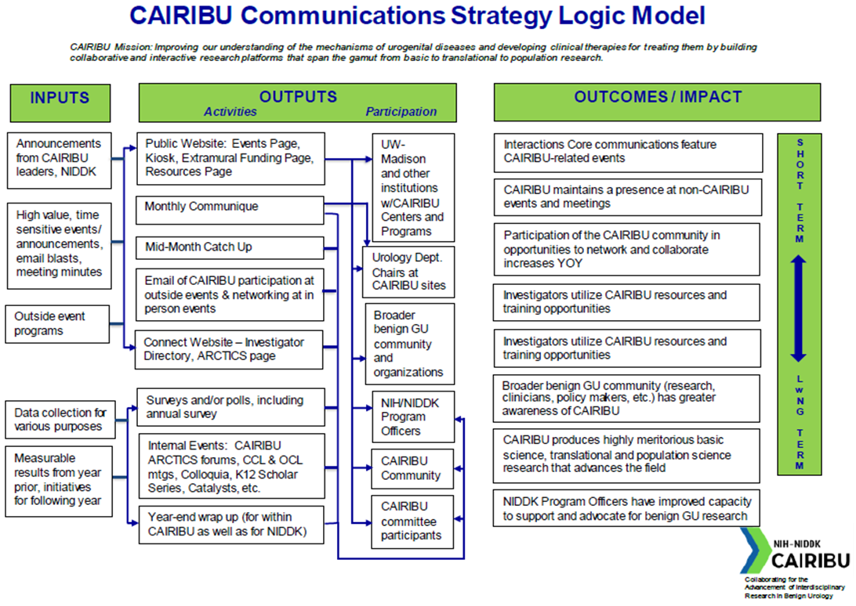
Accomplishments – Aim 3
CAIRIBU Website URL: https://niddkcairibu.urology.wisc.edu

Slide 18
Interactions Core Aim 1
CAIRIBU Website URL: https://niddkcairibu.urology.wisc.edu
Collaborating for the Advancement of Interdisciplinary Research in Benign Urology

Slide 19
Accomplishments – Aim 4
CAIRIBU Website URL: https://niddkcairibu.urology.wisc.edu
Evaluation plan
PURPOSE
Determine effectiveness in supporting development of highly meritorious collaborative research
GOALS
- Reasonable and feasible
- Low burden
- Interim measures for continuous
improvement
QUESTIONS
What does success look like for the CAIRIBU Interactions Core?
What does success look like for cross-program interactions within CAIRIBU?
What are the Mission + Vision of the Initiative?
What do you want to achieve scientifically?
What do you want to achieve organizationally?
What is Success?
What does scientific success look like in tangible outputs and outcomes?
What does organizational success look like?
What is the Scope of the Evaluation?
Minimal, just ongoing quality improvement by PD and/or program staff
Modest, small external evaluation or evaluation by a coordinating center
Full-scale evaluation by contractor or NIH expert evaluator

Slide 20
Accomplishments – Aim 4
CAIRIBU Website URL: https://niddkcairibu.urology.wisc.edu
Cross-CAIRIBU Interactions
New investigators participate in CAIRIBU | Non-CAIRIBU participants in the annual meeting | Registration information | December
 | Non-CAIRIBU participants as grant reviewers | Reviewer spreadsheet | Collected after soliciting reviewers
 | Non-CAIRIBU applicants for CAIRIBU funding | Award tracking | Collected after each application closes
Trainees and ESIs participate in CAIRIBU leadership opportunities | Number of trainees who participate in leadership opportunities (planning committees: meetings, forums) | Attendance tracking | Ongoing
CAIRIBU provides opportunities for higher-level trainees and early career faculty to understand interdisciplinary research and interact with investigators from other disciplines | Number of trainees who participate in ARCTICS | Attendance tracking | Ongoing
 | Trainee satisfaction with ARCTICS community | Survey to trainees after ARCTICS forum series | After final ARCTICS session
 | Self-reported opportunities to initiate collaborative/mentoring relationships at ARCTICS events | Survey to trainees after ARCTICS forum series | After final ARCTICS session
 | Description of ARCTICS: how many sessions were educational sessions, how many were listening/discussion sessions (gauge participation) | Planning in progress | Completed after sessions finalized
CAIRIBU provides opportunities for investigators to learn new things about the research and research tools used by other investigators | Changes in knowledge before and after scientific sessions (CAIRIBU meeting) | Post-CAIRIBU meeting evaluation survey | December
 | Self-reported opportunities to learn new things about the research and research tools of other investigators (CAIRIBU meeting) | Post-CAIRIBU meeting evaluation survey | December
 | Number of CAIRIBU events each year | Event tracking | Ongoing
CAIRIBU provides opportunities for people from diverse backgrounds to be part of the benign GU field | Demographic information of annual meeting registrants | Registration information | Collected as investigators register for annual meeting
Increased engagement with cross-institutional research | Levels of Collaboration Survey | Levels of Collaboration Survey | Annual – Sept.
 | Self-reported interdisciplinary collaborations | Quarterly Survey | Jan, April, July, Oct.
CAIRIBU investigators submit collaborative grant proposals | Number of new research teams created with CAIRIBU funding | Award tracking | Collected after each application closes
CAIRIBU investigators submit collaborative publications | Publication tracking of CAIRIBU community | PubMed | Ongoing
 | Impact of CAIRIBU events on new collaboration | Quarterly survey | Jan, April, July, Oct.
 | Assessment of Support for grant applications given within CAIRIBU | Quarterly survey | Jan, April, July, Oct.
The absolute number of successfully funded CAIRIBU investigators increases year over year | Grant tracking of CAIRIBU community (within CAIRIBU funded centers and programs) who is funded/has been funded within the last year? + funding amount | NIH RePORTER; other methods TBD via input from CAIRIBU Community Leaders | Ongoing

Slide 21
Agenda
CAIRIBU Website URL: https://niddkcairibu.urology.wisc.edu
History and background (5 min)
Specific aims (5 min)
Accomplishments (15 min)
Challenges (10 min)
Future directions (5 min)
Discussion
Collaborating for the Advancement of Interdisciplinary Research in Benign Urology

Slide 22
Challenges
CAIRIBU Website URL: https://niddkcairibu.urology.wisc.edu
Forming Research Interest Groups to promote collaborative research
  Fear of engaging with those who may be on scientific review committees
  Greater magnitude of effort required for grant applications involving multiple PI, institutions, etc.
  What support can CAIRIBU Interactions Core provide?
O’Brien Center summer student enrichment programs
  “Best practices” not currently shared across Centers
  Programs may benefit from some level of standardization
  What role can CAIRIBU Interactions Core play?
Patient engagement in research
  Some PIs well-suited for this and currently engaged in it
  Basic science researchers less familiar and supportive of idea
  How can CAIRIBU Interactions Core build this movement and enhance involvement?

Slide 23
Agenda
CAIRIBU Website URL: https://niddkcairibu.urology.wisc.edu
History and background (5 min)
Specific aims (5 min)
Accomplishments (15 min)
Challenges (10 min)
Future directions (5 min)
Discussion
Collaborating for the Advancement of Interdisciplinary Research in Benign Urology

Slide 24
Future directions
CAIRIBU Website URL: https://niddkcairibu.urology.wisc.edu
CAIRIBU evaluation program
  Engage PIs in CAIRIBU evaluation metrics
  Manuscript
Enhance activity and visibility within broader benign GU research community
  Provide leadership, momentum, and logistical support to nascent CAIRIBU Research Interest Groups (RIGs)
  Be involved with relevant organizations and societies
  Organize CAIRIBU “presence” at urologic research meetings
  Communicate and organize
    Quarterly CAIRIBU Connections
    Quarterly CAIRIBU Catalyst Conversations
    CAIRIBU ARCTICS Community Forums
    CAIRIBU K12 Seminar Series
    CAIRIBU YouTube Channel and other social media venues
      Cross-CAIRIBU social media committee to develop guidelines for CAIRIBU Interactions Core presence on Twitter

