Slide 1

Annual CAIRIBU Meeting 2021
SESSION 4: Therapeutic Advances in Benign Genitourinary Research
NGF-targeting therapy for prostatic inflammation and LUTS
Naoki Yoshimura
Department of Urology
University of Pittsburgh School of Medicine
NIH/NIDDK U54 DK112079

Slide 2
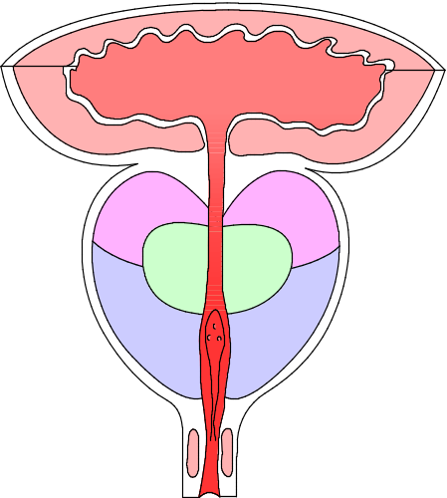
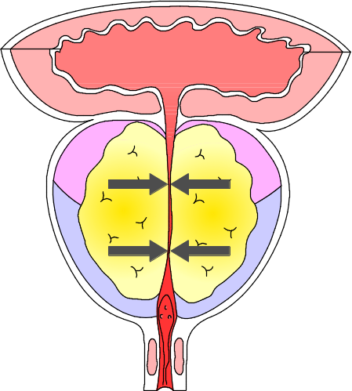
BPH and Lower urinary tract symptoms (LUTS)
Normal
BPH
Bladder
Storage symptoms
⬆
Hypertrophy
Ischemia
Afferent activation
(Positive ice-water test)
Prostate/Urethra
Compression
Inflammation
⬇
Voiding symptoms
Normal voiding is
possible
(urethra is not compressed)
Urethra is compressed
due to prostate
hyperplasia
(transition region)
Significant correlation between LUTS and prostatic inflammation in BPH patients
Transition region
Central region
Marginal region
Notes:
製品編
2

Slide 3
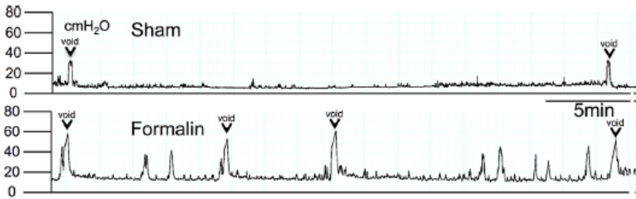
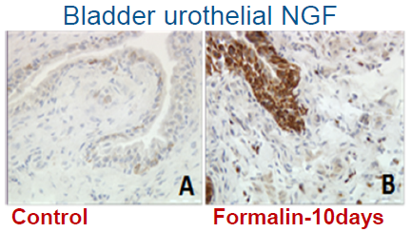
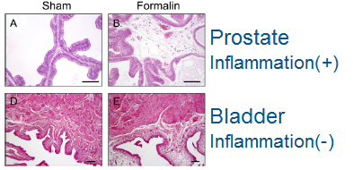
Afferent sensitization following prostatic inflammation
DRG
Bladder overactivity
Spinal cord
Afferent sensitization
Bladder urothelium- Nerve Growth Factor (NGF)⬆
In dichotomized (18-19%) and bladder afferents,
TRPV1, TRPA1⬆
ATP receptor P2X₂⬆
+
Hyperexcitability of bladder afferent neurons & Kv1.4⬇
Bladder
Rat model: intraprostatic formalin injection
Funahashi et al., J Physiol 597:2063-2078, 2019
Mouse model: prostate-specific E-cadherin downregulation
Pascal et al., Endocrinology 162, 1–15, 2021
Prostate
Prostatic inflammation

Slide 4
Neurotrophic factors & their receptors
Nerve growth factor (NGF) -TrkA
Brain-derived neurotrophic factor (BDNF)- TrKB
Neurotrophin 3 (NT-3)- TrkC
Intravesical NGF-targeting therapy
  Liposome-conjugated NGF antisense
Trk receptor-targeting therapy
  Trk receptor antagonist (GNF 5837)

Slide 5
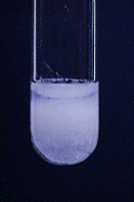
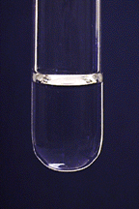
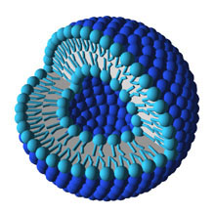
Liposome-based Therapy
Intravesical liposomal application
Clinical
  Empty liposomes
    BPS/IC
  Botulinum toxin
    BPS/IC
    OAB
  Pentosan polysulfate
    BPS/IC
  Tacrolimus (FK506)
    Hemorrhagic cystitis
Pre-clinical
  NGF antisense
Spherical vesicle consisting of lipid bilayers

Slide 6
Nerve growth factor (NGF) and afferent sensitization
-Our previous findings-
Anti-NGF antibody treatment in the spinal cord reduces bladder overactivity in spinal cord injured (SCI) rats (J Urol, 2002, 2004)
Spinal cord NGF administration induces DO and C-fiber bladder afferent hyperexcitability in rats (J Neurosci, 2006)
Anti-NGF antibody treatment reduces DO & bladder afferent hyperexcitability in SCI mice (N&U; Exp Physiol, 2018)
Prostatic-to-bladder cross sensitization after prostatic inflammation induces bladder NGF upregulation (J Physiol, 2019)
Liposome-based intravesical NGF antisense therapy reduces bladder hypersensitivity in colitis rats and enhanced vascular responses (autonomic dysreflexia) in SCI rats (J Urol, 2016; Exp Neurol, 2017 )

Slide 7
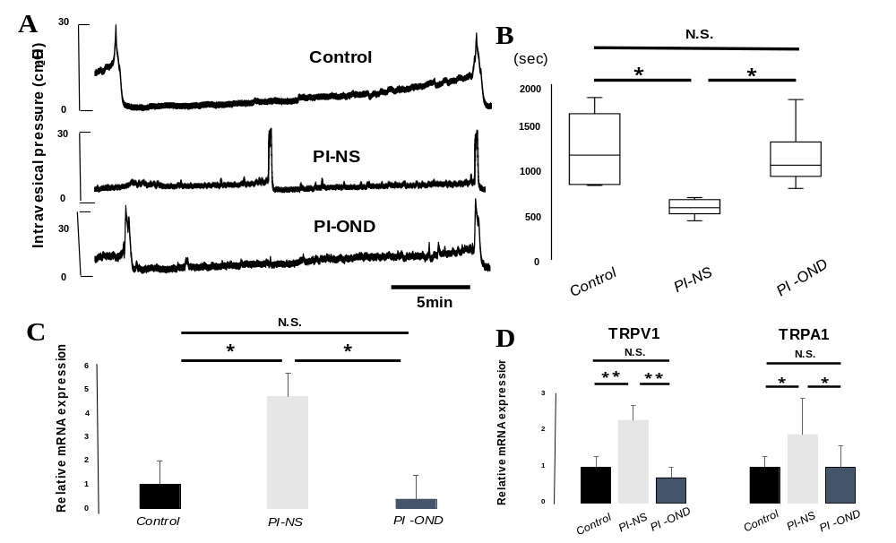
NGF-targeting therapy- Rat model of prostatic inflammation (PI)
Cystometry
ICI: Intercontaction interval
Igarashi et al., The Prostate. 81: 1303–1309, 2021
On day 14 after PI induction, liposome conjugated NGF antisense （PI-OND) was instilled directly the bladder
On day 28, therapeutic effects were evaluated
*P<0.05
N=9 each
Bladder NGF
L6/S1 DRG
Liposome-conjugated NGF antisense therapy in the bladder reduced bladder overactivity and afferent activity (TRPV1/TRPA1 in L6-S1 DRG) in PI rats

Slide 8
Neurotrophic factors & their receptors
Nerve growth factor (NGF) -TrkA
Brain-derived neurotrophic factor (BDNF)- TrKB
Neurotrophin 3 (NT-3)- TrkC
Intravesical NGF-targeting therapy
  Liposome-conjugated NGF antisense
Trk receptor-targeting therapy
  Trk receptor antagonist (GNF 5837)

Slide 9
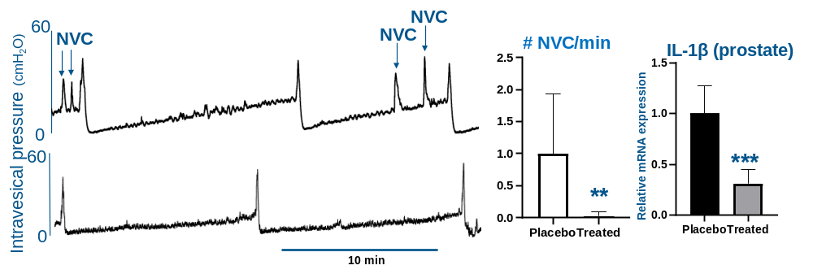
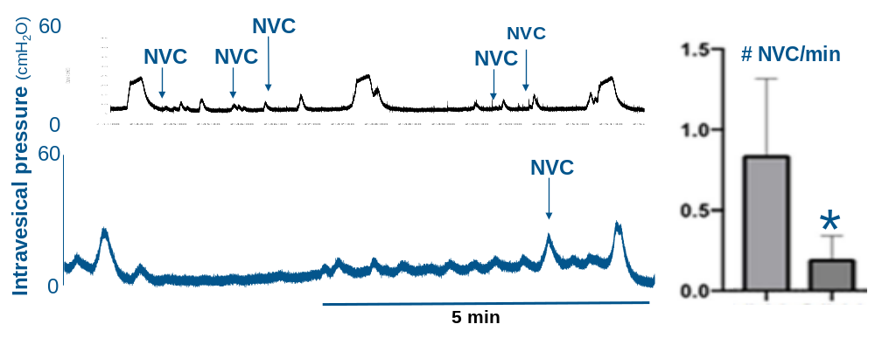
Trk receptor antagonist (GNF 5837) - Rat & Mouse models of PI
GNF 5837 (40mg/kg) was orally administered daily for 10 days
1. Rat PI model
(intraprostatic formalin injection)
NVC= non-voiding contraction
Placebo
P<0.01
P<0.001
Treatment
2. Mouse PI model
(prostate-specific E-cadherin downregulation; Cdh-/-)
Placebo
Treatment
P<0.05
Placebo treatment
Trk receptor blockade (systemic) reduced bladder overactivity and prostatic inflammation (IL-1β) in PI models.

Slide 10
NGF-targeting therapy- Summary/Conclusion
NGF upregulation in the bladder is an important mechanism inducing prostate-to-bladder cross sensitization due to PI, leading to bladder overactivity
Liposome-based intravesical NGF antisense therapy reduces bladder overactivity and afferent sensitization indued by PI
Trk receptor inhibition therapy reduces PI-induced bladder overactivity and inflammatory responses in the prostate
NGF-targeting therapy could be effective for the treatment of storage LUTS in BPH patients with prostatic inflammation

Slide 11
Acknowledgements
Pitt: Urology
Pitt: Medicine
Zhou Wang
Shinsuke Mizoguchi
Jianshu Ni
Pradeep Tyagi
Eduardo Alexandre
Meri Okorie
Lori A. Birder
Amanda Wolf-Johnston
Youko Ikeda
Anthony J. Kanai
Supported by NIH/NIDDK U54 DK112079
Pitt: Pharmacology & Chemical Biology
Donald B. DeFranco

Slide 12
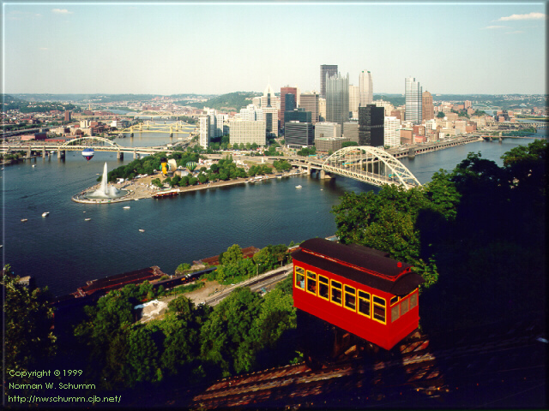
Thank You
Pittsburgh-downtown

