Slide 1
Sources of Urine Oxalate:
Unknowns and Future Research
John Knight PhD
Department of Urology

Slide 2
Sources of Urine Oxalate
Endogenous Oxalate Synthesis
Dietary Oxalate Absorption

Slide 3
Endogenous Oxalate Synthesis Rates in Healthy Volunteers
Endogenous Synthesis (mg/day)
18 ± 5 (11 – 26)
Females (n=4): 15 ± 5 (11 – 21)
Males (n=5): 22 ± 4 (17 – 26)
Knowledge Gaps
Factors influencing endogenous oxalate synthesis: sex, obesity, T2D?
Oxalate synthesis different in calcium oxalate kidney stone formers?

Slide 4
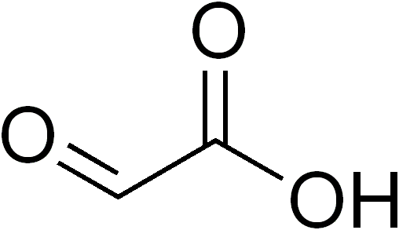
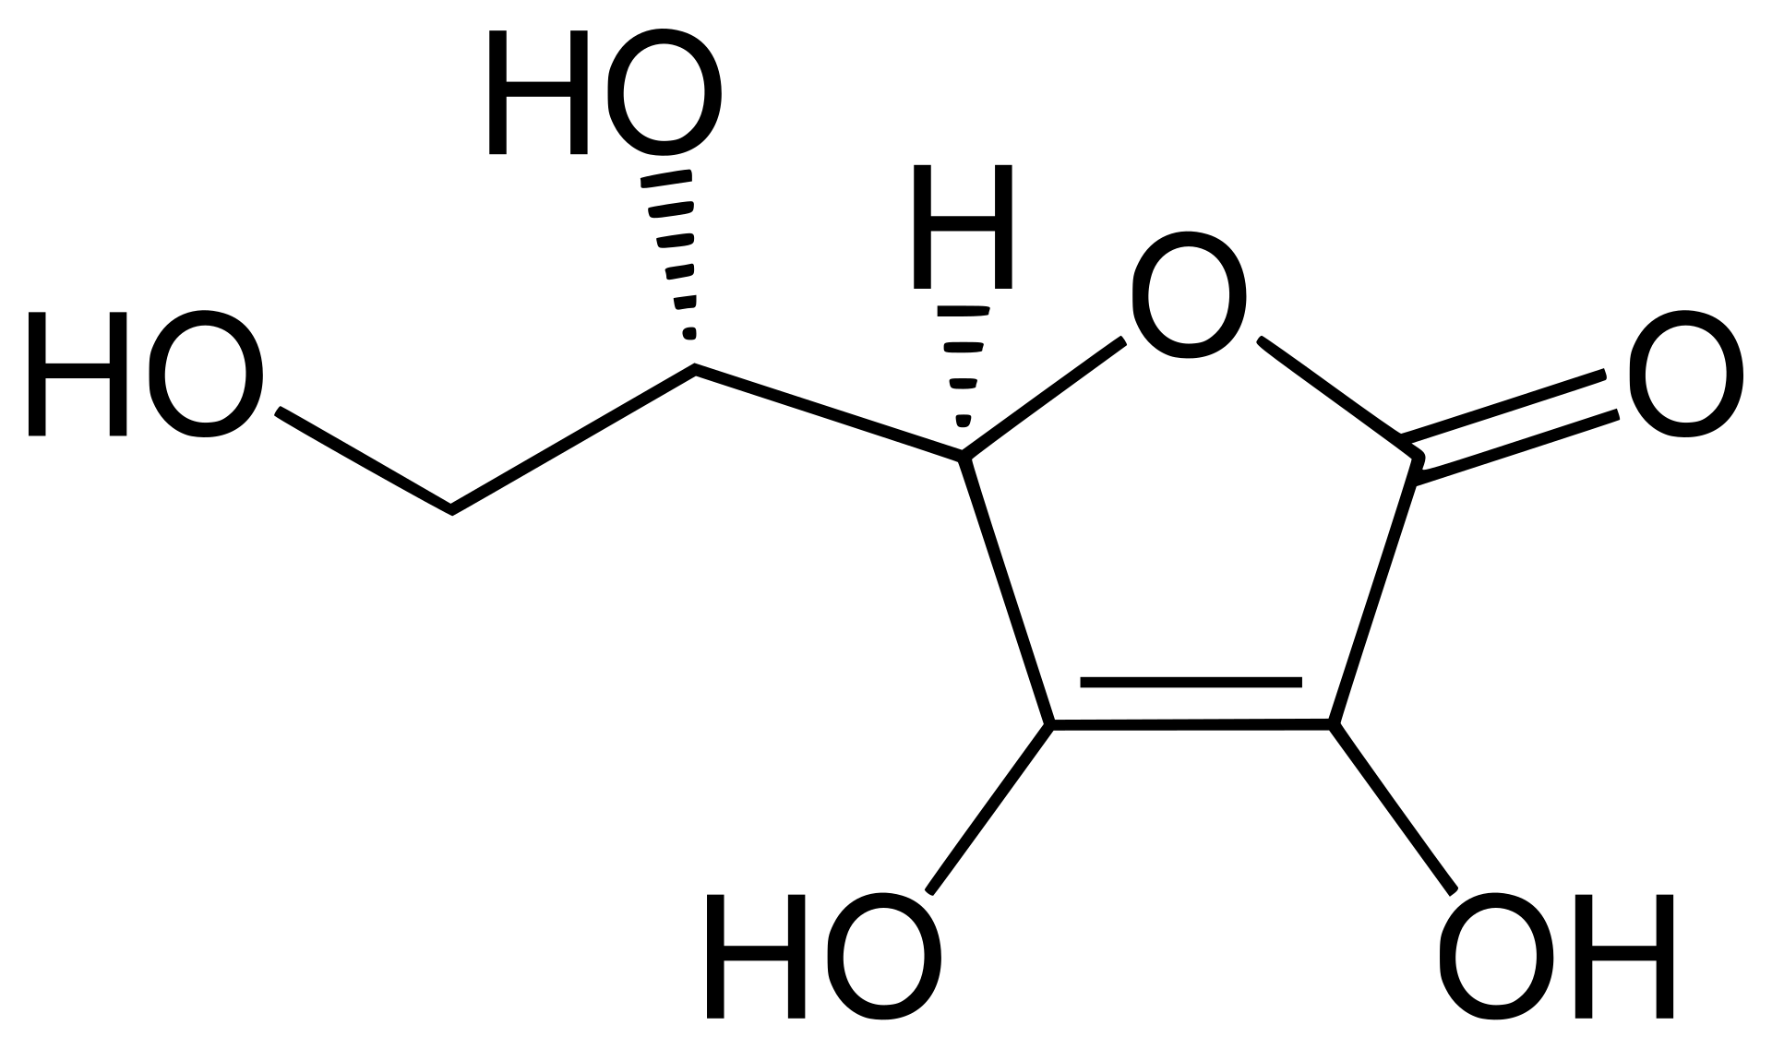
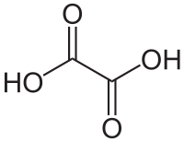
Precursors of Oxalate Synthesis
GLYOXYLATE VITAMIN C
Lactate Non-enzymatic
Dehydrogenase breakdown
OXALATE
Knowledge Gaps
Regulation of these pathways
Role of different tissues in oxalate synthesis
Is the contribution from these sources different in CaOx kidney stone formers?

Slide 5
Dietary Oxalate Intake and Urine Oxalate
Healthy, Non-Stone Formers
Knowledge Gaps
Gut Oxalate Transport:
Sites of absorption
  Paracellular vs. Transcellular
Dietary oxalate handling in CaOx stone formers
Fixed Diets- Calcium Content
■ Calcium 1000mg/day
Δ Calcium 400mg/day

Slide 6
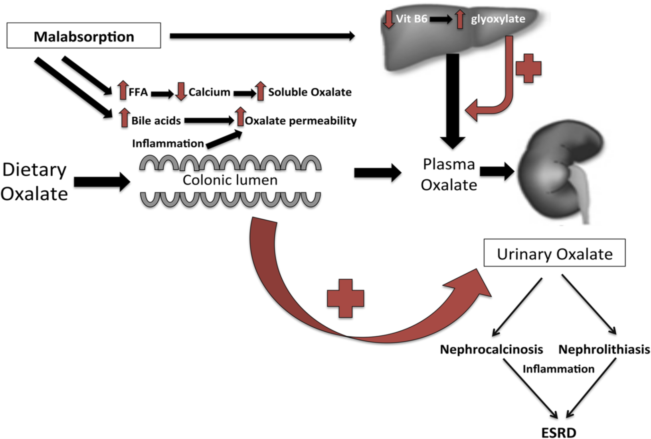
Enteric Hyperoxaluria
Most common causes:
  Gastric bypass surgery for obesity/T2D (~60% of cases)
  Inflammatory bowel disease (~20%)
  Celiac disease (8%)
  Chronic pancreatitis (4%).
Research focused on developing therapies that increase gut oxalate degradation
Malabsorptive Conditions
Gut Lumen
Urine
Oxalate

Slide 7
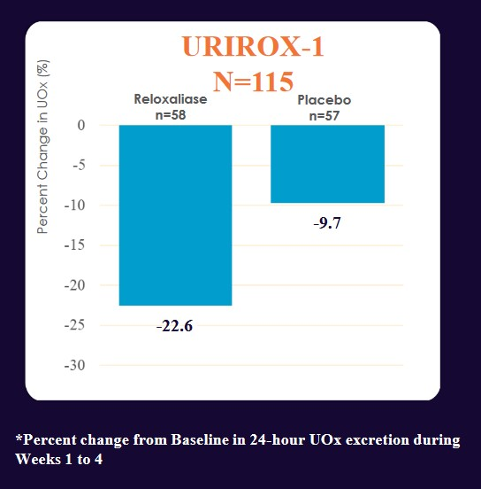
Allena: Enteric Hyperoxaluria Clinical Trial
Knowledge Gaps
Sources of urinary oxalate and dietary oxalate handling poorly defined in EH

Slide 8
Oxalate degrading gut microbes
Healthy Volunteers: Fecal Oxalate
Knowledge Gaps
Factors that influence colonization of oxalate degrading gut bacteria
Gut bacterial oxalate degrading function in stone formers
Impact on urinary oxalate excretion
Jiang et. al. Journal of Urology 2011

Slide 9
Future Collaborative Research
Low oxalate diets to examine endogenous oxalate synthesis
    Sequencing of genes involved in oxalate synthesis
Controlled diets varying in oxalate to more precisely define:
    Dietary oxalate handling in Enteric Hyperoxaluria
    Microbial gut oxalate degradation

Slide 10
THANK YOU

