Slide 1


The Promise of Machine Learning Analysis of Diagnostic Imaging to Augment Clinical Decision Making for the Treatment of Renal Stone Disease
Justin B. Ziemba, MD MSEd
On Behalf of the CHOP/Penn Center for Machine Learning in Urology
CARIBU Symposium
12/2/2021
Notes:
Add note to this slide

Slide 2
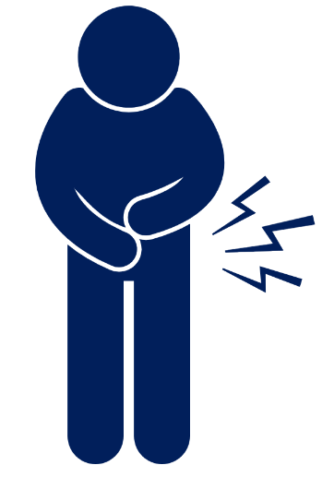

Initial Presentation
1
54 year-old woman with a history of kidney stones comes to your office with 1 day of acute onset left flank pain
Notes:
Add note to this slide

Slide 3

Initial Differential Diagnosis
2
Kidney Stones
Notes:
Add note to this slide

Slide 4

Initial Management
3
Diagnostic Imaging
Surgical Management of Stones AUA/Endourology Society Guidelines recommends (based on panel consensus) CT as it is the most sensitive and specific imaging modality for the diagnosis of upper urinary tract stone disease.
Notes:
Add note to this slide

Slide 5




CT Image
Visualize, Extract Features, and Interpret
Notes:
Add note to this slide

Slide 6



Treatment Planning
4
Medical Expulsive Therapy
Surgical Therapy
Surgical Management of Stones AUA/Endourology Society Guidelines almost exclusive provides recommendations based on size and location
Location
Size
Notes:
Add note to this slide

Slide 7
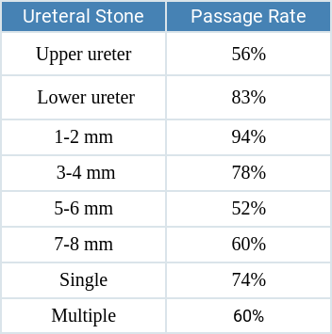
Treatment Outcomes
5
Medical Expulsive Therapy
Location
Size
Meltzer, A. C., Burrows, P. K., Kirkali, Z., Hollander, J. E., Kurz, M., Mufarrij, P., ... & Jackman, S. V. (2020). Accuracy of patient reported stone Passage for patients with acute renal colic treated in the emergency department. Urology, 136, 70-74.
Notes:
Add note to this slide

Slide 8
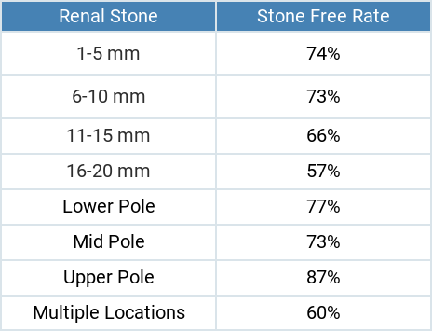
Treatment Outcomes
5
Surgical Therapy--Ureteroscopy
Location
Size
York, N. E., Zheng, M., Elmansy, H. M., Rivera, M. E., Krambeck, A. E., & Lingeman, J. E. (2019). Stone-free outcomes of flexible ureteroscopy for renal calculi utilizing computed tomography imaging. Urology, 124, 52-56.
Notes:
Add note to this slide

Slide 9


Personalization
Interpretation of Demographic and Clinical and Radiographic Information
Notes:
Add note to this slide

Slide 10

Machine Learning
Interpretation of Demographic and Clinical and Radiographic Information
Notes:
Add note to this slide

Slide 11
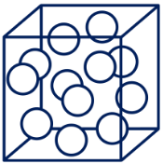
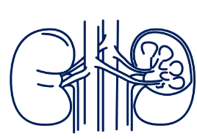



Stone Density and Composition
Stone Size
Stone Location
Calyceal and Ureteral Anatomy
Demographics and Clinical History
Stone Shape
Notes:
Add note to this slide

Slide 12
Initial Presentation
1
54 year-old woman with a history of kidney stones comes to your office with 1 day of acute onset left flank pain
Notes:
Add note to this slide

Slide 13
Initial Management
2
Diagnostic Imaging
Surgical Management of Stones AUA/Endourology Society Guidelines recommends (based on panel consensus) CT as it is the most sensitive and specific imaging modality for the diagnosis of upper urinary tract stone disease.
Notes:
Add note to this slide

Slide 14










Stone Size
Stone Location
Stone Density and Composition
CT Image
Machine Learning
Stone Shape
Calyceal and Ureteral Anatomy
Demographics and Clinical History
Notes:
Add note to this slide

Slide 15

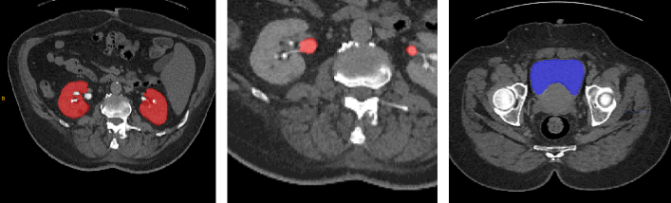

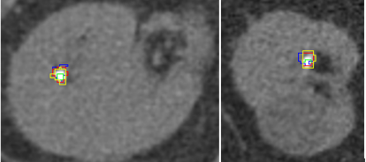
Treatment Planning
3
Personalized
Medical Expulsive Therapy
Surgical Therapy
Notes:
Add note to this slide

Slide 16



Treatment Planning
3
Personalized
Medical Expulsive Therapy
Surgical Therapy
Surgery
Spontaneous Passage
The Probability of Needing Surgery in the Next 14 Days
The Probability of Spontaneous Passage (Avoidance of Surgery) in the Next 14 Days
Notes:
Add note to this slide

Slide 17



Treatment Planning
3
Personalized
Medical Expulsive Therapy
Surgical Therapy
Surgery
Spontaneous Passage
The Probability of Needing Surgery in the Next 14 Days
The Probability of Spontaneous Passage (Avoidance of Surgery) in the Next 14 Days
Notes:
Add note to this slide

Slide 18






Application of Machine Learning
Leverage Complex Data
Integrate into Decision Support
Improve Clinical Outcomes
Notes:
Add note to this slide

Slide 19




Gregory Tasian, MD MSc MSCE
Yong Fan, PhD
Katerina Lembrikova, BS
Rilwan Babajide, BA
Katherine Fischer, MD
Yuemeng Li, MS
Ester Choi, BS
Benjamin Schurhamer, MD
justin_ziemba
justin.ziemba@pennmedicine.upenn.edu
Notes:
Add note to this slide

Slide 20
Notes:
Add note to this slide

