Slide 1

Health Disparities in Benign Urology:
Gaps and Bridges
Jill A. Macoska, PhD
Distinguished University Professor of Science and Mathematics
Director, Center for Personalized Cancer Therapy
Project PI, University of Wisconsin-Madison U54 O’Brien Center

Slide 2



A health disparity (HD) is a health difference that adversely affects disadvantaged populations.
The resolution of health disparities leads to health equity.

Slide 3
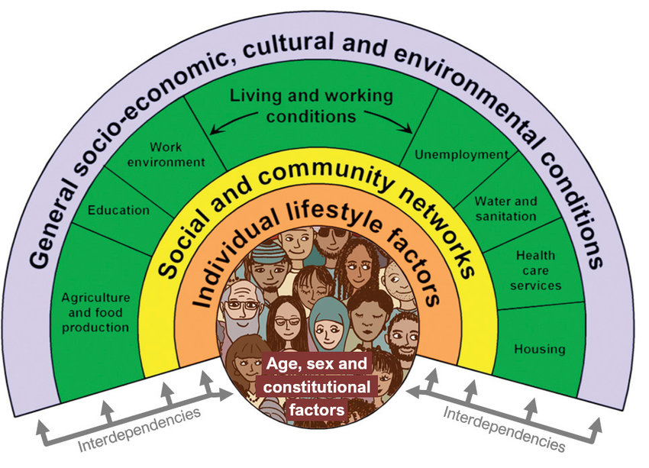
Social and Genetic Determinants of Health
genetics
Modified from: Dahlgren G, Whitehead M. Policies and Strategies to Promote Social Equity in Health. Stockholm, Sweden: Institute for Futures Studies, 1991.

Slide 4
Epidemiological Studies of BPH /LUTS: Risk Factors
Egan KB, Urol. Clin. N. Am. 43: 289-297, 2016.

Slide 5
Age and Ethnicity are Strong Predictors of BPH Risk and Severity
Adjusted hazard ratios
Adjusted hazard ratios
*
*
*
*
*
*
*
*
*
*
*
*
Kristal et al, J. Urol. 177: 1395-1400, 2007.
Jin et al., J. Clin. Endo. Metab. 84: 3613-3619, 1999.
Wei et al., J. Urol. 165: 1521-1526, 2001.
Platz et al., Urology 59: 877-883, 2002.
Van Den Eeden et al., J. Urol. 187: 185-189, 2012

Slide 6


Are BPH Health Disparities a product of Social and/or Genetic Determinants of Health? (GAP)
1. Social Determinants of Health:
BRIDGED
Comparison of 2488 white vs. 4188 black men (Southern Community Cohort Study)
Overall International Prostate Symptom Score (IPSS) and the prevalence of moderate/severe LUTS were not significantly associated with race but Higher IPSS scores were significantly associated (p<0.05) with a lower income, marital status, and source of insurance.
Low Socioeconomic Status (SES) disproportionately contributes to health disparities.
AND… SES is, on average, lower in AA and Hispanic than white communities (U.S. Bureau of Labor Statistics)
Fowke et al., J. Gen. Int. Med. 26: 1305-1310, 2011

Slide 7

Are BPH Health Disparities a product of Social and/or Genetic Determinants of Health? (GAP)
?
1. Genetic Determinants of Health:
Existing data: GAP
Many studies indicate genetic variants that increase risk for PCa development or progression.
One recent GWAS study (Gudmundsson et al., Nat. Comm. 9: 4568-4576, 2019) reported 23 genome-wide significant variants located at 14 loci between BPH/LUTS and control patients of European Ancestry. These variants did not overlap with those reported for PCa.
Similar studies have NOT been accomplished for individuals of non-European ancestry…HOWEVER, a recently funded (Chan Zuckerberg Initiative) study (“An Atlas of the Human Prostate Across Ancestries”; Doug Strand, Co-PI) may provide some much-needed data on this.

Slide 8
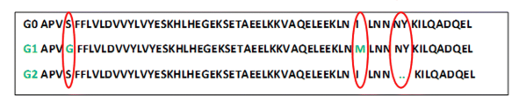
Are BPH Health Disparities a product of Social and/or Genetic Determinants of Health?
?
1. Genetic Determinants of Health:
Potential Rationale?
Inheritance of the G1 and G2 allelic variants of the the APOL1 gene are highly prevalent (~30%) among people of Western African heritage.
This includes African Americans for whom the majority originated from West Africa.
These germline mutations are highly protective against death from trypanosomiasis
BUT…they also contribute disproportionately to Chronic Kidney Disease (CKD) leading to End Stage Kidney Disease (ESKD) in African Americans.
Do APOL1 allelic variants contribute to the development or progression of lower urinary tract disorders (LUTS)????

Slide 9
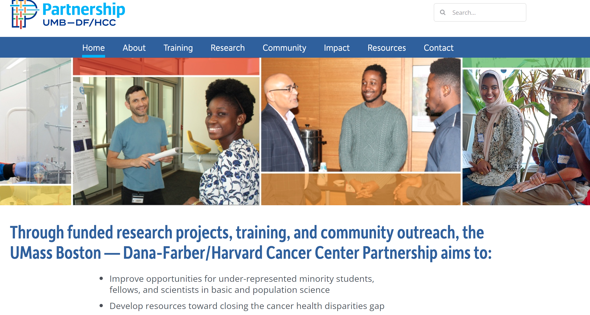

We need intent and resources to understand and close health disparities gaps in benign urologic disease!

Slide 10

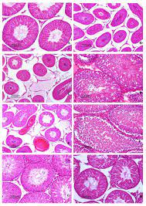
Reducing Benign Urologic Health Disparities Requires Intent and Resources: BRIDGING THE GAPS
Conscious effort / requirement to properly annotate human data with ethnic origin (even self-reported data is better than no data) (GAP).
Conscious effort / requirement for inclusion in studies involving human subjects (ethnic diversity for specimens / data) (GAP).
Specified funding opportunities for benign urologic health disparities research: NOT-DK-20-003, Addressing Health Disparities in NIDDK Diseases (BRIDGED).
Assistance with access to inclusive biorepositories/databases like the Veteran’s Administration Million Veteran Program (MVP), a voluntary research program to help researchers understand how genes affect health and illness; >800,000 veterans already enrolled (GAP). Others?

Slide 11
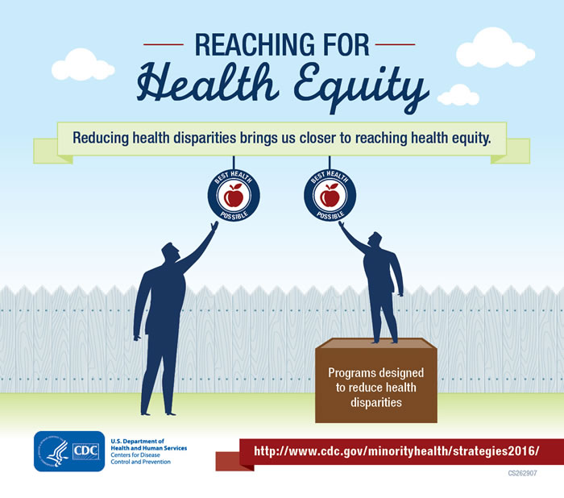

Reducing Benign Urologic Health Disparities Requires Intent and Resources to BRIDGE THE GAPS and Achieve Health Equity.

