Slide 1
Collaboratively-Developed Pipeline for Microbial Genomes
Grace Morales
Advisors: Drs. Jonathan Schmitz and Maria Hadjifrangiskou
CAIRIBU meeting
December 3, 2021

Slide 2
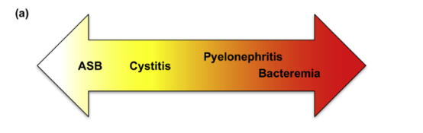
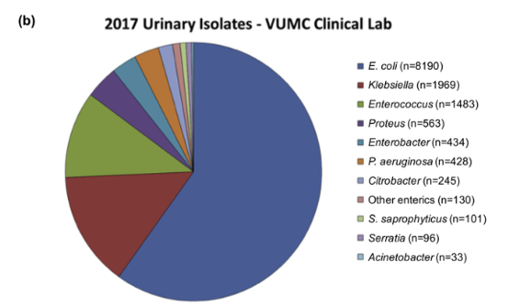
Collaboratively-Developed Pipeline for Microb
UTIs are caused by diverse bacteria, including those under-studied
Up to 50% of women will experience at least one UTI in their lifetime
The associated cost of these infections is about $1.6 Billion.
E. coli cause approximately 80% of these infections
Bacteriuria is a spectrum of clinical presentations
Notes:
Bacteriuria is a spectrum of clinical presentations

Slide 3

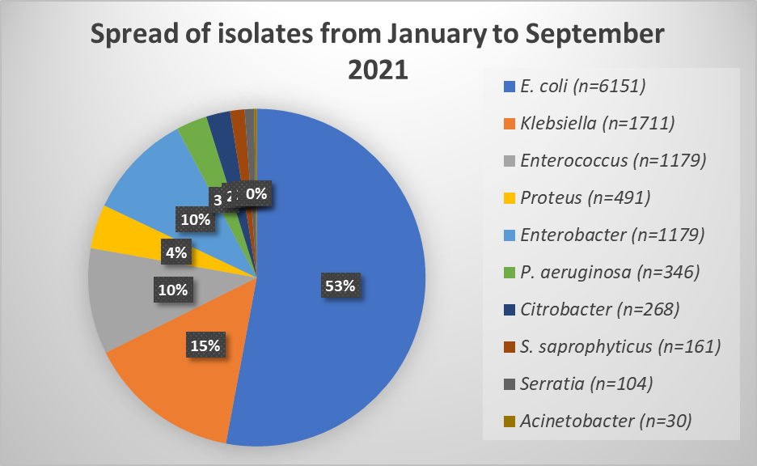
Collaboratively-Developed Pipeline for Microb
microVU provides the basis of the pipeline
Connecting de-identified patient data with bacterial isolates
Reflects current distributions of bacterial colonization in the population
Notes:
At Vanderbilt, Drs. Schmitz and Hadjifrangiskou are co-directors for a microbial biobank system, microVU, which operates in conjunction with the Vanderbilt Urinary Isolate Repository.
Here, we bank bacterial isolates from urine and now respiratory isolates for use for research purposes. One of the highlights of this biobank is the linking to de-indentified electrtonic health records for these isolates. This allows for connecting bacterial genotypes with patient phenotypes. At this point, we have tens of thousands of isolates banked. Pictured here is just a snap shot of what this past year's collections have looked like. Between January and September in 2021, we banked more than 12,700 urinary bacterial isolates. What I hope you can appreciate from this graph is we see the majority of these isolates being E. coli isolates. However, we are also being able to pick up less frequent uropathogens such as S. saphrophyticus and Acinetobacter. However, in order to make utilization and to leverage the amount of diverse bacterial samples, I have worked to create a computational pipeline with input from various expertise to make the most of the information afforded by the biobank.

Slide 4

Collaboratively-Developed Pipeline for Microb
Incorporation of many expertise sets the pipeline apart
Researchers
Clinical Microbiology
Physicians
Notes:
We leaned on the expertise of several groups throughout the development of this pipeline: researchers, clinical microbiologists, as well as clinicans. What we wanted to do was make a pipeline that would glean information useful to all groups, with the basic idea of

Slide 5
Collaboratively-Developed Pipeline for Microb
Incorporation of many expertise sets the pipeline apart
Researchers
Advancement of Urology Research
Clinical Microbiology
Physicians
Notes:
Advancing urology research. We kept in mind aspects each group would want to know—researchers of what genes or specific alleles of genes are found in the isolates. For clinical microbiology, genomic survellance of pathogens. And for the clinicians, additional information that could inform care down the line.

Slide 6
Collaboratively-Developed Pipeline for Microb
A computational pipeline for genomic characterization of uropathogens
Isolates from clinical micro and microVU
Sequencing
Genotyping (MLST, phylogroup, etc)
Annotation
Downstream analysis (SNP calling, association studies, etc)
Key features:
  Generalizable for bacterial isolates
  High-throughput analysis
  Provides framework for genomic surveillance
Notes:
Here is a basic outline of the pipeline: once samples are obtained, we can go ahead and sequence them. Once sequecning is complete, we are able to quality check the genomes, and start processing for genomic information. This includes genotyping on multiple levels—MLST, phylogroup, even serotypes. We can additionally ask what genes are present, this can be especially relevant for tracking virulence factors as well as antimicrobial resistance genes. And finally, a variety of downstream analyses can be preformed, such as looking for SNPs in specific genes or regions, preforming association studies such as microbial GWAS, even just looking at the pangenome and all the genes found in the uropathogen of choice and seeing how that differs between other infections caused by the same species. I'd like to show you a bit of how this looks with real data

Slide 7
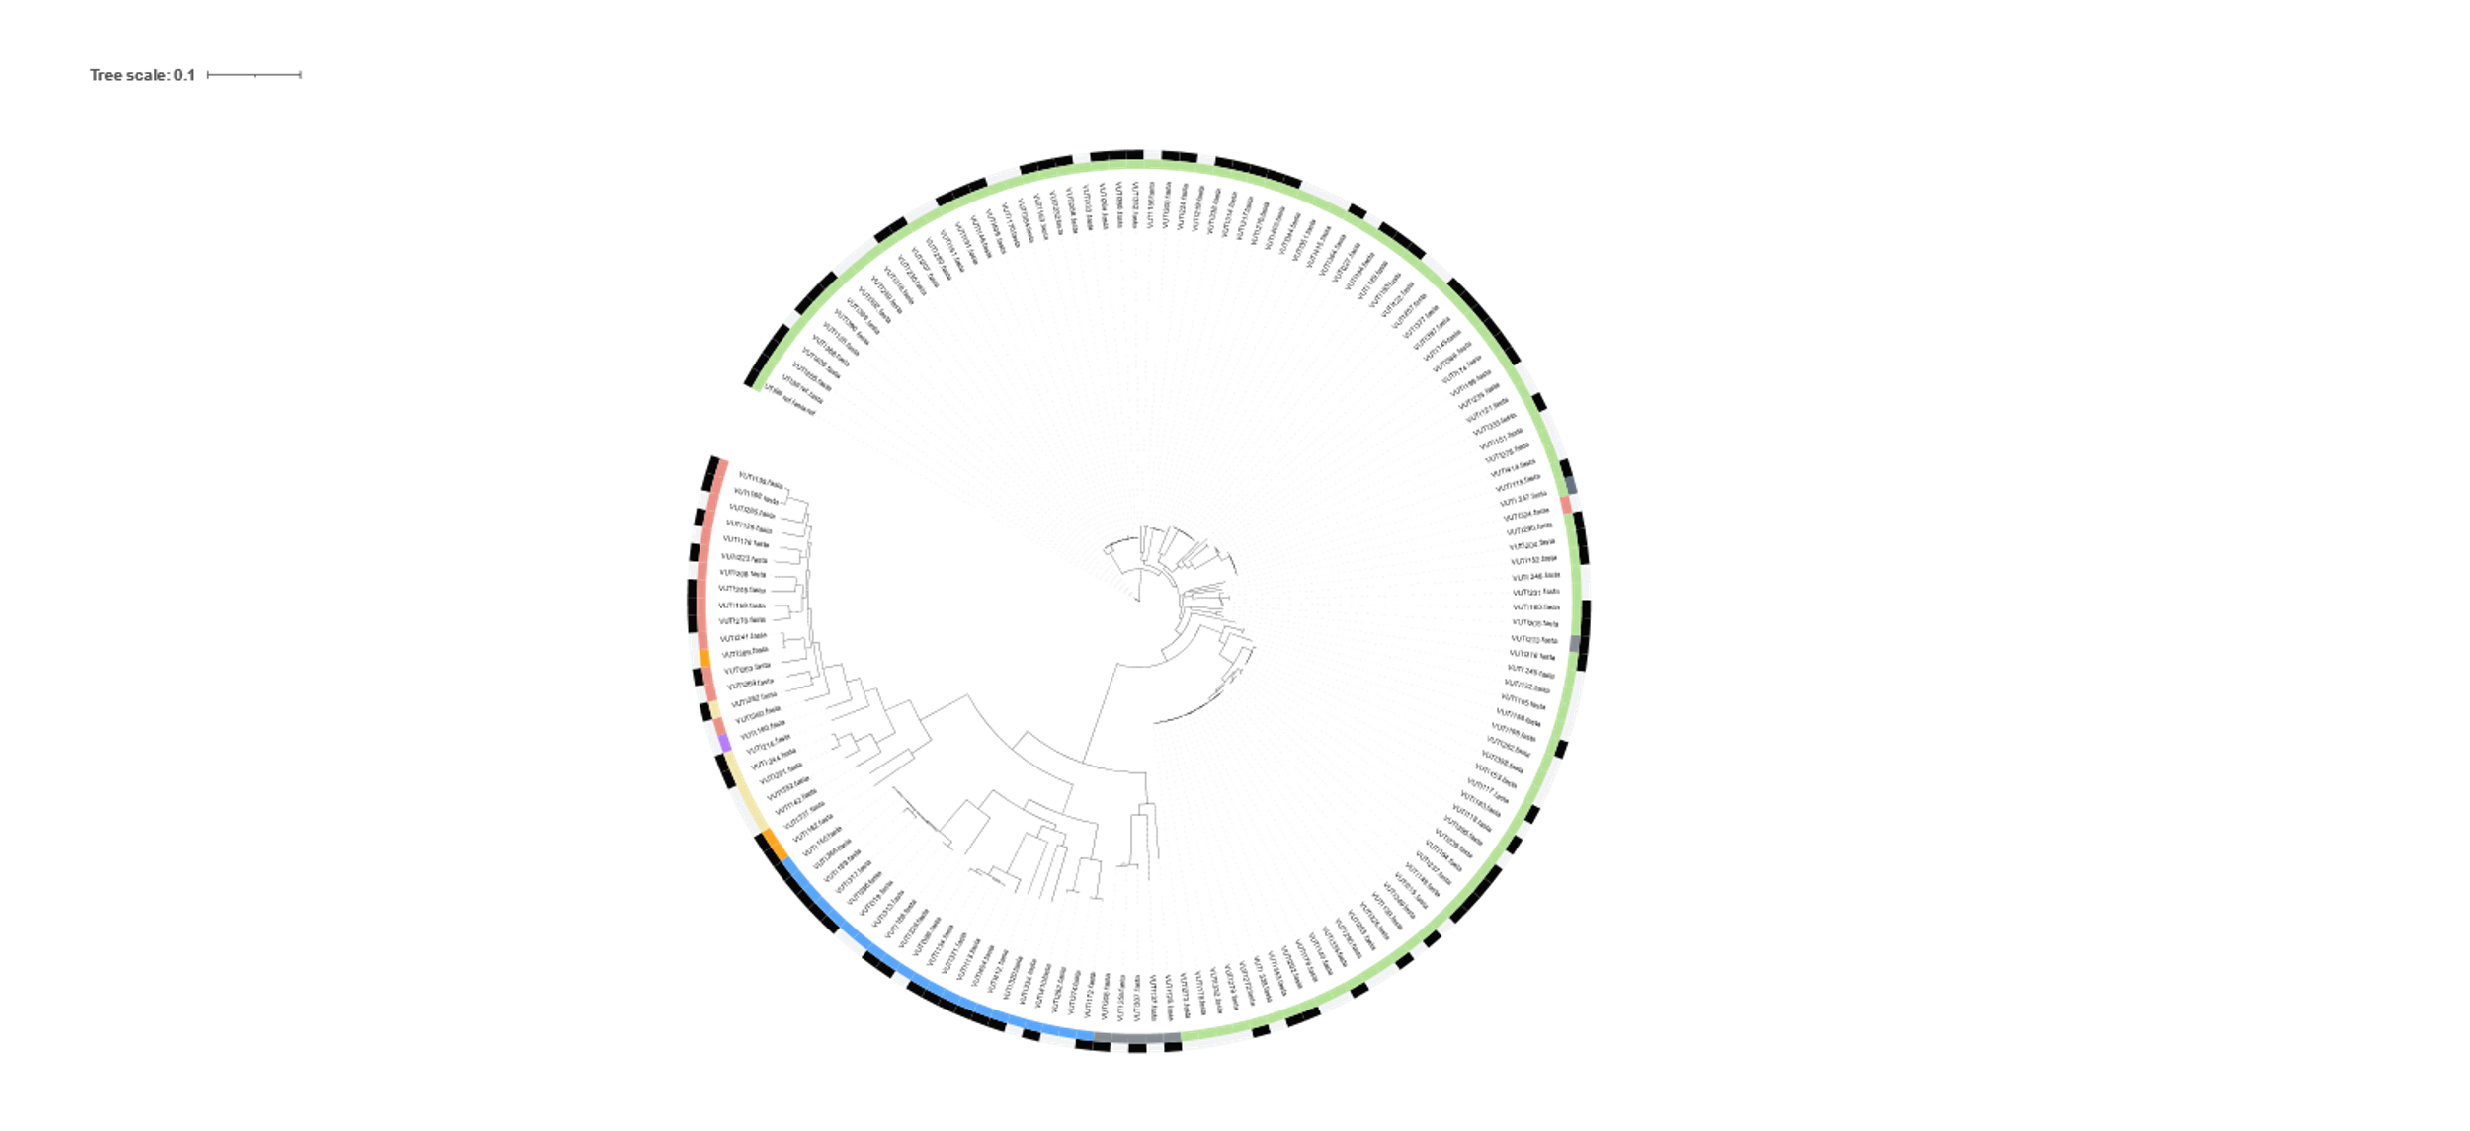
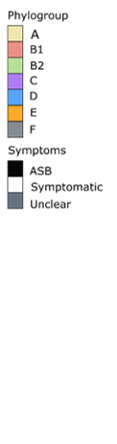
Collaboratively-Developed Pipeline for Microb
Proof of Concept: Escherichia coli is a diverse uropathogen
Urine-isolated E. coli belong to all phylogroups
Disease severity is not predicted by phylogroup
Notes:
Since the vast majority of UTI's are caused by E. coli, it provides a nice proof of concept for the pipeline, to characterize the diverse set of organisms. Here is a phylogenetic tree of a sampling of 150 E. coli isolates from microVU. These were isolated from sypmtomatic and asymptomatic patients. The inner ring color represents the phylogroup of the isolate, and the outer ring represents the presence of syptoms in the source patient. I'd like to highlight that we have identified urinary E. coli isolates from every phylogroup. Additionally, Asymptomatic isolates are also found in every phylogroup, underscoring how diverse these isolates are, even without regard to disease severity.

Slide 8
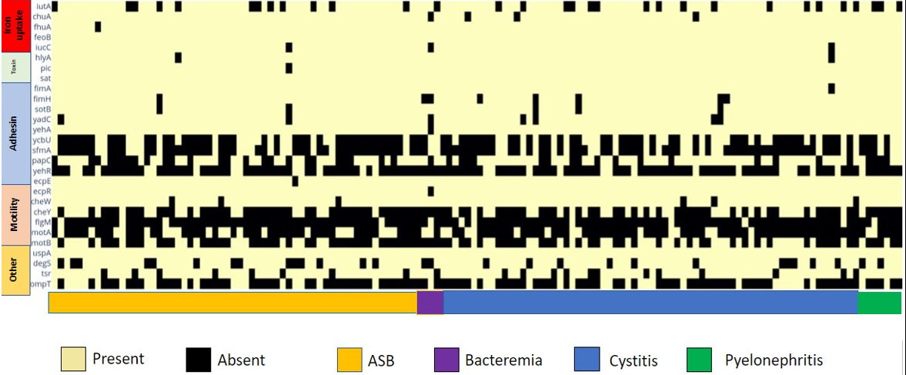
Collaboratively-Developed Pipeline for Microb
Urinary E. coli isolates carry a wide range of virulence factors with no correlation with disease severity
Notes:
When we start characterizing it further, we can look at how difference fitness factors are carried. Along the same vein as what I just showed, we see there is no correlation of virulence factors and the presence of symptoms or the severity of disease. Just to give a brief overview of what else we can do with this pipeline, you may recall from my poster earlier where we characterized the presence of mobile genetic elements in urinary E. coli. We are looking at specific SNPs in important metabolic pathways such as purine biosynthesis and salvage. This pipeline provides a jumping off point for answering a variety of genomics questions, and the ability to associate back to patient phenotypes.

Slide 9
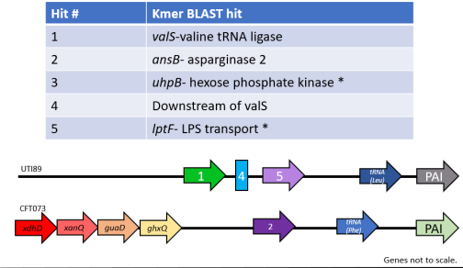
Collaboratively-Developed Pipeline for Microb
Applying machine learning to predict phenotypes in urine-isolated E. coli
Application of two ML approaches to predict the presence of symptoms in source patients
Consistent hits in PAI integration loci
Notes:
When we start characterizing it further, we can look at how difference fitness factors are carried. Along the same vein as what I just showed, we see there is no correlation of virulence factors and the presence of symptoms or the severity of disease. Just to give a brief overview of what else we can do with this pipeline, you may recall from my poster earlier where we characterized the presence of mobile genetic elements in urinary E. coli. We are looking at specific SNPs in important metabolic pathways such as purine biosynthesis and salvage. This pipeline provides a jumping off point for answering a variety of genomics questions, and the ability to associate back to patient phenotypes.

Slide 10
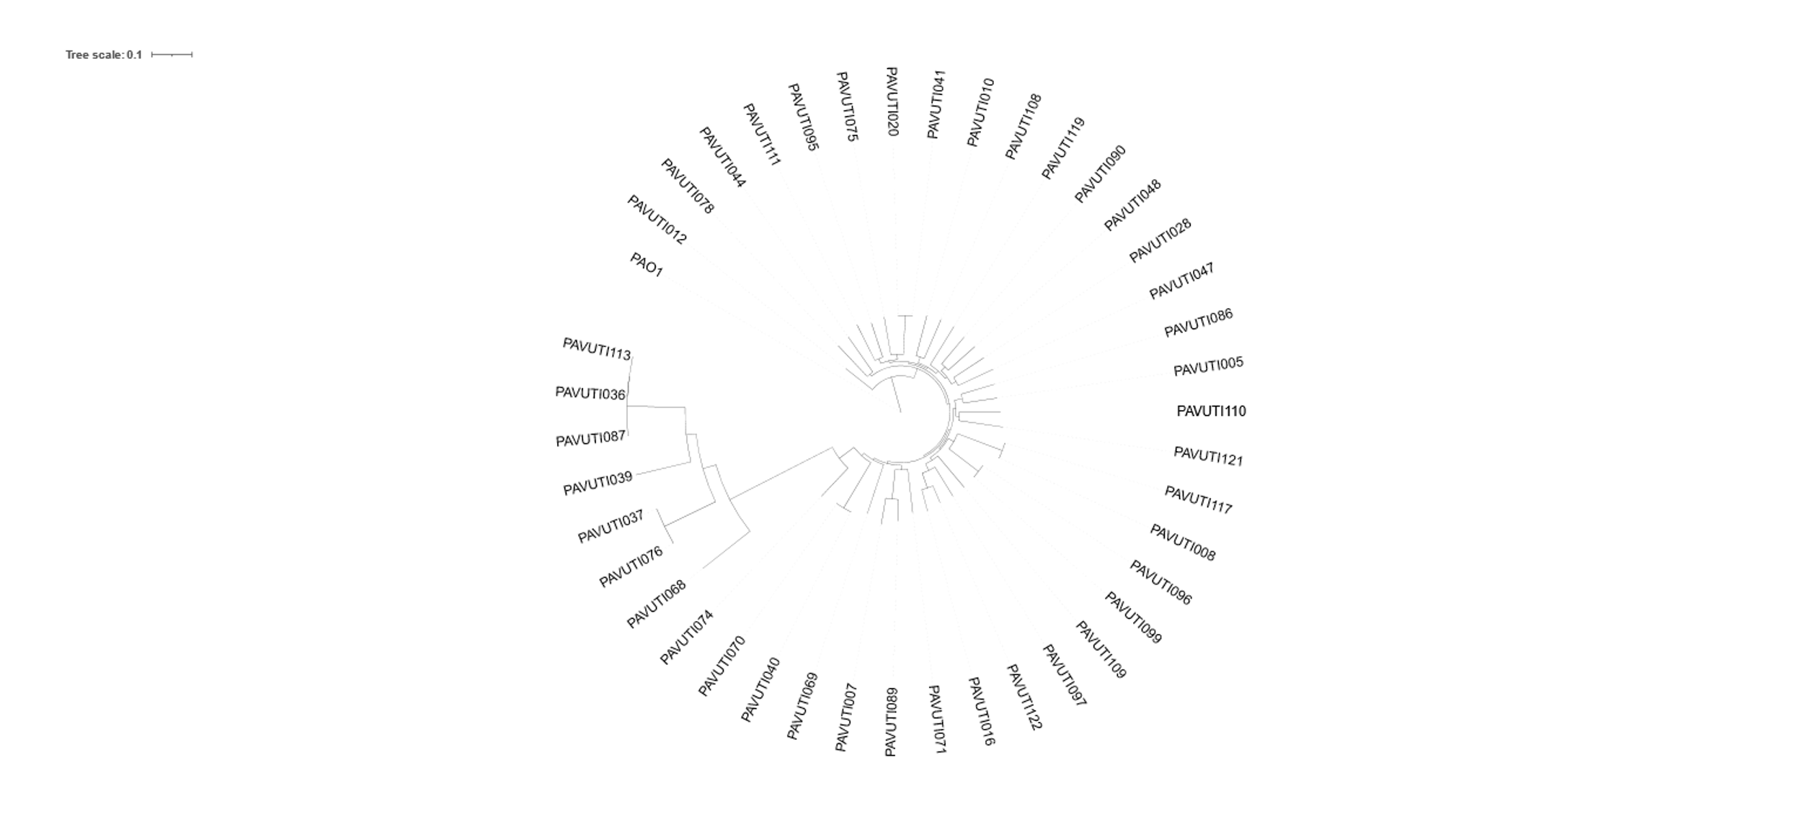

Collaboratively-Developed Pipeline for Microb
Application of the pipeline to other organisms: P. aeruginosa
64% were CAUTIs
58% hospitalized patients
9% emergency department
33% outpatient
Sources from a range of clinical presentations
  ASB to urosepsis
  Includes recurrent infections
Work done with Seth Reasoner
Notes:
I'd like to offer you one additional recent application. Now that I've shown you some of what we have done as a proof of concept, we are now applying this pipeline to other important uropathogens. I've been working with an MSTP student, Seth Reasoner, where we are characterizing P. aeruginosa as a uropathogen. Here is some preliminary work where first we wanted to see how closely related these isolates are to each other.

Slide 11


Collaboratively-Developed Pipeline for Microb
Looking to the future
Computational pipeline leveraging massive amounts of genomic information available
Utilizing clinical microbiology resources to connect bacterial genotypes and patient phenotypes
Translational discovery
Opportunities to connect researchers and clinicians
High-throughput research in uropathogens

Slide 12


Collaboratively-Developed Pipeline for Microb
Acknowledgements
Schmitz Lab
Jonathan Schmitz, PhD, MD, DABMM
Gerry Van Horn, PhD, DABMM
Hamilton Green
Sara Bowen
Tim Williams
Erin Reid
Mackenzie Attwell
Dayton Marchlewski
Amelia Dodds
Favour Akabogu
Hadjifrangiskou Lab
Maria Hadjifrangiskou, PhD
John Brannon, PhD
Connor Beebout
Melanie Hurst
Michelle Wiebe
Tomas Bermudez
Seth Reasoner
Vanderbilt Institute for Infection, Immunology and Inflammation
Funding
Trans-Institutional Reinvestment Award
Center for Personalized Microbiology
P20 DK123967-01
VUMC Center for Personalized Microbiology

