Slide 1
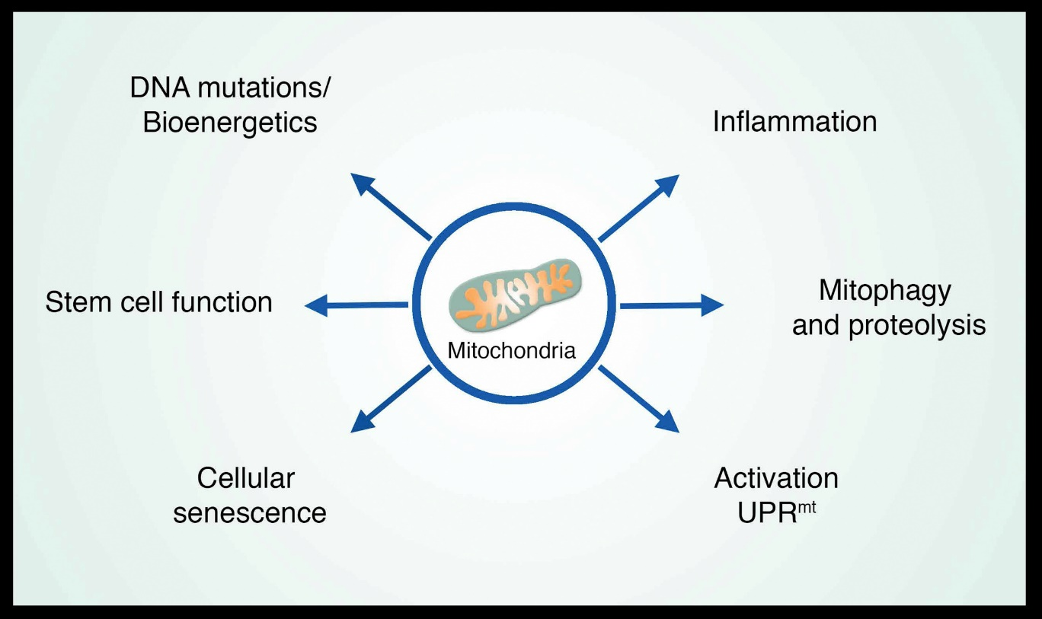
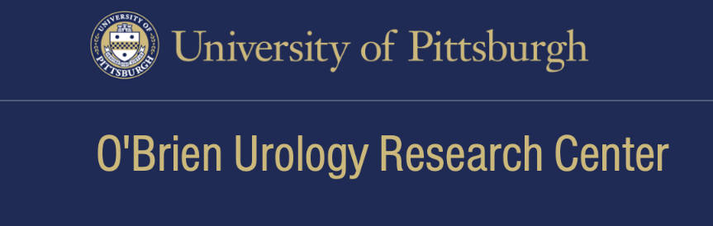


Mitochondrial dysfunction in benign prostatic hyperplasia
Sun, Youle, Finkel (2016). Mol. Cell
Notes:
Collaboration between Pitt and Wisc Obrien Centers with inspiration from colleagues at PIND

Slide 2
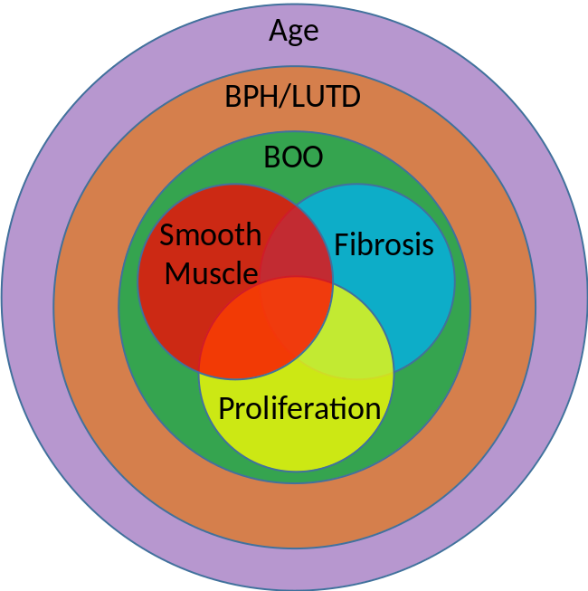
BPH/LUTD
Adapted from Liu et al, 2019
Why study mitochondrial dysfunction in aging? What new information can be obtained?
What specific alternations in mitochondria occur in the aging prostate?
How do they contribute to BPH pathology and LUTS?
Does mechanistic understanding provide opportunities for desirable therapeutics?
Notes:
More to come from Teresa Liu

Slide 3
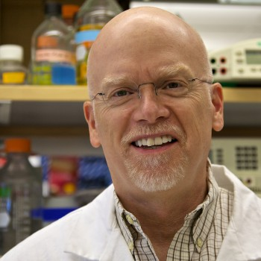
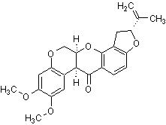
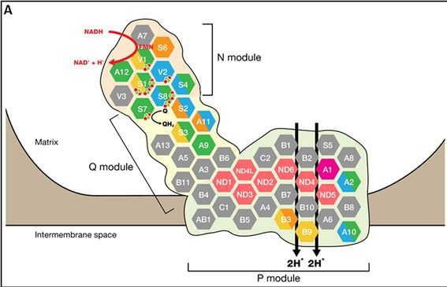
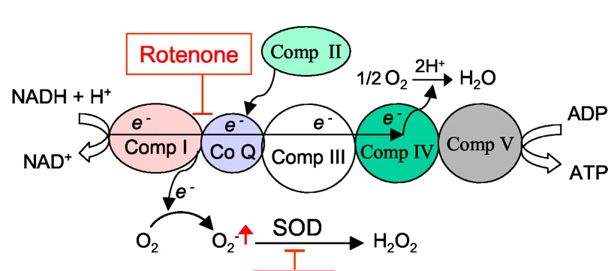
Rotenone: an inhibitor of complex I of the mitochondrial respiratory chain
JT Greenamyre
Rotenone exposure has been shown to correlate with the occurrence of several
Parkinson’s disease (PD)-like symptoms in humans. Chronic administration of rotenone has been used to create experimental animal models of PD.
Disruption of mitochondrial complex I induces progressive parkinsonism
D. James Surmeier lab (2021) Nature 599, 650
Elisa Fassone, and Shamima Rahman J Med Genet 2012;49:578-590
NDUFS3

Slide 4
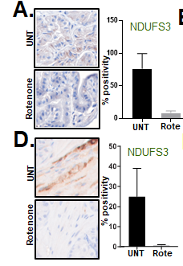
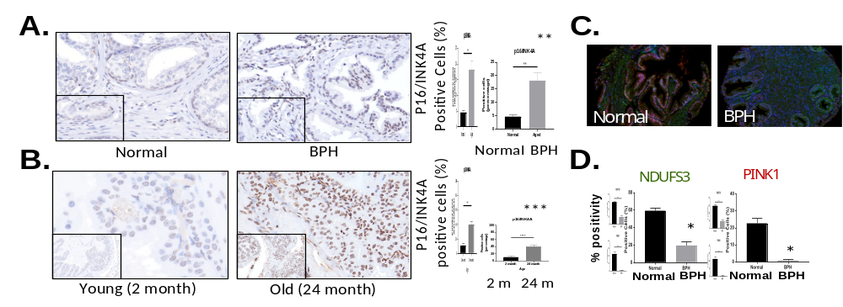
Is mitochondrial function altered in BPH tissue and what are the consequences?
Human Tissue
Lewis Rats
5 day
Mice: C57Bl/6J
16 weeks
n=2
n=2
NDUFS3: Major subunit of CI linked to many mitochondrial diseases
PINK: Regulator of mitophagy
From Teresa Liu (U Wisconsin- Madison)
Notes:
Reduced levels of NDUFS3 has been demonstrated (mainly from work in PD field) to be a useful cellular biomarker of CI inhibition
Quantification of staining demonstrates a significant decrease normal mitochondria in BPH/LUTS. n=6 *, p-value<0.05; **, p-value<0.01; ****, p-value<0.0001.
Functional studies underway
For the rat and mouse staining, the quantification was a combination of both stroma and epithelium since it was difficult to train separate tissue compartments. For the humans, the quantification graphed is just the stroma but the epi cells have the same trend. The normal in this case is normal adjacent prostate tissue from prostate cancer patients. The tissues that were stained were from our progression TMA.

Slide 5
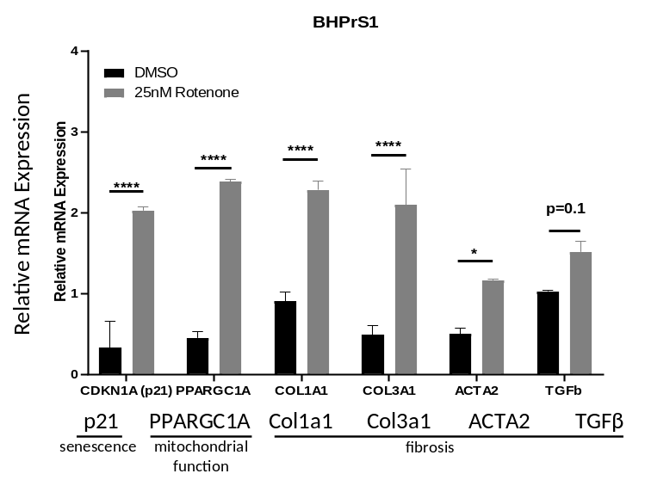
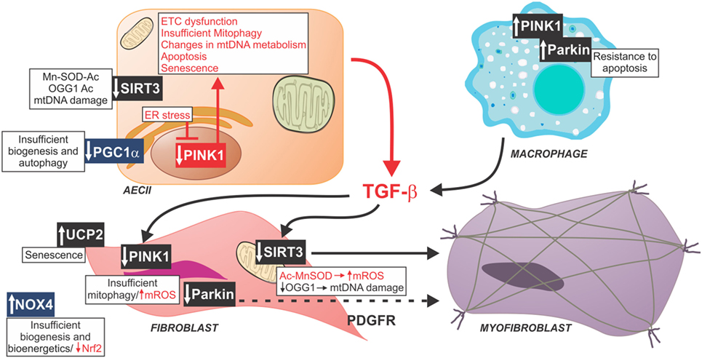
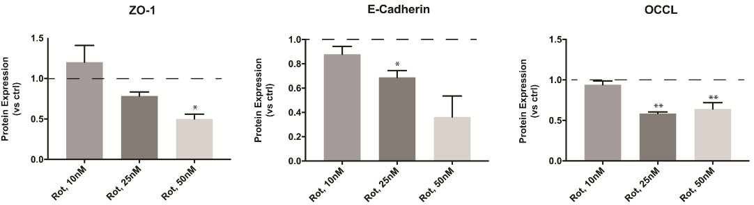
Does mitochondrial dysfunction contribute to prostatic fibrosis?
BhPrS1 Cells (T. Liu, W. Ricke)
Lessons from idiopathic pulmonary fibrosis
RWPE1 Cells (K. He)
Zank DC et al., (2018) Front. Med.
Mito ETC dysfunction
Reduced mitophagy (PINK1)
Multiple cell types involved
Multiple junctional proteins affected
Notes:
More to follow from Teresa
Major effort of Ricke lab
Highlight communication between cells via cytokines and perhaps chemokines

Slide 6
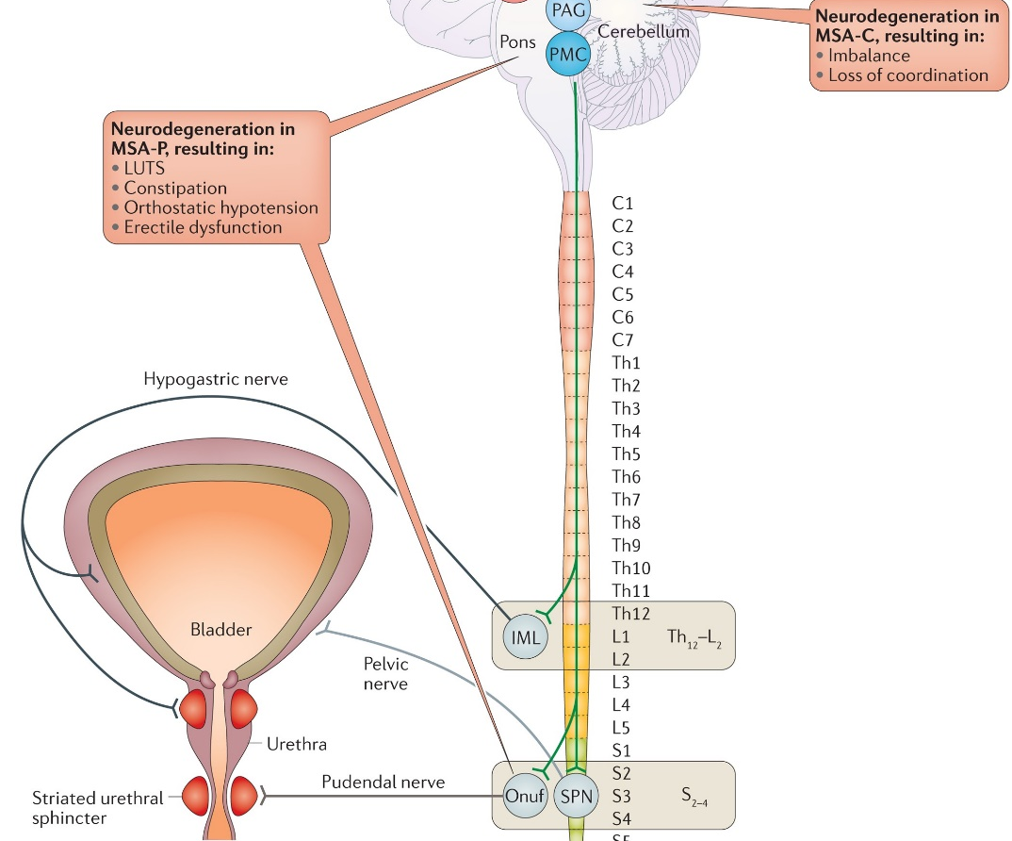
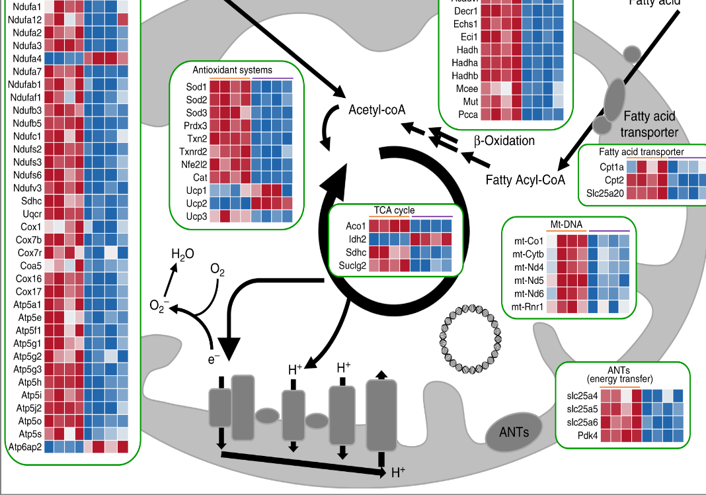
Challenges
Is mitochondrial dysfunction in the lower urinary tract in aging males confined to the prostate?
Peripheral Nervous System?
Bladder?
Cathy Mendelsohn lab
Gene expression changes in urothelium of Pparg mutant mice (Nat. Commun. 2019)
Prevalence and treatment of LUTS in patients with Parkinson disease or multiple system atrophy. Naoki Yoshimura Lab Nat Rev Urol. 2017
Lori Birder Lab (Pitt): Studying aging-related changes in mitochondrial function in urothelium
Notes:
Many implications in urothelial development and homeostasis (from Mendelsohn paper)
Conditional deletion in adults also showed altered mito morphology and lipid transport into mito matrix
Birder Lab studies

Slide 7
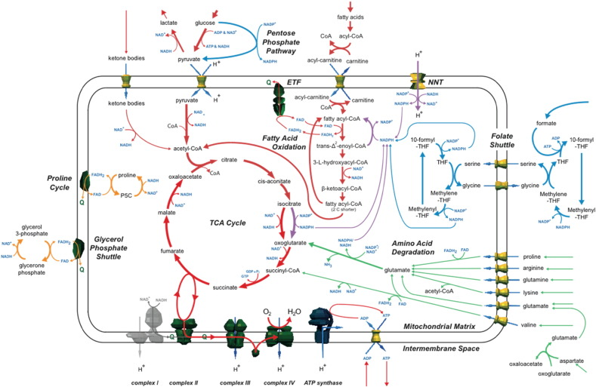
Challenges
What metabolic adaptations to specific mitochondrial dysfunction (complex I?) are compromised in the lower urinary tract of aging males?
From AJ Robinson Lab: Mitochondrion (2016)
Notes:
Or in fact are there metabolic compromises?
CI inhibition, decreased NAD+/NADH ratio

Slide 8
FUTURE DIRECTIONS
Can biomarkers of mitochondrial (ETC Complex I) dysfunction be identified in BPH?
“Respiratory Complex I‐mtDNA mutations (in the NADH ubiquinone oxidoreductase chain 4 gene), MFN2, and IMMT proteins were detected in the circulating exosomes in serum of men with benign prostate hyperplasia (BPH) and progressive PCa! (Philley JV, et al., J Cell Physiol. 2016 Jun;231(6):1364-74.)
Platelet bioenergetics correlate with muscle bioenergetics and are altered in older adults.
Shruti Shiva and Anne Newman (Pitt): JCI Insight 2019
Co-occurrence of lower urinary tract symptoms and frailty among community-dwelling older men.
Scott Bauer, Will Ricke and colleagues: J. Am. Geriatr. Soc. 2020
Succinate
NDUFS3
Can drugs that “restore” mitochondrial function reverse various phenotypes observed with in vitro and in vivo models of prostatic epithelial cell dysfunction, inflammation, or LUTS?
Notes:
Succinate oxidation in Complex II via FAD generates e- that are transferred to ubiquinone, which is ultimately fully reduced (by 2 e-) to ubiquinol, which then transfers e- to complex III
Scott following up studies and examining mito function
We are working with Shruti as well for bioenergetic studies in animal models and perhaps humans

Slide 9





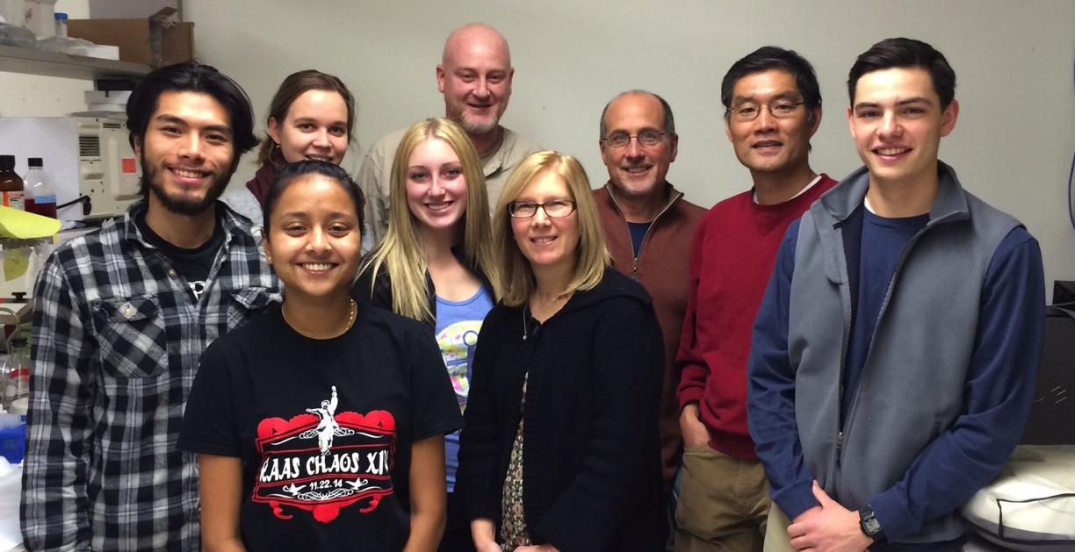
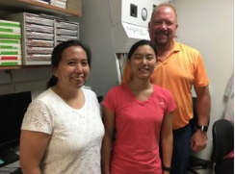



Acknowledgments
Univ of Pittsburgh O’Brien Center
DeFranco Lab
Kai He
Laura Pascal
Juliann Jaumotte
Caroline Madigan
Chandler Hudson (MD, Pitt Med, O’Brien Summer Research Fellow; Urology Resident, USI)
Pittsburgh Institute for Neurodegenerative Diseases
Tim Greenamyre
Roberto Di Maio
Univ. Wisconsin O’Brien Center
Will Ricke
Teresa Liu
Emily Ricke
Alexis Adrian
Liv Myklebust – Pitt Med MS1 (MSTP)
Mel
Laura
Caroline
Juliann
Kai
Kai
Caroline
Will
Teresa
Liv
Roberto
Tim
Alexis
Notes:
All members of Pitt Obrien Center Directed by Zhou Wang

