Slide 1
Benign GU research needs a clinical/translational approach to benign prostate research
James D. Brooks, MD
Keith and Jan Hurlbut Professor

Slide 2
Outline of talk
Long term aspiration: New targeted therapies for BPH
Shorter term goal – Precision Therapy
Opportunities and challenges in translating molecular taxonomies of BPH into the clinic

Slide 3
Long term aspiration: New targeted therapies for BPH

Slide 4
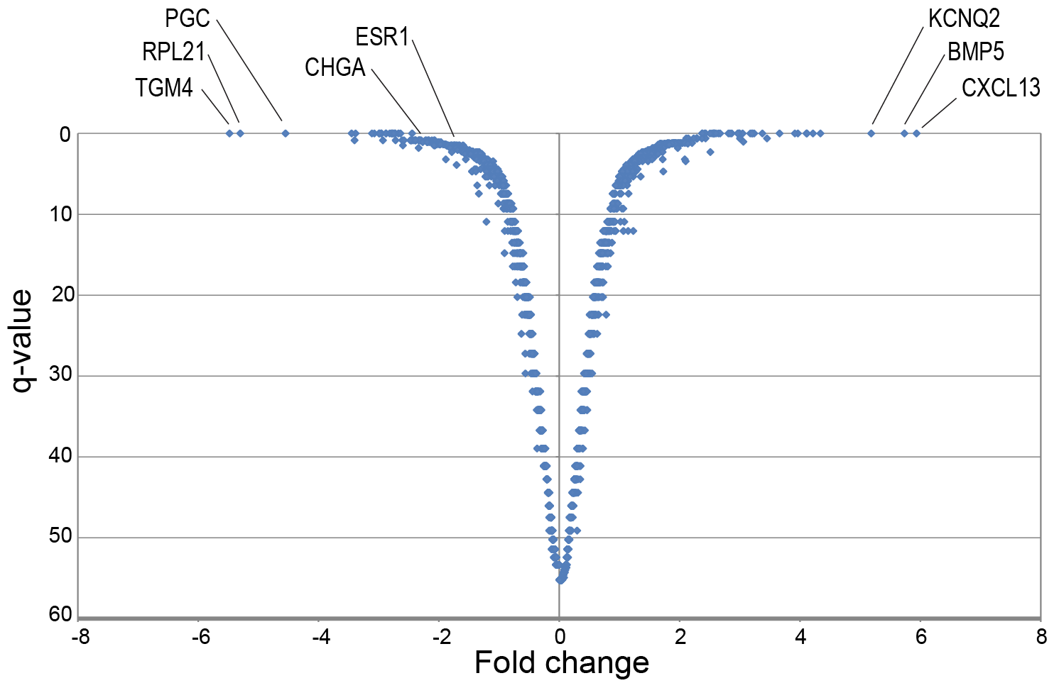
Gene expression profiling
Up in normal prostate
Up BPH
Candidate
Bioactive
Ligands
(Log2)
Middleton, JCI Insight, 2019

Slide 5
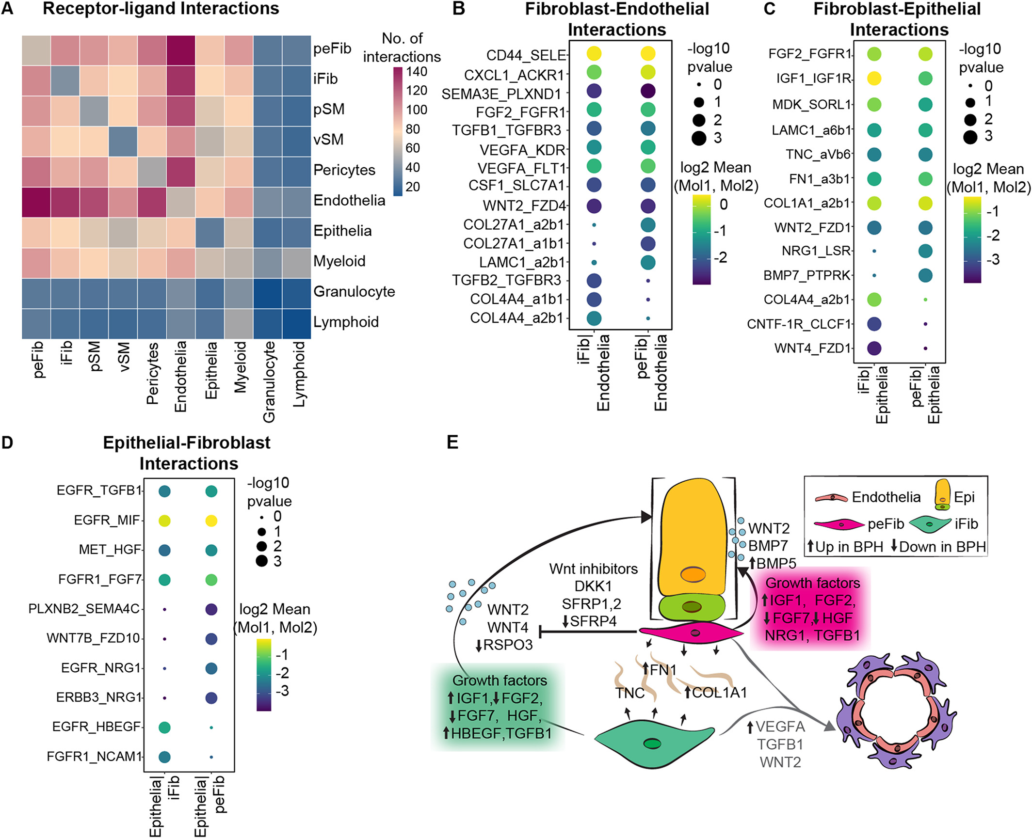
Cell interaction networks – candidate ligand receptor pairs
Joseph DB et al. Journal of Pathology 255: 141-154, 2021

Slide 6
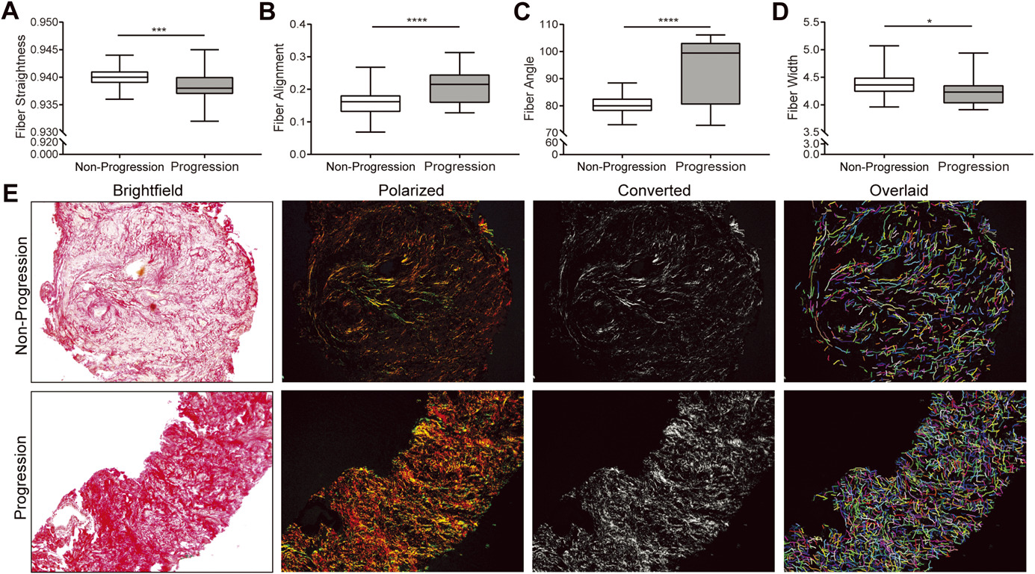
Fibrosis associated with LUTS
Macoska JA et al. Journal of Urology 202: 1240-1247, 2019

Slide 7
Shorter term goal – Precision Therapy

Slide 8
Definition precision therapy
Existing therapies for BPH are effective for some, but not others
Few clinical predictors of success or failure, aside from prostate size
Biomarkers to better select the appropriate treatment for each patient
Necessary elements:
  New taxonomy of BPH (molecular, cellular, imaging. . .)
  Technologies to measure these subtypes in the clinic
  Defined clinical applications and clean clinical trial design

Slide 9
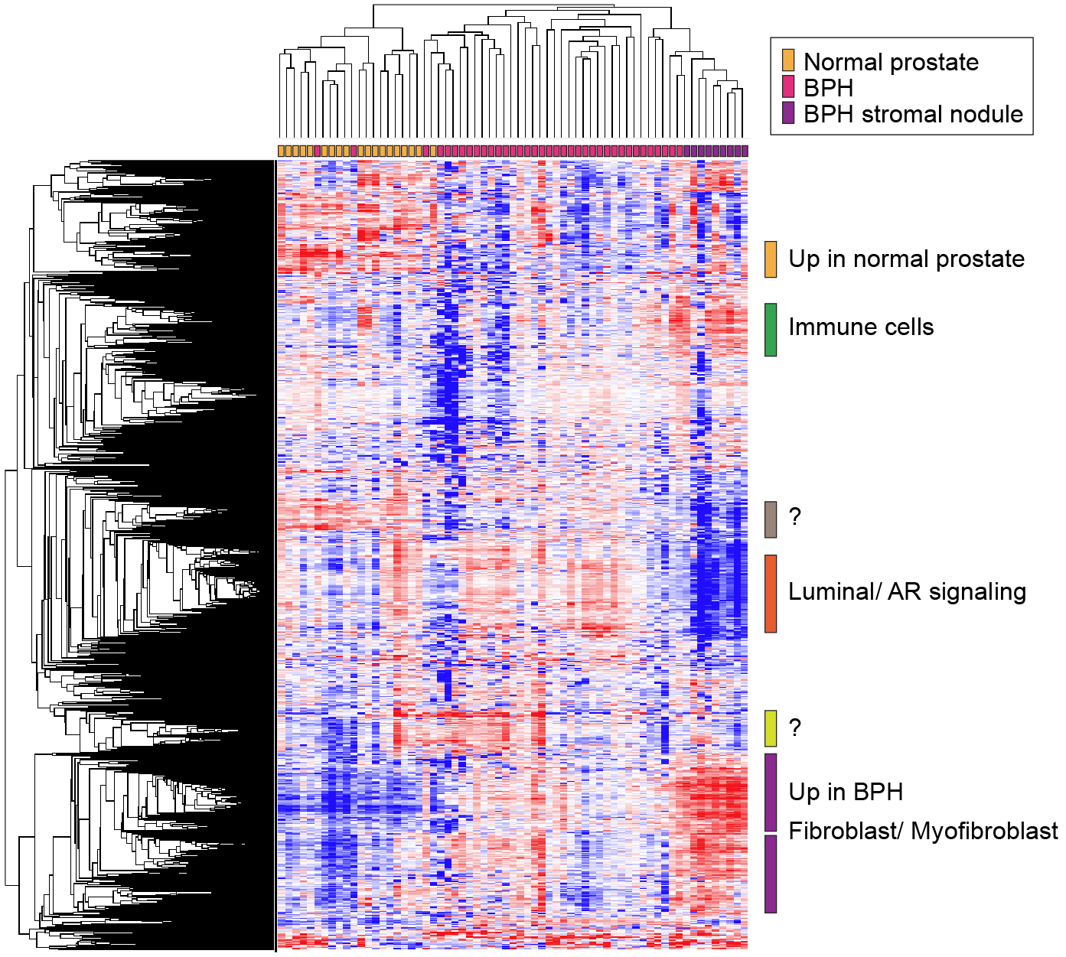
BPH shows 2 gene expression subtypes
n=19
n=37
n=9
Middleton, JCI Insight, 2019

Slide 10
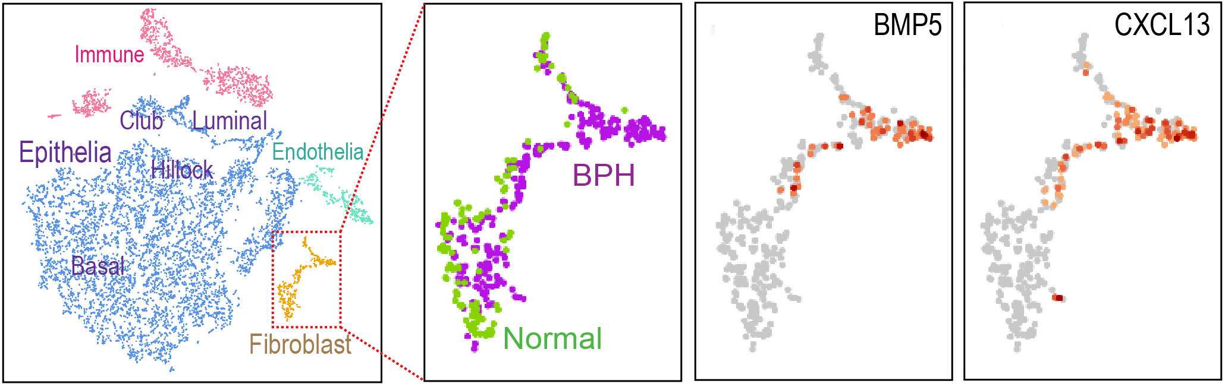
Single cell RNA-Seq and BPH cell types
Henry GH, Cell Reports, 2017
Middleton, JCI Insight, 2019
Joseph DB, Prostate, 2021
Joseph DB, J. Pathol, 2021

Slide 11
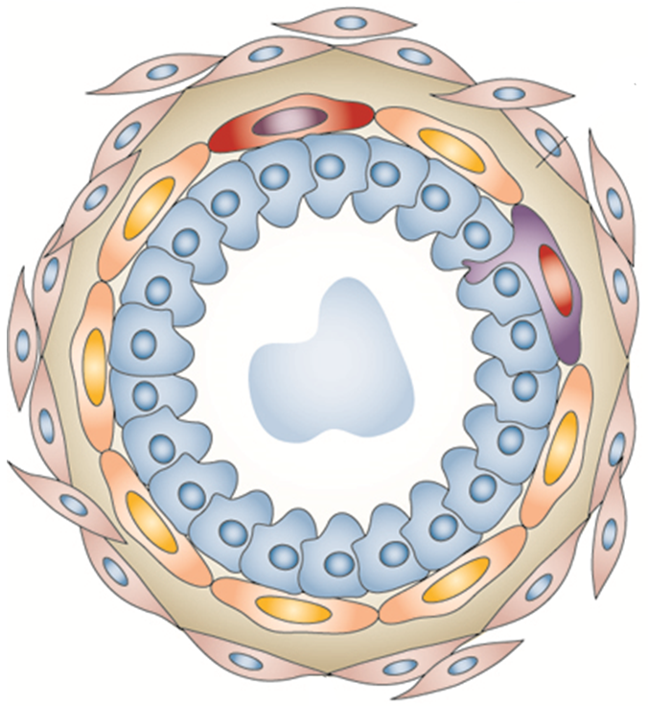
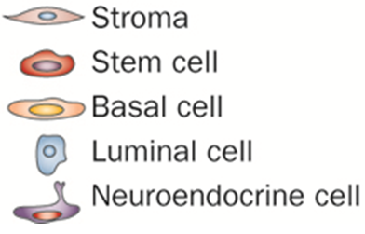
Cellular re-landscaping in BPH
Normal prostate
BPH
X
X
X

Slide 12
Molecular cellular taxonomy of BPH
BPH can be categorized into distinct subtypes based on transcriptome or cellular composition
These subtypes could be measured – assays will need to be developed
These subtypes provide a toehold for testing whether distinct subtypes respond differently to therapies

Slide 13
However, more work needs to be done!
Problem of small N. Largest study had 38 BPH samples. For true assessment of molecular subtypes, best to examine hundreds of samples, bring out rare subtypes, better flesh out pathways
The problem of spectrum bias
Many new technologies for assessment of BPH “phenotypes”
  DNA methylation
  Proteomics, glycoproteomics, metabolomics other single cell technologies
How much of a problem is heterogeneity?
What clinical endpoints require biomarkers?

Slide 14
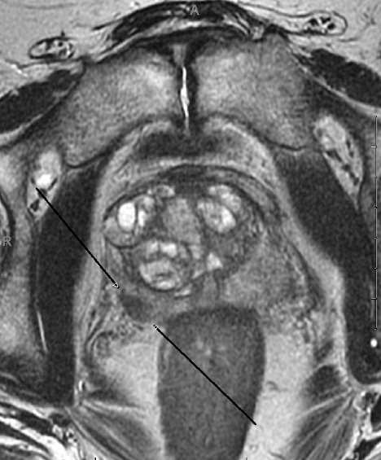
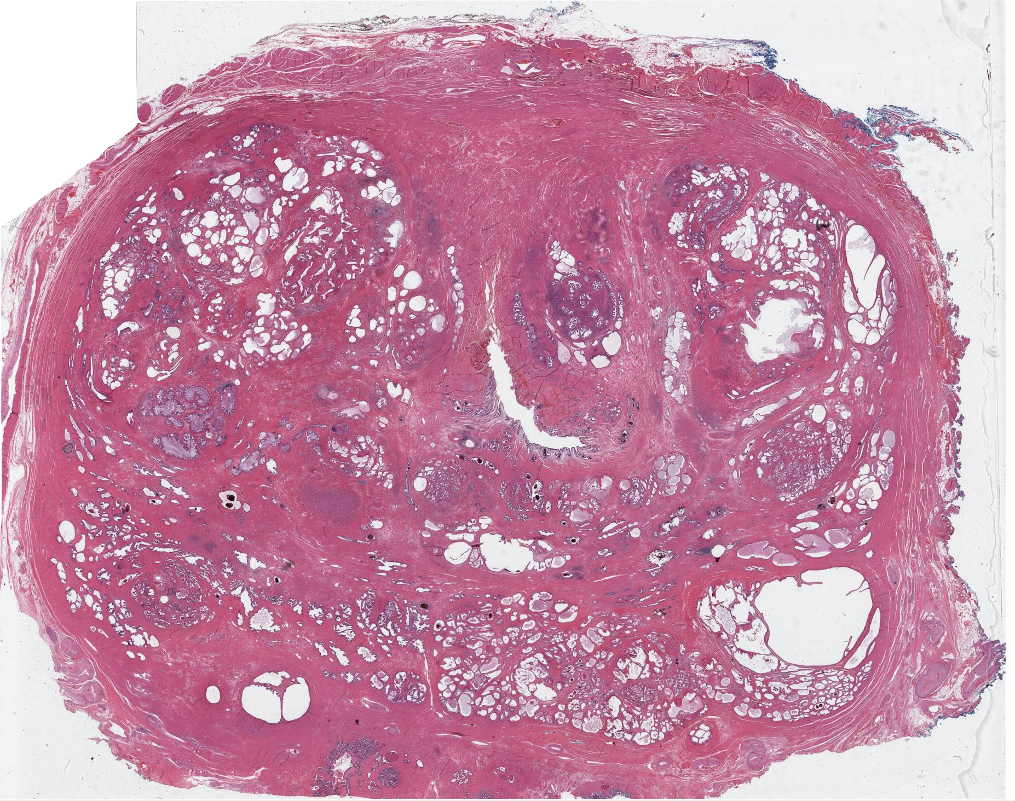
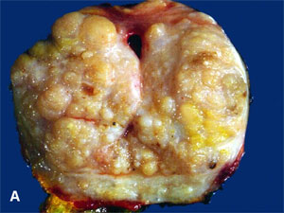
BPH is highly heterogeneous

Slide 15
Thoughts on clinical translation of BPH molecular and cellular subtypes

Slide 16
BPH diagnostic biomarkers
Several studies report candidate biomarkers for BPH and discovery-based studies such as ‘omics analyses will yield differences

Slide 17
BPH diagnostic biomarkers
Several studies report candidate biomarkers for BPH and discovery-based studies such as ‘omics analyses will yield differences
What is the clinical use? Do we need biomarkers to tell us who has BPH?

Slide 18
BPH diagnostic biomarkers
Several studies report candidate biomarkers for BPH and discovery-based studies such as ‘omics analyses will yield differences
What is the clinical use? Do we need biomarkers to tell us who has BPH?
What is the endpoint for BPH? What precisely are our biomarkers predicting?

Slide 19
Commonly used clinical endpoints are imperfect
Hard endpoint: Urinary retention is relatively uncommon and might not capture irritative voiding symptoms
Surgery: Tremendous variation in practice patterns, different reasons men choose surgery
IPSS: subjective, prone to misinterpretation and misalignment in IPSS and BI:
  IPSS 8, BI 6; IPSS 28, BI 2
Prostate volume

Slide 20
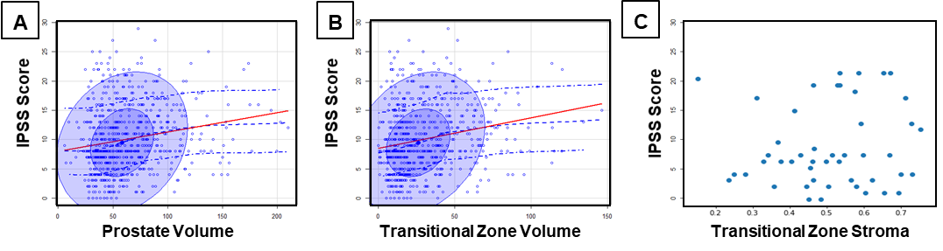
Prostate volume and IPSS
Fig. 3: Correlation of IPSS scores with MRI determined (A) total prostate volume, (B) transition zone volume, and (C) Stroma in the Transition Zone. Prostate capsule, transition zone and stroma were segmented with an automated program.
Rusu M, Unpublished

Slide 21
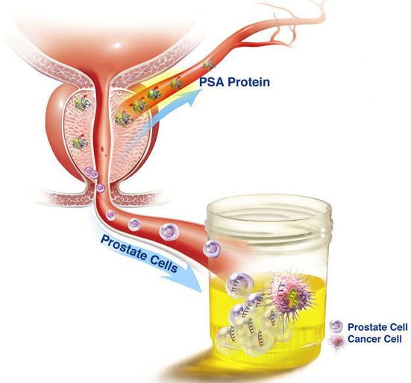
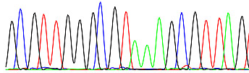
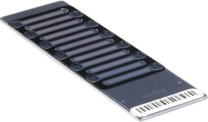
What to measure? How to measure it?
DNA/RNA Analysis
Requires biomarkers with high
Sensitivity/Specificity
Modified from Urological Science Research Foundation

Slide 22
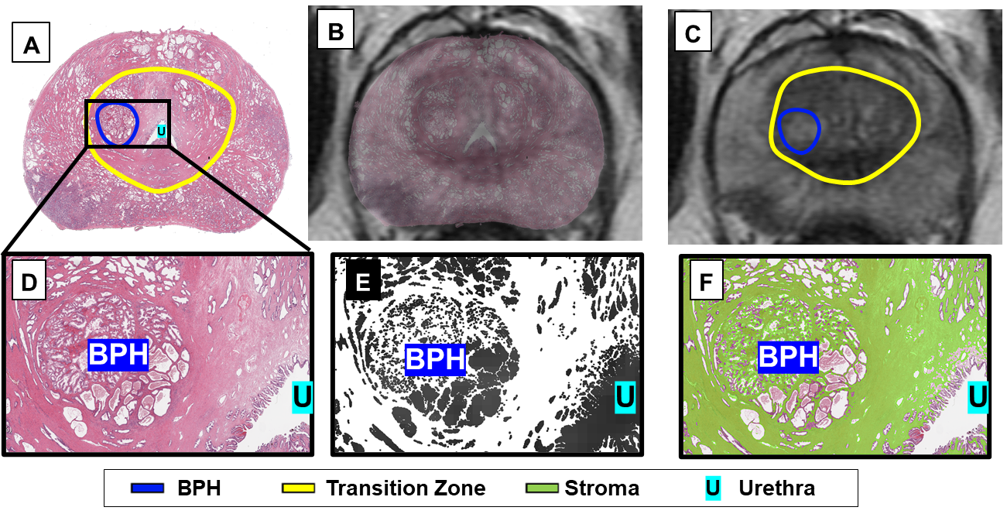
What to measure? How to measure it?
Fig. 1: RAPSODI accurately registers (A) histology and (B-C) MR Images mapping BPH (blue) and Stroma (green) from histology onto MRI. (D-E) close up into BPH nodule; (D) Histology Image, (E) stroma segmentation; (F) stroma outlined on the histology image
Rusu M, Unpublished

Slide 23
What are areas where molecular phenotypes could be useful?
Who is at risk for developing symptomatic BPH as they age?
Which patients are at risk for hard endpoints: urinary retention, obstructive nephropathy, bleeding, infections related to obstruction?
Can we identify men who will or will not respond to medical therapies so that we choose the correct therapy and prevent futile therapies?
Which men have irreversible bladder dysfunction or primary bladder dysfunction and will not be helped by a procedure?
Which men are at risk for regrowth and a second procedure?
Each question demands a specific trial design.

Slide 24

Conclusions
Molecular taxonomy of BPH will help develop new therapies and better apply existing therapies
Need new models for testing new therapeutics
Need strategies for non-invasive measurement
Thoughtful trial design for meaningful endpoints

Slide 26
Thoughtful clinical trial design
Minimizing biases in patient cohort selection:
  Open prostatectomies skew to large glands only. Discovery needs to encompass all sizes and symptoms
  RP samples could have field defects
Selection of meaningful endpoints:
  Successful response to oral therapies: confounding placebo effects in 40% of men – identify non-responders compared to responders
  LUTS from prostate obstruction vs. OAB: perhaps compare successful to unsuccessful TURP
  Other surrogate endpoints: reduction in prostate size, flow rate, PVR, Nocturia

Slide 27
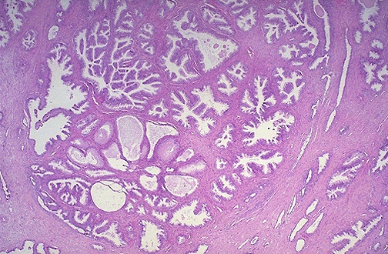
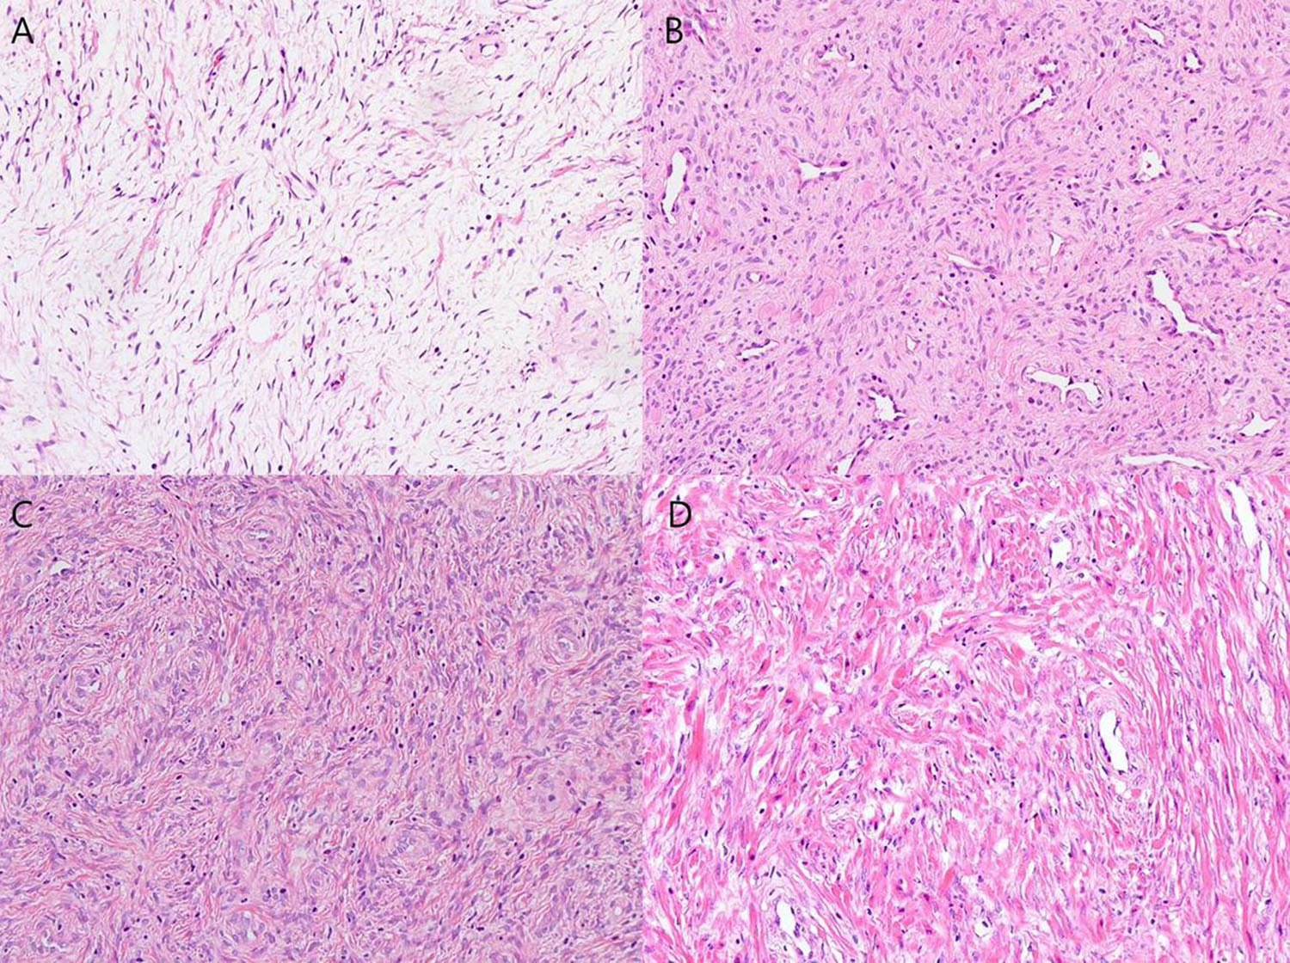
BPH is highly heterogeneous
Branching ducts
Cystic glands
Epith rich glands
Atrophic glands
Stromal nodules
Sampling error
In determining
Molecular subtype
Cell populations

Slide 28
More discovery work needs to be done!
Problem of small N. Largest study had 38 BPH samples. For true assessment of molecular subtypes, best to examine hundreds of samples, bring out rare subtypes, better flesh out pathways
Very limited work in proteomics, and opportunities in studying protein modifications including glycosylation
These molecular subtypes and the biomarkers arising from these studies can serve as classifiers to phenotype BPH and associate with clinical outcomes.
Barbieri study suggests
methylation differences

Slide 29
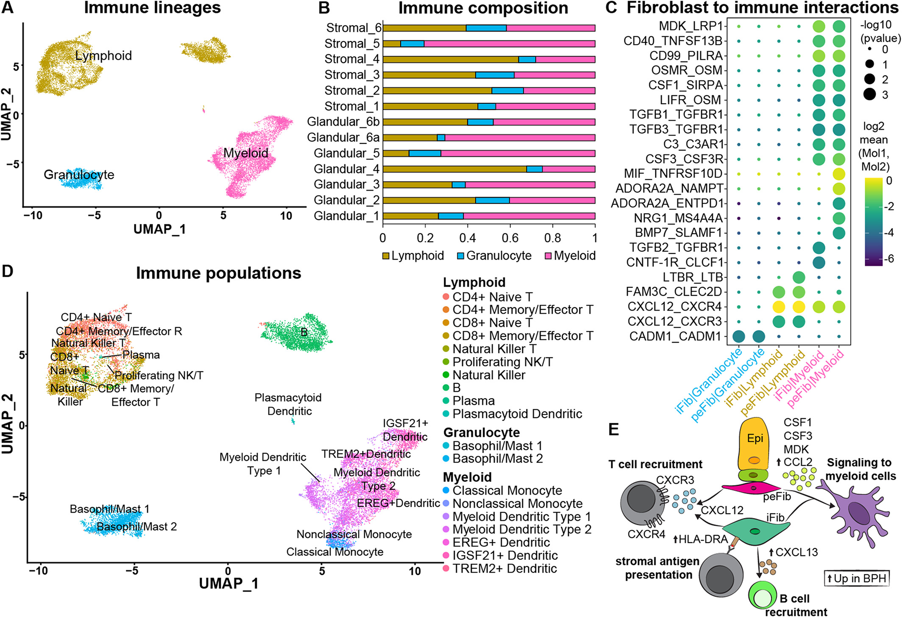
Cell interaction networks – candidate ligand receptor pairs
Joseph DB et al. Journal of Pathology 255: 141-154, 2021

