Slide 1


Collaborating for the Advancement of Interdisciplinary Research in Benign Urology
CAIRIBU 2021
Annual Meeting
December 2-3, 2021
Virtual Meeting

Slide 2



Welcome to the CAIRIBU Community
Collaborating for the Advancement of
Interdisciplinary Research
in Benign Urology
U54
O’Brien Urology
Centers
K12
KURe
UroEpi
Broad Benign Urology
Research Community
and Beyond!
P20
Exploratory Centers
U24
CAIRIBU
Interactions Core

Slide 3
Creating a Learning Community to Develop Early-Career Investigators, Improve Understanding of Benign GU Conditions, and Enrich and Support the Broader Research Community
Benign Urology Investigator Community
U54
P20
K12
Notes:
There are some structural challenges to building a LEARNING COMMUNITY – the community will be slightly different every year.
U54 and K12 grants are funded for 5 years with different start and end dates.
P20 Developmental Centers are funded for 2 years.
The O’Brien Centers are subject to competitive review.
NIDDK needs an organic LEARNING COMMUNITY that will be supportive of benign urology researchers that thrives independent of the funding mechanism.

Slide 4
  CAIRIBU aims to address challenges facing researchers interested in non-cancerous genitourinary conditions
No cohesive “story” for these conditions
Multiple medical specialties have a piece of the story
Perceived impact is primarily quality of life
  Many conditions are normalized and accepted
Conditions are not routinely screened
  Become apparent only when symptoms are recognized and reported
Lack of objective markers
Most conditions treated by surgeons with limited time to think like scientists
Many pts have some degree of stigma, limiting self-report and advocacy
  Limits usefulness of big data
Benign GU workforce pipeline insufficient to meet needs

Slide 5
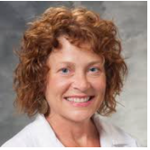


CAIRIBU U24 Interactions Core
Kristina Penniston, PhD, RDN
- PI, NIH/NIDDK U24 UW-Madison Urology Interactions Core (U24DK-127726)
- Senior Scientist, University of Wisconsin School of Medicine and Public Health,
Department of Urology
Jennifer Allmaras, MPH
- Researcher
Catherine Davis
- Administrative Assistant
For “real time” assistance during the meeting, contact Interactions Core staff in the Zoom chat OR by emailing CAIRIBU@urology.wisc.edu
Betsy Rolland, PhD, MLIS
- Co-Investigator, NIH/NIDDK U24 UW-Madison Urology Interactions Core (U24DK-127726)
- PI, Coordinating Center of the Cancer Center Cessation Initiative
- Director of Team Science & Research Development, University of Wisconsin School of Medicine and Public Health, Institute for Clinical and Translational Research
Collaborating for the Advancement of Interdisciplinary Research in Benign Urology

Slide 6
CAIRIBU Community Opportunities
CAIRIBU Collaboration Awards
CAIRIBU Travel Grants
CAIRIBU Research Travel & Development Grants
CAIRIBU Urology O’Brien Centers Opportunity Pool
Collaborating for the Advancement of Interdisciplinary Research in Benign Urology

Slide 7
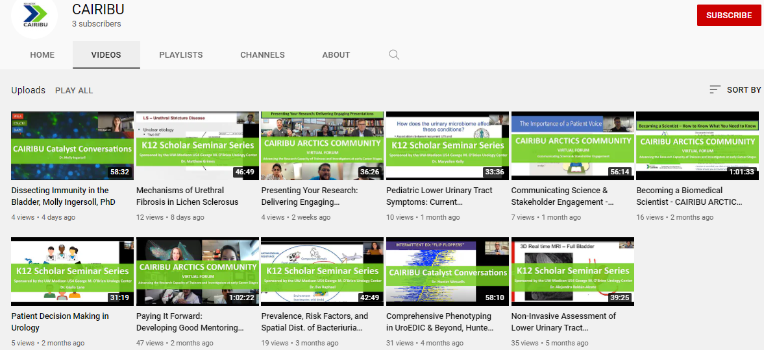
CAIRIBU Community
Website – Resources, info, links to local CAIRIBU Centers & Programs
YouTube channel

Slide 8

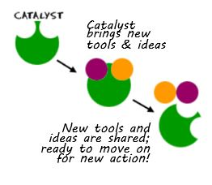




CAIRIBU Community
Virtual seminars, forums, and discussions
Research interest groups
s

Slide 9
CAIRIBU Program Officers at NIDDK
Deepak Nihalani, PhD Program Official
Julie Barthold, MD Project Scientist
Chris Mullins, PhD Scientific Advisor
Collaborating for the Advancement of Interdisciplinary Research in Benign Urology

Slide 10

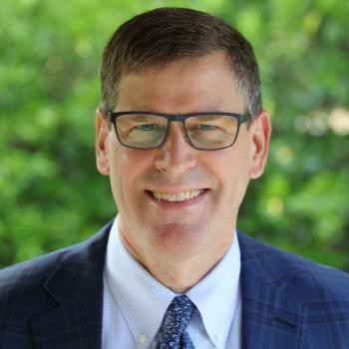
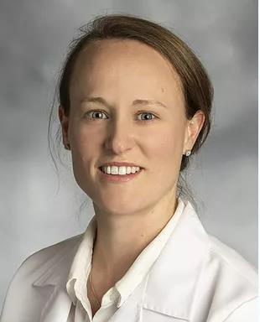
U54 CENTER
Stanford University George M. O’Brien Center
2021-2026 – PI, James Brooks, MD
P20 CENTER
Beaumont Hospital/ Oakland University Michigan State University 2021-2023 - Co-PIs, Bernadette Zwaans, PhD and Michael Chancellor, MD
NIH-NIDDK-CAIRIBU

Slide 11


NIDDK Funding Initiative RFA-DK-21-032: Fostering Research With Additional Resources and Development (FORWARD) Urology Centers (P20 Clinical Trial Not Allowed)
Goal: To foster and expand the benign urologic research community through collaborative teams and support for a Research Project that generates data for follow-on R01 submission(s)
Due Date: March 24, 2022 / New applications only
The P20 supports:
  Administrative (Project Support) Core: led by the P20 PD/PI, an established investigator, preferably in benign urology
  Research Project Team: 3 or fewer multidisciplinary investigators, at least 1 an ESI
  Research Project: scientifically distinct from PD/PI’s research; R01 submission by Y3
Duration: up to 3 years
Budget: up to $250,000 per year in Direct Costs
For More Information: Dr. Julie Barthold, NIDDK (julia.Barthold@nih.gov)

Slide 12
NIDDK Funding Initiative PAR-22-069: High Impact, Interdisciplinary
Science in NIDDK Research Areas (RC2)
The RC2 Program fosters collaboration between multiple investigators with complementary expertise to
  engage in innovative, high-impact studies designed to improve and enhance biomedical research.
The RC2 uniquely supports:
  Creation of large-scale unique resources and/or development of transformative technologies/tools
    that can benefit a wide range of investigators.
  High-impact discovery-based and/or hypothesis-generating science.
The RC2 does not support traditional hypothesis-testing studies more suited for a R01 application.
Two receipt dates per year. Next two: June 1 and November 2, 2022.
NOTE: Required Letter of Intent pre-review phase prior to submission. Applicants are asked to contact
  the NIDDK at least 3-6 months prior to planned receipt date.
For More Information: Dr. Chris Mullins, NIDDK (mullinsc@mail.nih.gov)

Slide 13
CAIRIBU 2021 Meeting
Provides platform for knowledge transfer and uptake
Facilitates awareness of breadth of benign GU research
Emphasizes intersections and shared objectives
Encourages networking and collaboration
Creates a sense of community
This year’s meeting:
  Every CAIRIBU Center represented on program
  Presentations by CAIRIBU K12 Scholars
  Interactions sessions promote team building
  Trainees and ESIs share their science in poster sessions

Slide 14
CAIRIBU 2021 Meeting Planning
CAIRIBU 2021 Meeting Program Committee
CAIRIBU 2021 Abstracts & Poster Session Committee
CAIRIBU 2021 Trainee Event Organizing Committee*
CAIRIBU Community Leaders
Mark Dennis and the Scientific Consulting Group
NIDDK Program Officers
Collaborating for the Advancement of Interdisciplinary Research in Benign Urology
* Trainee Event Organizing Committee:
Alexis Adrian, graduate student, UW-Madison U54 O’Brien Center
Grace Morales, graduate student, Vanderbilt University P20 Exploratory Center
Lauren Baker, PhD, DVM, K12 Scholar, UW-Madison KURe Program
Matthew Grimes, MD, K12 Scholar, UW-Madison KURe Program
Marvin Langston, PhD, MPH, K12 Scholar, UCSF-Kaiser Permanente KUroEpi Program
Michael Odom, PhD, K12 Scholar, Duke University KURe Program

Slide 15
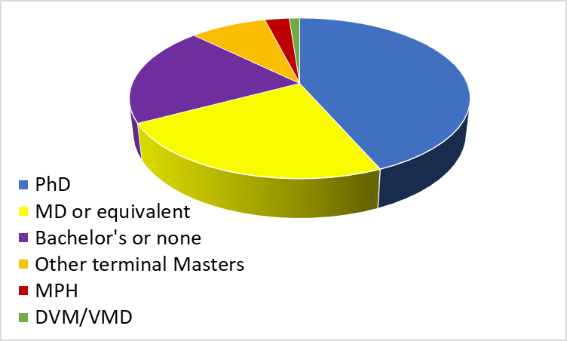
Outreach to broader benign GU community
Pre-registered = 231
Final registration =
Nearly 70 different organizations
58% from within CAIRIBU Community
67% from 15 institutions:
  UW-Madison, Duke University, Vanderbilt University, Medical College of Wisconsin, University of Pittsburgh
  Harvard (including Boston Children’s and BIDMC), Stanford University, Columbia University, NIH, Michigan State University
  UCSF-Kaiser Permanente, Albert Einstein Medical College, University of Alabama at Birmingham, University of Alabama at Huntsville, and University of Texas Dallas

Slide 16
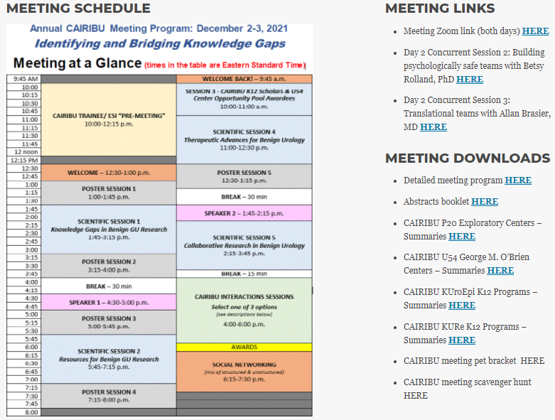
Keep CAIRIBU website open on your computer during meeting
  View and download meeting materials at “Annual Meeting” tab
https://niddkcairibu.urology.wisc.edu/

Slide 17
CAIRIBU 2021 Meeting Materials
View and download meeting materials from CAIRIBU website
(“Annual Meeting”)
Meeting schedule and link to full meeting program
Welcome slide set
Full meeting abstracts
NIH RePORTER summaries of CAIRIBU Centers and Programs
Links to publications by and info about speakers
Scavenger hunt form
Pet photos for the 1st annual CAIRIBU pet tournament
Virtual poster hall
Collaborating for the Advancement of Interdisciplinary Research in Benign Urology

Slide 18
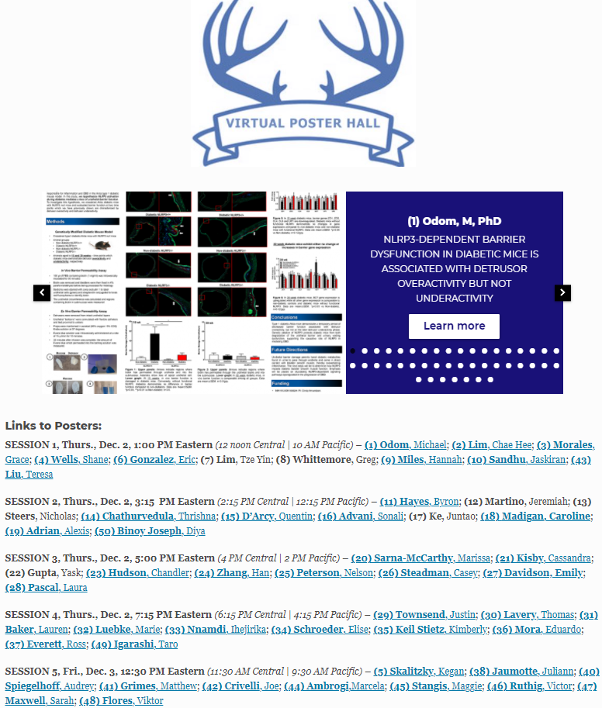
Abstracts booklet on CAIRIBU website features full-text abstracts

Slide 19
CAIRIBU 2021 Poster Sessions
50 abstracts submitted
  Each reviewed by 2-4 reviewers and evaluated according to standardized criteria
Highest score = Best Abstract
Five 45-minute poster sessions throughout meeting
  Each will begin with 9-10 one-minute “flash talks”
  Each presenter then hosts a 30-min Zoom breakout room for Q&A
  “Best Posters” in 6 topical categories announced at end of meeting
PLEASE make sure you are using the most updated version of Zoom so that you are able to participate in Zoom breakout rooms during poster sessions

Slide 20
CAIRIBU 2021 Best Abstract
Matthew Grimes, MD, K12 Scholar, UW-Madison KURe Program: (41) CD44 expression is decreased in lichen sclerosus
Tie for 2nd place
    Viktor Flores, MD, Urology Fellow, Vanderbilt University P20 Exploratory Center
  (48) Actinotignum schaalii: a commensal bacteria of the pediatric urinary microbiome
  Lauren Baker, PhD, DVM, K12 Scholar, UW-Madison KURe Program
  (31) Metabolome- and genome-wide association to discover genetic drivers of calcium oxalate kidney stone disease in a dog model
3rd place
  Victor Ruthig, PhD, Postdoctoral Researcher in laboratory of Dr. Dolores Lamb (prior PI of a CAIRIBU KURe Program)
  (46) Hypospadias occurs in the penis of mice and humans with RBFOX2 gene variation

Slide 21
CAIRIBU 2021 Meeting Interactions
KEEP YOUR ZOOM CHAT OPEN OR CHECK IT OFTEN FOR:
  Messages and instructions for taking part in interactive portions of the meeting
  Link to participate in CAIRIBU meeting scavenger hunt contest (entries are due by 8:00 PM Eastern time TODAY)
POLLS TODAY AND TOMORROW TO:
  Participate in the 1st annual CAIRIBU meeting pet tournament
  Meet the pets at the 4:00 PM break today (also on website)
  Vote on “final four” pets → 2 “playoff” pets → winner

Slide 22
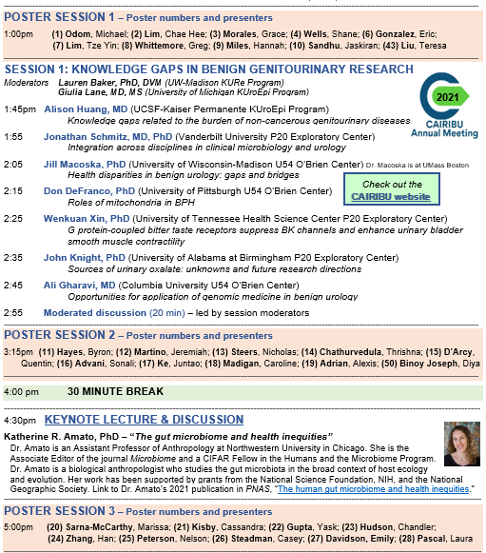
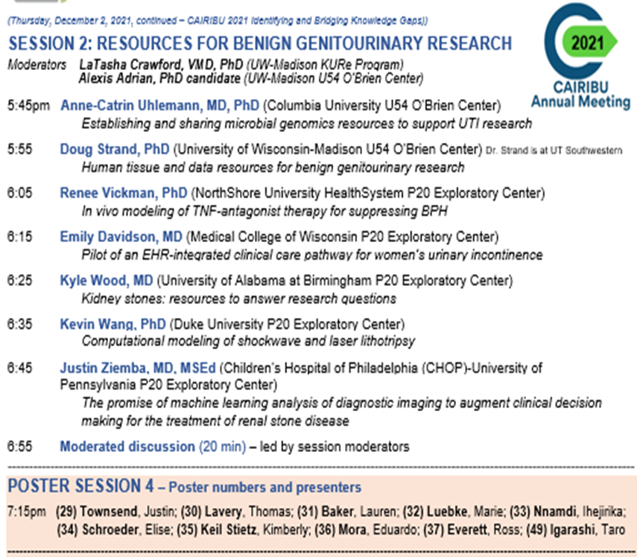
CAIRIBU 2021 Meeting Program – Day 1
2 scientific sessions
4 poster sessions
Keynote lecture/discussion

Slide 23
CAIRIBU 2021 P20 Center Acknowledgments
Completing P20 Exploratory Centers (2019-2021)
Albert Einstein College of Medicine
PI, Kelvin Davies, PhD
Duke University
PI, Pei Zhong, PhD
Vanderbilt University Medical Center
  PI, Maria Hadjifrangiskou, PhD
University of Tennessee Health Science Center
Read about these and other P20 Centers on CAIRIBU website:
https://niddkcairibu.urology.wisc.edu/
Collaborating for the Advancement of Interdisciplinary Research in Benign Urology

