Slide 1
Perspectives on UI Natural History and Careseeking: Nurses’ Health Studies
Fran Grodstein, ScD
Professor of Internal Medicine
Rush University Medical Center

Slide 2
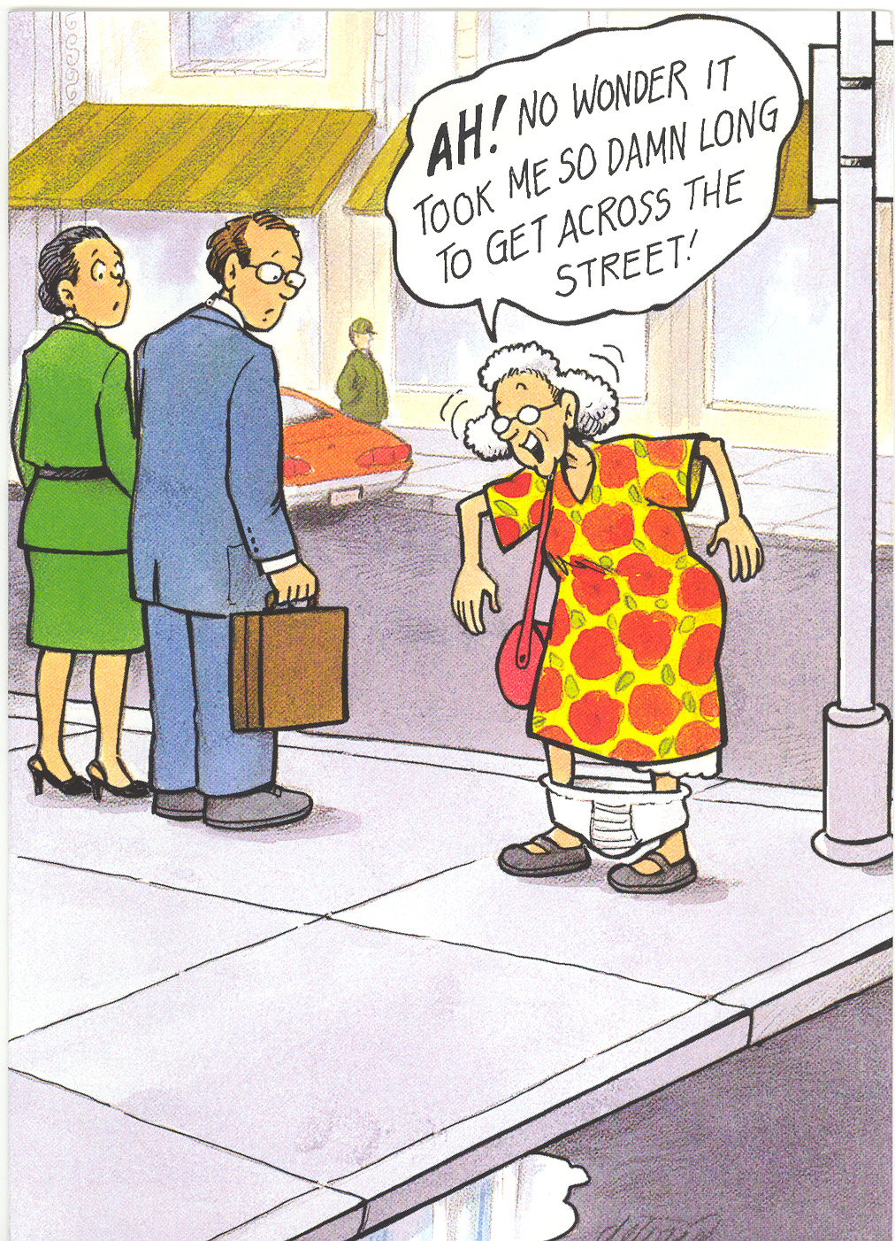

Slide 3
TOPICS
Natural history of UI
  Overall
  By UI type
Consequences of UI (Depression)
Healthcare seeking for UI
Notes:
SWAN: only 29% with UI in visits 7,8,9 reported healthcare seeking at any of those points

Slide 4
Nurses’ Health Study/Nurses’ Health Study 2
Began 1976/1989
237,000 US nurses
Age 25-55 years at baseline
Biennial mailed questionnaires

Slide 5
Nurses’ Health Study/Nurses’ Health Study 2
During the last 12 months, how often have you leaked or lost control of your urine?
When you lose your urine, how much usually leaks?
When you lose urine, what is the usual cause?
5 repeated measures over 12+ years

Slide 6
Natural History of UI in NHS
Question: if a patient comes to clinic with new UI, what can we tell them to expect?
NHS2: 7,491 incident UI cases in 2001
  Age 39-56 years
NHS: 9,376 incident UI cases in 2000
  Age 56-81 years
Hagan KA et al. AJOG 2018

Slide 7
UI Natural History over 12 Years, Nurses’ Health Study
 | Age Group in 2000 (Baseline)
 | 39-56 years |  | 56-81 years
 | Slight UI (n=2891) | Moderate UI (n=3348) | Slight UI (n=3206) | Moderate UI (n=4196)
Persist/worse | 81% | 41% | 83% | 46%
Any symptoms | - | 43% | - | 35%
Remission | 11% | 9% | 7% | 5%

Slide 8
UI Natural History over 12 Years, Nurses’ Health Study
 | Age Group in 2000 (Baseline)
 | 39-56 years | 56-81 years
 | Severe UI (n=1252) | Severe UI (n=1974)
Persist | 44% | 48%
Any symptoms | 52% | 49%
Remission | 4% | 3%

Slide 9
BMI and Risk of Progression from Mild/Moderate to Severe UI
 | Mild/moderate to Severe UI RR (95% CI)
BMI <25 | 1.0 (ref)
BMI 25-<30 | 1.4 (1.2–1.6)
BMI 30+ | 1.9 (1.6–2.2)

Slide 10
Natural History of UI Subtypes in NHS
NHS2: 6,956 incident UI cases from 2003
  Age 41-58 years
NHS: 3,393 incident UI cases from 2004
  Age 60-85 years
4 repeated measures of UI over 10 years
56% stress, 23% urgency, 21% mixed
Minassian VA et al. AJOG 2020
Notes:
SWAN: only 29% with UI in visits 7,8,9 reported healthcare seeking at any of those points

Slide 11
Natural History of UI Type, Nurses’ Health Study
 | INCIDENT UI TYPE AT BASELINE
 | Stress | Urgency | Mixed
UI type over 8 yrs
Stress | 60% | 6% | 20%
Urgency | 7% | 65% | 27%
Mixed | 18% | 20% | 45%
No UI | 15% | 9% | 8%

Slide 12
Consequences of UI, Nurses’ Health Study
Racial differences
Black women have less UI than white women
Black women more often have urgency UI
Urgency UI often associated with worse quality of life
Townsend MK et al. IUJ 2014

Slide 13
Characteristics of Black and White Nurses’ Health Study Participants, 2004
Characteristic | Black (n=934) | White (n=71,161)
Mean Age | 70 yrs | 70 yrs
UI, 1+ per month | 31% | 48%
UI Type:
Stress | 16% | 28%
Urgency | 46% | 36%
Mixed | 38% | 36%
>2x get out of bed to urinate | 41% | 33%
CES-D>10 | 14% | 16%

Slide 14
UI and Depressive Symptoms
 | Odds of High CES-D Score OR (95% CI) BLACK WOMEN | Odds of High CES-D Score OR (95% CI) WHITE WOMEN
No UI | 1.0 (ref) | 1.0 (ref)
UI weekly | 2.3 (1.3-4.0) | 1.6 (1.5-1.7)
UI severe | 2.6 (1.3-5.4) | 1.8 (1.7-1.9)
Mixed UI | 2.0 (0.8-5.5) | 1.4 (1.3-1.6)

Slide 16
Healthcare Seeking, Nurses’ Health Study
Have you talked to your health care provider about leaking urine?
2012/13 – 94,692 women with prevalent UI
Age 48-93 years
Overall – 34% of women with UI reported talking with their healthcare provider
Lane GI et al. J Geront 2020

Slide 17
Likelihood of Careseeking
 | Younger Women (48-68y) OR (95% CI) | Older Women (66-93y) OR (95% CI)
UI frequency:
UI weekly | 2.0 (1.8, 2.3) | 2.2 (2.0, 2.5)
UI daily | 3.9 (3.5, 4.4) | 4.8 (4.3, 5.3)
UI severe | 2.0 (1.8, 2.3) | 2.0 (1.8, 2.2)
UI type:
Urgency UI | 1.3 (1.2, 1.4) | 1.3 (1.2, 1.4)
Mixed UI | 1.3 (1.2, 1.4) | 1.4 (1.3, 1.5)
UI >10 yrs | 1.4 (1.3, 1.5) | 1.4 (1.3,1.5)

Slide 18
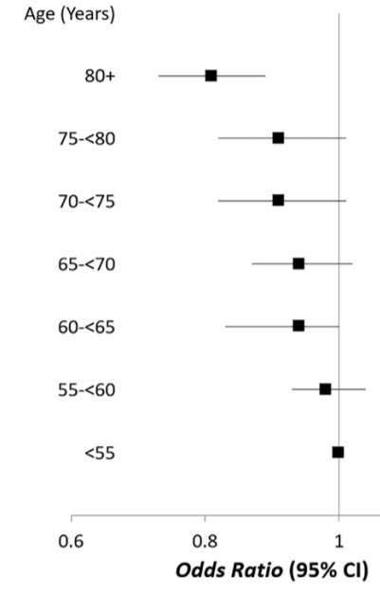
LIKELIHOOD OF CARESEEKING, BY AGE

Slide 19
UI Outpatient Evaluation and Management, Nurses’ Health Study
18,576 women age 65+ years
Prevalent UI (2012)
Linked to Medicare claims
Erekson E et al. J Urol 2020

Slide 20
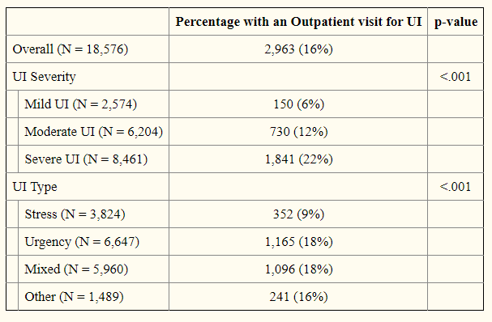
OUTPATIENT MEDICARE CLAIM FOR UI,
2011-12

Slide 21
CONCLUSIONS
½ of women with severe UI continue to experience severe symptoms over >10y, and only a minority are receiving care
Vast majority of women even with mild UI symptoms experience persistent or worsening UI over more than decade of f’up
Careseeking is remarkably infrequent – especially in women with mild symptoms, who likely could be successfully treated and reduce likelihood of worsening symptoms

