Slide 1
Understanding Interdisciplinary Research and Team Science
December 3, 2020
Betsy Rolland, PhD MLIS MPH
Director of Team Science + Research Development
Carbone Cancer Center and Institute for Clinical and Translational Research
University of Wisconsin-Madison
brolland@wisc.edu
Twitter: @betsyrolland, @UWICTR
© 2020 Betsy Rolland, PhD, MLIS, MPH

Slide 2
Science teams rarely fail because of the science; they fail or falter because of the organizational choices leaders make and the culture leaders build
Notes:
I want to start off with this important point. Science teams rarely fail because of the science; they fail or falter because of the organizational choices leaders make and the culture leaders build.
So, today we’re going to focus on how to make good organizational choices and build a positive, collaborative culture. I want to stress that this is not something you do once and forget about it, these are choices you’ll need to be making every day.

Slide 3
Introduction to Interdisciplinary Research and Team Science

Slide 4
Team Science Definitions
Team Science
  Scientific collaboration, i.e., research conducted by more than one individual in an interdependent fashion, including research conducted by small teams and larger groups
  Some definitions focus on interdisciplinary teams
Science Teams
  Entities of 2-10 individuals conducting science together
  Larger groups (10+)
National Research Council (NRC). (2015). Enhancing the effectiveness of team science. Washington, DC: National Academies Press.
Notes:
In my opinion, this isn’t a super useful definition, and I get asked all the time, Is what I’m doing Team Science? I generally say, if you’re working with other researchers who don’t report to you on a project you couldn’t do just within your own lab or research group, you’re probably doing team science.

Slide 5
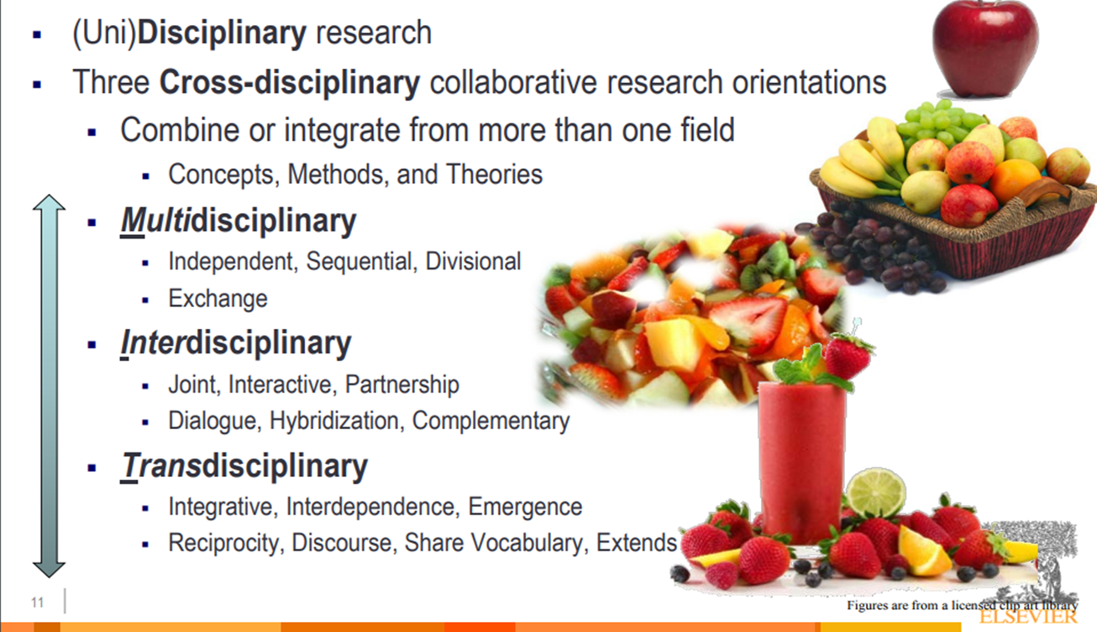
Interdisciplinary Research
Slide Credit: Dr. Holly Falk-Krzesinski
Notes:
A variety of terms are used, often interchangeably, to talk about research involving multiple disciplines. We often use a fruit smoothie analogy to explain the differences among the terms. Uni-disciplinary research is the traditional definition of a discipline, represented here as an apple. It’s one type of fruit, easy to distinguish from other fruits, eaten alone. Multidisciplinary research engages more than one discipline, but those disciplines may operate independently and sequentially, with not a lot of interactions between or among the disciplines. This type of research is represented here by the fruit basket. Each piece of fruit is still whole and easily distinguished from the others, but they are together in the basket. Interdisciplinary research is the next level of integration, with work being done jointly, maybe more interactions between or among the disciplines. Here, we represent interdisciplinary research with the fruit salad. You can still see, generally, which fruit is which, but the are mixing together and maybe the flavors are melding a bit. The final orientation is transdisciplinary, which is characterized by integration, interdependence, and emergence. You may see shared vocabularies and entirely new methods or perspectives. Transdisciplinary research is represented here by the smoothie. You don’t notice the individual fruits that went into the smoothie – in fact, there may even be some kale in there that you don’t notice – and the taste is the sum of all the parts coming together to create something new and different.
In practice, these terms may be used in many different ways and mean very different things to different people. The main area where the distinction is important is when submitting grant proposals to agencies or solicitations that use one of these terms in a specific way, and you should be sure to do the same.

Slide 6
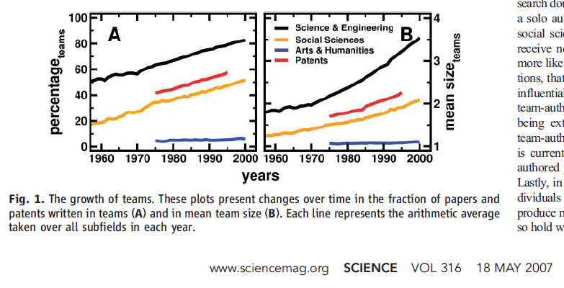
The expansion of teams
The Rise of Networked (aka Team) Science
  Wuchty, Jones & Uzzi 2007
Notes:
Takeaway: more science is being done in teams, so if you’re engaged in research, you’ll most likely be doing so in teams.

Slide 7
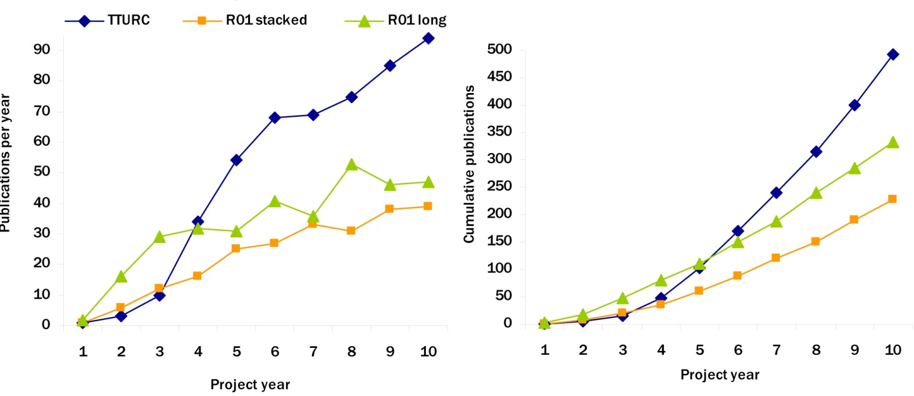
Productivity of Teams
Productivity of the Transdisciplinary Tobacco Use Research Centers (TTURC) program (1994-2004)
TD center publications have longer start up period compared to R01s but become more productive over time
Centers initial lag in number of publications is eliminated around Project Year 4.
Hall et al, Am J Prev Med 2012; 42:157

Slide 8
Impact of Successful Interdisciplinary Teams
Team products have documented impact on society, and economic growth
    NRC “Convergence..”, 2014, National Academies Press.
Team research is cited at a higher frequency and patents more likely to be licensed
    Wuchty, 2007, Science, 316:1036; Singh, Management Science, 2010, 56:41.
Team approach fosters innovation and greater retention of advancements
    Disis, 2010, Science Translational Medicine,22:22cm9
Teams have higher publication rates than collections of projects
    Hall, 2012, Am J Preventive Med 42:157
Participants in teams have enhanced satisfaction
    Cooke, 2015, “Enhancing the effectiveness of team science” National Academies Press

Slide 9
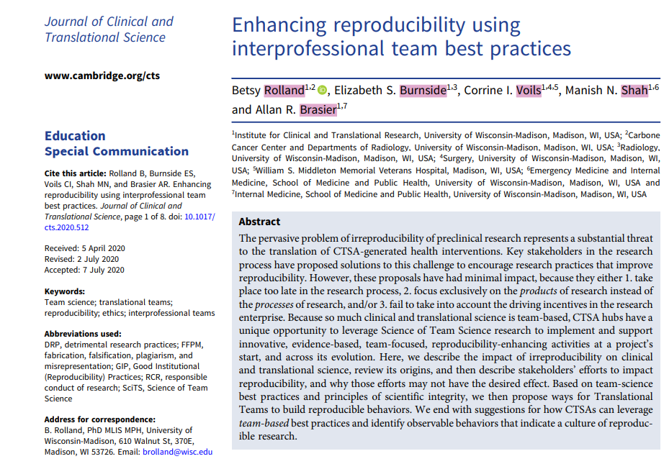
Team Science Enhances Reproducibility
Notes:
One of the things that my team at UW-ICTR has been exploring recently is the ways that team-science best practices can increase the reproducibility of research.
Takeaway message from the paper is that teams are an opportune target for a “right-sized” intervention with broader and deeper impact than training individuals, but which is still smaller and less complex than trying to change a university. Such an intervention, focused on building team-based reproducibility behaviors from the beginning, targeting the process of research, and taking into account competing incentives, can create an environment within the team that supports all three types of reproducibility. Bonus feature is that we know that these team-science best practices also lead to higher-impact science overall.
So, those are some of the benefits of working in teams.

Slide 10
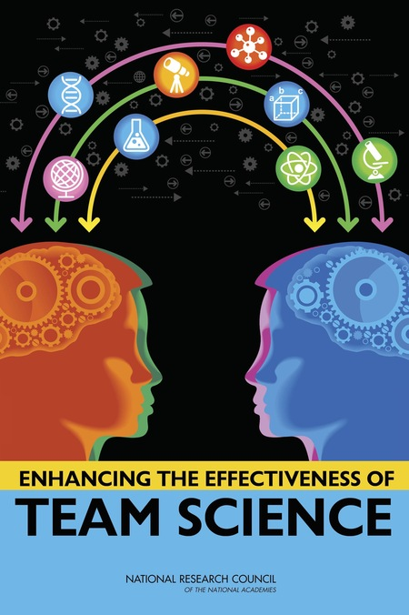
Challenges of Conducting Team Science
High diversity of membership
Deep knowledge integration
Large team size
Goal misalignment with other teams
Permeable boundaries
Geographic dispersion
High task interdependence
National Research Council (NRC). (2015). Enhancing the effectiveness of team science. Washington, DC: National Academies Press.

Slide 11
1. High diversity of membership
Disciplinary
  Biologist + epidemiologist + statistician
Professional
  Academic + industry
Demographic
  Race/ethnicity
  Gender
  Age
Career stage
  Early-stage investigators + senior professors
Personality type and work style

Slide 12
1. High diversity of membership
Leadership response:
  Stress that diversity brings strength to the team, and different approaches and viewpoints enhance team creativity and problem-solving
  Create a culture where all members have a voice and feel comfortable using it

Slide 13
2. Deep knowledge integration
Integrating knowledge from different perspectives to the shared research problem
Different levels of integration may be needed depending on the complexity of the problem
Integration issues include:
  Vocabulary
  Frameworks
  Data sets
  Statistical approaches
Notes:
Each problem will require a different kind of knowledge integration. More complex problems will generally require more complex knowledge integration. This could range from just talking about different approaches like a basic scientist explaining a new vaccine to a clinician. Maybe the clinician doesn’t need to know all the details behind why the vaccine works, as they’re simply delivering it to patients to see if it works. Maybe, though, the clinician is engaged in the research and needs to help select the population in which to test the vaccine, so she can help the basic scientist understand aspects of physiology or behaviors that might impact how the vaccine works. Finally, maybe the researchers are working together to create a completely new approach that blends the two disciplines together so completely they end up with something that looks like a new discipline, like behavioral economics or astrobiology.

Slide 14
2. Deep knowledge integration
Leadership response :
  Early and ongoing discussions about the research problem, engaging different perspectives and examining different disciplinary frameworks
  Request everyone define terms or jargon during discussions
  Engagement of a facilitator for more deep knowledge integration needs

Slide 15
3. Large team size
More people working together on ever-larger and more complex problems
Pros:
  Enhanced productivity
  More diversity of thought
Cons:
  Higher coordination costs
  Harder to communicate effectively
  Less one-on-one interaction to build trust and shared understanding
Notes:
The problems scientists are trying to solve are more challenging and more complex than ever. Large problems require more diverse skill sets to address, which means bringing more people together onto teams. While larger numbers of people working together can, in theory, result in enhanced productivity and more diversity of thought, there are costs to those benefits. Keeping everyone on the same page and moving at the same pace is hard and has to be someone’s job. Larger teams also require substantial communication but it has to be very targeted communication, with the right information being delivered to the right investigator at the right time to avoid swamping people with information. This is not something we have really figured out how to do well in large teams. Finally, it’s harder to know everyone on the team and be able to trust them or build that shared understanding that’s so critical for interdisciplinary work.

Slide 16
3. Large team size
Leadership response :
  A communication plan that lays out who needs to know what kind of information
  Transparent task assignment and tracking
  Clear roles and responsibilities so everyone knows who’s doing what
  Holding face-to-face kickoff meetings as often as feasible can help build that trust. Social time is important.
  Engaging staff working at the intersection of groups as translators or information brokers

Slide 17
4. Goal misalignment with other teams
Center/Institute/ Department
Project Team
Workgroup/Lab
Individual
University
Lead PI Team
Team 1
Team 2
Team 3

Slide 18
4. Goal misalignment with other teams
Leadership response:
  Spending time up-front to understand why your collaborators are participating in this team and what they hope to accomplish
  Paying special attention to the needs of community collaborators and junior faculty
  Consistent messaging about the overarching goals and why the team is working together
Notes:
PROSPR example

Slide 19
5. Permeable boundaries
Who is a member of this team?
Teams change over time as the science progresses
Trainees come and go
Challenging for communication and coordination

Slide 20
5. Permeable boundaries
Leadership response:
  Think carefully about who needs to be involved along the lifecycle of the grant and plan for those transitions
  Encourage open communication and transparency in activities so everyone can see the status of the project

Slide 21
6. Geographic dispersion
Across universities, nations, time zones
Challenges in managing organizational norms and policies
Communication across time zones
Trusting relationships take longer to develop
Notes:
ACC example

Slide 22
6. Geographic dispersion
Leadership response:
  Be cognizant of people’s normal work hours when scheduling calls
  Give people as much advance warning as possible when you need things from their organizations. Processes at different universities can be wildly different.
  Hold face-to-face kickoff meetings as often as feasible to help build trust. Social time is important.

Slide 23
7. High task interdependence
By definition, team tasks are interdependent
Increased need for coordination and communication
Increased potential for conflict

Slide 24
7. High task interdependence
Leadership response:
  Clear roles and responsibilities
  Clear and transparent task assignment and tracking
  Regular communications about project and task status

Slide 25
Addressing the Challenges: Themes
Address challenges early and often through planning for collaboration
Build in transparency to your tools – google docs, shared portal, project management software
Develop clear, effective communication systems
Maintain focus on the interdisciplinary nature of the conversations and remember that integration takes time
Remind the team of the overarching goals and reasons why you’re collaborating
Notes:
You may think that most of these things are out of your control as trainees, especially for those who are still post-docs or graduate students, but there are many ideas here that you can either use for your own work or maybe you can try to influence your mentors to improve.
What exactly this looks like will change dramatically over the course of your career. When you’re starting your own lab, your systems might not need to be as elaborate as when you’re collaborating with researchers at 4 different universities. However, if you invest time upfront, now early in your career, to develop robust systems that can scale as your lab and your research program grows, that will help you dramatically.

Slide 26
Being an effective interdisciplinary collaborator and team member
Notes:
Now that you’re situated in the field on team science, what it means, how it works, let’s dive more into how you can be an effective interdisciplinary collaborator and team member.
Most of you are early in your scientific careers, so you are probably still working on teams that are being led by others. So, we are going to focus this next section on how to be a good team member, how you can help the team leadership be more effective, and how you can develop your own team leadership skills no matter where you are in the team.

Slide 27
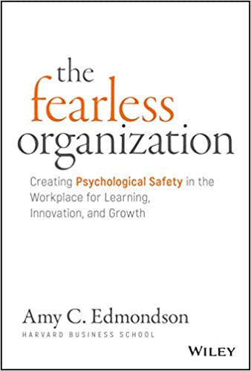
Psychological Safety
The single greatest predictor of team performance is Psychological Safety
  “In a workplace, psychological safety is the belief that the environment is safe for interpersonal risk taking. People feel able to speak up when needed — with relevant ideas, questions, or concerns — without being shut down in a gratuitous way. Psychological safety is present when colleagues trust and respect each other and feel able, even obligated, to be candid.”
Lack of psychological safety leads to hiding rather than surfacing problems

Slide 28
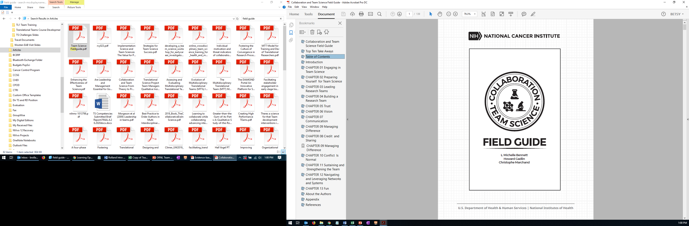
Communication Challenges
Understanding dimensions of conflict
  Interpersonal vs. scientific
Interdisciplinary language
Cultural differences
https://www.cancer.gov/about-nci/organization/crs/research-initiatives/team-science-field-guide
Notes:
By being aware of these potential challenges, the team can think in advance how to address them
Scientific conflict can be generative. When we argue about our science in a respectful way, focusing on differences in ideas, we generate new approaches, resolve questions. However, interpersonal conflict is when people attack one another for their beliefs instead of focusing on the scientific differences. Some interpersonal conflict is, more or less, inevitable on a team, and can generally be minimized through the creation of a psychologically safe environment. The key to minimizing its impact on the team and its work is to deal with conflicts early, create an culture where everyone feels free to seek help or speak up if they are feeling attacked, and for leaders to model the kind of productive scientific discussions that propel the science forward. I encourage you to reach out to your HR training program and find the course they offer in conflict management or difficult conversations and take it now as a graduate student.
We’ve talked a bit about the challenges of interdisciplinary research, with differences in language being a key challenge. Different disciplines have their own languages and approaches. The same word may mean quite different things for different disciplines, so it’s critical that collaborators are comfortable asking questions when they don’t understand something and that speakers define terms when they use them to make sure everyone is on the same page. Something as simple as data can be challenging. What researchers consider data may be very different across fields. Oceanography example.
Cultural differences, too, can be challenging. Different cultures have difference communication norms, around who is allowed to speak, how they put forward ideas. When you’re collaborating with scientists across the globe, it’s really important to be cognizant of this fact.

Slide 29
Communication: Supporting idea generation and creativity
Embrace the notion that differing opinions may hold the seeds to creativity and important new ideas.
Expect team members grounded in different disciplines to have different perspectives on scientific issues.
Conduct regular meetings in which team members take turns presenting data and providing feedback.
Ensure that all team members feel able to participate in discussions about data, methods, results, and other aspects of the science, as well as various issues affecting the group.
Convene a journal club or other forum to discuss current topics and methodologies.
Provide an environment and opportunities for team members to talk informally about their work.
https://www.cancer.gov/about-nci/organization/crs/research-initiatives/team-science-field-guide

Slide 30
Communication: Tending to team dynamics to enhance communication
Establish ground rules for how people are expected to communicate with each other during meetings.
Develop an expectation that data and results will be shared with all team members as well as procedures for doing so.
Respectfully address and resolve debates over science or scientific results through literature reviews, experimentation, outside expert opinion, and other relevant methods.
Help people translate when there are differences in concepts, methodologies, and frameworks.
When disagreeing, be sure to disagree with the idea, not the person.
Support the contribution of team members at all levels of seniority.
https://www.cancer.gov/about-nci/organization/crs/research-initiatives/team-science-field-guide

Slide 31
Case Study
Dr Jones has come to the conclusion that several of her junior team members joined her team primarily because of the research funding she was able to offer. Once these team members had the resources they needed, they stopped attending team meetings and withdrew from interactions with members of the team.
Other team members, especially senior researchers in leadership roles, continued participating in the team effort, but failed to share data openly or discuss research results honestly. Team members often did not interact directly and were openly resistant to considering alternative ideas or perspectives offered by other team members.
“On paper we are a research team, but I get the feeling many team members are focusing on their own research,” she said. “I guess they do not share my collaborative spirit.”
Adapted from Collaboration Team Science Field Guide
Notes:
We’re going to start with a case study focused on communication. I’m going to ask you to read this to yourself, maybe take a screenshot or a picture with your phone, because I’m going to send you off into breakout rooms to discuss it in a minute. It’s also posted on the Google doc, if you’re able to access that.

Slide 32
Discussion: Breakout (10 min)
What could Dr Jones have done differently with her team from the beginning to set expectations for collaboration?
Given the difficulties that Dr Jones is facing with her team, what can she do to change the group dynamics to promote more collaborations?
What does she need to communicate to the team, and how should she approach them?
How can she model the collaborative spirit for her own team?

Slide 33
Authorship
Varies by discipline and by lab
Key is clarity of expectations:
  Every lab needs an authorship policy
  Every new collaboration needs a discussion of authorship
  Every new project should be specific about authorship for the resulting publications
Many sample policies on the web
Notes:
Of course, no discussion of conflict and communication is complete without a section on Authorship. Authorship may well be the number one source of conflict in team science.

Slide 34
ICMJE Authorship Criteria
Substantial contributions to the conception or design of the work; or the acquisition, analysis, or interpretation of data for the work; AND
Drafting the work or revising it critically for important intellectual content; AND
Final approval of the version to be published; AND
Agreement to be accountable for all aspects of the work in ensuring that questions related to the accuracy or integrity of any part of the work are appropriately investigated and resolved.
http://www.icmje.org/recommendations/browse/roles-and-responsibilities/defining-the-role-of-authors-and-contributors.html

Slide 35
Authorship case study
Dr. Salazar and Dr. Buchanan, two scientists from different institutions, were involved in a long-term collaboration. Dr. Salazar published a paper in a high-visibility journal using data that had been generated by post-docs in her laboratory as well as postdocs in Dr. Buchanan’s laboratory. Although Dr. Salazar acknowledged Dr. Buchanan’s lab contributions in the paper, none of the researchers from Dr. Buchanan's lab were included as authors.
Dr. Buchanan disagreed with the way data from her lab was presented in the published paper and asked Dr. Salazar to retract it. When Dr. Salazar failed to address the concerns raised, Dr. Buchanan contacted senior-level scientists in Dr. Salazar’s organization to air complaints. Those leaders initiated a formal investigation into the charges.
Adapted from Collaboration Team Science Field Guide

Slide 36
Discussion: Breakout (10 min)
Who in this scenario qualifies as an author?
What could these two labs have done differently along the way to avoid this conflict?
What qualifies as authorship in your field of study?

Slide 37
Managing Up: Help senior researchers help you
Center for the Improvement of Mentored Experiences in Research
  https://cimerproject.org/
Mission
To improve the research mentoring relationships for mentees and mentors at all career stages through the development, implementation and study of evidence-based and culturally-responsive interventions.
The Center for the Improvement of Mentored Experiences in Research (CIMER) will:
Facilitate research mentor and mentee training for mentees and mentors at all career stages
Develop and study new approaches and resources for advancing mentoring relationships
Promote cultural change that values excellence in research mentoring
Build a network of mentors, mentees, and those engaged in enhancing and studying research mentoring relationships
Advance diversity in the research enterprise
Notes:
One of the best things you can do as an early-career researcher is really think about how you will manage your relationship with your more senior collaborators.
I’m going to just touch on this briefly, because it’s a bit outside of the realm of team-science training, but I think it can be difficult to really know what is expected of you as a trainee. This is especially true for first-generation graduate students and international students who may come from very different research cultures. I encourage you to visit the website for CIMER, based here at the University of Wisconsin-Madison, for resources on how to be a collaborative trainee, maybe even invite your mentoring committee to check out these resources.
While these resources are focused more specifically on your relationship with your specific mentor, the skills that are included here will translate to working with senior researchers more generally on team-science projects.

Slide 38
Summary
Leading breakthrough science teams requires attention to both scientific and organizational elements
Science teams rarely fail because of the science; they fail or falter because of the organizational choices leaders make and the culture leaders build
You can be a leader from anywhere in your team
Proactive planning and addressing potential sources of conflict can help teams function at a higher level
Investing in team processes pays dividends in scientific progress

Slide 39
Questions?
Betsy Rolland, PhD MLIS MPH
Director of Team Science + Research Development
Carbone Cancer Center and Institute for Clinical and Translational Research
University of Wisconsin-Madison
brolland@wisc.edu

