Slide 1
Insights into prostate involvement and inflammation following localized and systemic infection
Marvin Langston, PhD, MPH
Division of Research
Kaiser Permanente Northern California
December 3, 2020
Notes:
I’m an epidemiologist by training and my current research interests include understanding risk factors and outcomes of prostate diseases. I am very interested in prostate inflammation and its relationship to prostatitis and other diseases of the prostate including prostate cancer and benign prostatic hyperplasia. In this talk, I highlight empirical work on potential sources of prostate inflammation completed in the lab of my postdoc mentor Siobhan Sutcliffe, but continued while at Kaiser. One potential group important for inflammation is infection. While this field has been initially focused on infections previously found to directly target and involve the prostate, I hope to show that other non-direct pathways to chronic inflammation may exist.

Slide 2
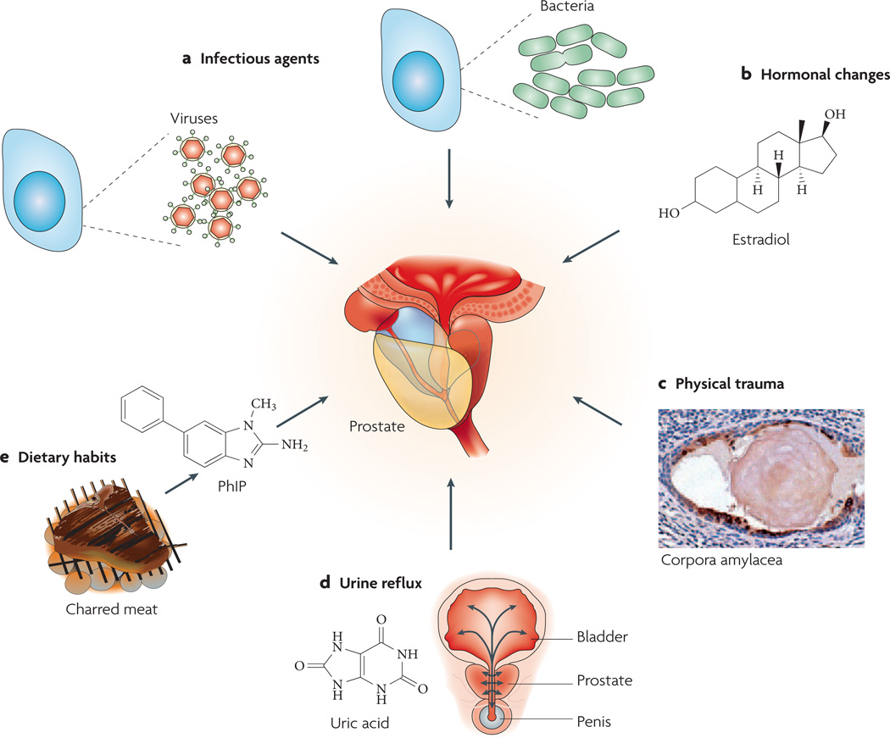
Potential causes of prostate inflammation
De Marzo et al. Nat Rev Cancer. 2007. 7(4) 256-269.
Notes:
Several potential causes of prostate inflammation have been proposed, however today’s talk focuses on infectious agents. Both viral and bacterial infections have been long described as triggers of acute inflammation. I hope to show in my work that these infections may also continue to have long-term effects on the prostatic environment long after the initial insults.

Slide 3
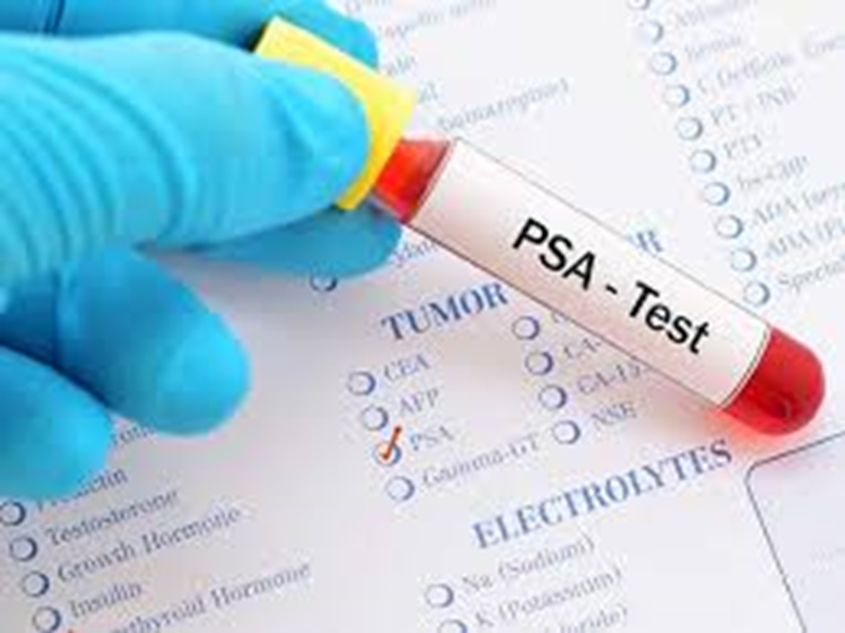

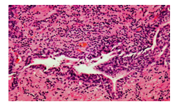
Prostate inflammation has been assessed in various ways in population health research
Notes:
There are several methods to study prostate inflammation in clinical research. Some of the most rich analyses come from visually assessing the extent and intensity of inflammatory cell pathology using prostate biopsy specimen. However, this is difficult due to the need for a prostate biopsy which can be invasive and impractical for most population health studies as a clinical indication for biopsy is needed. Therefore, we often use PSA or a diagnosis of prostatitis to serve as proxies of inflammation. Both tools have their own limitations. To effectively study prostate inflammation, I have assessed inflammation using all of these methods in my work. Other approaches to assess inflammation include using banked semen or urine and emerging technology in prostate imaging.

Slide 4
Acute and long-term influence of infections on PSA in young military men
The Department of Defense Serum Repository Studies
Notes:
The initial aim here was to determine whether acute exudative STIs (gonorrhea, C. trachomatis infection, and non-gonococcal urethritis) influence short- and long-term PSA trajectories in young men. We use PSA as we need to sample the prostate in a non-invasive way and PSA allows us to do that. PSA is a non-specific indicator of prostate involvement following various prostate triggers. These triggers disrupt the prostate epithelium leading to PSA leakage into blood serum.

Slide 5
Department of Defense Serum Repository
Contains serum remaining from routine (~ every 15 months) or indicated HIV testing of all US military personnel from the early 1990s to the present date:
  38 million serum specimens from over 8 million military personnel
Linked to a relational database containing information on demographics, service-related activity and medical diagnoses (Reportable diagnoses of chlamydia, gonorrhea, and non-gonococcal urethritis)
Good representation of African-American and Caucasian men
High STI incidence rates
Notes:
We focused on younger men because they are at higher risk of STIs and because they may be more susceptible to prostate insults, having completed prostate development and maturation more recently.

Slide 6
Acute effects of infection on PSA
Study Design
Acute
infection
sample
Pre-
infection
sample
PSA concentration (mg/mL)
1995
1998
2001
2004
2006
Men with infection diagnoses
Men with no infection diagnoses
Notes:
In order to look at both the acute and long-term effects of infections on PSA men needed to have serum samples in all four of our sampling windows. Candidate infections for this analysis included chalymdia, gonorrhea, and infectious mononucleosis among others.
In the acute study design, For men with infection diagnoses, two specimens from the DoDSR, one collected near the time of case diagnosis which represents the acute sample, and the first specimen collected more than 3-6 weeks before their acute specimen to account for the maximum typical incubation period of each infection studied.

Slide 7
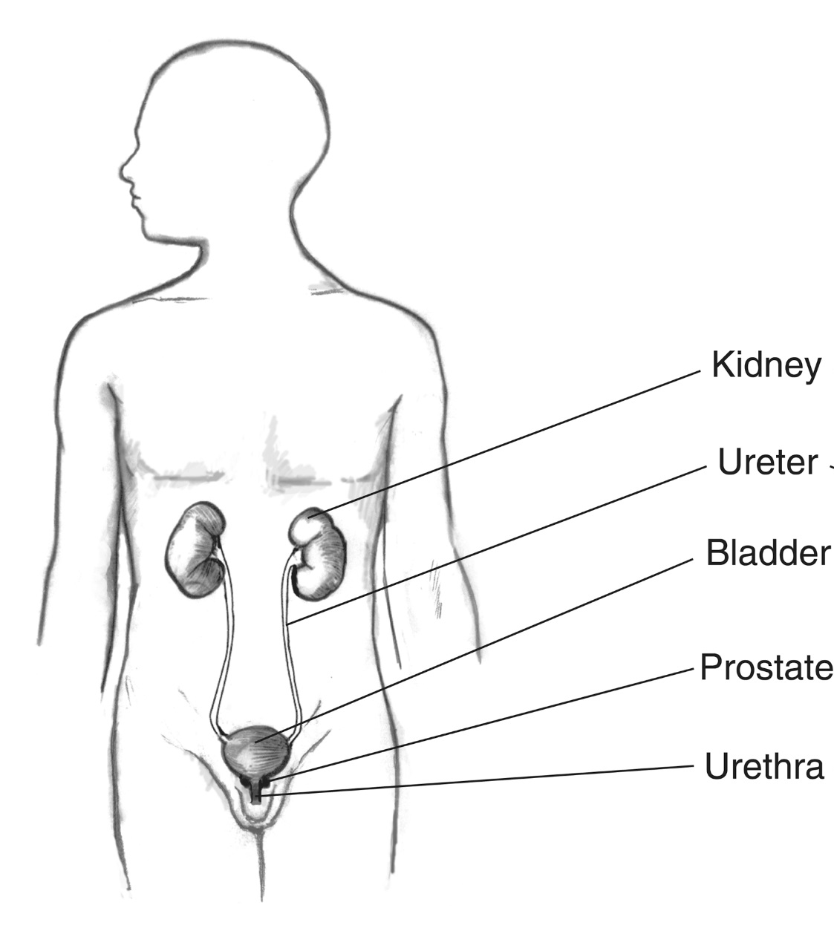
Acute effects of infection on PSA
More likely to have large rise (>40% change) in PSA than controls
Chlamydia
Gonorrhea
Infectious mononucleosis
Systemic infections
Sutcliffe…Langston et al. Int J Cancer 2016
Sutcliffe et al. Br J Cancer 2011
Notes:
For acute genitourinary tract infections, such as chlamydia and gonorrhea, PSA rise likely represents prostate infection and consequent prostatic inflammation, although we cannot rule out a generalized response to infection at other genitourinary sites, such as the urethra.
The STI findings were somewhat expected, but were surprised by the IM and systemic infections findings since these do not represent genitourinary infections, but more systemic infections. Systemic infections includes diagnoses such as whooping cough, varicella, and staph infections.
We must note that other researchers have also found PSA has also risen in instances of trichomonas infection, febrile UTI, chikungunga virus, HHV-8,

Slide 8
To determine whether PSA changes are sustained over longer periods of time, we measured PSA concentration in specimens collected early in young US military men’s careers and specimens collected an average of 10 years later.
Study population:
<25 years of age as of 1995
On continuous duty through follow-up
4 available serum specimen, one collected in each time window
Acute
infection
sample
Last
sample
Pre-
infection
sample
PSA concentration (mg/mL)
First
sample
1995
1998
2001
2004
2006
Short-term effects
Long-term effects
Men with infection diagnoses
Men with no infection diagnoses
Langston et al. Prostate 2018
Notes:
Some lingering thoughts following the acute study were did the rises that we saw represent only transient rises? Sustained rises may be important as midlife PSA concentrations may be predictive of future prostate disease risk and severity.
The long-term analysis will help us determine the trajectory of PSA. Here we compared samples in the first window to samples in the last window and created case/control groups based on intervening diagnoses throughout the 10-year period.

Slide 9
Characteristics of military sample at baseline
 | No STI Controls (n=258) | Chlamydia (n=265) | Gonorrhea (n=72) | IM (n=58) | Systemic Infections (n=91)
Mean age (Years) | 23.4 | 23.0* | 23.0* | 23.3 | 23.1
Race/ethnicity (%)
African-American | 54.3 | 49.8 | 76.4 * | 13.8 * | 56.0
White | 36.8 | 39.3 | 18.1 | 81.0 | 36.3
Other | 8.9 | 10.9 | 5.6 | 5.2 | 7.7
Mean # of blood draws during follow-up | 9.9 | 11.7* | 12.1* | 10.0 | 9.9
Mean PSA (ng/mL) | 0.66 | 0.60 | 0.64 | 0.61 | 0.67
Notes:
This military cohort was originally powered to look at the association of exudative STI’s and PSA. Mean time between baseline and follow-up is 10 years. We see that men have 10+ blood draws during this period or roughly once yearly.
Again Systemic infections here include medical record diagnoses such as whooping cough, varicella, staph infections

Slide 10
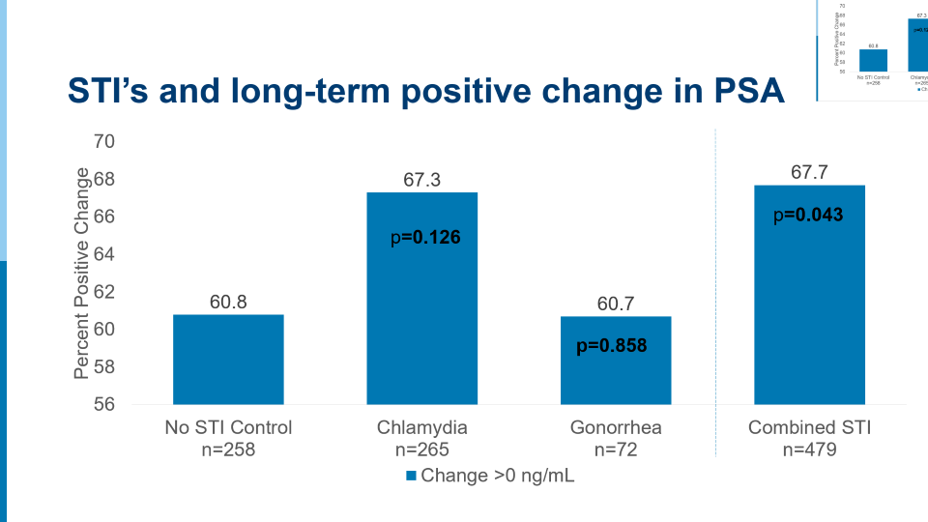
STI’s and long-term positive change in PSA
Notes:
We compared the percentage of cases and controls whose PSA rose to any degree (>0 ng/mL) between their baseline and 10-year follow-up specimens, using linear regression to calculate proportions of race-adjusted PSA change. P values were calculated by logistic regression to assess differences.
We see some long-term PSA elevation for men with chlamydia, however this was not significant. When we combine history of exudative STIs, we see a significant result that is largely driven by the effects of chlamydia.
PSA elevation may be more evident for some STIs than others (e.g., CT more than GC) likely because CT presents more often as an asymptomatic infection than GC, and thus may persist undiagnosed and untreated for a period of longer time, allowing for sustained damage to the prostate epithelium.

Slide 11
IM, other systemic infections and long-term positive change in PSA
p=0.062
p=0.047
Notes:
Though underpowered to reach significance, we actually see the largest magnitude of effect for those with a history of IM, which is a more systemic infection and not necessarily known to involve the prostate.
Why would these infections not known to directly target the prostate cause PSA rises? Systemic infections may contribute to elevated PSA by several possible mechanisms, including systemic inflammation-mediated cell damage and increased vascular permeability, or increased vascular permeability in the context of preexisting prostate epithelial cell damage from other sources.
Therefore, overall systemic infection burden may be important for prolonged inflammation.

Slide 12
Adult-onset infectious mononucleosis and diagnosis of clinical prostatitis
Notes:
I wanted to replicate the DoD studies in some way using a different assessment of potential prostate inflammation. I wanted to see if an infection could lead to a clinically relevant prostate disease outcome. The candidate infection needed to mount a response that may lead to a clinical visit. Therefore we chose adult-onset infectious mononucleosis.
Symptoms of IM are clinical manifestation of exaggerated T cell response to EBV and the release of inflammatory cytokines. Symptoms include:
Fever ▪ Swollen glands
Sore throat ▪ Fatigue

Slide 13
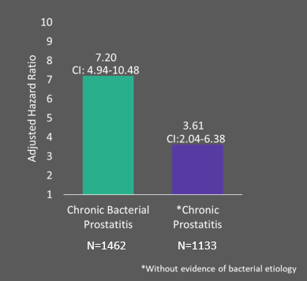
Adult-onset IM is associated with chronic prostatitis diagnosis
Study Design Highlights
Population/Design:
Cohort study, 893,442 male members
Setting:
KPNC integrated health system
Exposure:
Adult onset (18+) IM
Outcome: Chronic prostatitis assessed through
ICD codes, urinalysis results, and antibiotic treatment
Adjusted for: age at baseline, race/ethnicity, and
neighborhood deprivation index
Notes:
We see that adult-onset IM is strongly associated with chronic prostatitis after a median follow-up of 8.26 years. However, several limitations must be noted. Cases of IM needed to be severe enough to warrant clinical care and enter the medical record. Therefore, some misclassification of exposure is likely, which may lead to underestimation of the true HR.
Residual confounding likely as we could not control for sexual activity
If causal, these findings suggest that either IM or some other correlated, unmeasured factor may induce long-term pathological effects on the prostate and/or genitourinary symptoms.
Alternatively, differences in inherent immune system response, rather than direct influences of IM infection, may explain this association as some men have a greater affinity to mount big responses to infections systemically and within organs.

Slide 14
Secondary analyses suggest IM severity may impact the association with prostatitis
Severity Proxy |  | HR for prostatitis | 95% CI
Age at first occurrence | No IM | Ref | --
 | Ages 18-23 | 4.16 | 2.60-6.64
 | Ages 24-29 | 5.35 | 2.00-14.30
 | Ages 30+ | 7.19 | 4.52-11.45
 | p-Trend |  | <0.0001
Diagnosing Entity ¥ | No IM | Ref | --
 | Primary & Specialty Care | 5.00 | 3.42-7.31
 | Emergency & Urgent Care | 3.31 | 1.24-8.82
 | Hospital & Nursing Facility | 9.35 | 4.45-19.64
Notes:
We see that the association strengthens with increasing age at IM diagnosis. This is important as IM severity has been shown to increase with delayed onset of IM. This provides additional rationale for this interesting association.
Similarly, when looking at the diagnosing entity, we see that IM diagnosed at hospital and nursing facilities has the strongest association with prostatitis. Impatient diagnoses may represent a more severe course of IM, however we can’t rule out that IM may not be the primary reason for these impatient stays.
Since prostatitis is a heterogenous condition with other possible differential diagnoses, we assessed the specificity of our association by looking at the relationship of IM with other urological and chronic pain syndromes. These associations were largely null strengthening the rationale that IM may specifically be related to a diagnosis of prostatitis.

Slide 15
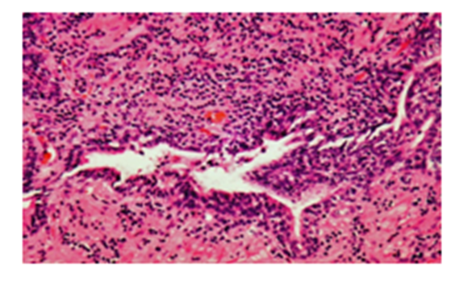
Studies in Progress
Infection serostatus & prostate inflammation (visually assessed)
  Placebo arm of the Prostate Cancer Prevention Trial
  Infections include Human papillomavirus Virus (HPV) 16, 18, and 31; Human herpes virus-8, Cytomegalovirus, and Trichomonas vaginalis
All known circulating viruses in relation to PSA concentration
  Analyzing virus content within exosomes
  Serum samples from the multiphasic health study cohort
  Will move the field past the “candidate infection” paradigm
  Questions?
Notes:
My previous goal in this field was to explore the evidence of an association for infections and prostate diseases using a variety of exposure and outcome ascertainment approaches. This work continues with an ongoing study looking at the serostatus of several infections and the prevalence, extent, and intensity of inflammation within the placebo arm of the Prostate Cancer Prevention Trial.
Additionally, since we found that other systemic infections were associated with PSA elevation, we are now interested in capturing all known circulating viruses in relation to PSA and eventually prostate diseases including prostatitis, prostate cancer, and BPH. I am conducting a small pilot study using banked serum from Kaiser Members. We will be able to scan all known circulating viruses using novel virus scan technology developed at UCSF. In the pilot phase our main objective is to assess the prevalence and abundance of these viruses.

Slide 16
Acknowledgements
Kaiser/UCSF
-Dr. Stephen Van Den Eeden -Dr. David Aaronson
-Dr. Stephen Francis -Dr. Donna Deng
Washington University in Saint Louis:
- Dr. Siobhan Sutcliffe - Ratna Pakpahan
Johns Hopkins:
- Dr. Elizabeth Platz - Dr. William Isaacs - Dr. Charlotte Gaydos
- Dr. Jonathan Zenilman - Dr. William Nelson - Dr. Debrah Elliott
- Dr. Angelo De Marzo - Dr. Lori Sokoll - Dr. Remington Nevin

