Slide 1
CAIRIBU 2020 Trainee and Early Investigator Session
NIDDK PANEL 10:00-10:45am
NIH/NIDDK Overview and Funding Considerations (~20-30 minutes)
Tamara Bavendam, M.S., M.D.
NDDK Project Scientist for the Urology Centers Program
Chris Mullins, Ph.D.
NDDK Project Officer for the Urology Centers Program
Question/Answer/Discussion Period (~15-20 minutes)
Tamara Bavendam, M.S., M.D.
Chris Mullins, Ph.D.
Julia Barthold, M.D.
NIDDK Program Director
Former Scientific Review Officer for the CSR
Additional NIDDK Program Staff TBD

Slide 2
Topics to be Discussed
Where National Institutes of Health fit in Government
Organization of National Institute of Diabetes and Digestive and Kidney Diseases
Urology Team in NIDDK
Grant Life Cycle and Key Roles
Tools for Grant Submission and Funding

Slide 3
U. S. Dept. of Health and Human Services –
Executive Branch of Government
Secretary of Health and Human Services
Administration for
Children and Families
(ACF)
Administration for
Community Living
(ACL)
Food and Drug
Administration
(FDA)
Health Resources
and Services
Administration
(HRSA)
Center for Medicare & Medicaid Services
(CMS)
Agency for
Healthcare Research and Quality
(AHRQ)
Indian Health
Services
(IHS)
National Institutes
of Health
(NIH)
Centers for
Disease Control
and Prevention
(CDC)
Agency for Toxic
Substances and
Disease Registry
(ATSDR)
Substance Abuse and
Mental Health Services
Administration
(SAMHSA)

Slide 4

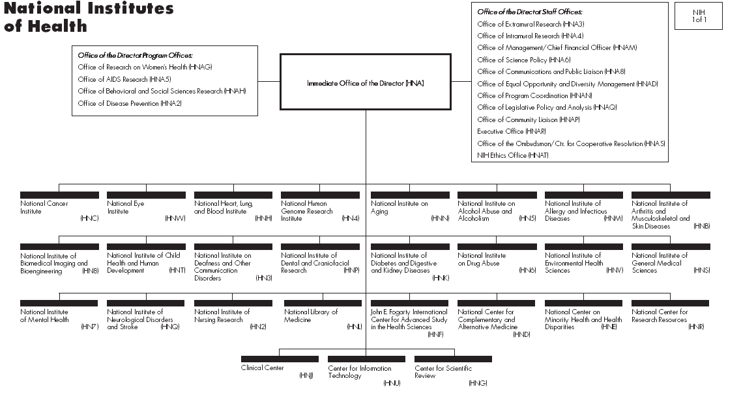
NIH is 27 Institutes and Centers
NIH Office of the Director
Francis Collins MD, PhD

Slide 5
A Typical Institute/Center
National
Advisory
Council
Office of the IC
Director
Extramural
Intramural
Scientific
Programs
Laboratory
Studies
Clinical
Studies
Grants
Contracts

Slide 6
NIDDK Organizational Structure
Office of the Director
Dr. Griffin Rodgers
Teams
Kidney
Urology
Hematology
Division of Diabetes, Endocrinology, and Metabolic Diseases
Division of Digestive Diseases and Nutrition
Division of Kidney, Urologic, and Hematologic Diseases
Crohn’s Disease
Ulcerative Colitis
Liver Disease
Hepatitis
Drug Induced Liver Injury
Non-alcoholic Steatohepatitis
Hemochromatosis
Obesity
Irritable Bowel Syndrome
Gastroparesis
Barrett’s Esophagus
Type 1 Diabetes
Type 2 Diabetes
Childhood Diabetes
Diabetes Complications
Cystic Fibrosis
Inborn Metabolic Errors
Wasting Syndrome
HAART Therapy
Molecular Therapies
Endocrinology of Bone
Obesity
Chronic Kidney Disease
Polycystic Kidney Disease
Kidney Injury &Failure
Vesicoureteral Reflux
Urinary Incontinence
Urinary Tract Infections
Benign Prostatic Hyperplasia
Chronic Prostatitis
IC/Bladder Pain Syndrome
Anemias & Iron Overload
Sickle Cell Disease
Notes:
13
13
Not shown: Office of Minority Health Research Coordination, Office of Obesity Research. Also housed within NIDDK is NIH’s Division of Nutrition Research Coordination

Slide 7
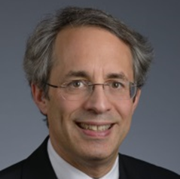
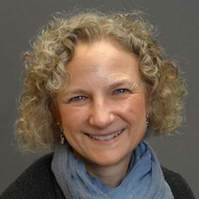
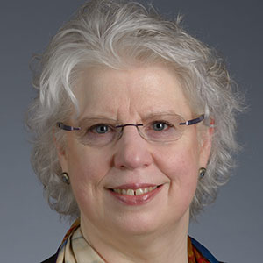
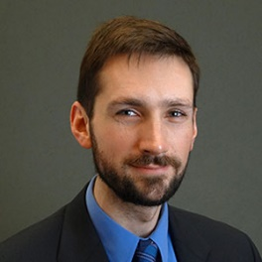

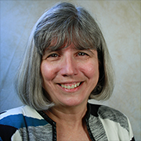
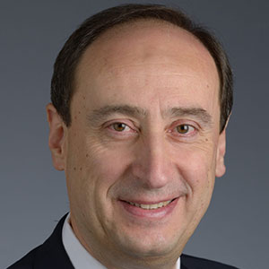

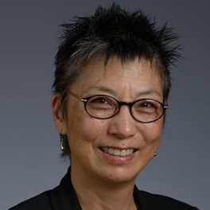
NIDDK program staff want to speak with you!
Rob Star, MD
Director, KUH
robertstar@nih.gov
Tracy Rankin, PhD, MPH
Deputy Director, KUH
Career Development, Diabetic Uropathy; Urology Molecular Endocrinology
tracy.rankin@nih.gov
Tamara Bavendam, MD
Women’s Urologic Health
tamara.bavendam@nih.gov
Danny Gossett, PhD
Small Business, Tech Development; Translation daniel.gossett@nih.gov
Victoria Spruance, Ph.D.
Neurourology; Institutional Training Programs victoria.Spruance@nih.gov
Julie Barthold, MD
New to NIDDK Urology Team
Ziya Kirkali, MD
Clinical Urology; Erectile Dysfunction; Urology HIV/AIDS
ziya.kirkali@nih.gov
Chris Mullins, PhD
Cell Biology Programs in Kidney and Urologic Disease mullinsc@mail.nih.gov
Deborah Hoshizaki, Ph.D.
Kidney & Urogenital Development, Regeneration & Repair, Urology Centers
deborah.hoshizaki@nih.gov

Slide 8

How the NIH works
$
Great idea
NIH
Application

Slide 9
Deconstructing the Black Box -
NIH Institutes and Centers
Director of NIH
Dr. Francis Collins

Slide 10
Assignment of Grants to Institutes
Prostate Cancer
NCI
NINR
Prostate Enlargement
NIDDK
NIAID
NIDDK
NIA
Bladder Infection
Urinary
Incontinence
NIDDK
NICHD
NCCIH
NICHD
NIA
NIA
NCCIH
NINR

Slide 11
Key Roles to Support Extramural Research
Extramural Research Roles
  Program Officers
  Scientific Review Officers
  Grants Management Specialists

Slide 12
NIH Staff Roles in Life Cycle of a Grant
Stages of Grant | Program Officer | Scientific Review Officer | Grants Management Specialist
Grant Preparation
Grant Submission
Grant Review
Summary Statement
Grant Revision
Grant is Funded

Slide 13
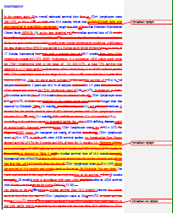
Key Messages
What excites you is far more important than what the NIH is interested in
NIH Program Officers are your friends – use us
Communicate clearly and tell a coherent story – you are “selling” your research
You will need more than one mentor

Slide 14

Seeking NIH Support? You’ll Need The Right Tools
MediEvil Standard Edition - PlayStation 4
Skillset
Mentors/advisors
Niche
Realistic timeline
Perseverance
Information
What, Who, Where,
When, How???

Slide 15
NIDDK Training and Career Development Programs
https://www.niddk.nih.gov/research-funding/training-career-development
Loan repayment program
R01
Investigator-initiated award
K08, K23
Clinical degrees
*
R03
Supplement to K award
F99/K00
(PhD graduate students, transition to post-doc)
K01
(PhD/non-licensed MD)
Individual Award to Single Applicant
*
F30, F31
(pre-doctoral/dual degree)
F32
(PhD, MD)
K99/R00
Fast-Track CDA
Career Stage
HS/Undergraduate
Graduate/Medical School
Postdoctoral
Transition/Jr. Faculty
Faculty/Tenured
R25
U2C/TL1
(PhD candidates; MD,
PhD post-docs)
K12
(KURe and UroEPI)
Institutional Award
(Faculty Select Trainees)
*
T35
(Medical students)
Does not require citizenship
NIDDK Research and Career Development: https://www.niddk.nih.gov/research-funding/training-career-development
Dr. Tracy Rankin, KUH Urology Training and Career Development Programs
Notes:
Emphasize direction of arrow from least skilled/committed to most skilled/committed
Break out by individual vs. institutional; double-check math—OK, rounding errors result in differences; say few words re R25 program—primarily summer research programs, but does include other educational activities
Individual grants: $89.4 million
Institutional grants: about $62.2 million
Emphasize these represent total dollars—competing and non-competing

Slide 16
National Research Service (NRSA) Awards:
Training (Ts) and Fellowships (Fs)
Key
The NIH Ruth L. Kirschstein National Research Service Award (NRSA) program works to
ensure a diverse pool of highly trained scientists is available to address the Nation’s
biomedical, behavioral, and clinical research needs.
Must be a citizen or permanent resident
Pre-doc, med student, and/or post-doctoral trainees
  T35 – Short Term Institutional Research Training (pre-doc or med student)
  F30 – M.D./Ph.D or other dual degree trainees to increase pool of physician-scientists
  F31 – Pre-doctoral fellowship for mentored research training
  F32 – Post-doctoral fellowship for mentored research training
NIDDK Research and Career Development:
https://www.niddk.nih.gov/research-funding/training-career-development
Dr. Tracy Rankin, KUH Urology Training and Career Development Programs

Slide 17
Junior Investigators Transitioning to Independence: K awards
K01 – Basic scientist (typically PhD) as they develop career w/ support of a mentor
K08 – Early career M.D. proposing basic research
K23 – M.D. proposing patient-oriented/clinical research w/support of a mentor
K25 – Post-doc fellows in quantitative science moving into biomedical research
K99/R00 – Pathway to Independence; only option available to non-US citizens; mentored and independent phases
Read FOA Carefully for IC-Specific information!
Contact NIDDK Program Staff with Questions!
NIDDK Research and Career Development:
https://www.niddk.nih.gov/research-funding/training-career-development
Dr. Tracy Rankin, KUH Urology Training and Career Development Programs

Slide 18
NIH Loan Repayment Program
The NIH Loan Repayment Program (LRP) is designed to recruit and retain highly qualified health professionals into biomedical or biobehavioral research careers.
Repayment of up to $50K qualified educational debt per year (up to two years) in return for a commitment to engage in NIH mission-relevant research.
Applicants should match to one of five LRP Research Categories:
  Clinical Research
  Clinical Research for Individuals from Disadvantaged Backgrounds
  Contraception and Infertility Research
  Health Disparities Research
  Pediatric Research
Rolling application deadlines from September through November
See NIH LRP Website (www.lrp.nih.gov) for Eligibility and How to Apply

Slide 19
Additional NIDDK-Specific Award Types To Support Trainees/Career Development
K01 – Ph.D. or non-board eligible M.D.; must have two years post-doc experience but not greater than seven. Support for transition to independence.
F99/K00—Graduate students outside urology as they transition to post-doc positions in NIDDK urology (also kidney, hematology) research
U2C/TL1—NEW: Institutional Network Award for Promoting Kidney, Hem. and Urology for Pre-/Post-docs.
R03—Supplemental support for NIDDK K awardees to enhance their work
Diversity R21— Support for short term projects by under-represented minority (new) investigators
Urology KURe (K12)—”Slots” for M.D., Ph.D. with diverse expertise for research in benign urologic disorders. Currently Wisconsin and Duke.
UroEpi K12—”Slots” for M.D., Ph.D. for epidemiological research in benign urologic disorders. Currently UCSF and Michigan.

Slide 20
A Few Research Grants to Consider
(And Some Funding Acronyms You May Encounter)
FOA
R01: “Gold standard” hypothesis-driven, investigator-initiated
R03: Small, developmental grant
R21: Small grant for innovative research
Others (Not As Common): U01, RC2, U24, R13, R15, STTR/SBIRs, etc…
FOA – Funding Opportunity Announcement (solicitation for applications)
RFA – Request for Applications (funds and special review)
PA – Program Announcement (no funds or special review)
PAR – Program Announcement w/ Referral/Review (special review)
PAS – Program Announcement w/ Set-aside (some available funds)
NOTICE - Official NIH announcement relating to a change in policy, procedure, etc
Read FOAs
carefully for
IC-specific
information!
See NIH Grants and Funding: https://grants.nih.gov/grants/funding/funding_program.htm

Slide 21
Selected NIDDK Research Grant FOAs….
R01
  Stimulating Urology Interdisciplinary Team Opportunity Research (SUITOR) (PAS-19-241)
  Medical Simulators for Practicing Patient Care Providers Skill Acquisition, Outcomes Assessment and Technology Development (PA-19-065)
  Underactive Bladder in Aging (PA-18-570)
  HIV/AIDS research (RFA-DK-20-022; RFA-DK-20-023)
  Investigator-Initiated Clinical Trials Targeting Diseases within the Mission of NIDDK (PA-18-330)
  Small R01s for Clinical Trials Targeting Diseases within the Mission of the NIDDK (PAS-20-160)
R21
  Secondary Analyses in Obesity, Diabetes and Digestive and Kidney Diseases (PAR-18-741)
  Catalytic Tool and Technology Development in Kidney, Urologic, and Hematologic Diseases (PAR-20-140)
NIH Grants and Contracts “Find Funding”:
https://grants.nih.gov/funding/searchguide/index.html#/

Slide 22
Additional, Select NIDDK Supported Urology Initiatives
SUITOR Program
  Soliciting R01 applications proposing innovative, high quality, interdisciplinary research in targeted areas of the NIDDK’s urology mission interests (e.g., urinary incontinence).
NIDDK-Supported Clinical Networks—Ancillary Studies Welcome (e.g., R01s)
  Multi-disciplinary Approach to the Study of Chronic Pelvic Pain (MAPP) Research Network
  Symptoms of Lower Urinary Tract Dysfunction Research Network (LURN)
  Prevention of Lower Urinary Tract Symptoms (PLUS) Research Consortium
  Urinary Stone Disease Research Network (USDRN)
  For General Info on Ancillary Studies to Ongoing Clinical Studies See:
  https://www.niddk.nih.gov/research-funding/human-subjects-research/ancillary-major-ongoing-clinical-studies

Slide 23
A Few NIDDK Pilot Programs in Urology…..
O’Brien Urology Centers (U54) Opportunity Pool Programs
  University of Wisconsin Center
  Columbia University Center
  University of Pittsburgh Center
  Urology Centers Interactions Core
Small, Short-Term Grants Awarded on a Competitive Basis to Support Collaborative Urology Research, Enrich the Investigator Base, and Provide a Foundation for Follow-on Applications
Diabetic Complications Consortium (Diacomp) (see: https://www.diacomp.org/)
  Advance the Study of Diabetic Complications, Including Urologic Complications
  Active Pilot and Feasibility Program for Broad Research Efforts
Dr. Kris Penniston, Director Interactions Core
See: https://niddkcairibu.urology.wisc.edu/opportunities-and-awards/

Slide 24
Grant Writing Tips
https://grants.nih.gov/grants/about_grants.htm
NIAID “Apply for a Grant” page for tips, samples applications, etc: https://www.niaid.nih.gov/grants-contracts/apply-grant
A Few Considerations in Writing a Grant Application:
  Know your audience: Reviewers!
  Ask collaborators and non-collaborators to pre-review the ideas/application (i.e., the
  more eyes the better; gather opinions) and PROOF-READ!
  Know your receipt date and work back to plan writing (i.e., not last minute)
  Submit early!
  Write to meet the review criteria (especially true for a special FOA)
  Is it too ambitious? Match proposed studies to requested funds, award period, expertise
  If in doubt discuss mission-/award-type fit, eligibility, and current policies with NIH
  Program Staff before submission (before writing!)
NIH Grants and Funding “About Grants”:
https://grants.nih.gov/grants/about_grants.htm

Slide 25
If Unsure About Just About Anything:
Contact your Program Officer
https://grants.nih.gov/policy/natural-disasters/corona-virus.htm
Some Examples of the Information You May Receive:
Advice on relevance to the NIDDK’s mission (or other NIH Institute?) and the right award type for the proposed study.
Help in navigating the NIH grants process: Before submission, after review, and during the project period….and some steps in between.
Sometimes direction toward a better contact, e.g., a different Program Officer at the NIDDK or a different Institute, a colleague in the Grants Management Branch or Review, etc.
Information on additional, broad scientific and administrative considerations!
A couple of Good Practices:
Useful to send a quick e-mail and perhaps a one-pager (draft aims), if possible, as a start….and often better than a “cold-call.”
Some basic questions can be addressed by a simple e-mail while others merit a phone call (especially for junior investigators)…and if we don’t answer after a bit please check back!

Slide 26
A Few, Select NIH Online Resources
NIH Grants and Funding Home Page: https://grants.nih.gov/grants/oer.htm
NIH Research Portfolio Online Reporting Tools (RePORT) and RePORTER Tool:
https://report.nih.gov/
Matchmaker Tool to Identify a Good-Fit NIH Project Officer: https://projectreporter.nih.gov/reporter.cfm (see “Matchmaker” tab)
Center for Scientific Review (CSR) Assisted Referral Tool to Identify Study Sections: https://art.csr.nih.gov/ART/selection.jsp
Center for Scientfic Review (CSR): http://public.csr.nih.gov/Pages/default.aspx
Early Stage Investigators: http://grants.nih.gov/policy/new_investigators/index.htm
NIH COVID-19 Information/Policy:
https://grants.nih.gov/policy/natural-disasters/corona-virus.htm

