Slide 1
Contributions of Clinical Studies in Benign LUTD
What Do We Still Need?
J. Quentin Clemens, MD, FACS, MSCI
Edward J. McGuire Professor of Urology
Associate Chair for Research
University of Michigan Medical Center
MAPP Network Chair

Slide 2
‘Lower Urinary Tract Dysfunction’
Afferent
Efferent
Structural
Clemens JQ Neurourol Urodyn 29:S29-31, 2010

Slide 3
‘Lower Urinary Tract Dysfunction’
Sensory (Afferent) Abnormalities
  IC/BPS
  CP/CPPS
  OAB dry
  Orchalgia
Motor (Efferent) Abnormalities (Objective measurements)
  Detrusor underactivity
  Urge incontinence/ Detrusor Overactivity
  Detrusor sphincter dyssynergia
Structural Abnormalities (Objective Measurements)
  Stress incontinence
  Pelvic prolapse
  Diminished bladder compliance
  Bladder outlet obstruction
Clemens JQ Neurourol Urodyn 29:S29-31, 2010

Slide 4
‘Lower Urinary Tract Dysfunction’
Sensory (Afferent) Abnormalities
  IC/BPS
  CP/CPPS
  OAB dry
  Orchalgia
Motor (Efferent) Abnormalities (Objective measurements)
  Detrusor underactivity
  Urge incontinence/ Detrusor Overactivity
  Detrusor sphincter dyssynergia
Structural Abnormalities (Objective Measurements)
  Stress incontinence
  Pelvic prolapse
  Diminished bladder compliance
  Bladder outlet obstruction
Pain
Urgency
Clemens JQ Neurourol Urodyn 29:S29-31, 2010

Slide 5
Definitions
Pain
  ‘Unpleasant sensory or emotional experience associated with actual or potential tissue damage, or described in terms of such damage’
    International Association for the Study of Pain, 1994
Urgency
  Sudden compelling desire to pass urine, which is difficult to defer
    International Continence Society, 2002
  ‘I feel like my bladder is going to burst’!
  (Sounds a lot like ‘pain’ to me!)

Slide 6
Patient Perspective
The last month has been pretty bad for me. I’ve had terrible abdominal pain. At first I thought it was a bladder infection but the tests all came back negative, and antibiotics wouldn’t work. The pain is just unbelievable. I’ve been on my back with ice packs for a month. I cry when the pain gets bad. I prop my feet up on my desk at work, and it hurts to walk. This has turned my life upside-down and I’m very scared about the future.
The doctors think I have interstitial cystitis. I’ve learned that people suffer for years with it, some wind up on disability, etc. They have some treatments but most work only about 30% of the time and just reduce the symptoms.
It doesn’t seem believable that something like this exists, until you hear the patient’s stories about it. I’ve been on a diet of water, rice, potatoes, and plain chicken for 2 weeks, desperate to reduce the pain. I’ve gotten a couple of better days but still no relief. What’s awful is that the pain is always there, but it comes and goes in severity without warning, so you never know what is around the corner or how long the pain will last.

Slide 7
Patient Perspective
I must say to you personally that you have given me new life. I had lost interest in my most favorite activities, lost the will to leave my home because of the debilitating pain and urgent need for bathrooms wherever I went. I was reluctant to be in the car for any trip more than half an hour. I no longer looked forward to my daily tennis games that give me so much pleasure.
Most important and more significant than anything else, you have given back a loving and devoted grandmother to my three precious grandchildren. How can I find the words to describe to you what a gift that is.

Slide 8

The 1980’s
No large-scale studies of IC or CP
No consensus on:
  Epidemiology
  Terminology
  Diagnosis
  Treatment
  Pathophysiology
  Anything else

Slide 9


Harry Reid (D)
U.S. Senator, Utah (1987-2017)
Vicki Ratner, MD
Founder, Interstitial Cystitis Association (1984)

Slide 10
IC/BPS
CP/CPPS
NIDDK Consensus Definition
1987, 1990
NIDDK Consensus Definition
1995
Cohort Study (ICDB)
1991-1996
Cohort Study (CPC)
plus
Validated Instrument (CPSI)
plus
Clinical Trial
(CPCRN1)
1997-2002
Validated Instrument (ICSI)
1997
Clinical Trials (ICCRN1)
1998-2003
More Clinical Trials (ICCRN2)
2003-2008
Another Validated Instrument (GUPI)
More Clinical Trials (CPCRN2)
2003-2008
Another Validated Instrument (GUPI)
Cohort Study (MAPP)
2008-2013, 2014-2022
(UCPPS term)

Slide 11
Early Multi-Site Cohort Studies (ICDB, CPC)
Feasibility of identifying UCPPS patients, collecting data across sites
Standardized inclusion criteria
Validated instruments
Severe QOL impact
Longitudinal data – 20% with improvement over 2-3 years
Collection of comorbidity data
Men – no association with prostate cancer or PSA or prostate fluid findings

Slide 12
ICCRN 1 (1998-2003)
9 sites, DCC
Trial 1 – Oral PPS vs Oral Hydroxyzine
  2X2 factorial design
  Slow recruitment – study drugs were readily available for clinical use
  Neither showed statistical benefit over placebo
    PPS 34% vs 18%, Hydroxy 31% vs 20%
Trial 2 – Intravesical BCG vs placebo
  Negative study (21% vs 12%)
  Open label BCG treatment for nonresponders also not helpful
Sant GR, et al. J Urol 170:810-15, 2003
Mayer R, et al. J Urol 173:1186-91, 2005

Slide 13
ICCRN 2 (2003-2008)
10 sites, DCC
Trial 1 – Oral amitriptyline vs placebo
  Treatment naïve patients
  All received standardized behavioral modification
  Negative study, but those who reached the higher doses (50mg or 75mg) did demonstrate benefit
Trial 2 – Oral mycophenolate mofetil vs placebo
  Treatment refractory patients
  Study terminated early – slow recruitment, new FDA black box warning, interim analysis favored placebo (16% vs 15%)
Foster HE Jr, et al. J Urol 183:1853-58, 2010
Yang CC, et al. J Urol 185:901-6, 2011

Slide 14
CPCRN 1 (1997-2002)
7 sites, DCC
Trial 1 – Oral Cipro vs Oral Tamsulosin
  2X2 factorial design, 6 weeks
  No significant reduction in symptoms compared with placebo
  But only 6 weeks
  Also many patients had seen these drugs already (heavily pre-treated group)
Alexander RB, et al. Ann Intern Med 141:581-6, 2004

Slide 15
CPCRN 2 (2003-2008)
10 sites, DCC
Trial 1 – Oral alfuzosin vs placebo
  No prior treatment with alpha-blockers, 12 weeks
  p-value 0.99 (!)
Trial 2 – Oral pregabalin vs placebo
  6 weeks
  No difference in primary endpoint (p=0.07) but all secondary endpoints favored pregabalin
Nickel JC, et al. N Eng J Med 359:263-73, 2008
Pontari MA, Arch Intern Med 170:1586-93, 2010

Slide 16
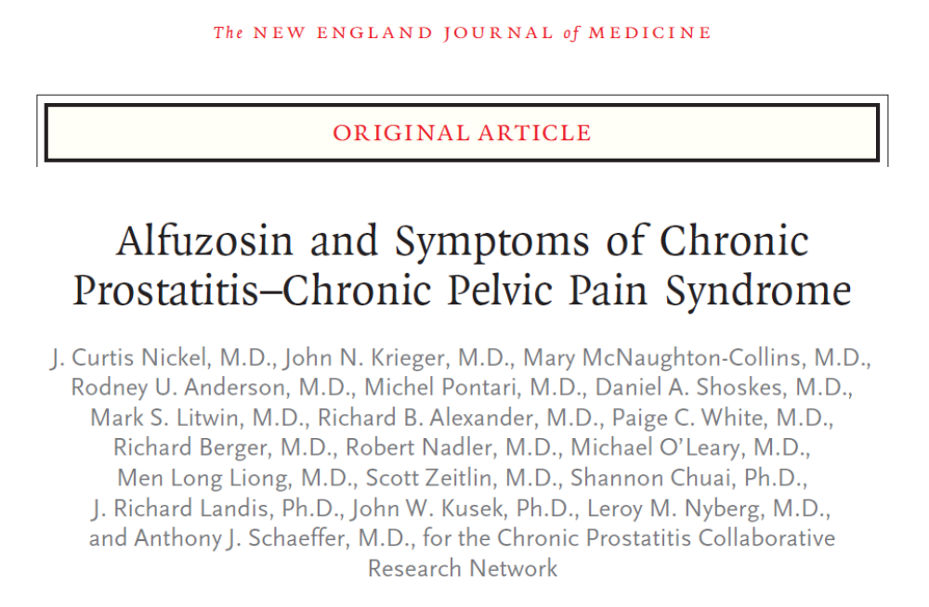
N Eng J Med 359:263-73, 2008

Slide 17
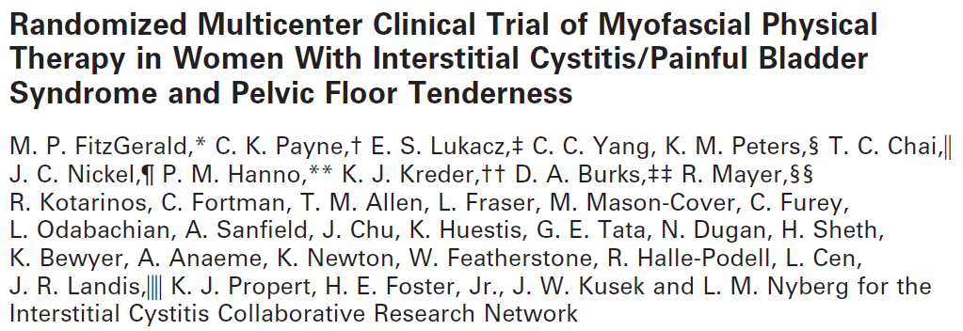
UPPCRN
PT Trial
  Myofascial PT vs therapeutic massage
  Feasibility trial first – men and women
  Then full trial in women
  Response: PT 57%, massage 21%!
J Urol 187:2113-8, 2012

Slide 18
Comments on UCPPS Clinical Trials
Inclusion criteria
  Sx severity, pain vs frequency, heavily pretreated or not
Stratification?
Intervention
  Is it already available/ widely used?
  Can we find a company to provide it?
Sham/ placebo
Concomitant treatments
Impact of behavioral therapies
Study length
Endpoints

Slide 19
Epidemiology Studies
CPIC study
  J. Quentin Clemens (PI)
  2001-2006
Events Preceding Interstitial Cystitis (EPIC)
  John W. Warren (PI)
  2003-2008
RAND Interstitial Cystitis Epidemiology (RICE) study
  Sandra Berry (PI)
  2004-2009

Slide 20
CPIC Study (My First Grant)
(2001-2006)
Response to RFA from NIDDK – Epidemiology of IC
  I gave up 3 times
  Got funded despite a mediocre score (23)
Collaboration with Kaiser Permanente Northwest (Portland)
  Stable population (~450,000) with EMR (EPIC)
  Research infrastructure
Coded EMR diagnoses with supplemental mailings
  Prevalence (diagnoses, symptoms), costs, risk factors/ comorbidities, etc.

Slide 21
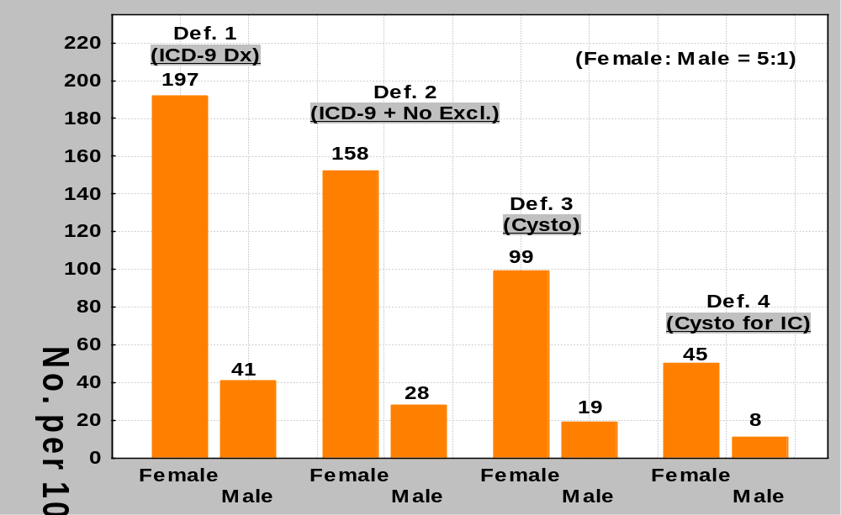
Clemens JQ, et al. J Urol 174:576-80, 2005.

Slide 22
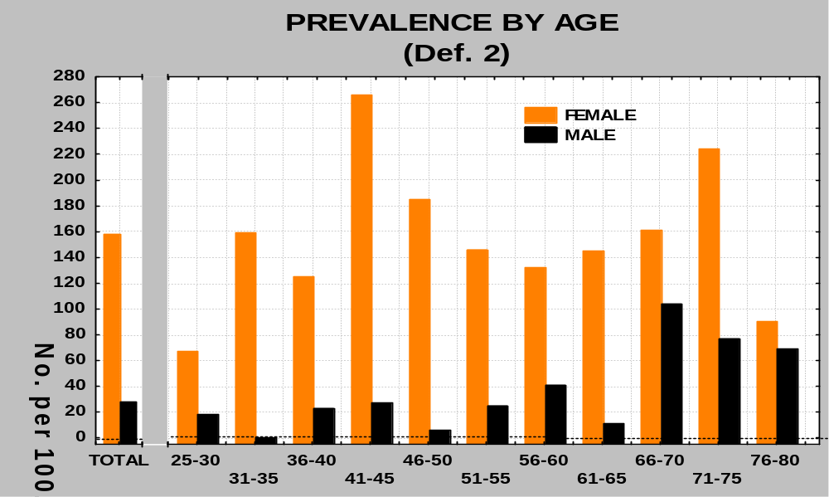
Clemens JQ, et al. J Urol 174:576-80, 2005.

Slide 23
Other Findings
Symptoms much more common than coded diagnoses
  IC symptoms 6.2% women, 2.3% men
  CP symptoms 5.9%
IC associated with
  endometriosis, fibromyalgia, IBS, anxiety, depression, headaches
Annual costs 4X higher than non-IC controls
Clemens JQ, et al. J Urol 2005;174:576.
Clemens JQ, et al. Urology 2008;71:776
Clemens JQ, et al. J Urol 2008;179:2222.

Slide 24
Events Preceding IC (EPIC)
Identified 314 women with new onset IC/BPS
  Recruited from urologists, gynecologists, ICA, ICN, support groups, Internet
  Also 314 controls
There were 11 antecedent syndromes associated with IC/BPS
  FM, CFS, IBS, sicca syndrome, migraine, depression, panic disorder, endometriosis, vulvodynia, asthma, allergies
  FM, CFS and IBS clustered together
Warren JW, et al. Urology 73:52-7, 2009.
Warren JW, et al. Urology 77:313-9, 2011.

Slide 25
EPIC Study
Very high incidence of nonbladder surgeries (esp. hysterectomy) just before IC onset
  Susceptibility plus local insult?
  Could this suggest central sensitization?
At 33 mo. median follow-up, these early IC cases tended to improve more commonly (35%) than ICDB patients (20%)
  But few had resolution of all symptoms
Warren JW, et al. Am J Obstet Gynecol 208:77.e1-6, 2008.
Warren JW, et al. J Urol 184:2333-8, 2010.

Slide 26
RAND Interstitial Cystitis Epidemiology (RICE) Study
Goal – determine prevalence and burden of IC/BPS in US women
Step 1 – Develop case definition
  Questionnaires from clinic patients with IC/BPS, OAB, endometriosis, vulvodynia
Step 2 – Two-stage population screening
  Brief screening items as part of polling calls (2000/week => ~146,000 households screened)
  Follow-up call
Step 3 – Complex weighting process
Berry SH et al. J Urol 2011;186:540.

Slide 27
RICE Study
Prevalence 2.7-6.5%
  3.3 to 7.9 million US women
Symptom severity and impact very similar to clinic patients
More than 90% had sought care for their symptoms
10% did not work due to their symptoms
75% persistent symptoms at 1 year
88% sexual dysfunction (43% general population)
Short sleep duration (<6h) 61% (29% general population)
Berry SH et al. J Urol 2011;186:540.
Konkle KS, et al. J Urol 2012;187:508.
Suskind AM, et al. QOL Res 2013;22:1537.
Beckett MK, et al. J Urol 2013;191:83.
Suskind AM, et al. Int Urogyn J 2014;25:1639.
Troxel WM, et al. J Clin Sleep Med 2014;10:1331.

Slide 28
Comments on LUTD Epi Studies
Administrative data have limited usefulness
  Codes, procedures
  Usually not meds
  Often limited to certain age groups
  Need symptoms from patients!
    ‘SEER-Medicare for LUTD’
Often derided due to high range of prevalence estimates
  The results make sense if you take the time to study them

Slide 29

Clinical Challenge
For symptom-based urologic disorders (OAB, IC/BPS, LUTS, etc) we need treatments that are:
  Personalized
  Evidence-based
  More effective

Slide 30

MAPP Network (2009) – Multidisciplinary Approach to the Study of Chronic Pelvic Pain
  Studying IC/BPS and CP/CPPS
    Urologic Chronic Pelvic Pain Syndrome (UCPPS)
LURN (2012) – Lower Urinary Tract Dysfunction Research Network
  Studying non-painful urinary symptoms (LUTS)

Slide 31

Why Do We Need MAPP?
Lack of clinical advancement in the field of UCPPS
Little interdisciplinary work
New literature (and clinical experience) suggesting that UCPPS likely represents a heterogeneous group of patients, many of whom suffer from pain that reaches far beyond the urogenital system.
Better Phenotyping = Better Outcomes

Slide 32
MAPP Organization
Six Discovery Sites (Include Urologic and Non-Urologic Expertise)
  Northwestern University
  UCLA
  University of Iowa
  University of Michigan
  University of Washington
  Washington University in St. Louis (Univ of Miami, UAB)
Data Coordinating Center – University of Pennsylvania
Tissue and Technology Core – University of Colorado
Additional sites
  Boston Children’s, Queens University, Stanford (MAPP I), Cedars Sinai (MAPP II)
NIDDK

Slide 33
MAPP Timetable
MAPP Phase I - July 2008 through June 2014
  12-month cohort study (Epidemiology and Phenotyping Study)
  424 UCPPS participants
    Biweekly internet-based questionnaires
    ‘Deep phenotyping’ at baseline, 6 and 12 months
  415 controls and 200 ‘positive controls’ – single ‘deep phenotyping’ visit
MAPP Phase II – July 2014 through June 2022
  36-month cohort study (Symptom Patterns Study)
  620 UCPPS participants
    Internet-based questionnaires every 3 months
    ‘Deep phenotyping’ at baseline, 6, 18 and 36 months

Slide 34
Two UCPPS Phenotypes
Pain and urinary symptoms should not be combined into a single score: psychometric findings from the MAPP research network. Griffith JW, Stephens-Shields AJ, Hou X, Naliboff B, Pontari M, Edwards TC, Williams DA, Clemens JQ, Afari N, Tu F, Lloyd R, Patrick DL, Mullins C, Kusek JW, Sutcliffe S, Hong BA, Lai HH, Krieger JN, Bradley CS, Kim J, Landis JR. J Urol. 2016; 195:949-54.
Implications
  Suggests two phenotypes => pain-predominant and urinary-predominant
  Consider abandoning composite symptom scores for clinical and research use

Slide 35
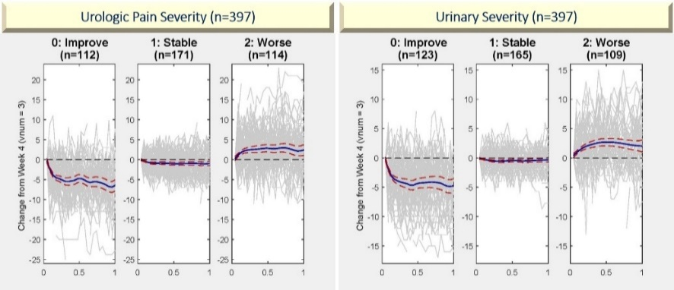
12-Month Symptom Trajectories
Naliboff BD, et al. J Urol 2017;198:848.
Symptom progression impacted by:
  Widespread pain (measured with body map)
  Severity of bladder-focused symptoms

Slide 36
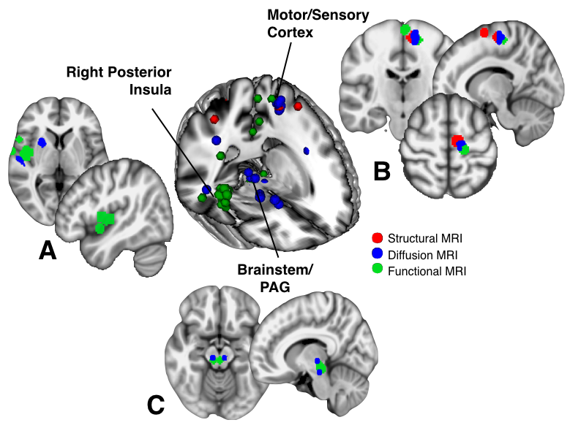
Neuroimaging
UCPPS =>
Altered function (green)
Altered gray matter (red) and white matter (blue) structure
Findings associated with widespread pain
Implications:
UCPPS dysfunction is not confined to the pelvis
? Predictor of treatment response/ disease course?
Clemens JQ, et al. Nature Rev Urol 2019;16:187

Slide 37
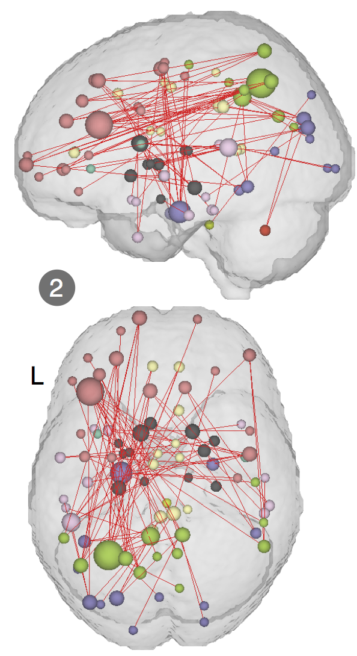
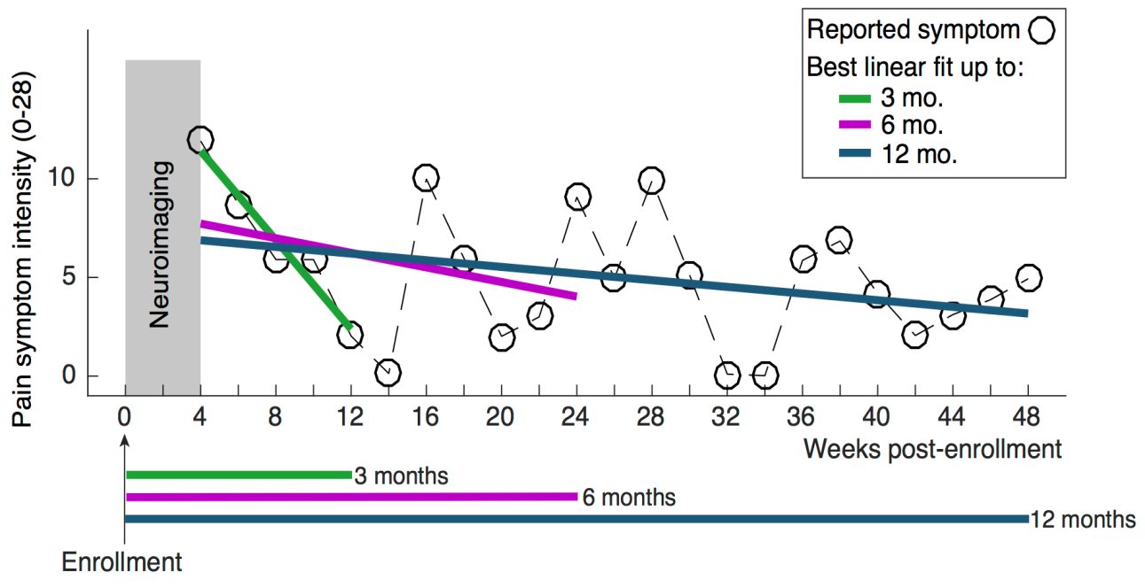
Increased functional connectivity in the frontoparietal brain network associated with reduced UCPPS symptoms at 3 months
Predict treatment response
  Long-term goal: predict treatment response
  First step: predict longitudinal symptom change
Kutch JJ, et al. Pain 2017;158:1069.

Slide 38



Pain Testing

Slide 39

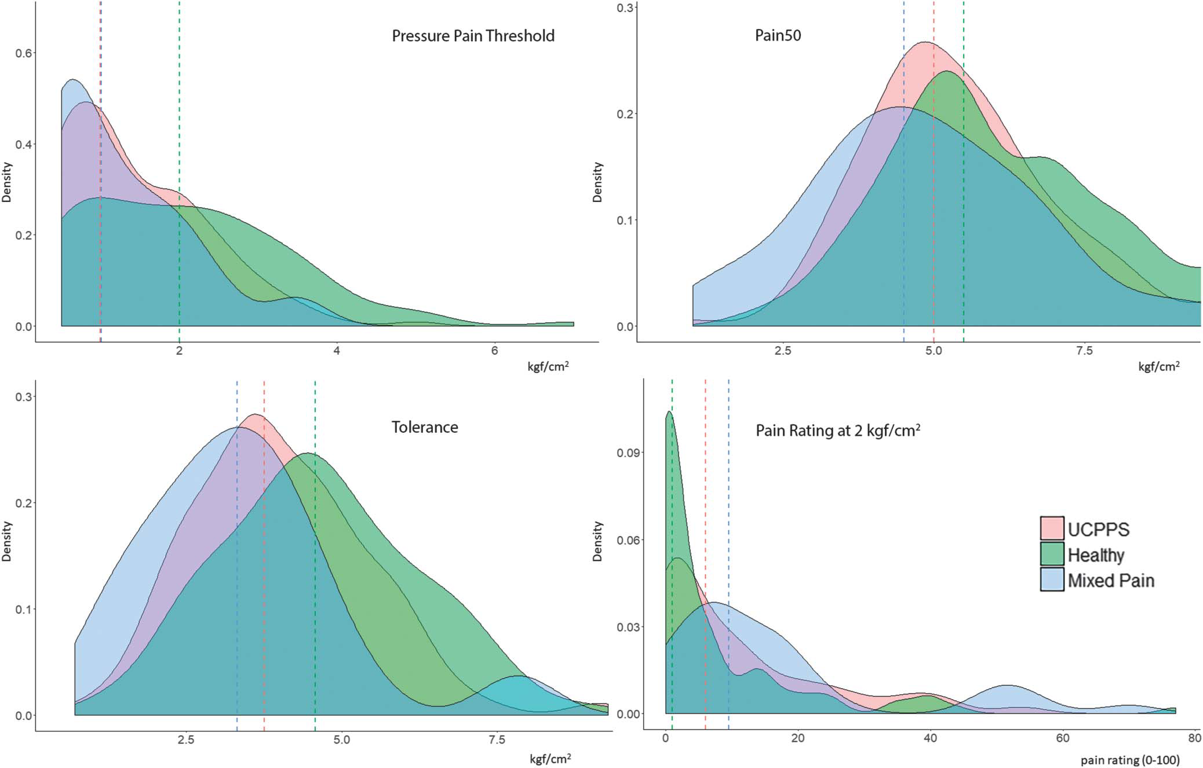
‘Centralized’ Phenotype
Thumbnail Pressure Pain-Sensitivity (MAST System)
UCPPS
Positive Controls (PC) (central pain phenotype)
Healthy Controls
Pain Tolerance:
Healthy>UCPPS>PC
Pain Sensitivity:
PC>UCPPS>Healthy
PC
UCPPS
Healthy
UCPPS
PC
Healthy
Increasing Tolerance
Greater Sensitivity
Lower Sensitivity
Lower pain sensitivity = greater likelihood of improvement
Patients reporting a “flare” at test showed greater pain sensitivity
Greater pain sensitivity = more widespread pain (body map)
Inference of central contribution for some patients
Modified from Harte, S., et al 2019. PAIN. (160): 1270-1280

Slide 40

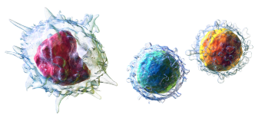
Primed Inflammatory Phenotype
Toll-Like Receptor (TLR) 2 and 4
TLR Activation Assay
Bacterial
Lipopeptides
UCPPS Blood
Samples
S. aureus
(TLR-2)
LPS
(TLR-4)
TLR-2
Immune
Mediators
(cytokines, etc)
NF-kB
LPS
TLR-4
Monocytes
Isolated
Cytokines
(ELISA)
IL-6
PM
NM
IL-1B
Provoked (stimulated) Immunity.
TNF-α
TLR activity previously implicated in
chronic pain (e.g., FM, back pain).
MCP1
↑ TLR-2 signaling distinguishes UCPPS from healthy controls
↑ TLR-4 signaling associated with greater UCPPS pain, symptom duration and more widespread pain
↑ TLR-2 and TLR-4 signaling associated with worse symptom outcomes over time
MAPP II – studies extended to all MAPP sites, include men and women
Schrepf A, et al. Pain 2014;155:1755.
Schrepf A, et al. Brain Behav Immun 2015;49:66.
Schrepf A, et al. Urology 2016;90:56.

Slide 41
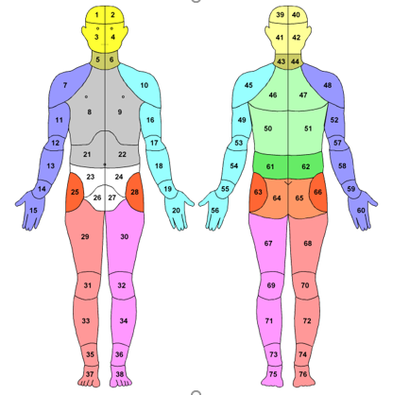
MAPP Body Map
1 pelvic region (white)
12 extra-pelvic regions
Categories:
  Pelvic pain only (0)
  Widespread pain (3+ regions)
  Intermediate (1-2 regions)

Slide 42
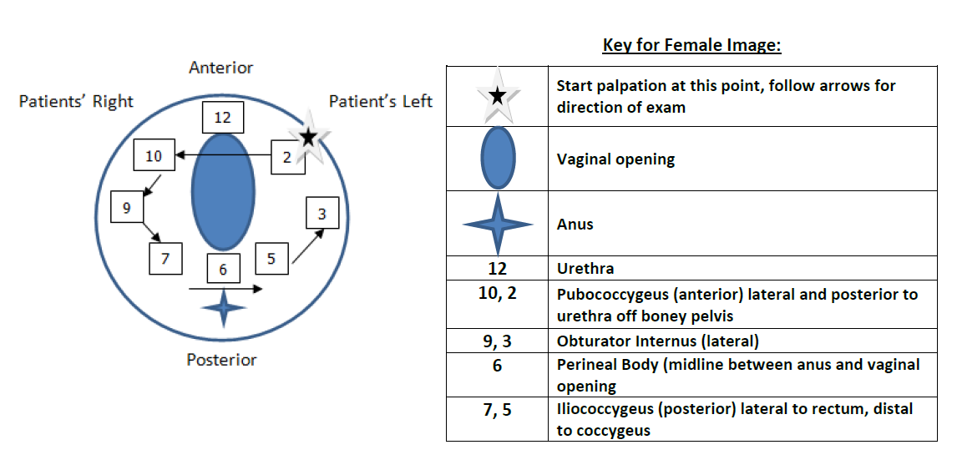
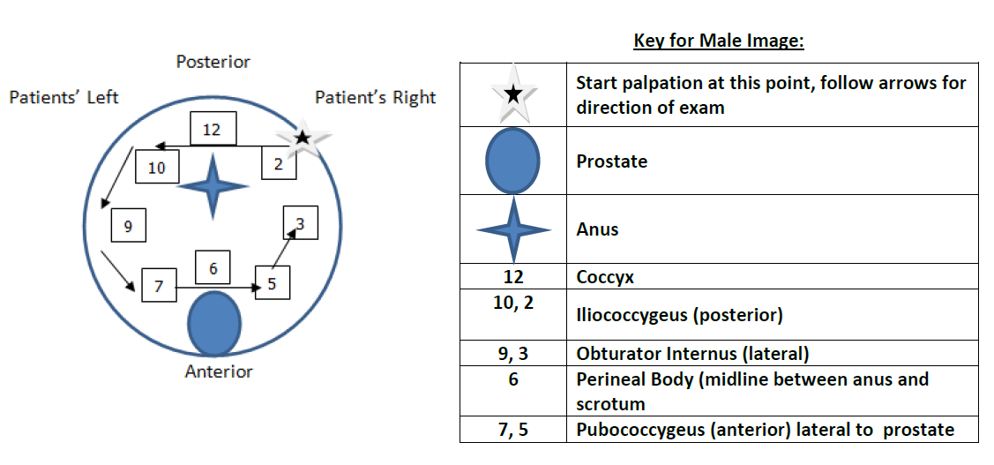
Pelvic Exam: Female (12:00 Anterior)
MAPP Pelvic Muscle Tenderness Scoring System
Pelvic Exam: Male (12:00 Posterior)
PEX Internal Pain Index6 | Frequency | Percent
0 | 24 | 6.50
1 | 23 | 6.23
2 | 52 | 14.09
3 | 46 | 12.47
4 | 71 | 19.24
5 | 51 | 13.82
6 | 102 | 27.64
PEX Internal Pain Index6 | Frequency | Percent
0 | 50 | 27.17
1 | 9 | 4.89
2 | 29 | 15.76
3 | 16 | 8.70
4 | 24 | 13.04
5 | 17 | 9.24
6 | 39 | 21.20

Slide 43
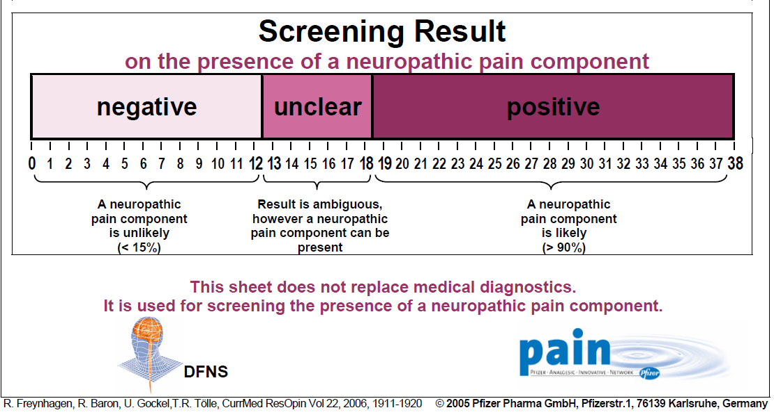
Neuropathic Pain in 10% of UCPPS Participants
Base_pain index38 | Cumulative Frequency | Cumulative Percent
-1 | 6 | 1.04
0 | 28 | 4.84
1 | 55 | 9.52
2 | 85 | 14.71
3 | 124 | 21.45
4 | 157 | 27.16
5 | 202 | 34.95
6 | 234 | 40.48
7 | 265 | 45.85
8 | 303 | 52.42
9 | 332 | 57.44
10 | 361 | 62.46
11 | 379 | 65.57
12 | 407 | 70.42
13 | 425 | 73.53
14 | 456 | 78.89
15 | 480 | 83.04
16 | 495 | 85.64
17 | 508 | 87.89
18 | 519 | 89.79
19 | 530 | 91.70
20 | 542 | 93.77
21 | 550 | 95.16
22 | 557 | 96.37
23 | 560 | 96.89
24 | 565 | 97.75
25 | 566 | 97.92
26 | 569 | 98.44
27 | 572 | 98.96
28 | 575 | 99.48
29 | 577 | 99.83
36 | 578 | 100.00

Slide 44
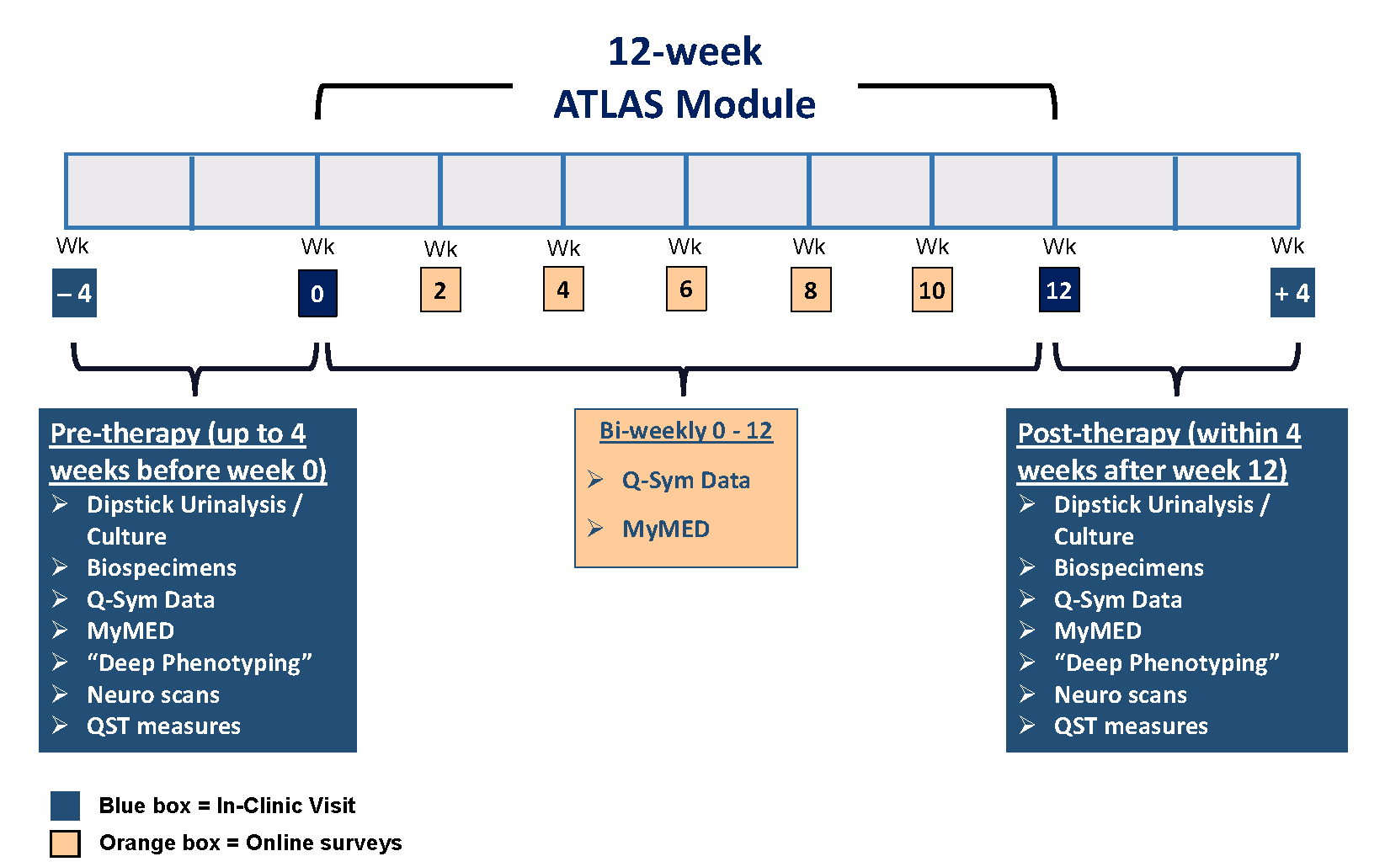
Predicting Treatment Response (ATLAS)
Analysis of Therapies During the Longitudinal Assessment of Symptoms

Slide 45
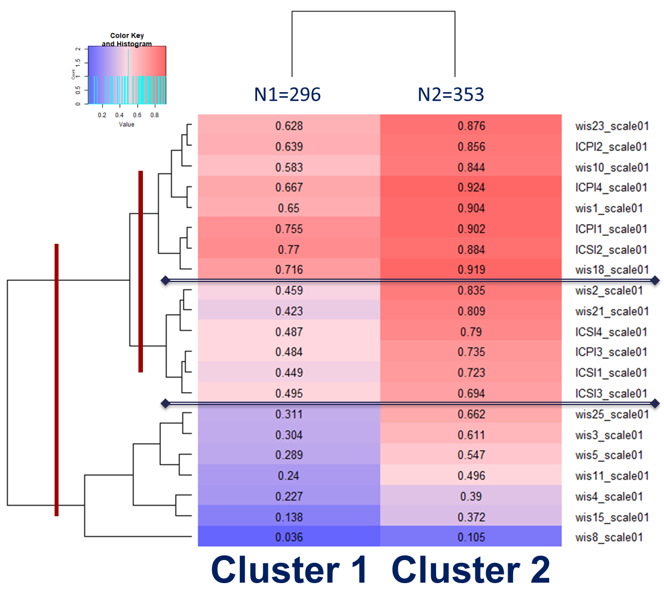
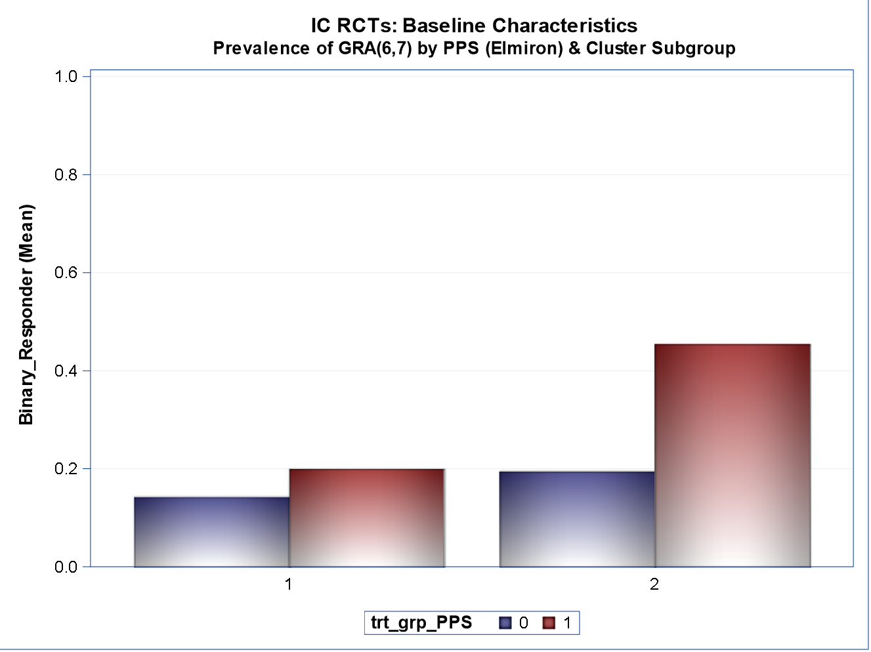
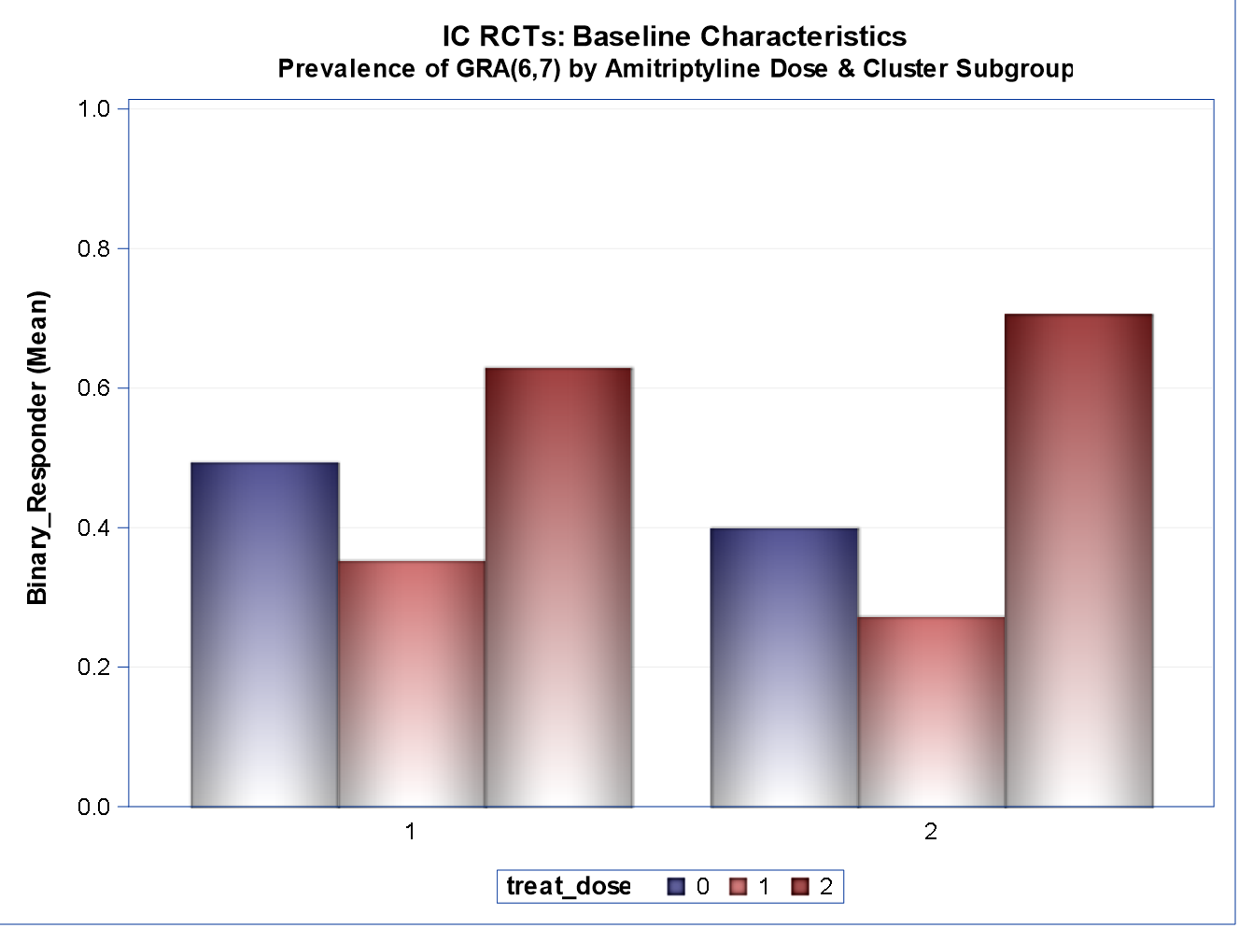
Re-Analysis of NIDDK UCPPS RCT Results
NIDDK RCTs for UCPPS
1998-2007: 10 RCTs for IC/BPS and CP/CPPS using varied treatments
Primarily non-significant response using heterogenous cohorts and global response outcomes
Retrospective Re-Analysis of RCT Data for Sub-groups and Outcomes (example)
RCT (3 IC/BPS) data combined for sub-group discovery and response
K Means clustering for partitioning phenotypic measures into patient sub-groups
Differing Cluster-specific Response
Cluster Predictors
Include Bladder
Pain, Difficulty Sleeping,
Widespread Pain

Slide 46
Cross-Modal Analyses
MAPP I Total
MAPP II
Pain Testing
Neuroimaging
Pain Testing
Neuroimaging
35
790
Biomarkers
Biomarkers

Slide 47
Some Thoughts About ‘Network Science’

Slide 48
Other NIDDK Network Studies/ Clinical Trials in LUTD
MTOPS
  Alpha blockers and 5-ARI for BPH
MIST
  Minimally invasive BPH treatments
CAMUS
  Complementary/ alternative treatments for BPH
UITN, PFDN (NICHD)
  SUI surgeries, prolapse surgeries, BTX vs SNM, etc

Slide 49
U01 Studies
Typically funded via Request for Applications (RFA)
  Dedicated funds, specific focus
Often preceded by a ‘consensus conference’
  Try to attend!
Involves coordination across multiple sites (clinical sites, data coordinating center, sometimes tissue/ lab core)
Types of studies
  Clinical Trials
  Cohort studies (‘Phenotyping’ Studies)
  Epidemiology studies

Slide 50
U01 Studies
Typically funded for 5 years
Most are funded for 2 cycles (10 years) or more
  Carry-forward funds, no-cost extensions can be used to add time without requiring more funds
10-12 years is a long time!
  Some investigators retire
  Some clinicians move away from research
  Research coordinator turnover is inevitable
  ‘Core’ investigators change as the group’s focus changes

Slide 51
Typical 5-Year Network Timeline
Year 1 – develop protocol
Years 2-4 – collect data
Year 5 – analyze data, write manuscripts
But:
  1-year longitudinal study => all recruitment needs to be completed in years 2-3
  2-year longitudinal study => all recruitment needs to be completed in year 2
  There is an annual limit to both finances and resources
  RCTs – Overlap? Competing? Length of follow-up? Cost? How many can be competed in 5 years?
5 years goes by quickly, especially if it takes a long time to develop a protocol and get IRB approval

Slide 52
Four Phases of a Network Study
Protocol development
Recruitment/ retention
Data analysis
Publications/ Messaging
This is true for both RCT and cohort study – will focus mostly on cohort studies

Slide 53
Protocol Development
Everyone has written a grant, and each grant includes unique ideas
Need to educate the group about these various ideas/ proposals
Need to determine what is feasible and what needs to be abandoned
  ‘Making sausage’
This happens at the beginning of each funding cycle
  Cycle 1 – some/ many in the group do not know each other well
  Cycle 2 – some/ many in the group know each other too well!

Slide 54
Protocol Development
Good communication and engagement is key
Frequent in-person meetings
Identify common themes and exploit them
Try to have everyone give up something
  Usually this is required anyway due to budget constraints
Pay attention to the budget!
Divide up the responsibilities
  There will always be some ‘heavy lifters’ – this always includes the Network Chair and the DCC
Write a methods manuscript!

Slide 55
Protocol Development
External Experts Panel review
  Reviews the protocol and progress reports
  Remember they are your allies – they are an excellent gauge for how your studies will be received by the audience at large
  Also remember you are not required to do everything they suggest (but avoid major disagreements)
IRB approval
  Central IRB becoming more common
  Each site will have dozens of IRB amendments – work with your grant staff to help navigate this
    Keep your informed consent forms up to date!
    Always request permission to examine medical records and to contact participants after the study is complete

Slide 56
Recruitment/ Retention
Research coordinators are essential (duh!)
Frequent meetings/updates are necessary
  Identify problems when they are actionable!
  Number recruited, lost to follow-up, incomplete data
Identify best practices
  Reminders, efficiency, incentives, clinician availability

Slide 57
Recruitment/ Retention
Ideal vs practicality
  Its OK to adjust inclusion criteria (for cohort studies)
  Any data is better than none – be flexible!
    Electronic data capture
    Visits outside the expected time window
    Skip more onerous portions

Slide 58
Data Analysis
Much easier for an RCT than a cohort study (in my opinion)
This can become a never-ending exercise – always chasing the more complex or more ‘intriguing’ questions rather than stopping to finish (i.e. publish) your findings to date
How to prioritize?
  Start with data that are available (baseline, then 6 months, then 12 month, etc))
  Use your aims/ hypotheses as a guide (even if they may seem less interesting now)
  What publications are needed in order to provide a foundation for subsequent publications?
  Where is this analysis going?
  Is what we have ‘good enough’?
  Keep a timetable!

Slide 59
Data Analysis
Supervised vs Unsupervised
Supervised => prespecified hypotheses with data collection designed to answer the question
  UCPPS participants with short-term symptom duration will have less severe symptoms, less widespread pain, and more favorable symptom trajectory than those with longer-term symptoms
  Yields results which are interpretable but are limited by the imaginations of the investigators
Unsupervised => apply computer algorithms to large amount of data to look for patterns that may provide useful/novel info about the disease
  Pain and urinary symptoms are distinct features, sleep quality is important, neuropathic pain features are important, LURN LUTD symptom clusters
  May yield insights into important features that otherwise could be missed
  But results may be difficult to interpret

Slide 60
Data Analysis
Supervised vs Unsupervised
Perhaps the ideal situation is where unsupervised analyses can identify features which are confirmed to be important* using supervised analyses?
*Important
  Correlates with other ‘important’ things (QOL, symptom severity, psychosocial factors, etc)
  Correlates with longitudinal symptom trajectory / treatment response
  Correlates with pathophysiology (biomarkers, neuroimaging)

Slide 61
Publications/ Messaging
Should occur throughout the duration of the network, not just toward the end
Develop a manuscript proposal process
Form a publications committee
  Assess progress, prevent duplication of effort
Abstracts are easy, manuscripts are hard
Messaging
  Abstracts, publications, review articles*, plenary talks
  Clinical papers!
  Simplify the message but make sure it is accurate
  No matter how much messaging you do, people will still say they don’t know what the network is doing

Slide 62
Network Opportunities
Trainee research
  ‘Worker bees’ are always needed!
Young investigator involvement
  Effort can be provided
Ancillary grants (funded by the network)
  Not open to network investigators
  Funds set aside at the DCC
Ancillary R01 grants
  Projects which enhance network activities
  Standard R01 process (no dedicated funds)

Slide 63
Wish List
New NIDDK definition for IC/BPS
Bladder biopsy tissue for LUTD
For network studies:
  Allow cohort studies to do interventions
  Develop a more efficient method to pool resources

Slide 64
Future of LUTD Research
Evaluation:
  Move toward a standardized clinical evaluation, including outcome measures (LURN)
  Increased focus on patient input/ experience (PLUS)
  Continued exploration of unsupervised data analytic techniques
Treatment:
  Smaller-scale RCTs targeted at subgroups
  Novel pain agents for UCPPS
Pathophyiology:
  Extension of neuroimaging studies
  Increased use of urine for biomarker studies
    Better standardization of urine collection and processing
  Continued examination of the urinary microbiome
  Relationship with other COPCs
  Increased utilization of the NIDDK repository

