Slide 1
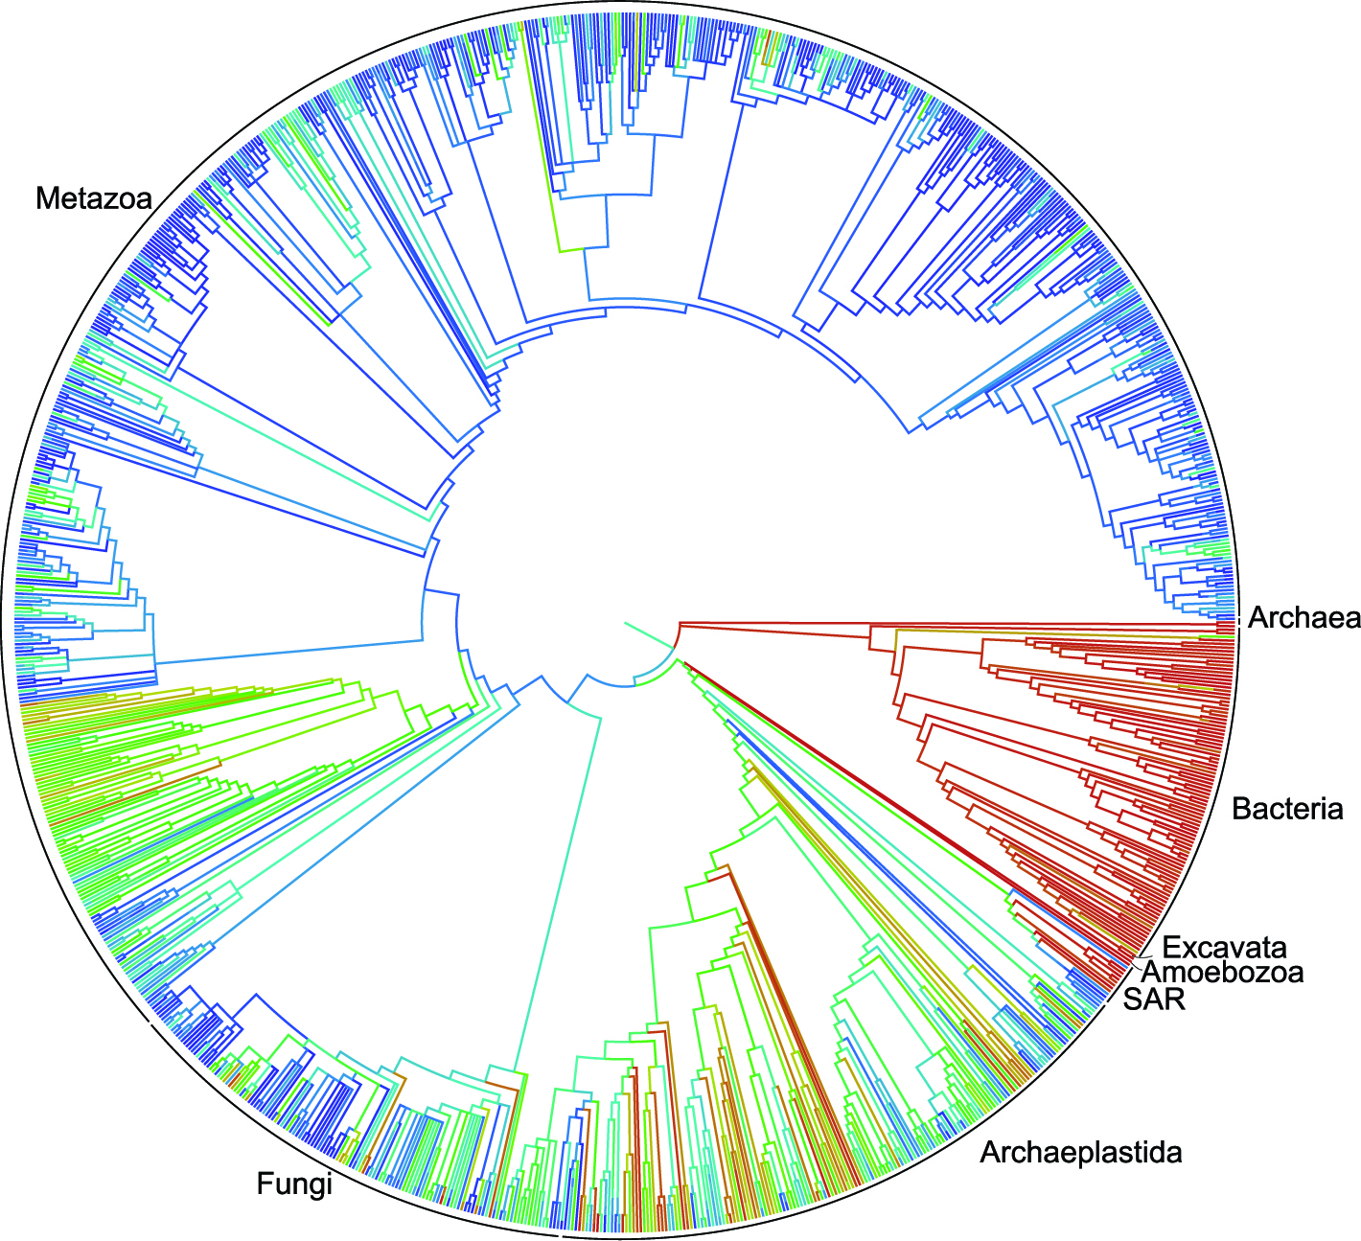
Antibiotic resistance – what are we up against?
Anne-Catrin Uhlemann, MD, PhD
Associate Professor of Medicine
Columbia University O’Brien Center for Benign Urology
CARIBU Meeting
December 4th 2020

Slide 2
Outline of talk
Overview of antimicrobial resistance challenges
The gut microbiome as a reservoir of antimicrobial resistance and UTI
Insights into mechanism of resistance to last resort antibiotics
Highlighting Columbia U54 O’Brien Microbial Genomics Biomedical Core Services (Microbiome and bacterial whole genome sequencing and gene editing of MDR Gram-negative bacteria).

Slide 3

Multi-Drug Resistant Organisms
Antibiotic development has lagged behind the emergence of antibiotic resistant bacteria
Increasing concern we are entering the post-antibiotic era by 2050
Drug-resistant Enterobacteriales are of particular concern

Slide 4
Urinary tract infections as reservoirs of antibiotic resistance
Estimated 10 million office and 3 million ER visits for UTI in the US
Enterobacterales Eschericia coli and Klebsiella pneumoniae account for majority of cases
National rise in antimicrobial resistance in UTI (2017)
- - 3rd generation cephalosporins (ESBL) 15.7%
-> requires treatment with carbapenems
-> carbapenem resistance -> polymyxin resistance
-> Mortality 20 to 70%

Slide 5
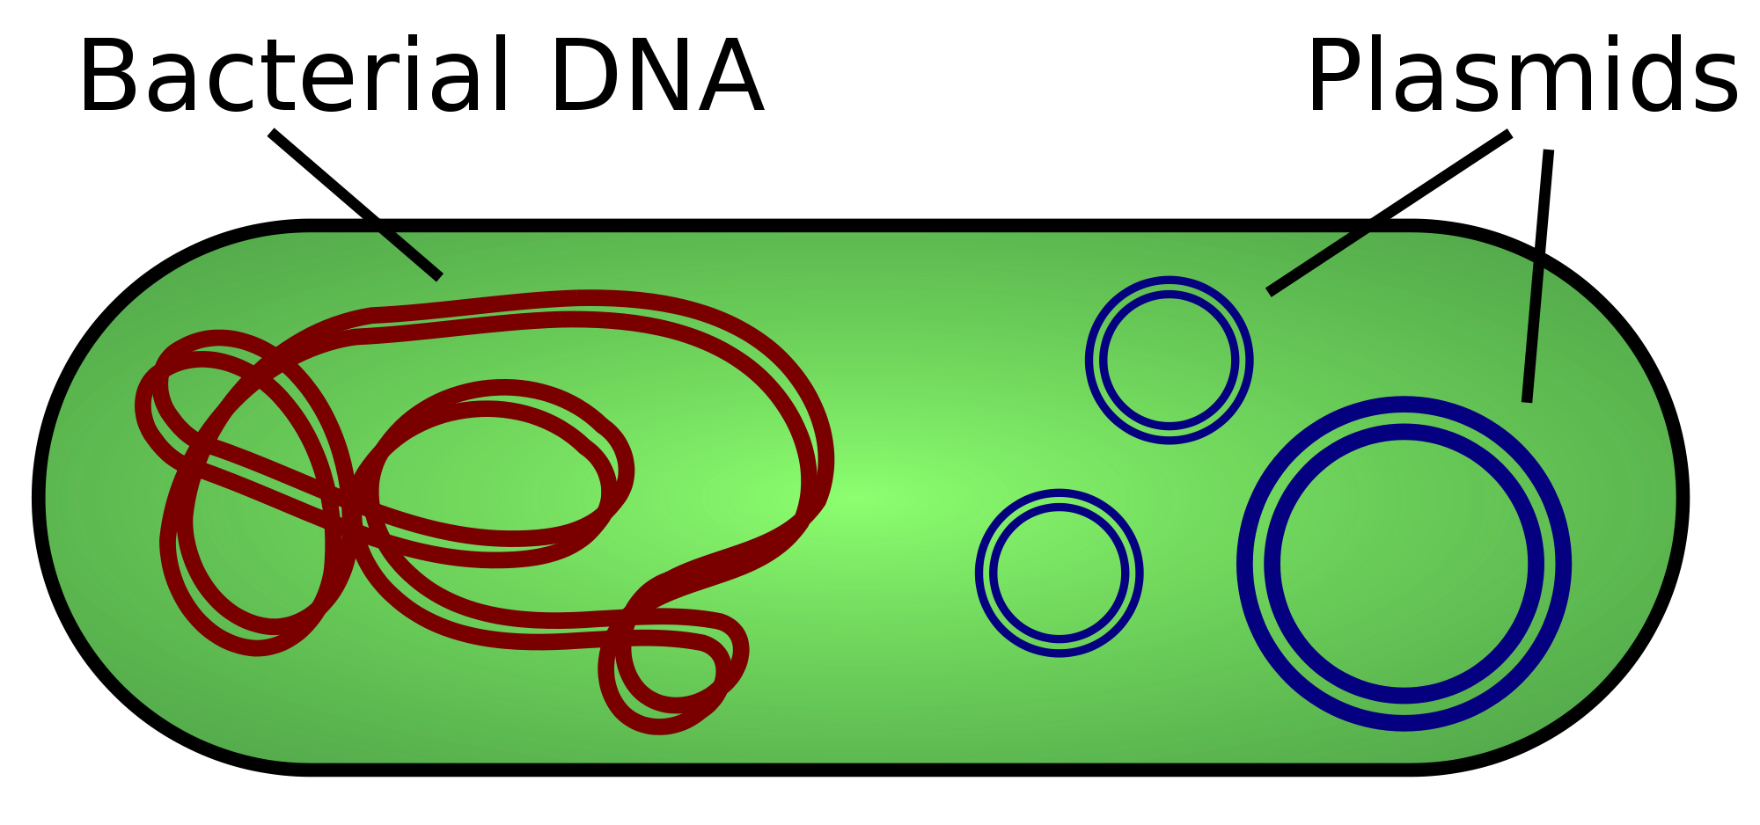
Horizontal gene transfer and resistance
UPEC clones:
Virulence factors encoded on core chromosome
AMR genes:
Plasmid encoded
ESBL (CTX-M15)
Carbapenemases
High potential for convergence of virulence and resistance features

Slide 6
Gut Microbiota and MDRO

Slide 7
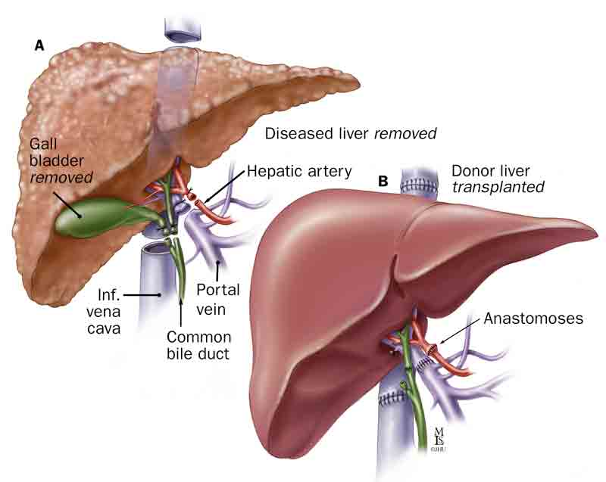
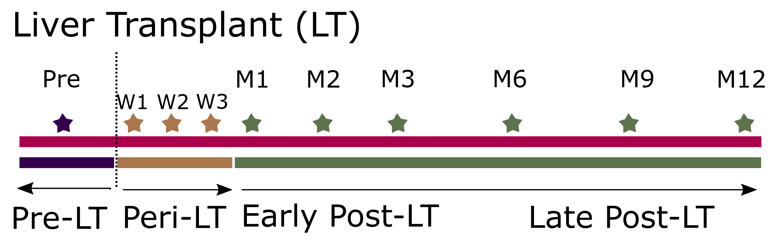
Prospective Cohort Study
  Adult liver transplant recipients (2014 – 2017)
  - High risk of MDR infections
  Longitudinal collection of fecal sample
Microbiology
- Samples screened for MDR colonization with CHROMAgar
- CRE, Ceph-R
Macesic et al CID 2018
Notes:
Clinical – infections, how were they defined

Slide 8
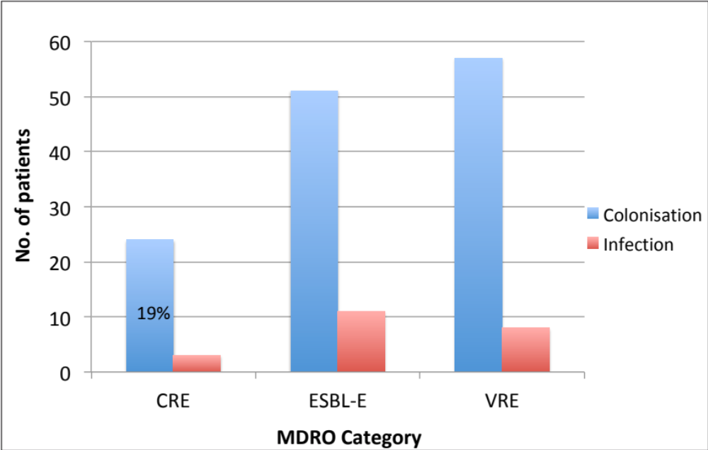
Frequent MDRO colonization associated with subsequent infection
p = 0.003
UTI accounted for 30% of infections
p = 0.031
41%
Illumina whole genome sequencing to discern isolate relatedness

Slide 9
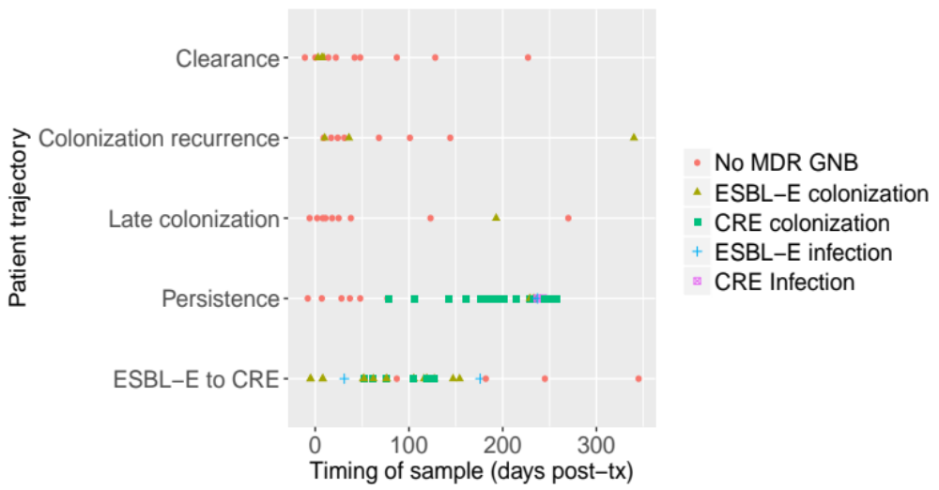
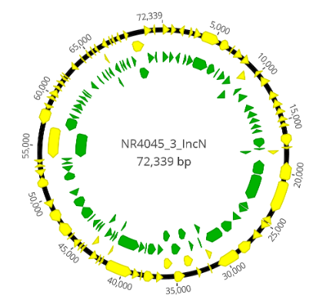
MDR persistence and progression from ESBL to CRE
10/51 (20%)
Notes:
Different trajectories: persistence, clearance, colonization recurrence
Currently exploring these issues.
Approximately 1/3 of pts with late ESBL col/col recurrence have had recent hospitalization or recent endoscopy
Switch from ESBL to CRE, particularly under pressure of broad-spectrum beta-lactam use eg. pip/tazo or meropenem
Occurred in 6 pts: 4 in setting of meropenem use, 1 pip/tazo and 1 ceftriaxone
Need to clarify the message
Can you create a summary schematic of this to

Slide 10
How does the microbiome adapt during MDR colonization?
Selected 703 samples (standardized time points)
16S rRNA V3-V4 region sequenced
Analyses:
- Alpha-diversity (diversity within sample)
- Beta-diversity: weighted UniFrac, Bray Curtis
- Differential abundance of taxa
Linear (mixed-effect) regression (α-div); PERMANOVA (β-div)

Slide 11
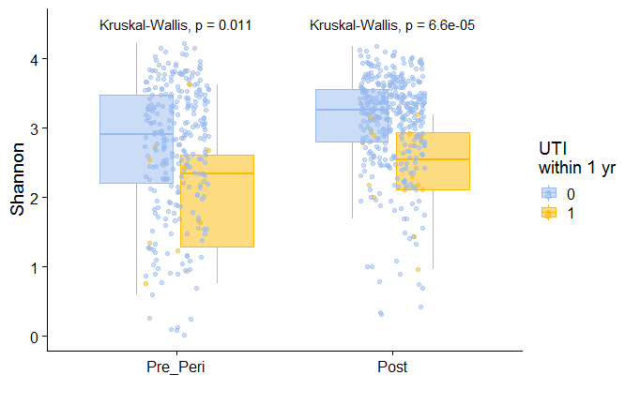
Reduced alpha-diversity in patients with subsequent UTI

Slide 12
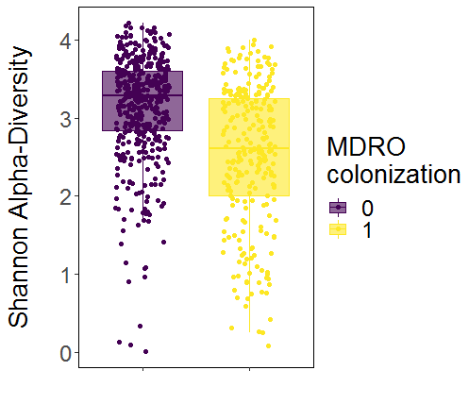
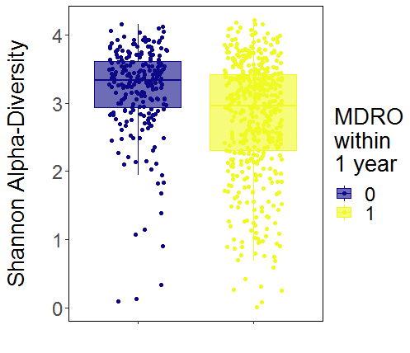
Microbial signatures of MDRO colonization
Patients had lower α-diversity during MDRO colonization
All samples from patients colonized with MDRO at any point had lower α-diversity
LME p<0.0001
LME p<0.0001

Slide 13
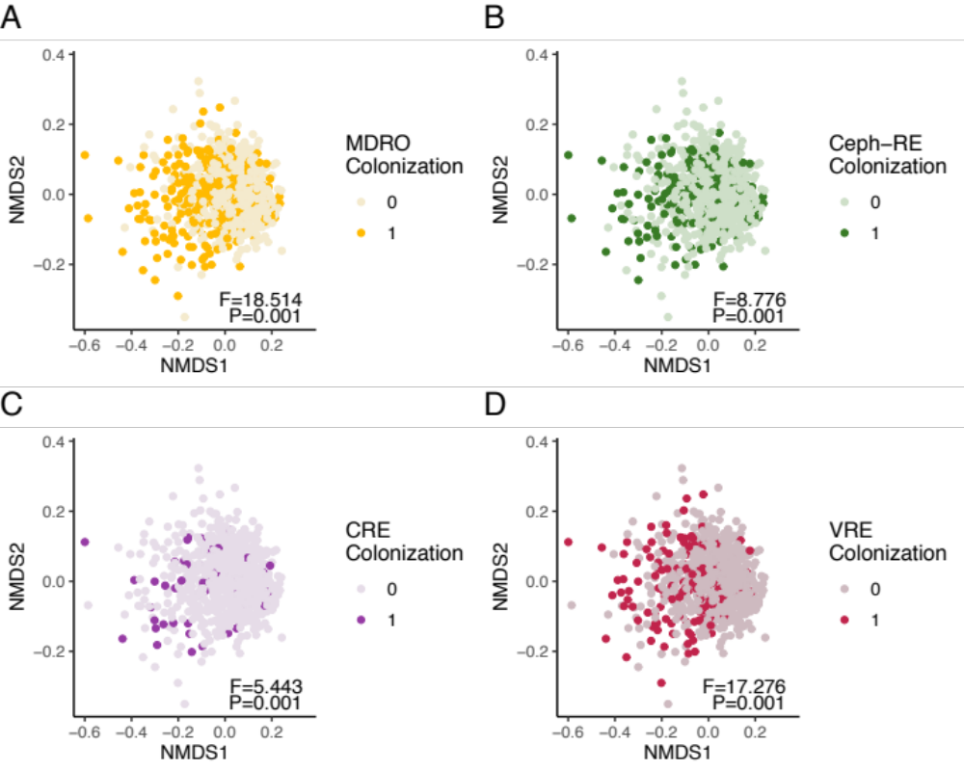
Beta-diversity (community composition) differs in colonized versus non-colonized samples
CRE
Ceph-R

Slide 14
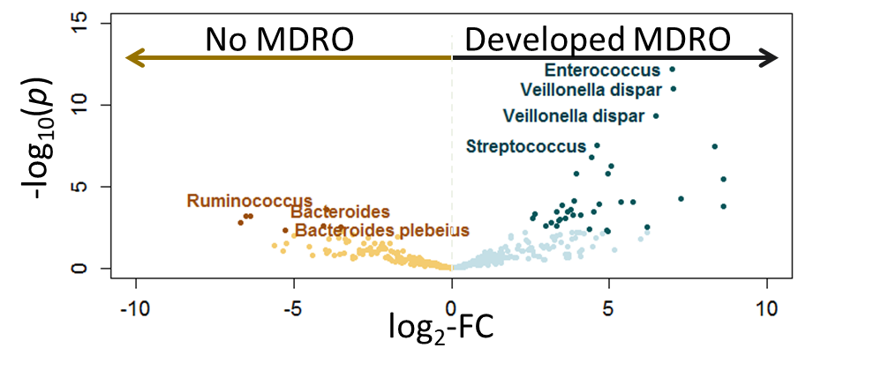
Differential abundance of taxa in PRE-LT samples in patients with future MDRO
Potential for future early diagnostics and therapeutic interventions

Slide 15
UTI and resistance to last resort antibiotics

Slide 16
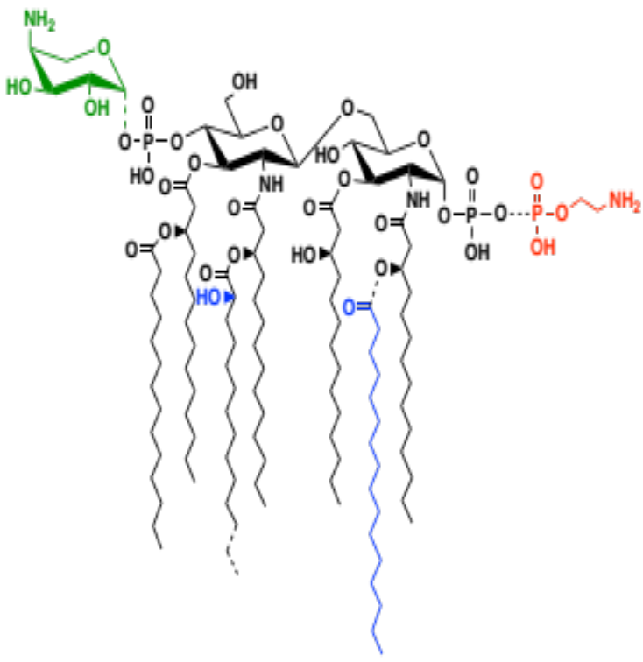
Polymyxin Resistance Occurs Through Lipid A Modifications
Z. Beilstein J. Org. Chem. 2018, 14, 25.

Slide 17
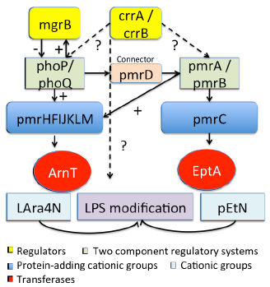
Genomic determinants of PR – many two-component systems
Canonical polymyxin
resistance genes
mgrB
crrA
crrB
phoP
phoQ
pmrA
pmrB
Notes:
Refresher on main causes of poly B resistance
Two component systems leading to lipopolysaccharide modifications

Slide 18
Multiplicity of alterations leading to PR
Comprehensive genomics of all PR isolates (n=164) compared to non-PR (n=388)
129 variants, 79 combinations in canonical genes
67/83 not previously described
Macesic et al. CID 2019
Notes:
129 individual variants in canonical PR genes, of which 83 were noted in PR isolates with 67/83 (82%) not described previously
72 genetic combinations to PR if each combination of variants in canonical PR genes is considered an individual pathway
On a patient level, 20/56 (36%) patients with serial PR K. pneumoniae isolates available were noted to have >1 genetic combination leading to PR

Slide 19
Mutations in canonical genes do not fully correlate with PR in clinical isolates
 | Susc. | Resistant (n=164)
MIC | <4 | 4 | 8 | 16 | 32 | 64 | > 128
No. of isolates | 224 | 10 | 42 | 35 | 40 | 15 | 22
mgrB | 7 | 2 | 15 | 19 | 18 | 5 | 2
phoP | 0 | 0 | 0 | 1 | 1 | 0 | 0
phoQ | 19 | 0 | 2 | 4 | 0 | 2 | 2
crrA | 1 | 0 | 0 | 1 | 0 | 0 | 0
crrB | 1 | 0 | 1 | 1 | 0 | 0 | 6
pmrA | 0 | 0 | 0 | 0 | 0 | 2 | 1
pmrB | 2 | 1 | 2 | 1 | 2 | 0 | 0
Multiple SNPs | 33 | 3 | 17 | 5 | 16 | 6 | 11
No SNPs / IS | 161 | 4 | 5 | 3 | 3 | 0 | 0

Slide 20
Barriers in the Field
Functional evidence is lacking for vast majority of detected variations
Unclear determinants of high-level PR (crrB)
Novel determinants of PR?
Barriers:
  Near pan-resistance complicates genome editing
  Lack of efficient markerless genetic manipulation systems

Slide 21
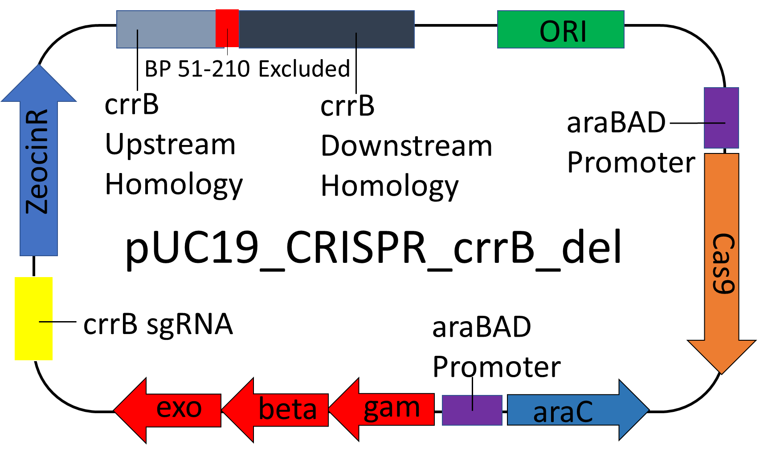
Adaptation of a singe plasmid CRISPR-Cas9 system to MDR K. pneumoniae
  Zeocin Resistance Cassette
    Bleomycin derivative with activity against CRE
  Cas9 Protein
    Streptococcus thermophilus
  Lambda Red Recombineering genes
    Improves homologous recombination
  Gene specific homology
    Gene knockouts
    SNP insertion
McConville et al. Cell Reports 2020

Slide 22
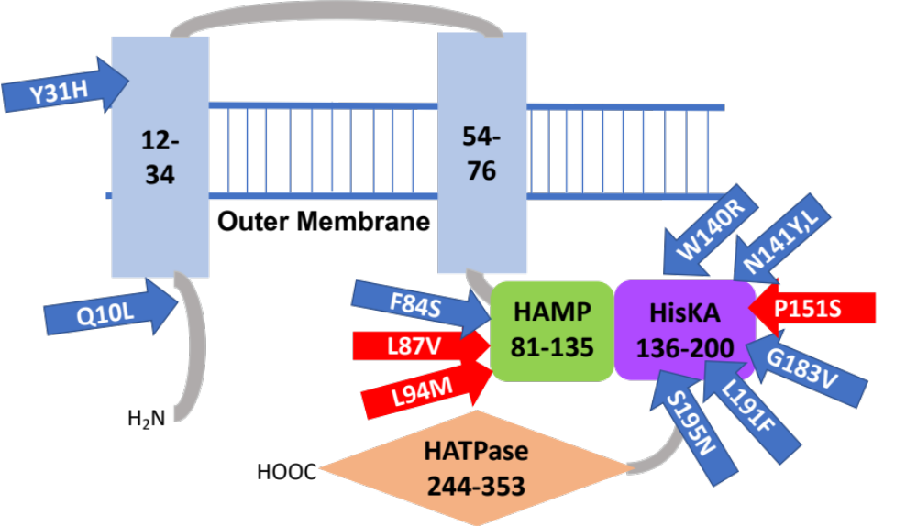
Several SNPs occurring in crrB
HAMP: histidine kinase phosphatase domain
HisKA: His Kinase A phosphoacceptor domain

Slide 23
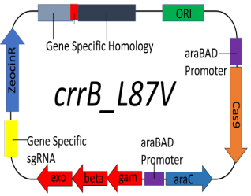
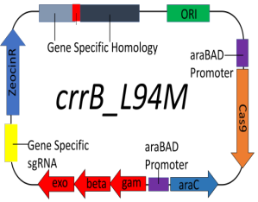

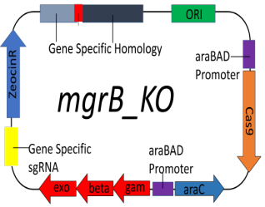
All three crrB SNPs confer high level resistance
NR5452
1
NR5452
CrrB_L87V
>512
NR5452
CrrB_L94M
>512
NR5452
CrrB_P151S
>512
NR5452
ΔmgrB
32

Slide 24
Isogenic mutants display differences in survival analysis in G. mellonella
Low:
crrB87
ΔmgrB
crrB151
Waxworm model
Hindleg injection
5 x 10⁸ CFUs/ml
72 hour survival
Groups of 20, triplicates
Differences between mutants
High:
crrB151
ΔmgrB
crrB94

Slide 25
Conclusions
Gut microbiome serves as an important reservoir for MDRO and subsequent infections
Last resort antibiotic resistance to polymyxins
  Polygenetic trait with different levels of resistance and virulence
  Intersection of antibiotic resistance and virulence

Slide 26
Acknowledgments
The Uhlemann Laboratory
  Medini Annavajhala
  Nenad Macesic
  Angela Gomez-Simmonds
  Sean Sullivan
  Marley Giddins
  Stephania Stump
  Sabrina Kahn
  Wenjing Geng
  Felix Rozenberg
  Jessica Weidler
  Thomas McConville
Columbia O’Brien Center
Ali Gharavi
Cathy Mendelsohn
Jonathan Barasch
Funding:
NIH/NIAID, NIH/NIDDK U54 Columbia University O’Brien Center

Slide 27
Thank you

