Slide 1
Reproductive Outcomes of Women with Physical Disabilities
Courtney Shepard Streur, MD, MS
Assistant Professor of Urology
K12 Scholar
University of Michigan UroEpi Program

Slide 2
Disclosures
Thanks, NIDDK, for funding this work!
Also funded by the Society of Women in Urology’s Elisabeth Pickett Research Award

Slide 3
Outline
Overview of spina bifida
Delivery outcomes of women with spina bifida (National Inpatient Sample)
Qualitative interviews of women with spina bifida
Current work on pregnancy outcomes in women with physical disabilities (MarketScan)

Slide 4
Overview of Spina Bifida

Slide 5
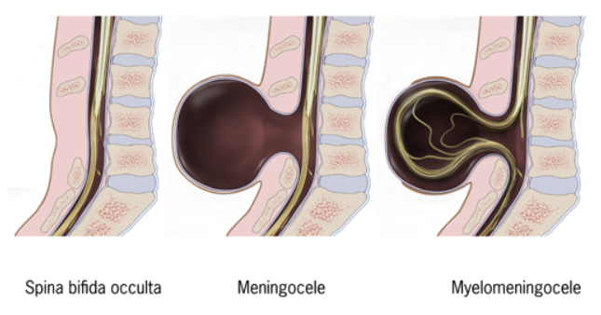
Notes:
Spina bifida is a neural tube defect and is the most common congenital cause of a physical disability. There are different types of spina bifida. Spina bifida occulta is the mildest form caused by a defect in the boney spine. Meningocele occurs when the sac covering the spinal cord protrudes through an opening in the baby’s back. Myelomeningocele is the most common and severe form, occurring when both the sac and neural elements of the spinal cord itself protrude through.

Slide 6
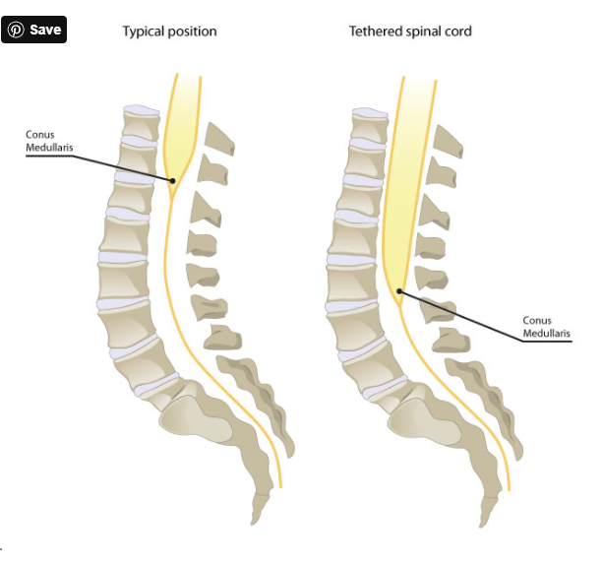
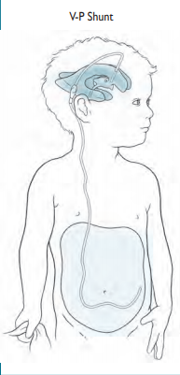
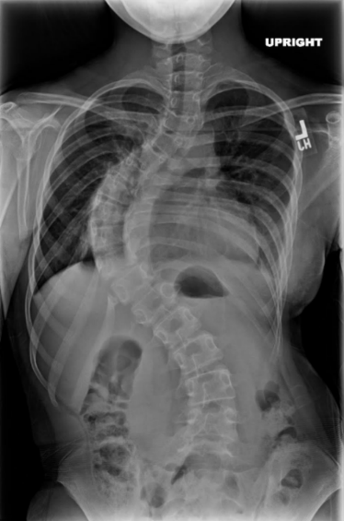

Hydrocephalus /
VP shunt
Hydrocephalus Association
https://www.hydroassoc.org/docs/About_Hydrocephalus_A_Book_For_Families1.pdf
Scoliosis and Contractures
Tethered Cord
https://www.liberaldictionary.com/tethered-cord-syndrome/
Neurogenic Bladder and Bowel

Slide 7
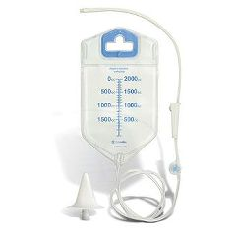


Management of Neurogenic Bladder and Bowel

Slide 8
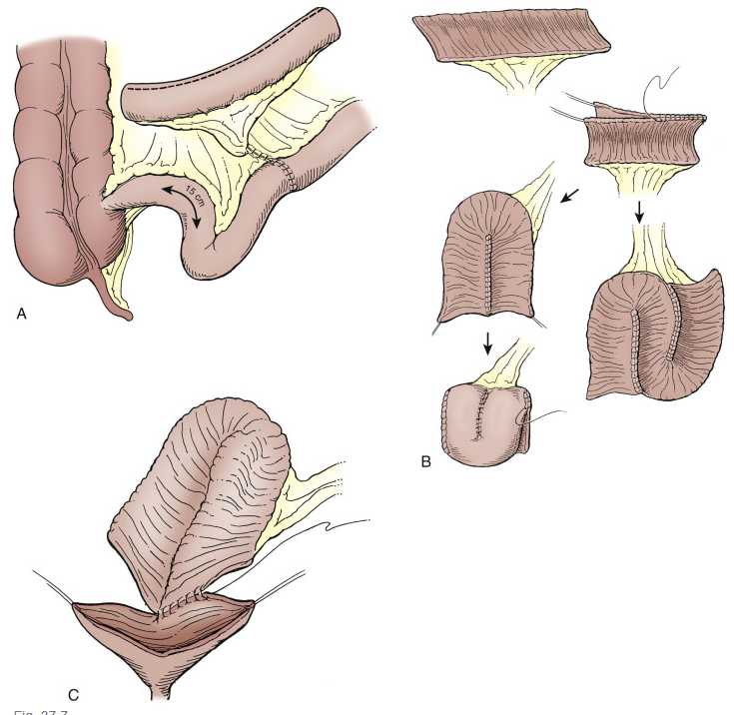
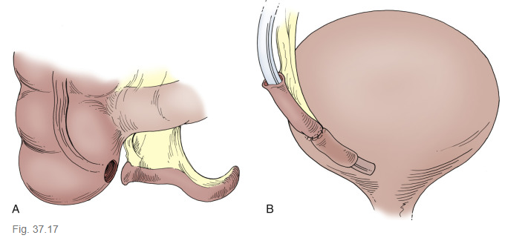
Management of Neurogenic Bladder and Bowel
From Campbell-Walsh-Wein Urology, 12th Ed, Lower Urinary Tract Reconstruction in Children

Slide 9


Background

Slide 10
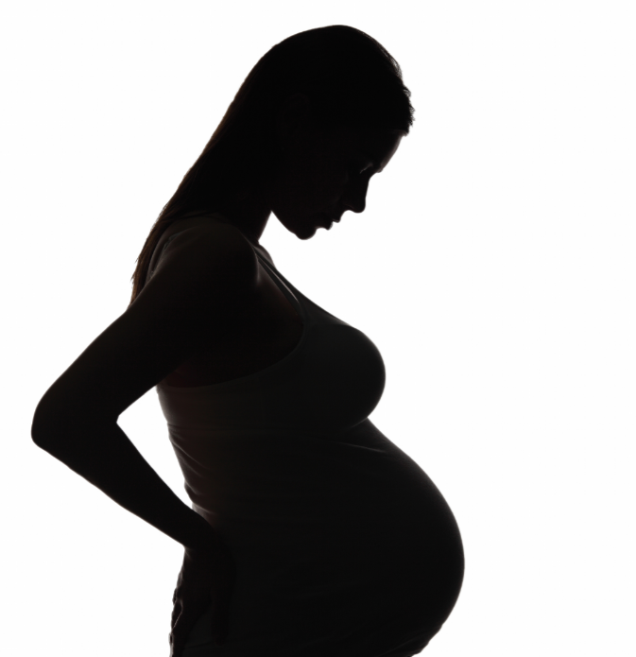
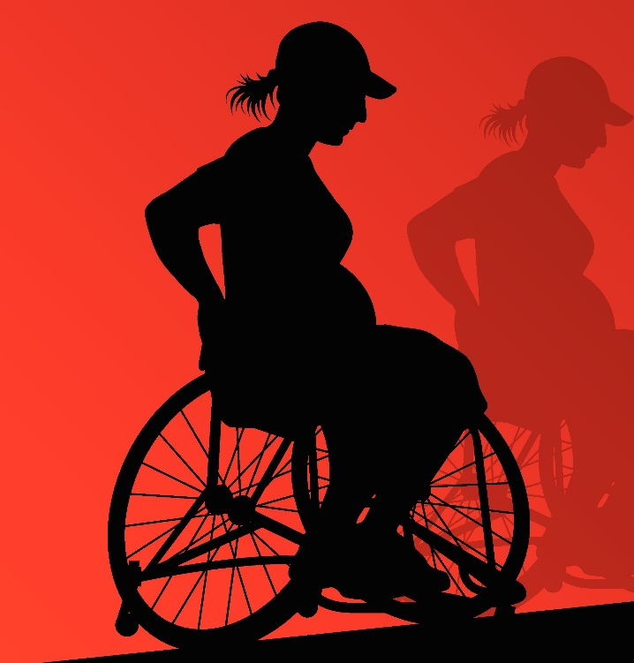
Background

Slide 11
Delivery Outcomes of Women with Spina Bifida

Slide 12
National Inpatient Sample
All women hospitalized for a delivery
2003-2013
Women with Spina Bifida
N=10,147
Women without Spina Bifida
N=42,197,763

Slide 13
Methods
Outcomes:
  Rate of hospitalization for delivery
  Mode of delivery utilized
  Complications associated with delivery

Slide 14
Spina Bifida Type
Spina Bifida Occulta
  N = 3409 (33.6)
No hydrocephalus
  N = 4840 (47.7)
Hydrocephalus
  N = 1897 (18.7)

Slide 15
Patient Characteristics
Compared to those without Spina Bifida, those with Spina Bifida were:
  Significantly younger (p=0.0023)
  More likely to have a comorbid condition (p<0.001)

Slide 16
p<0.001
Shepard CL et al, J Pediatr Urol 2018

Slide 17
 | No SB | SB | p-value
Mode of Delivery |  |  | <0.001
Normal Vaginal | 62% | 44%
Operative Vaginal* | 6% | 4%
Caesarean Section | 32% | 52%
*Operative Vaginal Delivery: use of forceps, vacuum, or breech delivery
Shepard CL et al, J Pediatr Urol 2018

Slide 18
 | Occulta | No Hydrocephalus | Hydrocephalus | p-value
Mode of Delivery |  |  |  | <0.001
Normal Vaginal | 54% | 41% | 32%
Operative Vaginal* | 4% | 4% | 4%
Caesarean Section | 41% | 55% | 64%
*Operative Vaginal Delivery: use of forceps, vacuum, or breech delivery
Shepard CL et al, J Pediatr Urol 2018

Slide 19




Vaginal Delivery Complications
UTI
3.5% vs. 0.7%
p<0.001
Acute Renal Injury
p=0.0033
Perineal Trauma
56.3% vs. 52.5%
p=0.021
Hematologic Event
2.3% vs. 1.2%
p=0.002
Shepard CL et al, Urology 2019

Slide 20







Cesarean Delivery Complications
UTI
5.6% vs. 0.9%
p<0.001
Intraoperative Injury
GU Tract: 1.4% vs. 0.3%
GI Tract: 0.5% vs. 0.1%
p<0.001
Blood Transfusion
3.7% vs. 1.9%
p<0.001
Hematologic Event
5.5% vs. 3.7%
p<0.001
Cardiac Event
1.2% vs. 0.6%
P=0.009
Neurologic Event
0.8% vs. 0.4%
p=0.0072
Pulmonary Event
1.7% vs. 0.3%
p<0.001
Shepard CL et al, Urology 2019

Slide 21
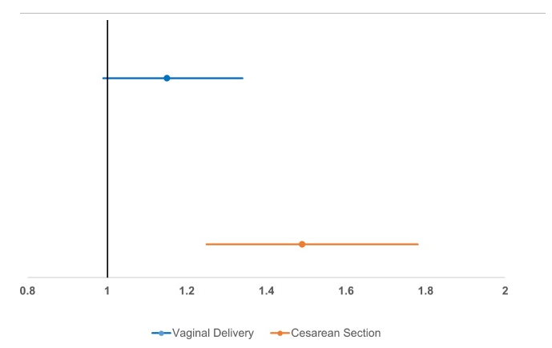
Odds of Complication
Shepard CL et al, Urology 2019

Slide 22
Unanswered Questions
What is happening during the pregnancy?
  Admissions/Treatment for UTIs
  Kidney Stones
  Urinary Retention
What happens after the pregnancy?
  Surgery for pelvic organ prolapse
  Long-term incontinence or changes in bladder management
  Long-term renal compromise
  Worsening UTIs
Are women having unintended pregnancies? Do they understand their reproductive health?

Slide 23
Qualitative Interviews of Women with Spina Bifida

Slide 24
Methods
Exploratory Qualitative Study
Study population: women with spina bifida ≥ 16
Individual semi-structured interviews
Outcomes: overlapping themes of women’ perspectives and experiences
Analysis:
  Grounded theory
  Interviews analyzed by 3 independent reviewers
  Consensus on themes was reached
Streur CS et al, Disabil Health J 2020

Slide 25
Results
25 Participants ages 16-52 years (mean 27.1, SD 8.1)
Ambulatory status:
  13 assistance
  11 no assistance
  1 unknown
Bladder management:
  15 CIC or urostomy
  10 no intervention or meds only

Slide 26
Qualitative Interview Themes
Women’s poor understanding of their reproductive potential
Interest in having a family
Facing provider’s opposition to their reproductive goals
Going into pregnancy and delivery unprepared
Shepard CL et al, Urology 2019

Slide 27
1. Poor Understanding of Pregnancy Potential
11/25 unsure if they could get pregnant or maintain a pregnancy
Unintended pregnancies:
  5/6 women who became pregnant

Slide 28
1. Poor Understanding of Pregnancy Potential
Medical doctors have looked at me for years and always told me that I would never bear a child, ever.
Shepard CL et al, Urology 2019

Slide 29
2. Interest in Having a Family
20/25 women would like to or already have children

Slide 30
2. Interest in Having a Family
I’ve always, always wanted to be a mother ever since I was little.
Shepard CL et al, Urology 2019

Slide 31
3. Facing Provider Opposition
4/6 women advised to terminate pregnancy
  All delivered healthy children

Slide 32
3. Facing Provider Opposition
[My doctor] told me he wanted nowhere near me if I ever decided that I was going to have kids because he said it would be extremely selfish for me to even think about it.
Shepard CL et al, Urology 2019

Slide 33
3. Facing Provider Opposition
Yes, every time that I got pregnant that was the first words that came out of their mouth, I think you should have an abortion.
Shepard CL et al, Urology 2019

Slide 34
4. Unprepared for Pregnancy
No counseling during pregnancy

Slide 35
4. Unprepared for Pregnancy
They didn’t have a clue what to do with me being pregnant, and that was the scariest part because they had no idea.
Shepard CL et al, Urology 2019

Slide 36
4. Unprepared for Pregnancy
And for my bowels I was not able to [use my MACE] so they had to heavily prescribe laxatives.

Slide 37
4. Unprepared for Pregnancy
Between 6 and 12 weeks I wasn’t able to put my catheter in, and I was like seriously what do I do.

Slide 38
4. Unprepared for Pregnancy
My bladder started leaking basically constantly around 20 weeks and I had a chronic UTI that I had to be on antibiotics for, for basically my entire pregnancy, and I was wearing support hoes… it was like I was a 90-year-old woman, pregnant.

Slide 39
4. Unprepared for Pregnancy
I was going into kidney failure… my urologist and obstetrician were arguing back and forth [as to the best plan]. They kept me in the hospital for 2 weeks on gentamicin… then they finally took me back for a C-section and my urologist helped.

Slide 40
Current Work on Pregnancy Outcomes

Slide 41
Current Work
MarketScan
  Longitudinal database
  Includes public and private insurance
Identified all women with a pregnancy with any outcome (ie: livebirth, abortion, etc)
  Comparing outcomes of women with a physical disability (neurogenic bladder) to those without

Slide 42
Current Work
Identify outcomes during pregnancy, delivery, and post-partum
  Antenatal diagnoses, prescriptions, labs, tests, surgeries, and admissions
  Evaluate outcomes based on their health in the year prior to becoming pregnant
    Baseline creatinine/renal function
    UTIs
    Hospitalizations
    Routine outpatient care (urology, gynecology, etc)

Slide 43
Additional Current Work
Online toolkit to educate adolescents with physical disabilities about their sexual and reproductive health
  Starting with spina bifida
  Intent to expand content to:
    All adolescents with physical disabilities
    All age groups (menses to menopause)

Slide 44
Conclusions
More women with spina bifida are having babies
C-sections are common
Overall, delivery appears to be generally safe
A majority of the common complications in pregnancy appear to be urologic in origin
Providers can improve their support and counseling of women interested in or who become pregnant

Slide 45

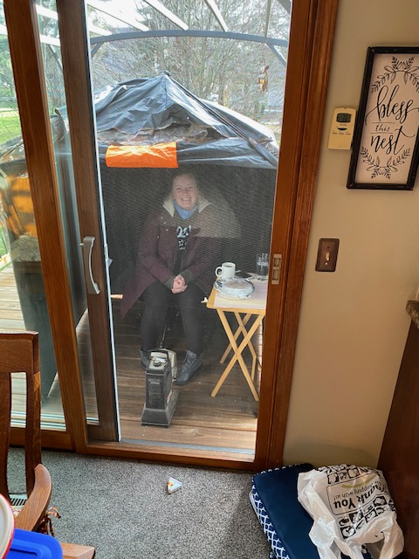
Thank you!
coshepar@med.umich.edu
@courtneysmd

