Slide 1
Office of Research
Johanny Kugelman-Tonos, PhD
Director of Research
October 8, 2025

Slide 2
AUA Office of Research
Office of Research Mission
To increase and maintain the workforce of urology physician-scientist and researchers
To catalyze the advancement of clinical practice and reduce the burden of urological disease through impactful research
FUNDING EDUCATION SUPPORT

Slide 3
Office of Research Overview
Career Development Opportunities
Medical Students
Residents
Basic
Pre-Clinical
Post Doctoral & Clinical Fellows
Junior Faculty & Early Career Physicians
Urology Researchers
Established Investigators
Translational
Clinical
Health Services Outcomes
Focused on AUA-OR Strategic Goals
Invest in the Future of Urologic Research
Develop Career Advancement Programs
Community-based Research
Education & Training
Patient-Centered Outcomes
Spanning the Biomedical Research Spectrum
Foundational

Slide 4
Research Grants & Investigator Support

Slide 5

Research Grants Support Overview
Research Areas Funded in 2025:
The OR aims to advance urological research by investing in the next generation of scientists and preparing them to become successful research leaders. We fund all stages of the research process, starting from understanding the basic biology of a disease to developing new treatment and prevention methods.
  Health Disparities
  Bladder Cancer
  Kidney Stones
  Developmental Anomalies
  Over- & Under-active Bladder
  Sexual Dysfunction
  Benign Prostatic Hyperplasia
  Prostate Cancer
  Transgender Health
  Incontinence
  Kidney Cancer
  Infertility
Funding Sources Include:
Endowments (Individuals, Societies, Sections)
Temporal partnerships (Industry, Societies, Sections)
Draw-down funds (Individual, Operational)

Slide 6
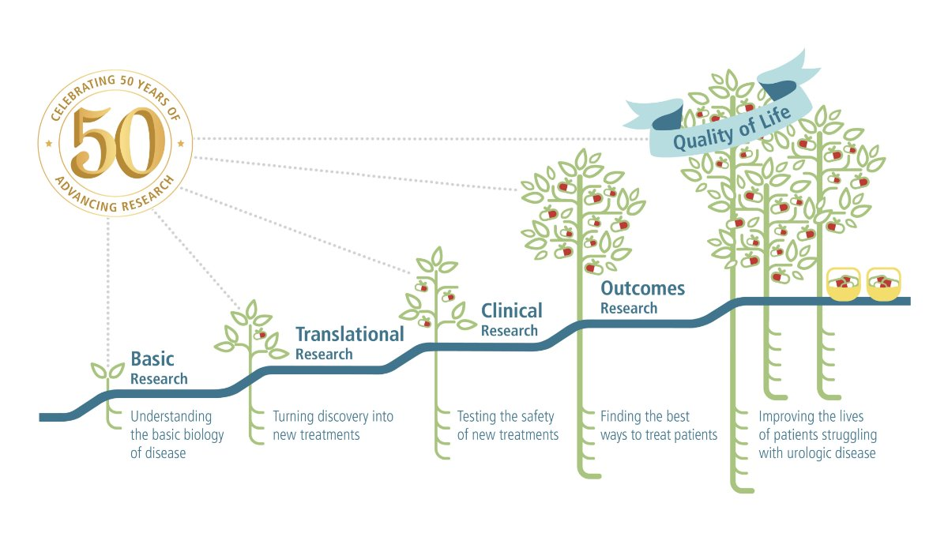
50th Anniversary - UCF Research Scholar Program

Slide 7

Grants Cycle Planner & Calendar.xlsx
New AUA/UCF Funding Mechanisms
Transformative Research Award
The goal of the new award is to accelerate science by:
encouraging interdisciplinary collaboration
supporting the pursuit of paradigm shifting research projects that will focus on exploring existing problems in urology from a new perspective.
The award is aimed at established investigators. Once fully funded by 2027, the program will launch by providing two grant recipients with $120,000 each, disbursed over a two-year period.
UCF Bridge Award Supported by Dornier MedTech
New funding mechanism aimed to support established urology researchers navigating critical financial shortages. Its goal is simple but impactful: sustain urologic projects that are at risk due to gaps between major grants, required post-peer review revisions, or unexpected laboratory setbacks.
Each year, two investigators will receive up to $60,000 in support over a 12-month period.

Slide 8
New Award Mechanisms
The Transformative Research Award and the Dornier MedTech Bridge Awards are critical additions to the AUA/UCF's research pipeline & portfolio, intending to support independent researchers in the urology space.
Mentorship & Training
Bridge Funds
Independent Research
Medical Students
Residents
Post Doctoral & Clinical Fellows
Established Investigators
Medical Students
Residents
Post Doctoral & Clinical Fellows
Junior Faculty & Early Career Physicians
Established Investigators
Junior Faculty & Early Career Physicians
Medical Student Fellowships
Boston Scientific Medical Student Innovation Fellowship
Residency Research Awards
LEAD Award
Research Scholar Awards
Rising Stars in Urology Award
Transformative Research Awards
UCF Bridge Award Supported by Dornier MedTech
Supplies / Resources
Salary
Support
Stipend
Salary
Support
$4,000
$20,000
$10,000
$10,000
$40,000-$80,000
Up to $200,000
Up to $60,000
$120,000

Slide 9
Application Process
AUA/UCF Grants Application Process
Release of the Program Announcement & Proposal Submissions
Compliance Check
Peer Review & Selection of Awardees
Notice of Awards

Slide 10

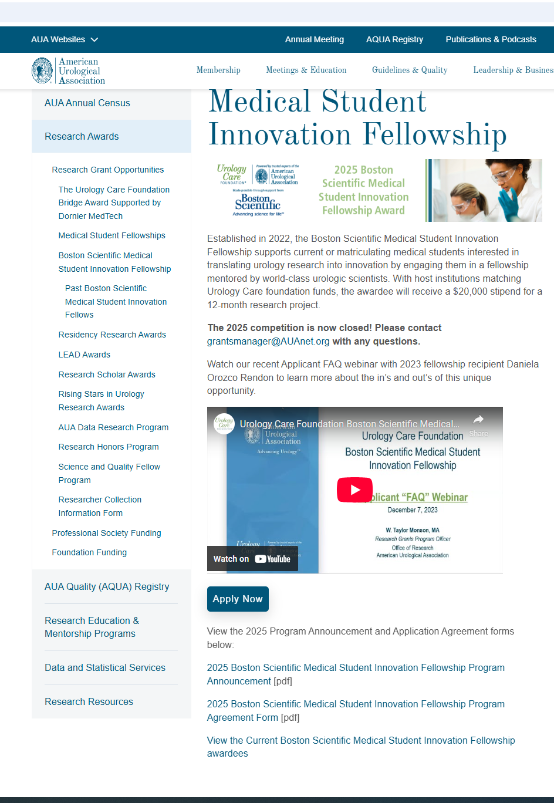
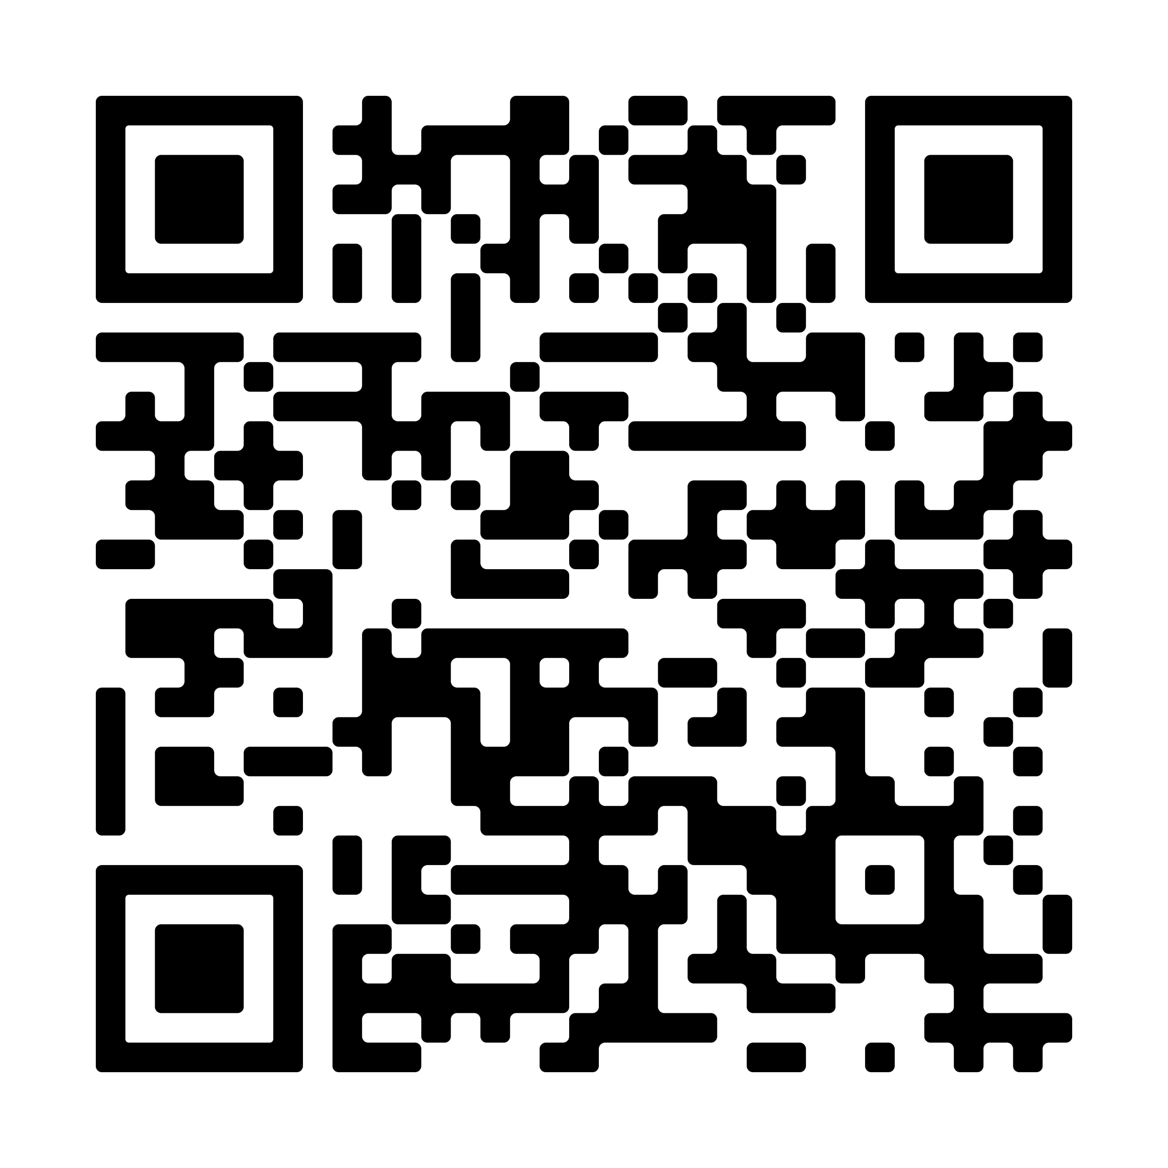
AUA Research Grants: Online Presence​
Check out our Funding Opportunities!

Slide 11
2026 Research Grants – Upcoming Opportunities
Residency Research Award
Letter of Intent is OPEN & CLOSES November 3
Full application OPENS November 7 & CLOSES January 5, 2026
LEAD Award
Full application OPENS November 7 & CLOSE January 5, 2026
Research Scholar Award
  Letter of Intent OPENS October 17 & CLOSES November 17
  Full applications OPEN November 21 & CLOSES January 19, 2026
  Visit the AUA Research Grants Page to Apply!
  https://www.auanet.org/research-and-data/research-awards/research-grant-opportunities

Slide 12
Urology Care Foundation Programs
Medical Student Fellowship
Boston Scientific Medical Student Innovation Fellowship
Humanitarian
Award
Health Equity Fellowship
Rising Star in Urology Award
Humanitarian Quality Improvement Research Program
UCF Bridge Award
Chesapeake Urology Clerkship
Expert Lecture Program
Humanitarian Recognition Award
UCF Gold Humanitarian Award
International Student Humanitarian Grant Program
Research Scholar Award
Residency Research Award
LEAD Award
For more information please visit: https://www.urologyhealth.org/research/what-we-fund
Notes:
In addition to the grants discussed in previous slides, the UCF offers additional programs that support the improvement of urological care globally by funding research, clinical education, patient education, and humanitarian programs.​

Slide 13
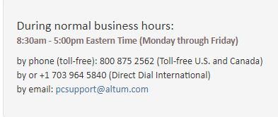
AUA Research Grants​
For program/grant questions, please contact:​
Sarah Gross, Sr. Manager for Research Grants – sgross@auanet.org​​
Hannah Green, Research Grants Coordinator – hgreen@auanet.org
Grants Programs Mailbox - grantsmanager@auanet.org ​
For ProposalCentral technical questions, please contact:
​
Thank you!​
​
​

Slide 14
Thank you for your time!

